Slide 1
Cyclone science and improving product recovery in spray drying (SD) processes
Romualdo Salcedo
CTO, Advanced Cyclone Systems
Professor, ChemEngDep, University of Porto
April 13th, 2016
University of Leeds

Slide 2
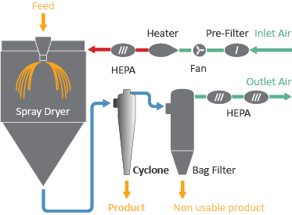
Why are cyclones important in SD?
Because they are the best collectors for first-grade product recovery
DISADVANTAGES OF LEGACY SOLUTIONS:
HE Cyclones:
Low efficiency for fine particles
Bag Filters:
Product degradation
Product contamination
Production downtime
Cleaning costs
Cyclones are the best devices
for high quality product recovery

Slide 3
Several constraints are imposed on design
Wide range of operating conditions:
…- 85ºC < T < 120ºC (negative T for cryogenic micronizers)
…mg/Nm³ < C_in < …kg/Nm³ (highest values occur with jet mill micronizers)
…25 Nm³/h < Q < …150,000 Nm³/h (highest flowrates occur with quasi-pharma applications, e.g., food ingredients)
Type of product:
…solid dispersions, inhalable, injectable, microcapsules, tablets’ waste recovery, …
…wide range of densities (non-porous, porous)
This makes it very difficult to have a single cyclone geometry to effectively deal with all cases

Slide 4
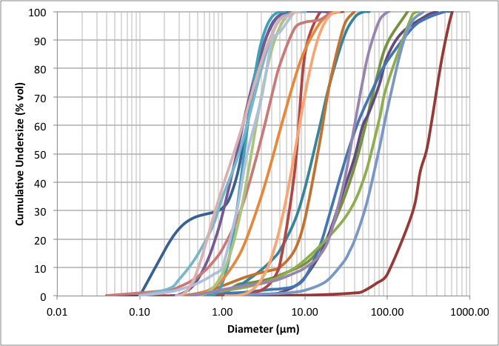
Particle size distributions in SD
Very Fine
Medium
Coarse
Fine

Slide 5
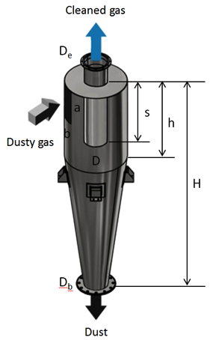
How can we design better cyclones?
The cyclone geometry is defined by 7 dimensionless ratios of its 8 independent dimensions to the cyclone D
To optimize the geometry becomes a problem with 7 degrees of freedom, usually non-linear and non-convex
A 2-level factorial design would require building 128 prototypes and a 4-level, 16384……

Slide 6
Setting up a mathematic problem
Maximize efficiency, conditioned to:
Equality constrains
Relevant design équations (cyclone modeling)
Particle size distribution and density
Gas flow rate and dust load
Gas temperature, density and viscosity
Solution:
Inequality constrains
Maximum pressure loss
Saltation velocity
Geometric constraints
Numerically optimized cyclones
Advanced Cyclone Systems | www.acsystems.pt

Slide 7
The solution
  We have abandoned pure empiricism and resorted to mathematical programming
Use empiricism only to test and possibly improve the numerical solution, found among thousands of virtual prototypes
But first, one has to understand how cyclones work…cyclones are deceptively simple

Slide 8
Cyclone dynamics
Effect of operating conditions
(P, T, PSD)
Effect of multiphase flow
(inlet concentration, particle density and porosity, …)
Possible clustering and strand formation (Muschelknautz)
Highly vorticial asymmetric turbulent flow field
CFD only in 2015 used for global optimization

Slide 9
How to proceed?
Find an appropriate collection model - neglect particle-particle interaction
Superimpose particle-particle interaction
Optimize using a global optimizer - stochastic is slower but much better at obtaining the global optimum (Salcedo, 1992)
Build and test the numerical solution

Slide 10
1. Find an appropriate collection model
The Mothes and Loffler model (1988) seems to best describe the collection of particles by cyclones, neglecting particle-particle interaction (Clift et al., 1991)
Problem: this model depends on the particle turbulent diffusivity, that depends on cyclone operating conditions, particle size distribution and cyclone geometry (Salcedo and Coelho, 1999)
With the above approach, the line of Hurricane (HR) cyclones has been developed and patented (EP0972572A2)

Slide 11
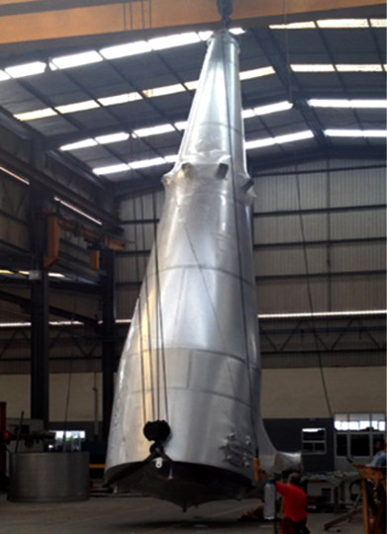
HR performance in SD applications
Technology: Hurricane
Application: Caseinate/Hydrolisate recovery
Dimension: 92,140 am³/h
Client: Arla Foods
Location: Denmark
Load into Cyclone: 17 g/Nm³
Hurricane Efficiency: 98.9-99.3 %
Alternative technology: Competitor HE cyclone
Alternative Cyclone Efficiency: 96 %
Increased Recovered Powder: 320 ton/year
Reduction in losses: 77%

Slide 12
Some Pharma results on HR performance
from leader API manufacturer
Project 1:
1,500 kg/h (N₂) @ 85ºC
Measured on HR: 96%
Competing cyclone: 83%. Reduction in losses: 76%
Project 2:
80 kg/h (N₂) @ 65ºC
Measured on HR: 85-95%
Competing cyclone: 80-90%. Reduction in losses: 25-50%
Project 3:
112 kg/h (N₂) @ 65ºC
Measured on HR: 84%
Competing cyclone: 60%. Reduction in losses: 60%
Project 4:
1250 kg/h (N₂) @ 85ºC
Measured on HR: 99.7%
Competing cyclone: 97%. Reduction in losses: 90%

Slide 13
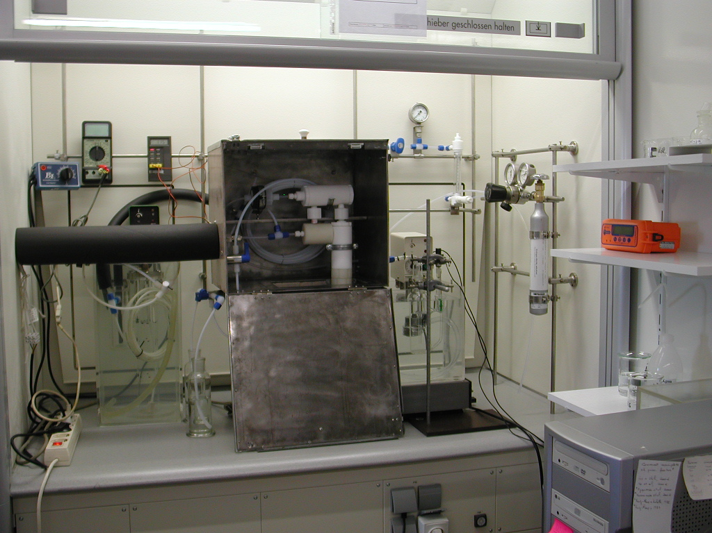
2. Superimpose particle-particle interaction
Grade-Efficiency at Lab Scale
Abnormal capture of fine particles - Why?
From D =20 mm
?
Mothes and Loffler (1988)

Slide 14
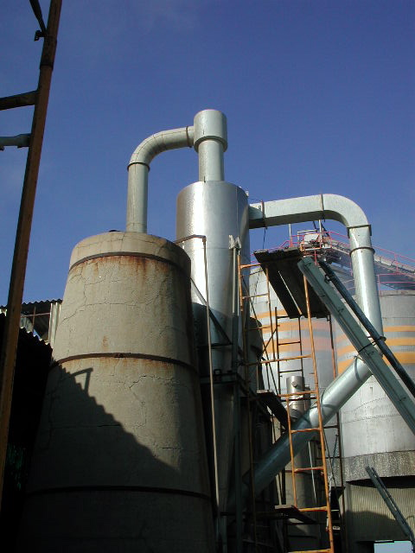
Grade-Efficiency at Industrial Scale
...to D =1200 mm
ML (1988)

Slide 15
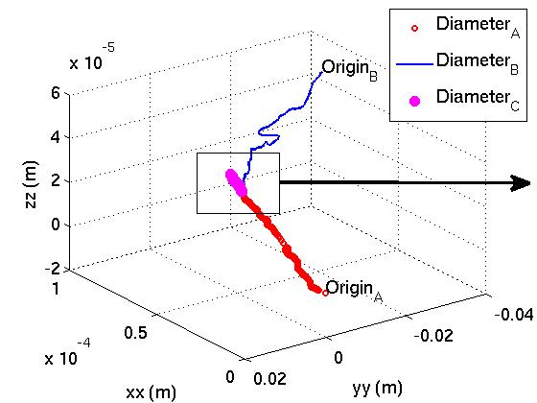
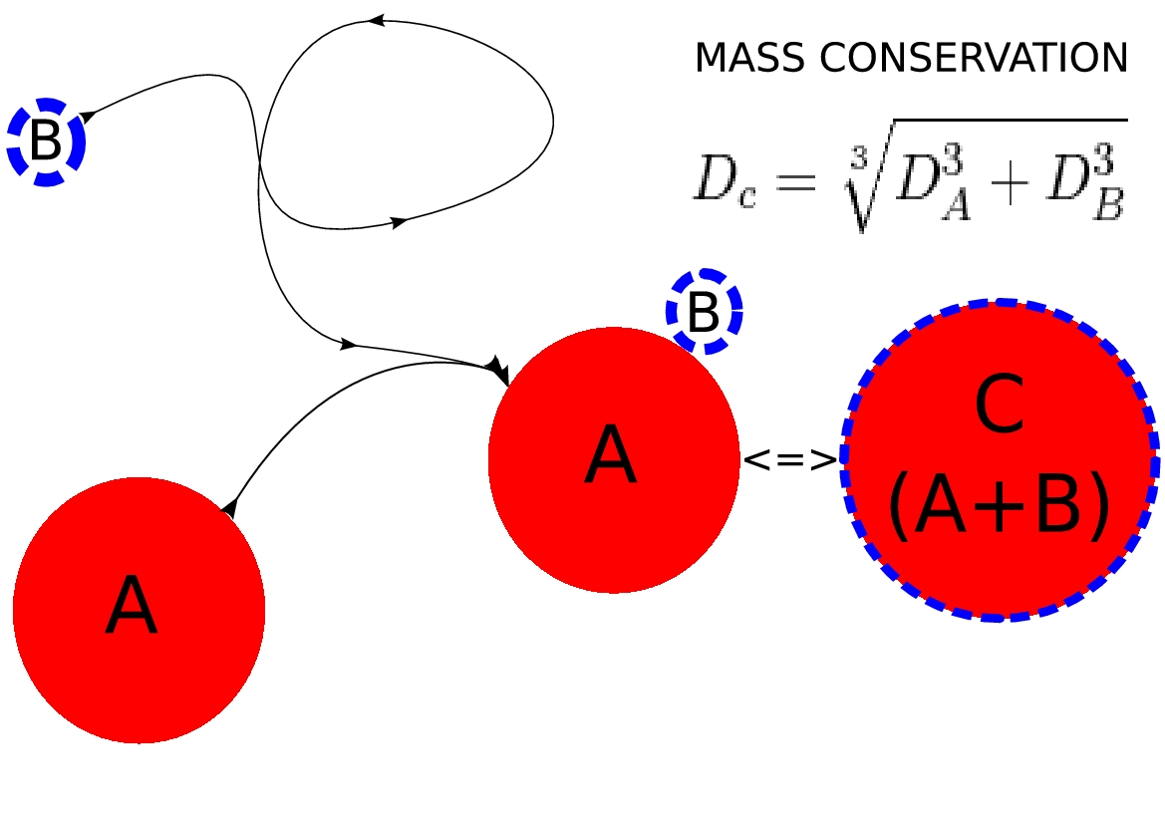
Schematics of particle-particle collisions
Trajectories
Agglomerate Formation

Slide 16
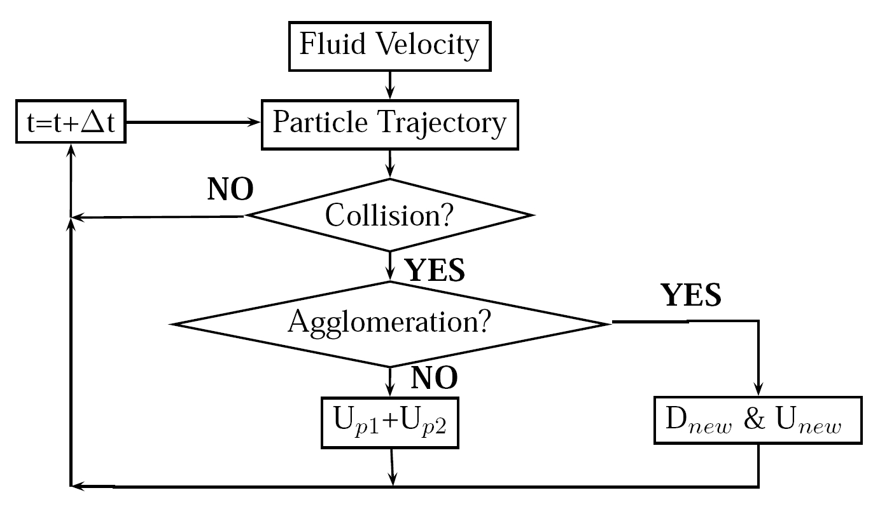
Clustering (based on Ho and Sommerfeld, 2002)

Slide 17
Main Model Equations (PACyc)
Particle Trajectory
Introducing Turbulence in the Fluid
New Class-Efficiency (after History Rebuild)

Slide 18
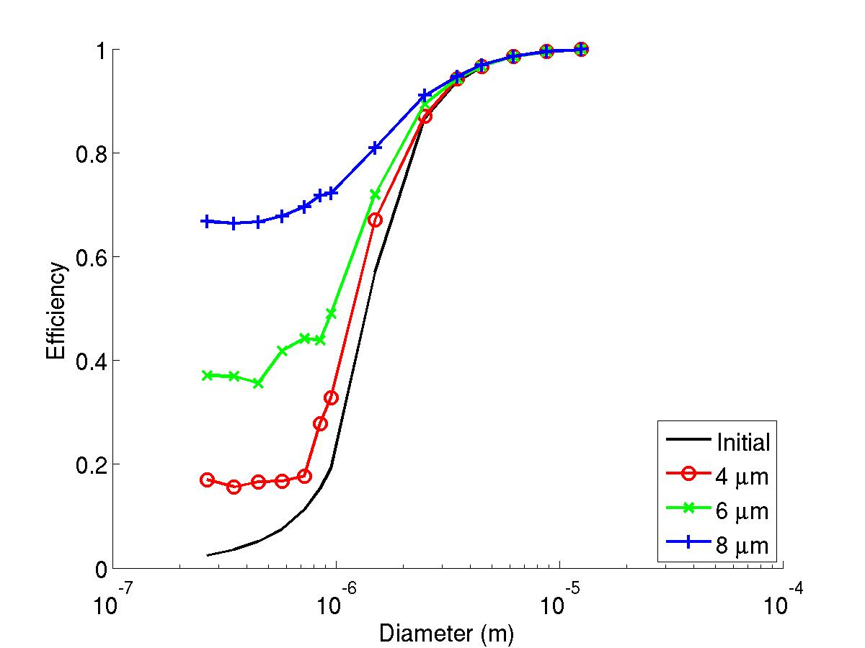
Effect of maximum collision (target) diameter

Slide 19
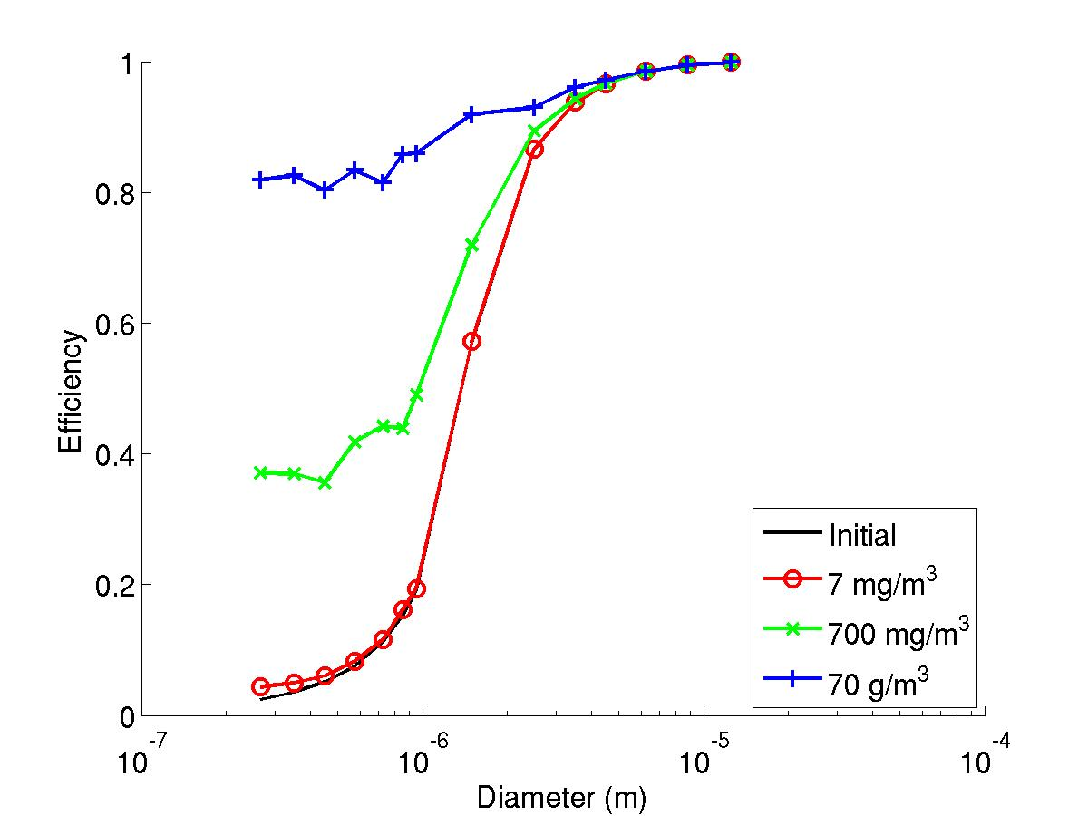
Effect of inlet concentration
700 mg/m3
70 mg/m3
7 mg/m3
_____ ML (not sensitive to C_in)

Slide 20
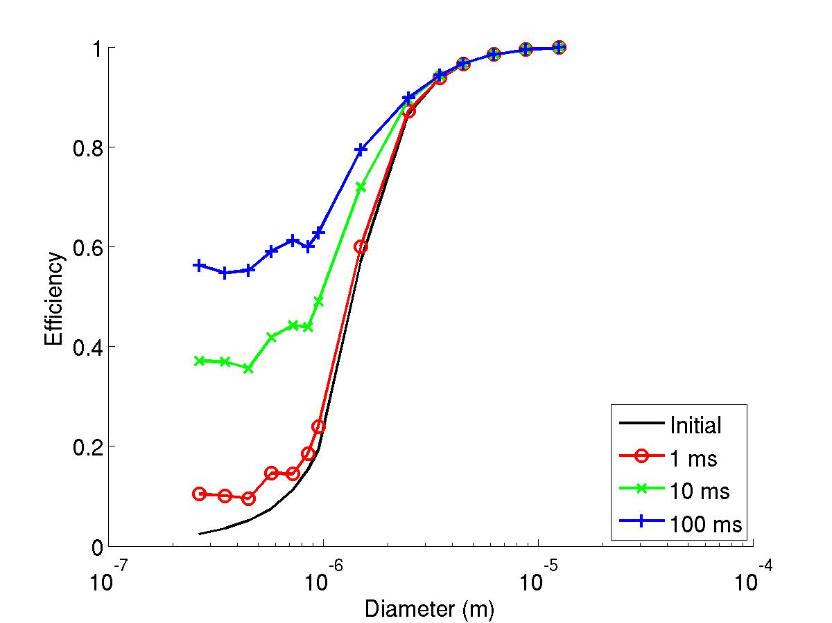
Effect of residence time
REF: ρ_{p}=1450 kg.m⁻³
D_{max} = 6 µm
t_{max} = 10 ms
C_{in} = 700 mg.m⁻³

Slide 21
Very good agreement with experimental data
PACyc (2010)
ML (1988)

Slide 22
PACyc conclusions
  We have extended the ML (1988) and Ho and Sommerfeld (2002) models to predict fine particle clustering in turbulent cyclone flows
  Fair agreement between experimentally observed grade-efficiency curves and those from our model
  Excellent agreement between predicted and experimental global collection efficiency
  There is now a theoretical framework on which to base our hyphothesis, viz. that clustering inside the cyclone may be responsible for the very high collection of fine particles

Slide 23
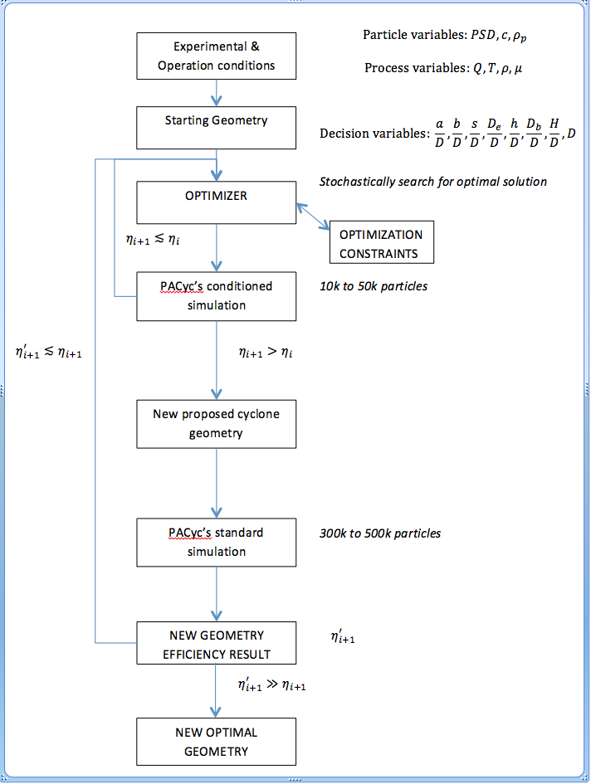
3. Optimize with the PACyc model

Slide 24
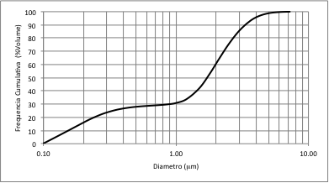
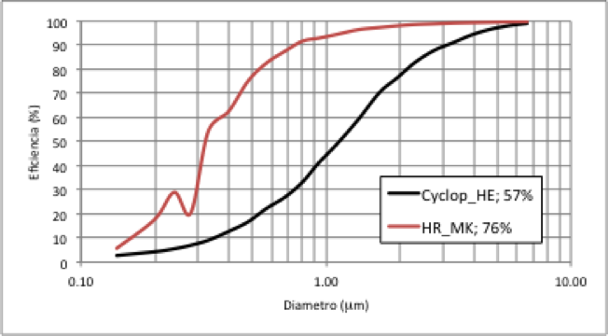
The outcome: the Hurricane_MK
Under patent pending (PTC 107312), it shares no more than 2 ratios with
≈ 190 geometries available in the scientific literature or in the marketplace
Projections for difficult API (ρ_{p}=450 kg/m³):
HR; 57%
HR_MK; 76%
Projections confirmed by client: Reduction in losses 44%

Slide 25
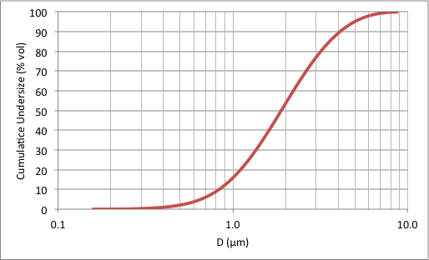
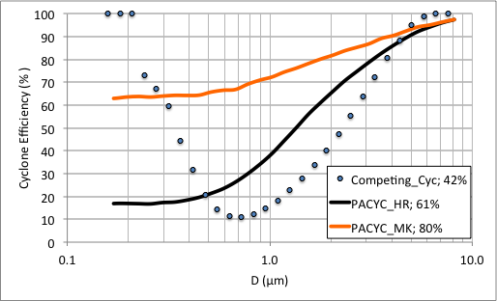
Grade-efficiencies including clustering
HR130; MK250
Fig. 1 - Particle size distribution reconstructed from cyclone (42%), filter (53%) and losses (5%).
Fig. 2 - Grade and global efficiencies from competing cyclone (experimental) and predicted by PACYC for HR and HR_MK cyclones
(particle density; 711 kg/m³)

Slide 26
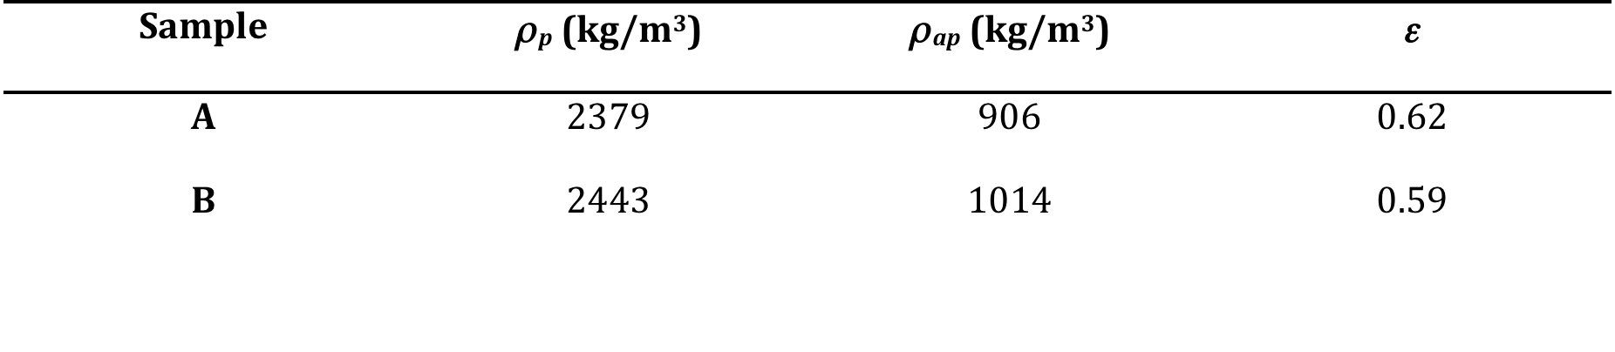
Pilot-scale test conditions

Slide 27
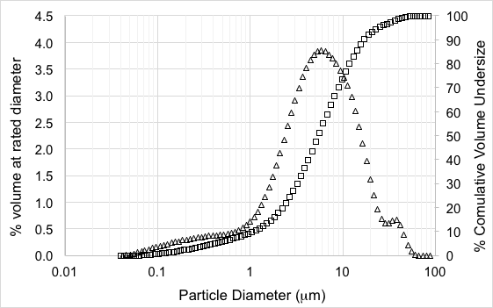
Sample – fine fly ash inlet PSD

Slide 28
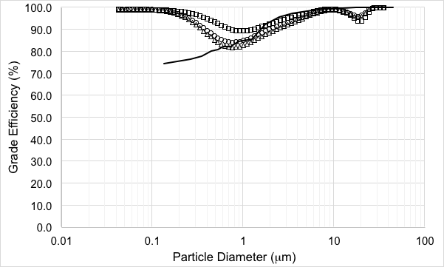
Sample – grade efficiencies
PACyc @ 572 mg/m³
Increased concentration
(121, 363, 1231 mg/m³)

Slide 29
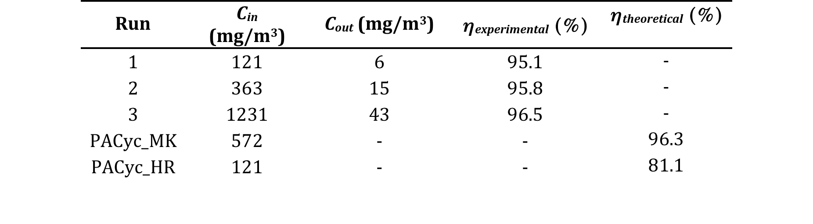
Sample – global efficiencies

Slide 30
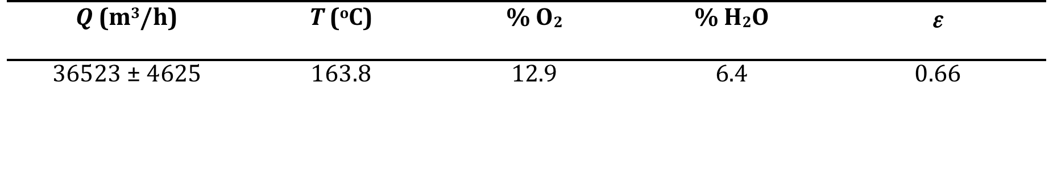
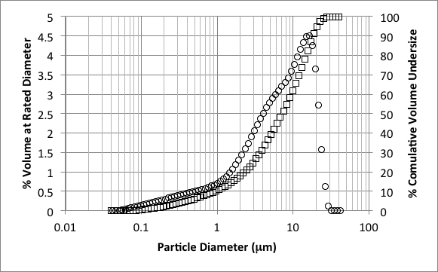
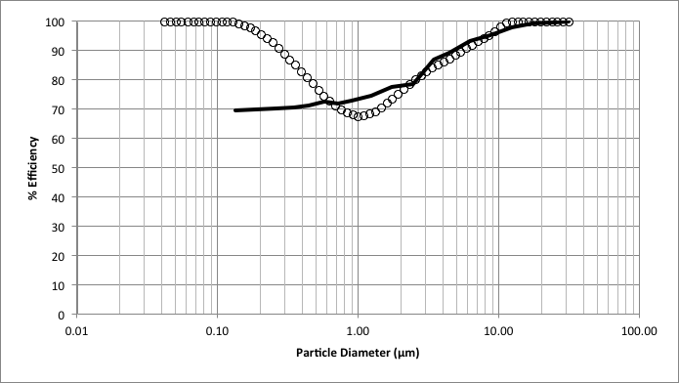
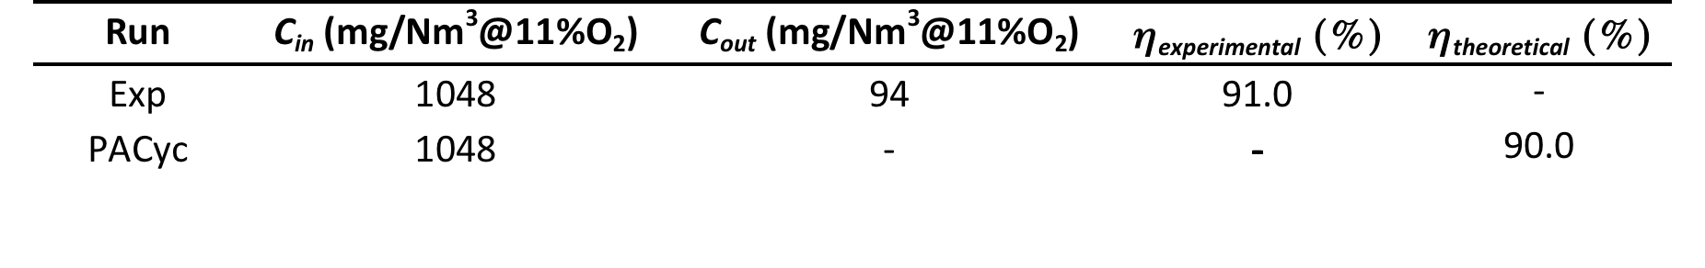
Industrial-scale test conditions
(24x1050mm HR_MK)

Slide 31
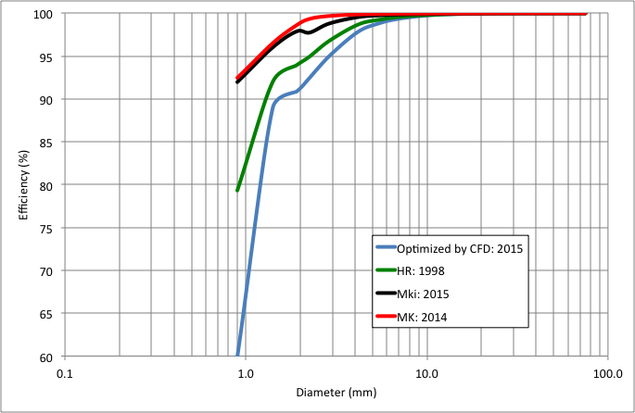
What about CFD? (Sgrott et al., 2015)

Slide 32
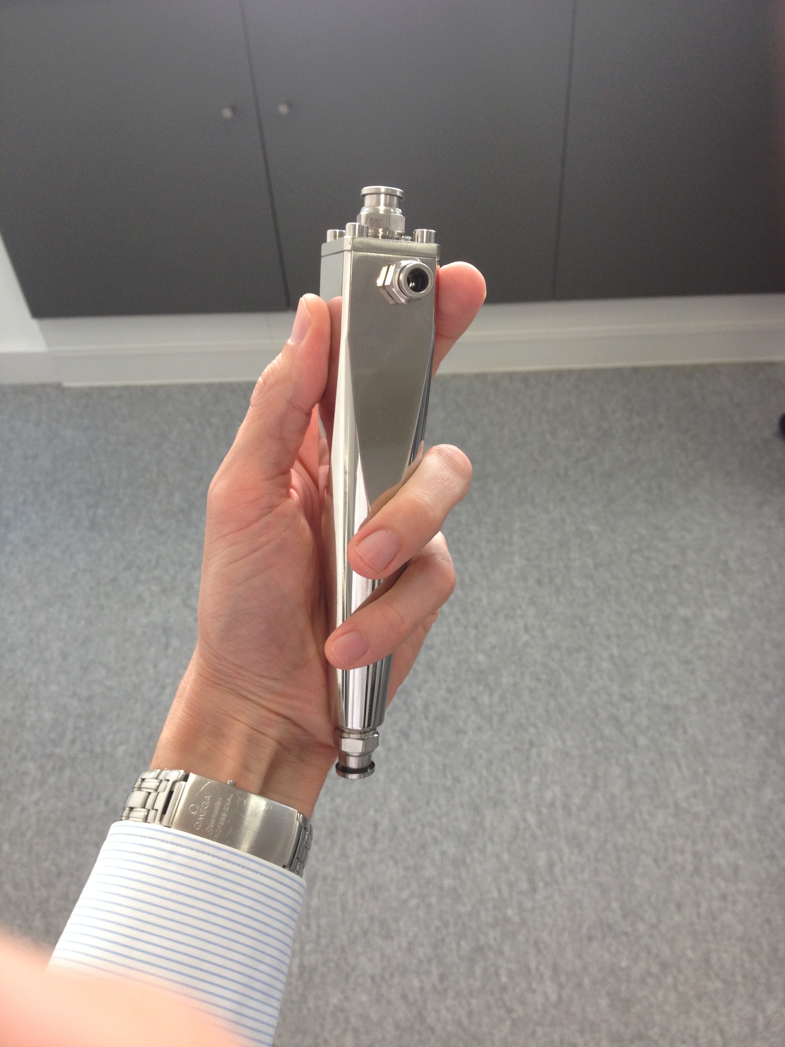
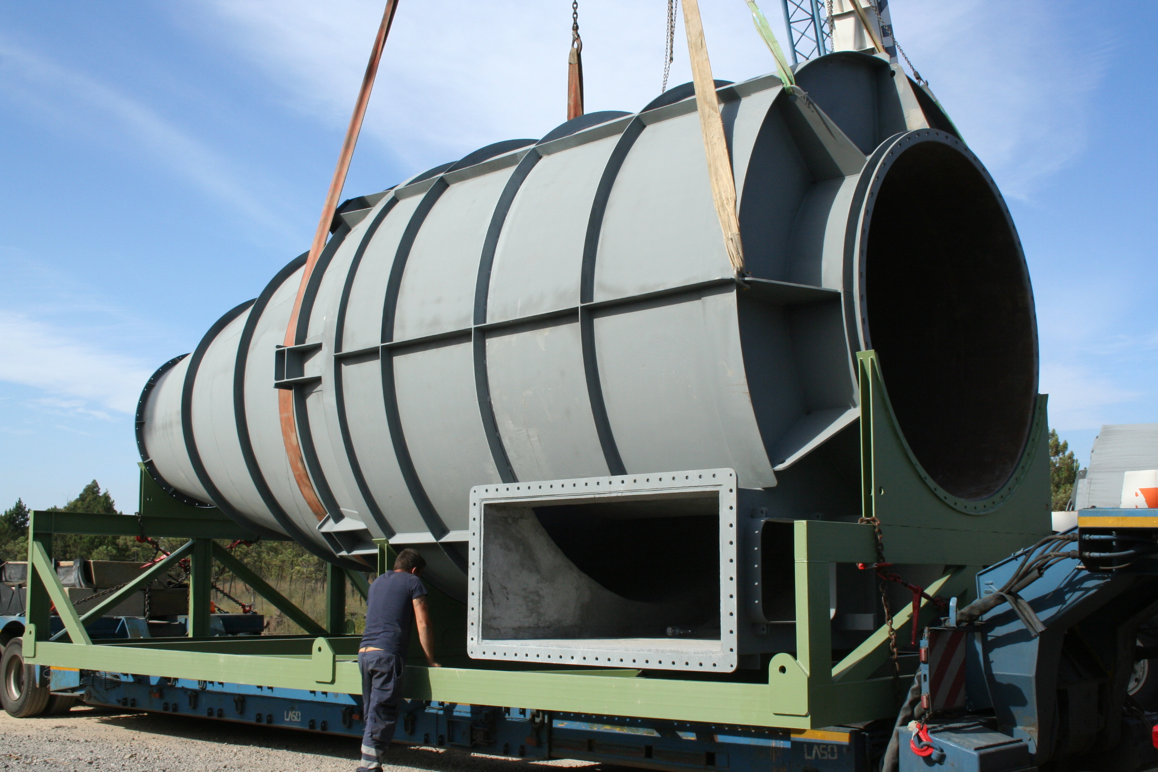
Scaling is no problem
1x10mm hydrocyclone for mamalian cell separation
4x3750mm cyclones for ferrous industry (600,000 m³/h)

Slide 33
Conclusions
Global optimization with a good simulation (PACyc) is a powerfull weapon to design better cyclones
Taylor-made cyclones can be designed to meet specific demands
Different simulation packages will obtain different ‘optimum’ solutions
The numerical solutions have to be throughly tested before implementation
ACS has gained a good confidence on its cyclone design methodology
Which is the better cyclone will depend partly on the operating conditions and mostly on particle properties (density, porosity and particle size distribution).

Slide 34
References
Alves, A., J. Paiva and R. Salcedo, Cyclone optimization including particle clustering, Powder Technology vol. 272, 14-22, 2015.
Ho, C. A. and M. Sommerfeld, Modelling of micro-particle agglomeration in turbulent flows, Chemical Engineering Science, vol. 57, 3073-3084, 2002.
Clift, R., M. Ghadiri and A. C. Hoffman, A critique of two models for cyclone performance, AIChE J., vol. 37 (2), 1991.
Sgrott, O.L., Noriler D., Wiggers, V.R. and Meier, H.F., ‘Cyclone optimization by COMPLEX method and CFD simulation’, Powder Technology, vol. 277, 11-21, 2015.
Paiva,J., R. Salcedo and P. Araujo, Impact of particle agglomeration in cyclones, Chem. Eng. J., vol. 162, 861-876, 2010.
Mothes, H. and F. Loffler, ‘Prediction of particle removal in cyclone separators’, International Chemical Engineering, vol. 28, 231-240, 1989.
Salcedo, R. L., ‘Solving Non-Convex NLP and MINLP Problems with Adaptive Random-Search’, Ind. Eng. Chem. Res., vol. 31, no.1, 262-273, 1992.
Salcedo, R. and Coelho, M., ‘Turbulent dispersion coefficients in cyclone flow – an empirical approach’, Can. J. Chem. Eng., vol. 77, 609-617, 1999.
Salcedo, R. L., High efficiency cyclones, EP0972572A2, European Patent Application 99670006.8, Bulletin 2000103, January 19, 2000 (granted).
Salcedo, R. and J. Paiva, Reverse flow agglomerating cyclone and process thereof, PTC 107312, INPI, November 25, 2013 (pending).

Slide 35
Thank you contacts: technical@acsystems.pt

