Slide 1
METR/ENVS 113 Lecture 8: Satellite Detection of Air Pollution (Part 1)
SJSU Fall Semester 2020
Module 3: Outdoor Air Pollution (Ozone & PM2.5)
Frank R. Freedman (Course Instructor)
Notes:
Hello, this is METR/ENVS 113 Lecture 8, Satellite Detection of Air Pollution (Part 1). This is the second lecture of Course Module 3 – Outdoor Air Pollution (Ozone and PM2.5)

Slide 2
Outline
Background: Satellite Measurement of Air Pollution (Part 1)
Motivation: Broader Spatial Coverage
Geostationary vs. Polar Orbiting
Visible vs. Infrared
Total column abundance
Demonstration (Part 2)
Hourly tracking of wildfire PM2.5 & fires in California (GOES-17 & Suomi)
Daily tracking of wildfire smoke across U.S. via carbon monoxide (Sentinel-5p)
Locating major urban emission centers via nitrogen dioxide (Sentinel-5p)
Notes:
The outline of this lecture is as follows.
We will first provide some background. We will discuss the motivation and prime advantage of satellite air quality measurements – which is to provide broader spatial coverage of measurements compared to what can be obtained used ground monitoring alone. We will then give a brief background on satellite remote sensing – the difference between geostationary vs polar orbiting satellites, visible versus infrared detection, and a discussion of total column abundance, which is how satellite remotely sensed air pollution is generally expressed.
In part 2, which is on a separate YouTube link, we will further demonstrate how satellites can be used to track important air pollution events. We will look at GOES-17 geostationary satellite measurements of wildfire smoke and Suomi polar orbiting satellite fire detections of the ongoing Sept 2020 wildfires in California, and daily tracking of wildfire smoke across the U.S. via carbon monoxide measurements from the Sentinel-5p satellite. We will also look at nitrogen dioxide measurements from Sentinel-5p, and how these indicate major urban emission centers of nitrogen oxides.

Slide 3
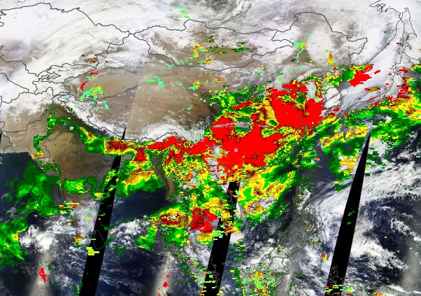
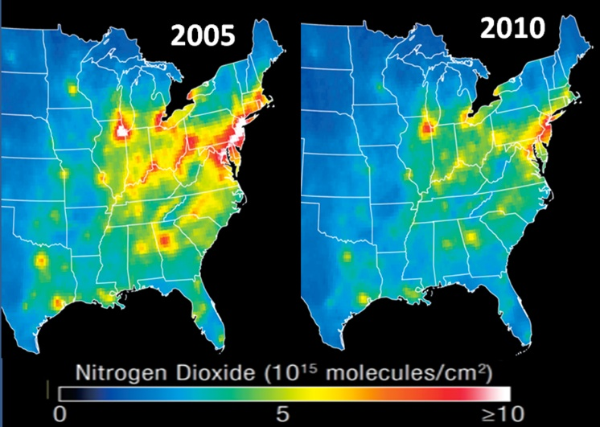
Background: Main advantage of satellite measurements
Continuous global coverage:
“See” pollutants where no monitors exist
Aerosol Optical Depth (AOD): South & East Asia
Nitrogen Dioxide over the Eastern U.S.
Notes:
Proceeding with our background discussion, we highlight on this slide the main advantage of satellite air quality measurements – the potential for much broader and complete spatial coverage compared to what can be obtained with ground monitoring alone. Examples illustrating this are shown below.
On the left is an image of aerosol optical depth detections across south & east Asia. Aerosol Optical Depth is a measure of particulate air pollution – often associated with fine particulate such as PM2.5. The red areas indicate high aerosol optical depth, decreasing across green to yellow to lower values. The image illustrates the broad spatial coverage possible from satellites, which are able to “see down” across large areas uniformly – as opposed to ground monitors which only measure at the location where the monitor is sited. One can also see in this image some of the limitations of aerosol optical depth detections by satellites – that they are not able to make accurate detections in cloudy area, nor bright desert surfaces. In spite of this, the spatial coverage of the area detected is impressive, and it would take a huge, impractical number of ground monitors to achieve the same uniformity of spatial coverage obtained by the satellite in this example.
On the right, is another example – composite images of satellite column nitrogen dioxide detections over the eastern United States for two years – 2005 & 2010. These composite images – which are constructed by averaging the once-daily measurements for each day of the year – indicate clearly the average spatial picture of nitrogen dioxide across the eastern U.S. Nitrogen dioxide is an air pollutant very much associated with industrial and mobile source combustion emissions. Comparing the two images, it is seen that NO2 greatly decreased in the 2010 vs. 2005. This is a result of the reduced emissions as a result of the 2008 and 2009 economic recession, which greatly reduced economic activity and air pollution emissions. The images illustrate how satellites can be used to track time trends in air pollution emissions over broad spatial areas.

Slide 4
Background: Different types of satellites
Geostationary
Fixed in place relative to rotating earth
Continuous coverage in time (hour by hour)
Geostationary Operational Environmental Satellite 16 (GOES-16): Eastern U.S.
Geostationary Operational Environmental Satellite 17 (GOES-17): Western U.S.
Sun Synchronous (“Polar Orbiting”)
Orbits around the earth’s poles
Passes over a place on earth once a day (usually around mid-day)
Daily snapshots (at around mid-day)
Several different satellites (e.g. Suomi, Sentinel-5P)
Notes:
We proceed now with some technical background on how satellite take environmental measurements, air pollution in particular. There are of two main types of satellites deployed, on which various monitoring equipment are included to measure environmental quantities.
First are geostationary satellites. These are fixed in place relative to the rotating earth, or in other words rotating in tandem with the earth. Because of this, geostationary satellites stay fixed in place above a particular line of sight, and therefore are able to measure a location continuously in time. The “Geostationary Operational Environmental Satellite” – or GOES – satellites are the U.S. geostationary satellites, with the most recent launches of the GOES-16 and GOES-17 over the last five years. We will look at GOES-17 detections of wildfire smoke in the second part of this video.
Second are sun synchronous – or polar orbiting – satellites. As opposed to geostationary satellites, which stay fixed in place relative to the rotating earth, polar orbiting satellites rotate on quasi north-south tracks around the globe passing over the north and south poles. As the earth rotates below, the satellite then takes successive snapshots of the earth with each orbit – a different location each time since the earth is rotating beneath. The speeds of the earth rotation and polar orbits of the satellite are such that each snapshot of a location occurs at the same local time for that location – generally around midday. Over a 24-hour daily period, the polar orbiting satellite completely covers the earth with the measurements for that day, repeating with measurements the next day as the satellites stays in polar orbit. There are many polar orbiting satellites deployed. We will look at measurements from two – Suomi and Sentinel-5p – in part two of the video.

Slide 5
Geostationary vs. Polar Orbiting Satellite (Visual)
Notes:
A simple visual of geostationary and polar orbiting satellites is shown here.
As seen, geostationary satellites rotate along a path following the earth, whereas polar orbiters rotate north/south along polar orbits. The approximate heights above earth of the two types of satellites are also indicated, geostationary at around 35000 km and polar orbiters at around 850 km. Each is above the height of the atmosphere of around 500 km.

Slide 6
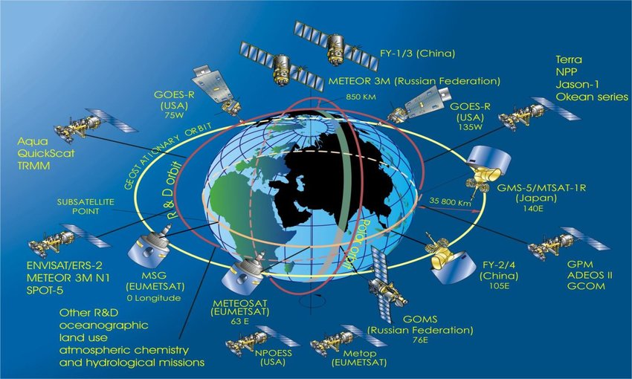
Global Suite of Environmental Monitoring Satellites
Note: Not current … several more recent launches and replacements of those shown above
Notes:
Shown here are the suite of environmental monitoring satellites deployed in recent decades. As seen, many satellites exist, deployed by various national agencies. Each is in turn equipped with many environmental monitoring instrumentation. Applications include weather system tracking, earth system monitoring of climate – including sea-level, sea-ice extent, earth temperature, and climate affecting gases such as carbon dioxide and methane – and many other important quantities. Air pollution, in fact, is a relatively recent addition to the environmental monitoring possible with satellites.
As noted below, the satellites shown on this image are not the most recent, with several more recent launches and replacements of those shown above. The image however gives a sense of the large number of environmental monitoring data available from satellites.

Slide 7
Background: Ways satellites measure air pollution
Visible sunlight
Visible sunlight reflected back to satellite sensor
Examples: Smoke, Dust, Urban/industrial PM2.5, nitrogen dioxide (NO2)
Infrared radiation
Infrared radiation (“heat”) emissions by gases to satellite sensor
Example: Carbon Monoxide (CO)
For both, satellite measures total column abundance
Total amount of air pollutant in column from surface to top of atmosphere.
Commonly as “aerosol optical depth” (AOD) for aerosols (smoke, dust, PM2.5)
Commonly as # of molecules per surface area for gases (NO2, CO)
Notes:
Proceeding with this technical background, we now briefly describe methods of how satellites detect air pollution.
The first way is by reflection of visible sunlight. In this case, the satellite receives sunlight reflected back to the satellite sensor by the earth’s atmosphere. The amount of reflected sunlight is affected by the amount of air pollution in the column air within the satellites line of sight with the earth. The satellite radiation detections received can then be expressed, using mathematical relationships, in terms of the amount of air pollution within the column of air. Examples of air pollutants where reflected visible light is the basis for satellite air pollution detection are aerosol content - smoke, dust and PM2.5 - and nitrogen dioxide.
The second way is by infrared radiation emissions by atmospheric gases. A portion of this radiation that escapes to space is received by the satellite sensor, which as with visible light detection methods is then re-expressed in terms of the amount of radiative emitting gas in the column of air detected. A greater amount of infrared energy detected by the satellites therefore indicates an increased column abundance of an air pollutant gas. An example of an air pollutant gas measured through infrared detection is carbon monoxide.
In both cases, the satellite measures total column abundance – the total amount of a measured air pollution species in the column of atmosphere within the line of sight of the satellite extending from the surface to the top of atmosphere. Common expressions of column abundance are aerosol optical depth – abbreviated AOD – for aerosols, and # of molecules per column surface area for gases.

Slide 8
Visible
“top of atmosphere”
(~ 500 km)
Example column of atmosphere, extending from surface to top of atmosphere
Satellite measures amount of sunlight reflected back to satellite sensor by atmospheric constituents within the column.
The amount and wavelengths of radiation received by satellite will change according to how much of the measured air pollutant is in the column.
Notes:
We proceed now to illustrate these concepts, first for visible light detection. The image indicates a satellite and a column of atmosphere within its line of sight extending from the earth’s surface to the top of atmosphere – indicated by the dashed line at its height of around 500 km.
We indicate rays of sunlight passing through the atmosphere, eventually through the column of atmosphere viewed by the satellite. Some of the radiation is reflected by atmospheric constituents – gases, aerosols and clouds – back to space, which the satellite detects. The levels of reflected light will be affected by the amount of air pollution in the column. Through careful analysis of the wavelengths of the reflected visible light received by the satellite, and methods to account for scattering by clouds and the earth’s surface or other non-targeted gases in the atmosphere - air pollution levels of the target species within the column can then be deduced.
*** toggle red box ***

Slide 9
Infrared
“top of atmosphere”
(~ 500 km)
Infrared radiation emissions from atmospheric gases
Satellite measures amount of infrared radiation from earth to space detected by the satellite sensor.
This amount will increase as the amount of pollutant gas is larger in the column.
Satellite detection must be set according to the specific wavelength emitted by gas
(e.g. around 2300 nm for CO)
Notes:
We proceed now to infrared energy detection. As before, the image indicates a satellite and a column of atmosphere within its line of sight extending from the earth’s surface to the top of atmosphere.
We indicate infrared radiation emitted by gases within the column, some of which passing through the top of the atmosphere and viewed by the satellite. Recall from previous lectures that infrared emissions by gases only occur for certain gases that are able to absorb and re-emit infrared radiation, and that these gases only do so within specific wavelengths in the infrared spectrum. In an earlier course lecture, we pointed out the main gases that do this – carbon dioxide, methane and water vapor, which we termed greenhouse gases. Aside from these greenhouse gases, carbon monoxide – an air pollutant – also has a narrow IR absorption band at around 2300 nm. The emissions of IR within this wavelength band are received by the satellite, and can be re-expressed in terms of carbon monoxide column abundance.
*** toggle red box ***

Slide 10
Total Column Abundance
“top of atmosphere”
(~ 500 km)
Example: Nitrogen Dioxide
Satellite measures total amount of pollutant within an atmospheric column.
This is generally called “total column abundance”.
See example … nitrogen dioxide amounts expressed as # of molecules per square centimeter.
Notes:
We now describe further the concept of total column abundance. As has been pointed out, the satellite measures total amounts within the column in its line of sight. We can see this explicitly from our earlier shown image of nitrogen dioxide from satellite measurements. Notice from the scale bar that the measurements on the map are in units of 10^15 molecules per square cm. The yellows on the graphic therefore indicate areas where the total number of NO2 in an atmospheric column of one square centimeter extending from the surface to the top of the atmosphere equals are around 5 x 10^15 molecules. Lower and higher levels are then indicated by the blues and red, respectively, according to the scale bar.

Slide 11
Total Column Abundance
However … most of this mass is generally within the troposphere
“troposphere”
(surface to ~ 10 km)
Notes:
Given this understanding of total column abundance, it is natural therefore to suspect potentially limiting applicability of satellite air pollution measurements to regulation and human health, since in these cases we are primarily interested in emissions and concentrations at the surface, where we live and breath, rather than the total amount in the column.
In most cases, however, the column mass mostly resides in the troposphere, where around 90% of the earth’s atmosphere exists as we can recall from lectures in the first course module. We attempt to illustrate this by the shading included now within the column, which is darkest within the troposphere – the lowest approximate 10 km of the atmosphere.
There are exceptions, however, most notably for ozone which mostly exists in the stratosphere due to the interactions of ozone and oxygen with ultraviolet sunlight, as we also learned earlier in this course.
Yet for many species it can be safely assumed that the majority of column abundance is within the troposphere.

Slide 12
Total Column Abundance
… and broken down further, mostly in mixed layer
“mixed layer”
(surface to ~ 1 km)
(also called “boundary layer”)
Notes:
We can break this concept down even further in the case of air pollution species. For air pollution, emissions are primarily near the surface due to anthropogenic activity, and often stay confined within the lowest 1 km in the “mixed layer” – a concept covered in Lecture 7. The mixed layer is the portion of the atmosphere beneath an elevated inversion layer that caps the mixed layer. Another term for “mixed layer” is the “boundary layer”. The shading of the column emphasizes this concentration of contaminants within the mixed layer.
Therefore for air pollution measurements, although satellites measure column abundance, it can often be assumed that most of the measured amounts reside near the surface within the mixed layer, making satellite air quality measurements relevant regulating, tracking and studying air pollution from a human health perspective.

Slide 13
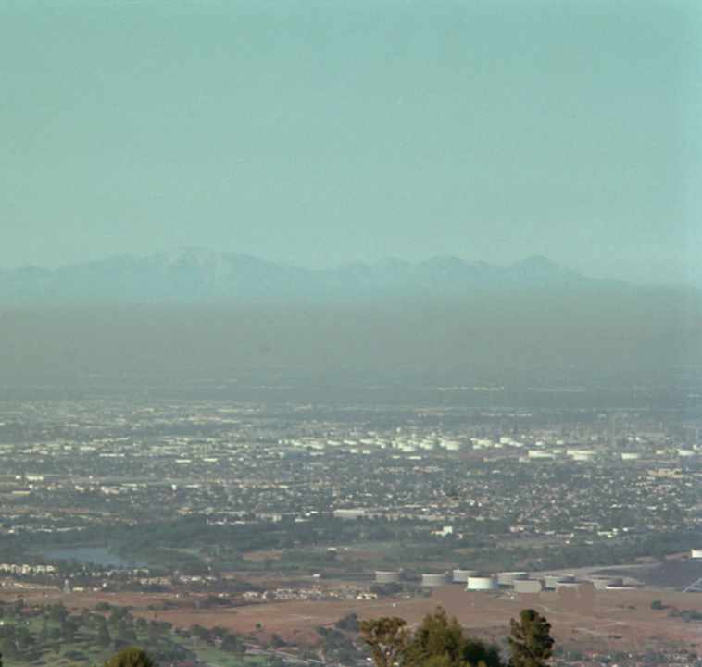
Reminder from Lecture 7
(Photograph looking over LA Basin)
Red line:
plot of temperature w height
subsidence inversion
base of inversion
Air pollution trapped
within “mixing depth” below inversion
Notes:
To make the concept of the mixed layer more clear, we recall here a graphic from Lecture 7 showing air pollution trapped beneath the subsidence inversion within the mixed layer looking over Los Angeles. The air pollution largely confined to the mixed layer can be seen clearly in the graphic.
The red line indicates the typical daytime temperature profile, most notably showing the subsidence inversion capping the mixed layer – where temperature increases with height. As discussed in Lecture 7, temperature inversions tend to inhibit vertical mixing of air, and hence act to trap air pollution emitted at ground level beneath it within the mixed layer.

Slide 14
Demonstration
(see part 2 of lecture video)
Websites to be shown …
https://www.star.nesdis.noaa.gov/jpss/mapper/
https://www.star.nesdis.noaa.gov/smcd/spb/aq/AerosolWatch/
https://fire.airnow.gov
Another site with many remotely sensed environmental measurements
https://worldview.earthdata.nasa.gov/
Notes:
From the background on satellite air pollution measurements just provided, we proceed to part two of the video. This is contained in a separate YouTube video uploaded to the Canvas-Module 3 folder. We will focus largely on wildfire smoke from the recent California fires of Sept 2020, looking at various satellite remotely sensed quantities on map layers from the following two NOAA web links. We will complement this with ground monitoring shown on the AIRNOW link we have been looking at over the previous weeks.
Another site with much data that we will not look at is NASA Worldview.
From a user perspective, it can be challenging for new visitors to these sites to figure out how to toggle layers and specify time periods of images to show, as well as to understand the various layers possible to include and toggle. With time and experience, this becomes easier, and I encourage students to attempt on their own to view some of the satellite data provided on these links.

