Slide 1
METR/ENVS 113
Lecture 10: Introduction to Epidemiology
SJSU Fall Semester 2020
Module 4: Air Pollution Epidemiology
Frank R. Freedman (Course Instructor)
Notes:
Hello, this is METR113 Lecture 10, Introduction to Epidemiology. This lecture is for Course Module 4 – Air Pollution Epidemiology

Slide 2
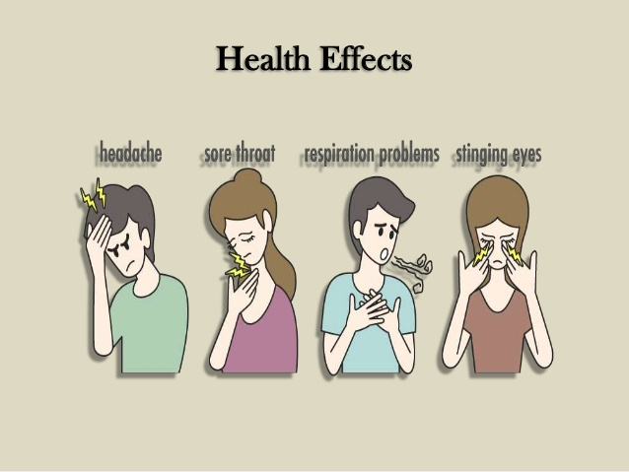
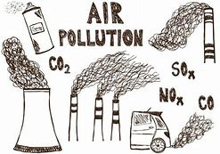
Environmental Factors
Air Pollution?
Other pollution sources (water, soil, indoor environment)?
?
?
Population
Hereditary, Gender, Age?
Diet, Smoking, Exercise, Body Weight?
Pre-Existing Health Condition?
Life-Style, Stress, Anxiety?
?
Notes:
Epidemiology is the study of diseases or other adverse health outcomes in human populations, and how these are linked to exposures to various risk factors. The terms “Disease”, “Outcomes” and “Exposure” will therefore come up often in this lecture.
In this course, we are focused on Air Pollution Epidemiology, a topic of Environmental Epidemiology which studies how adverse health effects are tied to air pollution exposure. This is illustrated by this graphic … which pictorially shows the key question, “is air pollution linked to adverse health effects.
While this may seem true intuitively, epidemiological studies would attempt to determine - to rigorous, quantitative scientific standards - whether increased exposure to poor air quality coincides with increased frequency of specific adverse health outcomes across studied populations. It also attempts to quantify the linkage … that is, to determine how much adverse effect would be expected per unit air pollution concentration exposure.
A key challenge in epidemiology is to properly account for the many other risk factors that may also be associated with the studied adverse health effect besides air pollution. These can include environmental factors, which besides air pollution may include other environmental pollution sources. These can also include many population factors that can be associated with the likelihood of disease in the population, for example age, smoking, pre-existing health conditions, and many other things.
Epidemiology attempts to sort all these things out using rigorous scientific methods. This lecture will provide a broad introduction to the topic.

Slide 3
Module 4: Outline
Introduction to Epidemiology (Lecture 10)
Video Exercise: Salmonella in the Caribbean
Video Exercise: Long-term health effects of PM2.5, Epidemiological Studies, Arden Pope talk
Notes:
The course module on Epidemiology will comprise only this lecture. After viewing this, you will then view two videos.
The first is a CDC web exercise where you will proceed through a series of steps of the Caribbean Epidemiology Center in tracing the cause of a Salmonella outbreak in the 1980s and 1990s in Trinidad and Tobago. It is interactive, with several study questions posed along the way that you will answer as you proceed through the steps.
The second is a talk by Dr. Arden Pope, a leading air pollution epidemiologist, that presents the key epidemiological studies that link specific chronic health effects to exposure to PM2.5. These landmark studies were the basis for the development ambient air PM2.5 standards.
In both, you will write written summaries as assignments for this module.

Slide 4
Lecture 10: Introduction to Epidemiology (Outline)
Background
  Exposure vs Outcome
  Experimental Study Design & Randomized Control Trials
  Presenting Results of Epidemiological Studies
  Absolute Risk & Risk Ratio
Epidemiological Study Design
  Prevalence vs. Incidence
  Cross-Sectional
  Case-Control
  Cohort
Causal Inference
  Chance, Statistical Significance, Confidence Intervals)
  Bias & Confounders
Notes:
The outline for this lecture is as follows.
We first provide background. We then present Epidemiological Study Designs. We conclude by presenting Causal Inference, which is the topic of interpreting results of epidemiological studies. Several sub-topics are covered in each, which we will explain as we go along.

Slide 5
This lecture is adapted from the original PPT lecture “Introduction to Epidemiology and Study Designs” by Thomas Songer, Ph.D., University of Pittsburgh and the Supercourse Team
Notes:
This lecture was developed from the original PPT lecture “Introduction to Epidemiology and Study Designs” by Thomas Songer, Ph.D. – University of Pittsburgh and the Supercourse Team.

Slide 6
Background
Notes:
Background

Slide 7
Basic Question
(Epidemiological Studies)
Are exposure and disease linked?
E
D
“Exposure”
“Disease”
“Outcome”
Notes:
The basic question of epidemiology is whether exposure to a particular contaminant or other risk factor leads to higher rates among a studied population of a particular disease or other outcome. This implies two things occurring.
First is the exposure to a particular contaminant or risk factor. We use the term “Exposure” to indicate the contaminant exposure. In air pollution, the exposure would be inhalation of a specific air pollutant with a particular concentration.
Second, a specific disease or adverse health outcome is examined. We use the term “Disease” or “Outcome” to indicate this. In air pollution, this may be asthma hospital visitations, or diagnosis of coronary heath disease as examples.
By “linked”, we specifically mean whether the increased exposure coincides with increased occurrences of the disease across the studied population. It is important to note that even if an epidemiological study results can establish this association, this does not by itself mean the exposure “causes” the disease – just the association exists. Other scientific evidence would also be needed to establish causation. The phrase “correlation does not imply causation” is often used to express this point.

Slide 8
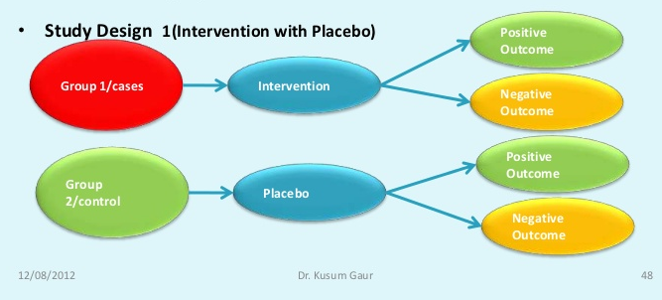
Experimental Study
Classic “placebo-controlled” experimental laboratory study
Four possible outcomes
Experimental
Control
Notes:
To provide context before presenting Epidemiological topics further, we first turn to the classic Experimental Study most people are familiar with. These are often used in Clinical settings to test the efficacy and safety of a drug or other intervention.
In this, study participants are enrolled and divided into two groups – an Experimental Group that receives the drug or intervention, and a Control Group that does not receive the drug or intervention. In human subjects, often a Placebo is given to the Control group, which looks, feels, tastes like the drug but is in fact inactive. This guards against one group being aware of taking a medication while the other is aware they are not, which can bias results through the “Placebo effect”.
Upon receiving or not receiving the drug, there are then four possible outcomes – a positive or negative outcome for each the Control and Experimental Groups. By “positive outcome” we mean that the intended effect of the drug occurred – for example reduced hypertension for a drug intended to lower blood pressure. By “negative outcome” we mean that the intended effect of the drug did not occur. A positive or negative outcome can occur for participants in either group, hence four possible outcomes.

Slide 9
Experimental Design
Randomization
- Participants assigned to Experimental & Control groups randomly
outcome
Intervention
no outcome
Study
population
outcome
Control
no outcome
baseline
future
Blinding
Single-Blinded: participants are unaware of intervention. Reason for Placebo.
Double-Blinded: participants & researchers are unaware of intervention.
time
Study begins here
Notes:
This experimental study design is further depicted on this slide.
The study begins at a particular time with the enrollment of a study population. The population is then divided into Control and Experimental groups. This is the baseline point in the study, at which time the intervention or placebo is applied and outcomes thereafter are observed and recorded.
An important aspect of Experimental studies is Randomization, whereby the assignment of study participants into Control and Experimental groups is done randomly. This helps to guard against the possibility of any selection bias between the two groups – or differences in the make-up of the groups that could lead to different outcomes independent of the drug or intervention.
The second important aspect is Blinding, whereby study participants and investigators are unaware along the study which group receives the intervention and which does not. A Single-Blinded study is one where the participants are unaware of this. The Placebo in the Control Group is a means of blinding in this case. A double-blinded study is one where both the participants and researchers themselves are unaware of which is the Control and which is the Experimental Group. For example, any recordings of data for the two groups will be labeled as “Group 1” and “Group 2”, rather than “Control” and “Experimental”, so that the researcher does not know which group is which. As with Randomization, Blinding reduces the chance of differences in results being a result of bias, rather than the intended effect of the intervention.
Another term for this experimental study design is Randomized Control Trial (abbreviated RCT). The double-blinded Randomized Control Trial is often called “the gold standard” of experimental studies – the one that provides the most convincing evidence for the efficacy and safety of a drug or other health intervention.

Slide 10
Experimental Studies: Summary
Investigator specifies exposure and examines outcomes.
“Control” vs. “Experimental” groups
Usually includes some level of randomization & blinding
Clinical drug trials are the most common example
Double-Blinded, Randomized Controlled Trials (RCTs)
  The “gold standard” of research design. Provides most convincing evidence of relationship between exposure and effect
Notes:
A summary of these points is provided here.

Slide 11
Experimental Studies: Disadvantages
Very expensive.
It may be unethical to assign persons to certain treatment or comparison groups. Not possible to use RCTs to test effects of exposures that are expected to be harmful to humans, for ethical reasons.
Not appropriate to study human exposures and diseases in natural environmental setting … like ambient air pollution exposure.
Notes:
Experimental Studies have a few key disadvantages, however.
The first is that they are very expensive. As a result, these are usually a final step, after several other benchmarks have been established.
The second is ethical consideration, which come up when studying human subjects if an intervention studied is expected to be harmful in some way.
The third is the one most relevant for us, and motivates epidemiological designs. It is that it is not possible to apply experimental study designs to answer questions about links between exposures and outcomes across human populations in their natural setting. This is because the experimental study requires a laboratory setting to carefully control exposure. Studying the effect of ambient air pollution across human populations therefore requires epidemiological approaches that gather and analyze data in a natural environmental setting. We will cover some of these main epidemiological approaches later in the lecture.

Slide 12
Presenting Epidemiological Study Results
Disease / Outcome
Exposure
2 x 2 table to display results of experiment
Symbol Definition
E+ (exposed), E- (not exposed), D+ (got disease), D- (did not get disease)
a: exposed that got disease, b: exposed that did not get disease
c: not exposed that got disease, d: not exposed that did not get disease
N₁: Total number exposed (= a+b), N₀: Total number not exposed (=c+d)
M₁: Total number disease (= a+c), M₀: Total number not disease (=b+d)
Notes:
In these types of studies, Experimental or Epidemiological, we have the four possibilities mentioned a few slides back: positive or negative outcomes for the two studied groups. In Epidemiology we call these the Exposed and Non-Exposed Groups, and the outcome “Disease” or “No Disease”. We will use the term “Outcome” and “Disease” interchangeably through this lecture.
For example in air pollution, we may have two groups – one exposed to high and another to low concentrations of ambient air pollution. We then may investigate differences in daily respiratory related hospital visitations between the two groups. We now summarize how the data gathered in such an epidemiological study are generally presented and analyzed.
Seen here is the classic “two by two” table, where the number of participants for each of the four possible study outcomes are recorded.
The rows of the table indicate the two groups: the Exposed group by E+ and Non-Exposed group as E-. The columns of the table indicate whether participants got or did not get the disease or outcome. The “+” column is getting the disease or outcome, the “-’ column is not getting the disease or outcome.
The ‘a’, ‘b’, ‘c’, and ‘d’ entries are then the number of participants in each of these four categories. Specifically, ‘a’ is the number of exposed participants who got the disease or outcome and ‘b’ is the number of exposed participants who did not get the disease or outcome, c’ is the number of non-exposed participants who got the disease or outcome and ‘d’ is the number of non-exposed participants who did not get the disease or outcome
The entries in the total columns are the additions of these entries. For example N1 is the total number of exposed participants, and would equal the sum of ‘a’ and ‘b’.
These symbols are defined here …

Slide 13
Example
180 Participants split into 80 Exposed and 100 Not-Exposed
Of the 80 Exposed, 10 got Disease
Of the 100 Not Exposed, 5 got Disease
 | D+ | D- | Total
E+ | 10 (= a) | 70 (= b) | 80 (= N₁)
E- | 5 (= c) | 95 (= d) | 100 (= N₀)
Total | 15 (= M₁) | 165 (= M₀) | 180
Notes:
Here we provide an example of the entries of a two by two table for the above hypothetical study conditions. The student should review the slide on their own and verify their understanding of the entries of the two by two table based on the conditions in the bullets above it.

Slide 14
Absolute Risk
Definition: Fraction of Total Number in a Group that Got the Disease (Outcome)
2x2 table
E+ (exposed), E- (not exposed),
D+ (got disease), D- (did not get disease)
N₁: Total number exposed, N₀: Total number not exposed
M₁: Total number disease, M₀: Total number not disease
R₁: Absolute Risk (Exposed)
R₀: Absolute Risk (Not Exposed)
Notes:
Once entries are places in the 2 by 2 table, a number of metrics analyzing the results can be calculated.
One of these is the Absolute Risk – which is defined as the fraction of the total number in a particular group that got the disease or outcome.
Specifically, the absolute risk for the Exposed Group, denoted here at R1, equals ‘a’ (the total number of exposed that got the disease) divided by N1 (the total number in the exposed group). This gives the fraction of the exposed group getting the disease, which is a measure of the risk of the exposed group getting the disease.
Likewise, the absolute risk for the Non-Exposed Group, denoted here at R0, equals ‘c’ (the total number of non-exposed that got the disease) divided by N0 (the total number in the non-exposed group). This gives the fraction of the non-exposed group getting the disease, which is a measure of the risk of the non-exposed group getting the disease.

Slide 15
Relative Risk or “Risk-Ratio” (RR)
Definition: Ratio of Absolute Risks of Exposed to Non-Exposed Groups.
Measures how much more/less likely Exposed Group got disease compared to Non-Exposed Group.
RR > 1, exposed group more likely to have gotten disease
RR < 1, exposed group less likely to have gotten disease
Notes:
From Absolute Risk, we can then calculate what is called the “Relative Risk”, also called the “Risk Ratio”. This is simply the ratio of the absolute risks of the Exposed over the Non-Exposed groups. The Relative Risk or Risk Ratio therefore indicates how much more or less likely the exposed group got the disease compared to the non-exposed group.
Below we can illustrate how this is calculated from Absolute Risks. As covered on the last slide, the absolute risks of the exposed group, R1, equals a/N1. The absolute risks for the non-exposed group, R0, equals c/N0. Dividing R1 by R0, we then calculate the ratio of the absolute risks of exposed to non-exposed groups, which is the Risk Ratio or Relative Risk.
If the Risk Ratio is greater than 1, the exposed group is therefore more likely to get the disease compared to the non-exposed group.
If the Risk Ratio is less than 1, the exposed group is therefore less likely to get the disease compared to the non-exposed group.

Slide 16
Returning to Our Example
180 Participants split into 80 Exposed and 100 Not-Exposed
Of the 80 Exposed, 10 got Disease
Of the 100 Not Exposed, 5 got Disease
 | D+ | D- | Total
E+ | 10 (= a) | 70 (= b) | 80 (= N₁)
E- | 5 (= c) | 95 (= d) | 100 (= N₀)
Total | 15 (= M₁) | 165 (= M₀) | 180
Absolute Risk:
R₁ = 10 diseases per 80 exposed = 10/80 = 0.125
R₀ = 5 outcomes per 100 not-exposed = 5/100 = 0.05
Relative Risk (Risk Ratio): = R₁/R₀ = (10/80) / (5/100) = 0.125/0.05 = 2.5
Interpretation: Exposed group was 2.5 times more likely to get disease than unexposed group. Exposed group was 2.5 times more “at risk” of getting disease.
Notes:
Returning to our example from a few slides back, one can then calculate the Absolute Risks and Relative Risk from these data. The student should review the slide on their own and verify their understanding of the absolute and relative risk calculations based on the entries in the table.

Slide 17
Epidemiological Study Design
Notes:
Epidemiological Study Design

Slide 18
Epidemiology
Definition: the study of the distribution and determinants of disease frequency as it exists across human populations.
  Descriptive Epidemiology: Measuring disease distribution across population.
  Analytical Epidemiology: Measuring the association between a disease and its risk factors (exposure).
Notes:
A formal definition of epidemiology is the study of the distribution and determinants of frequency of adverse health outcomes as these exist across human populations.
Epidemiological studies are divided into two types: descriptive and analytical.
Descriptive Epidemiology is solely dedicated to quantifying the distributions of disease across populations, independent of exposures and risk factors that may lead to getting the disease. It is therefore “descriptive” … describing the distribution of disease without analysis of dependence on exposures.
Analytical Epidemiology on the other hand attempts to pin down the association between a disease and one or more risk factors or types of exposures. It is therefore “analytical” … analyzing the dependence of disease frequency on these risk factors.

Slide 19
Prevalence vs. Incidence
Prevalence: measures the existence of a disease in a population at a particular time.
Incidence: tracks the occurrence of new cases of a disease in a population over a period of time.
Both are commonly expressed as # of disease cases per population (e.g. 100 cancers of all types per 100,000 people)
Notes:
As mentioned, epidemiology quantifies the distributions and frequency of diseases across populations. Two common ways this is quantified are prevalence and incidence.
Prevalence measures the disease frequency over a population at a particular time, while incidence tracks the occurrence of new cases of a disease over a population over a period of time.
In red font are the distinguishing aspects of prevalence versus incidence – prevalence being a particular time while incidence being new cases over a period of time.
Both prevalence and incidence are expressed as number of cases per unit population – for example 100 cases per 100,000 people.

Slide 20
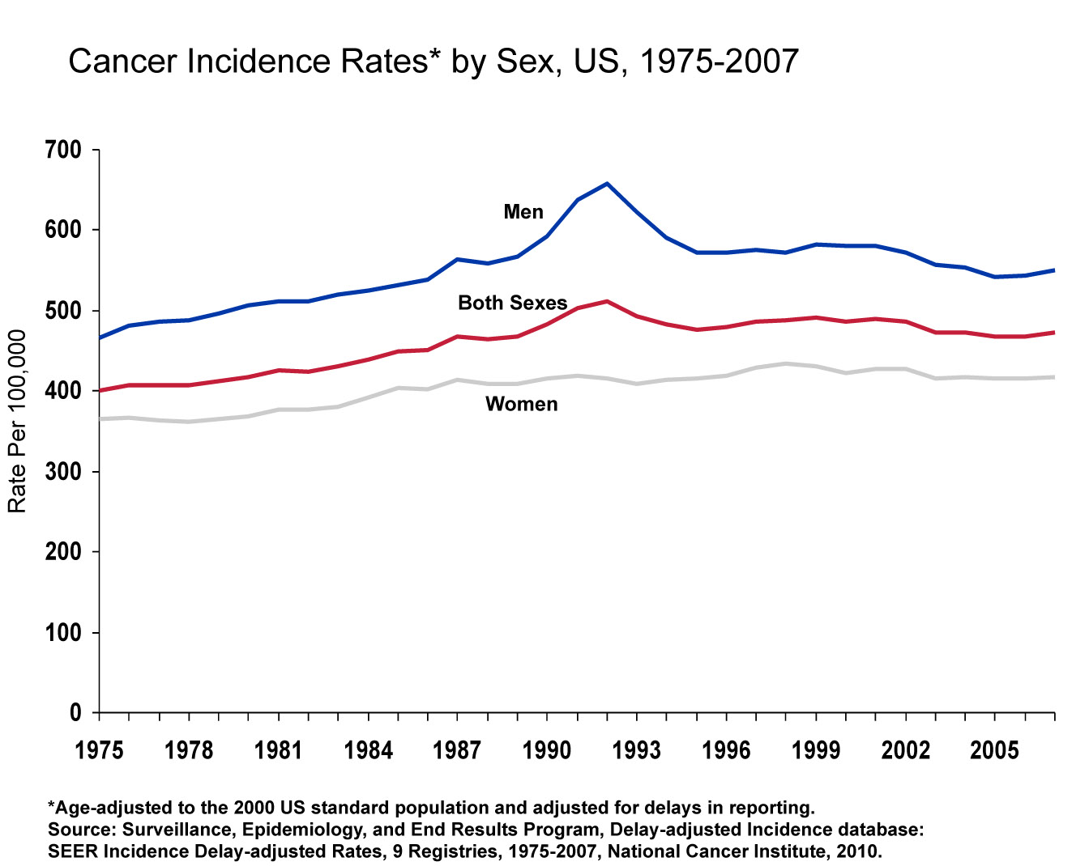
Notes:
To illustrate, we show here a graphic of the cancer incidence rate over the U.S. from 1975 – 2007. Since this is incidence rate, this is the number of new diagnoses of cancers of all types year-by-year from 1975 – 2007. The vertical axis gives the incidence rate as number of cancers per 100,000 people. The horizontal axis is year from 1975 – 2007.
The chart gives the cancer incidence rates for men, women and both sexes. Again, this is incidence rate – meaning tracking new cases over time. The steady increase over time seen on the chart – although flattening out a bit over the recent decade – is due both to an increase in number of cancers as well as better ability to diagnose new cases. The spike around 1993 in cancers among males, for example, is largely due to the introduction of new methods to diagnose prostate cancer through blood testing, rather than solely rectal examination. Many more males therefore got tested for prostate cancer around 1993, and therefore a higher number of prostate cancers were diagnosed that year.

Slide 21
Study Designs
Descriptive
Analytic
Experimental
Epidemiological
Case report
RCT
Cross-sectional
Case series
study
Descriptive
Covered earlier
in lecture
Epidemiology
Case-Control
study
Not covered in this Lecture.
Some in CDC Salmonella video exercise.)
Cohort study
Will now cover these)
Notes:
Descriptive vs. Analytical study designes is further summarized on this slide.
Descriptive study design involves only studying disease without analysis of exposure or risk factors. These therefore involve analysis of case reports and similar data. We will not cover this topic further in this lecture, although the CDC Salmonella video exercise you will view as part of this course module includes some additional material on descriptive epidemiology.
Among Analytical Studies are Experimental studies, in particular the Randomized Control Trials, which were covered at the beginning of this lecture.
We now turn to describing the design of common analytical epidemiological studies. We will cover cross-sectional, case-control and cohort studies.

Slide 22
Analytical Epidemiological: Study Design
Cross-Sectional: Measures prevalence of exposure(s) and outcome(s) over a population at a given time.
Case-Control: Tracks previous history of exposure in disease (“case”) versus non-disease (“control”) cases. The analysis tracks exposure backwards in time. This is therefore a retrospective study.
Cohort – Tracks incidence of disease (or other outcome) of enrolled subjects over time that have different measures of exposure to a risk factor for developing the outcome. Exposure status and outcomes of study participants are observed forward in time. This is therefore a prospective study.
Notes:
We now proceed to cover three types of analytical epidemiological studies.
First, cross-sectional studies measure the prevalence of disease and exposures at a given time. That is, data is gathered among the studied population at a certain time – say a particular year – and the prevalence of exposures and diseases across the population (i.e. cross-sectionally) are calculated.
Case-control studies, on the other hand, look backwards time to study the exposures of diseased individuals (“cases”) versus those of non-diseased individuals (“controls”). It is therefore a “retrospective” study, looking backwards in time by pairing known disease cases with control cases of similar age, sex, demographics, and analyzing differences in past exposures of diseased versus non-diseased cases.
Finally, cohort studies then look forward in time to track the differences in incidence of contracting a disease between exposed and non-exposed groups. It is therefore a “prospective” study, looking forward in time following an enrolled “cohort” of individuals with known differences in exposure, and tracking differences in disease occurrence between portions of the cohort with different exposures.

Slide 23
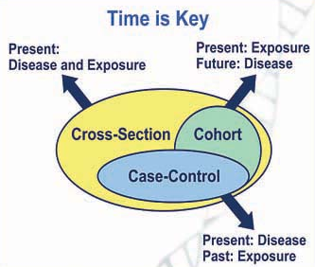
Epidemiological Studies: Analytical
Notes:
The key differences in the designs of cross-section, case-control and cohort studies are summarized on this graphic. As the title suggests “Time is the key”.
Cross-Sectional studies only analyze present time, characterizing the differences in exposure and disease occurrence across a studied population at that time.
Case-Control studies start at present time with known diseases and non-disease cases and analyze backwards, retrospectively, in the past to see what the differences in exposure were among disease versus non-disease cases.
Cohort studies start at present time with a selected cohort of individuals with known exposure differences, and analyze forward, prospectively, in the future to seen what the difference in disease outcomes are among exposed versus non-exposed groups.
In fact, these three types of studies fit into a logical sequence in increasing complexity, cost, and direct evidence of an association of a risk factor to a disease.
For example, a cross-sectional study may first be done, using only present-day data to see whether across a studied population increased cases of disease align with increased amounts of exposures to various risk factors.,
If there seems to be some association of disease to a certain risk factor, a case-control study then may be done, using existing as well as past data during previous years, to see if diseased cases were associated increased exposure to this risk factor.
If there still seems to be some association of the disease to the risk factor, a cohort study may then done, enrolling individuals of different levels of exposure to the particular risk factor and tracking forward in time, therefore gathering new data, to see if the exposed part of the cohort gets the disease moreso than the non-exposed.

Slide 24
Cross-Sectional Study
factor present
No Disease
factor absent
Study
population
factor present
Disease
factor absent
Study data gathered at a fixed point in time
Notes:
A graphical summary of a cross-sectional study is provided here. The student should view this graphic to confirm their understanding of a cross-sectional study based on previous slides.

Slide 25
Case-Control Study
factor present
Cases
(disease)
factor absent
Study
population
factor present
Controls
(no disease)
factor absent
present
past
time
Study begins here
Notes:
A graphical summary of a case-control study is provided here. The student should view this graphic to confirm their understanding of a case-control study based on previous slides.

Slide 26
Cohort Study
disease
Factor
present
Study
population
free of
disease
no disease
disease
Factor
absent
no disease
present
future
time
Study begins here
Notes:
A graphical summary of a cohort study is provided here. The student should view this graphic to confirm their understanding of a cohort study based on previous slides.

Slide 27
Causal Inference
Notes:
Causal Inference

Slide 28
Interpreting Study Results
(“Causal Inference”)
How to interpret the causes for study results pertaining to different outcomes for exposed vs. unexposed groups?
Example:
  Research study is designed to investigate link between smoking and higher incidence of coronary heart disease (CHD).
  Researchers conduct a cohort study. Results are a relative risk (RR) of CHD of smokers to non-smokers equal to 1.25, meaning smokers experienced a 25% higher incidence of CHD than non-smokers in the study.
  Can researchers therefore conclude smoking is associated a higher rate of CHD incidence based on these study results?
  What other possible explanations must be considered?
Notes:
Once data is gathered and analyzed for the two study groups of an experimental or epidemiological study, researchers must interpret the results. In particular, the researchers must determine if any measured differences in outcomes between groups can, with enough scientific certainty, be attributed to the different exposures or treatments of the group rather than other things unrelated.
An example problem will help make this more concrete.
Say for example a research study is designed … *** read through bullets ***

Slide 29
Example (continued …)
Study Results: RR = 1.25 for smokers getting CHD
Interpretation?
Possibility 1: Smoking causes coronary heart disease (CHD).
Possibility 2: There are other reasons for getting different CHD outcomes for smokers vs. non-smokers independent of the exposure differences (smoking vs. non-smoking). Among the main alternative possible explanations are …
  Chance
  Bias / Confounding
Notes:
Continuing with this example … the study results were a RR = 1.25 for the smoker’s group getting CHD, or the smoker group was 25% more likely to have gotten CHD compared to the non-smoker group. Broadly there are two possible interpretations for this results.
The first is that smoking is in fact positively associated, and may even cause, coronary heart disease … as evidenced by a RR > 1 for smokers vs. non-smoker groups in the study.
The second possible interpretation is that there is some other reason besides smoking that led to this result. We will cover two of these other possible explanations: chance and bias/confounding.
The presentations of these in coming slides will be brief and focused on communicating to students the main ideas without getting overly technical. These topics are, in fact, covered in great length and technical detail in statistics courses, especially those related to science, medicine and public health. Many students in this course may have taken a statistics course at some point, in which case some of the points covered may be familiar. However, the goal here is to provide basic explanations so that students can understand the main concepts without requiring background or a previous course in statistics.

Slide 30
Chance
When results of study are within expected random variation among samples, independent of exposure differences.
Differences in results between exposed and unexposed groups must generally be beyond the “95% confidence interval (CI)” to confidently rule out random chance as an explanation.
Differences beyond 95% CI: Rule out chance, differences are “statistically significant” (p-value < 0.05)
Differences within 95% CI: Can be due to chance, differences are not statistically significant (p-value > 0.05)
Larger the sample sizes (“large n”) lead to greater likelihood of statistically significant results.
Notes:
We start with chance. This arises due to variations in results due to random sampling that are expected to occur independent of any differences in exposure between the two study groups.
Students are likely familiar with the concept of random sample variation. For example, if one flips a coin ten times, records the number of heads and tails, and repeats the experiment a number of time, the number of heads and tails would vary for each set of ten flips. On average one would get five heads and five tails, but for any particular ten flips the results can be different.
Researchers conducting experimental and epidemiological studies go to great lengths to determine if differences in results between study groups are due to random chance … or stated more precisely, to determine if random chance can, with enough scientific certainty, be ruled out as an explanation for different results among study groups.
A common requirement used to rule out chance is that differences in results between groups must be beyond 95% Confidence Intervals – which can be interpreted as the range of results expected to occur due to random chance.
If differences are beyond the 95% CI, researchers then rule out chance and differences in results between groups are deemed “statistically significant”. Something called the “p-value” is often quoted alongside study results – when p < 0.05 differences in results are beyond the 95% CI and are therefore statistically significant.
Contrarily, if differences are within the 95% CI, researchers then cannot rule out chance, and different results between groups are not “statistically significant”. When p > 0.05 differences in results are within the 95% CI and are therefore not statistically significant.
Sample size is the most important thing under the researchers control to have a higher likelihood of getting statistically significant results. Sample size is generally indicated by the symbol ‘n’ when presenting results. The higher the sample size the higher the likelihood of statistically significant results. This is why researchers try to include as many study participants as possible. Of course, the more participants the higher the costs of the study.

Slide 31
Apply to our example …
Study Results: RR = 1.25 for smokers getting CHD
Interpretation?
Possibility 1: Smoking causes coronary heart disease (CHD).
Possibility 2: There are other reasons for getting different CHD outcomes for smokers vs. non-smokers independent of the exposure differences (smoking vs. non-smoking). Among the main alternative possible explanations are …
  Chance?
  Bias / Confounding
Notes:
So let’s return to our example problem to illustrate these concepts …
To remind, researchers calculated a risk ratio of 1.25 for smokers versus non-smokers getting CHD. The question is whether we can rule out random chance as the explanation for this result.

Slide 32
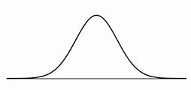
Chance: Applied to Our Example
Expected variation of Risk Ratio due to random chance (“bell curve”)
RR = 1 within 95%-CI
RR = 1 outside 95%-CI
RR = 1.25
RR = 1.25
RR = 1
RR = 1
“95% confidence limits”
“95% confidence limits”
RR = 1 within 95% CI (p > 0.05)
(RR = 1.25 is not statistically significant)
(Cannot rule out chance with sufficient confidence)
RR = 1 outside 95% CI (p < 0.05)
(RR = 1.25 is statistically significant)
(Can rule out chance with sufficient confidence)
Notes:
So proceeding … we see here a graphical view of the key result: RR = 1.25.
The depiction indicates two things:
First, the RR = 1.25 as the peak of the curve, and second, a bell curve spanning left and right of this point to indicate expected variation of the risk ratio due only to random chance. The bell curve is typically used to describe the distribution of values due to random of chance since it assumes equal probability of values being higher or lower than a certain value, which would occur during random events.
We then place bars left and right of the peak to indicate the 95% upper and lower confidence limits. The way to interpret this is that 95% of expected values due to random chance fall within these bounds. The 95% confidence limits therefore are a rough measure of the bounds of the bell curve, within which a randomly selected value will fall 95% of the time.
We can now pose a hypothetical situation in a value of Risk Ratio equal to 1 … which indicates no difference in CHD between the smoker vs non-smoker study groups … is within the 95% confidence intervals. In this situation, although the measured risk ratio in the study was 1.25, the range of expected variation due to random chance alone … independent of smoking vs. non-smoking … includes the point RR = 1, which means no difference in CHD between smokers vs. non-smokers.
In this case, the difference in results of the study group, expressed as a RR = 1.25, is therefore not statistically significant. That is, the researcher cannot rule out an occurrence of RR =1, or no difference among the groups, with enough confidence if the study were repeated many times with different samples. The increased CHD among smokers measured in the study would therefore not be deemed statistically significant, and not interpreted to conclude that smoking is positively associated, and therefore may cause, CHD.
Contrarily, a hypothetical situation can be posed whereby the RR = 1 point is outside the 95% confidence intervals. In this case, the researcher can rule out an occurrence of RR =1, if hypothetically the experiment were repeated many times with different samples, with enough confidence. In this case, the RR = 1.25 value would be deemed statistically significant, that is random chance can be ruled out as an explanation for the measured increased CHD among smokers in the study. The RR=1.25 values measured in the experiment can then be interpreted to conclude that smoking is positively associated, and therefore may cause, CHD.

Slide 33
Example (continued …)
Study Results: RR = 1.25 for smokers getting CHD
Interpretation?
Possibility 1: Smoking causes coronary heart disease (CHD).
Possibility 2: There are other reasons for getting different CHD outcomes for smokers vs. non-smokers independent of the exposure differences (smoking vs. non-smoking). Among the main alternative possible explanations are …
  Chance
  Bias / Confounding?
Notes:
We now turn to the second possible alternative explanation we will cover … the related topics of bias and confounding.

Slide 34
Bias
Selection Bias – errors in selecting participants that would systematically affect exposed and non-exposed groups differently.
Measurement Bias – errors in measuring or classifying exposures or outcomes among participants that would systematically affect exposed and non-exposed groups differently.
If these are an important driver explaining the cause of findings, one would say the study results are “biased”.
Notes:
The concept of bias involves differences in the characteristics study groups, aside from studied intervention or exposure, that may affect study results. Two types of biases are Selection and Measurement bias.
A selection bias occurs when errors are made in selecting participants of the study that would affect the exposed and non-exposed groups differently. For example, during selection of participants for the groups of smokers vs. non-smokers, it could turn out that the average age of the smoking group participants is larger than those in the non-smoking group. A bias was therefore made in the definition of the two groups based on the selection of participants.
A measurement bias occurs when errors in measuring exposures or outcomes affect the two groups in different ways. For example, it could turn out that smokers do not get annual physicals or otherwise go to the hospital as frequently as non-smokers. In this case, diagnosing CHD may therefore be more difficult for smokers compared to non-smokers.
Biases can affect interpretation of outcome differences through Confounding.

Slide 35
Confounding
Outcome differences are due to a “third risk factor”, aside from the exposure or intervention studied. This third risk factor is the main driver of the outcome.
Two requirements for something to be a “confounder”
  Presence of individuals exposed to third risk factor is different in exposed versus non-exposed groups (for example, a selection or measurement bias was made).
  The third risk factor is associated with the outcome, independent of the one studied.
Notes:
Biases can affect the interpretation of study results through confounding.
Confounding occurs when differences in results between study groups is mainly driven by a “third risk factor”, aside from the exposure or intervention studied. Using the example from the previous slide, it could be that the increased CHD among smokers versus non-smokers is not due to smoking but instead due to the fact that participants in the smoker group are older than those in the non-smoker group. In this case, age would be considered the “third risk factor” that could cause confounding.
For a third risk factor to be a confounder, two conditions need to be met.
First, the presence of the third factor must be different in the exposed vs. non-exposed groups. That is, the third risk factor must be introducing a bias affecting the two groups.
Second, the third risk factor must be associated with the outcome independently of the link between the studied exposure and outcome.

Slide 36
Confounding
Requirements for “third” risk factor to be a confounder
Example: Study on the link between smoking and CHD
Exposure of interest (smoking)
Outcome
Third risk factor (age)
Notes:
We can illustrate confounding and the two requirements for it to occur through graphical depiction. We use our example of smoking and CHD to illustrate.
Seen here is a triangle with interconnecting arrows.
On the top-left we see ‘Smoking’, which is the exposure being studied. To the right of this is CHD, which is the outcome being studied. The arrow connecting Smoking to CHD depicts the hypothesized causal link between smoking and CHD being studied.
Below these is ‘Age’, which is the third risk factor. Note that arrows connect age both to Smoking – the exposure of interest – and CHD – the outcome of interest.

Slide 37
Confounding
Requirements for “third” risk factor to be a confounder
Example: Study on the link between smoking and CHD
Exposure of interest (smoking)
Outcome
1. Ages are different btw smoker vs. non-smoker groups
Third risk factor (age)
Notes:
The arrow connecting Age to Smoking indicates the first requirement for confounding to occur, that the third risk factor – Age in this case – affects the two exposure groups differently. In our example, the average age of the smoking group is older than in the non-smoking group.

Slide 38
Confounding
Requirements for “third” risk factor to be a confounder
Example: Study on the link between smoking and CHD
Exposure of interest (smoking)
Outcome
2. There is an independent pathway
(age affects incidence of CHD independent of smoking)
Third risk factor (age)
Notes:
The arrow connecting Age to CHD indicates the second requirement for confounding, that the third risk factor – Age in this case – is associated with increased CHD by itself, independent of smoking. That is, older people are more likely to be diagnosed with CHD compared to younger people, independent of whether he/she smokes.
When both conditions are met, we have a situation where confounding can occur.
That is, the higher rate of CHD measured in the experiment in the smoking group may not, in fact, be due to smoking, but instead could be due to the fact that the smoking group is older.
As with chance, researchers go to great length to minimize the possibility of confounding by applying careful group selection procedures that control as best as possible for biases, and by applying advanced statistical methods in calculating outcome metrics to adjust for possible confounders. An example is the “adjusted risk ratio”, which applies several corrections to the standard calculation of risk ratio covered earlier in this lecture to account for possible confounders.

