Slide 1
METR/ENVS 113
Lecture 11: Local-Scale Air Pollution & Air Toxics
SJSU Spring Semester 2020
Module 5: Local & Indoor Air Pollution
Frank R. Freedman (Course Instructor)
Notes:
Hello, this is METR113 Lecture 11, Local-Scale Air Pollution & Air Toxics. This is the first lecture of Course Module 5 – Local & Indoor Air Pollution

Slide 2
Module 5: Local & Indoor Air Pollution
Lecture 11: Local-Scale Air Pollution & Air Toxics
Lecture 12: Indoor Air Pollution
Motivation …
To learn about aspects of air pollution that affect more at the individual rather than population level.
Notes:
We begin with an overview of this course module – the concluding one for this course.
It comprises two lectures. The first is on local air pollution and air toxics, which we will proceed with shortly. The second is on indoor air pollution.
The theme of the module and the lecture topics that comprise it is to learn about air pollution problems that affect more at an individual, neighborhood scale rather than over the larger population. This distinction – between individual versus population scale – will become more clear as we proceed with the material.
However as an example, one can imagine living near a major roadway or factory. In this case, while the air pollution levels across the city may be tolerable, the concentrations affecting you will be higher, and may not be tolerable if too high, since you live very close to an emission source – the road or factory. The first of the two lectures will cover these type of local air pollution issues in more depth. The second lecture topic, indoor air quality, relates to common types of air pollutants in the indoor environment – focusing on household sources, which of course vary individually and affect you more personally.

Slide 3
Lecture 11: Outline
Local vs. Ambient Air Pollution
Air Toxics
Notes:
The outline for this lecture comprises two topics.
We first more clearly define and describe local air pollution by comparing it to ambient air pollution, which we have primarily focused on in previous modules.
We then study a class of air pollutants called “air toxics”. These are independent of criteria air pollutants, and a class of air pollutants particularly important with respect to local air quality issues.

Slide 4
Local vs. Ambient Air Pollution
Notes:
Local versus Ambient Air Pollution

Slide 5
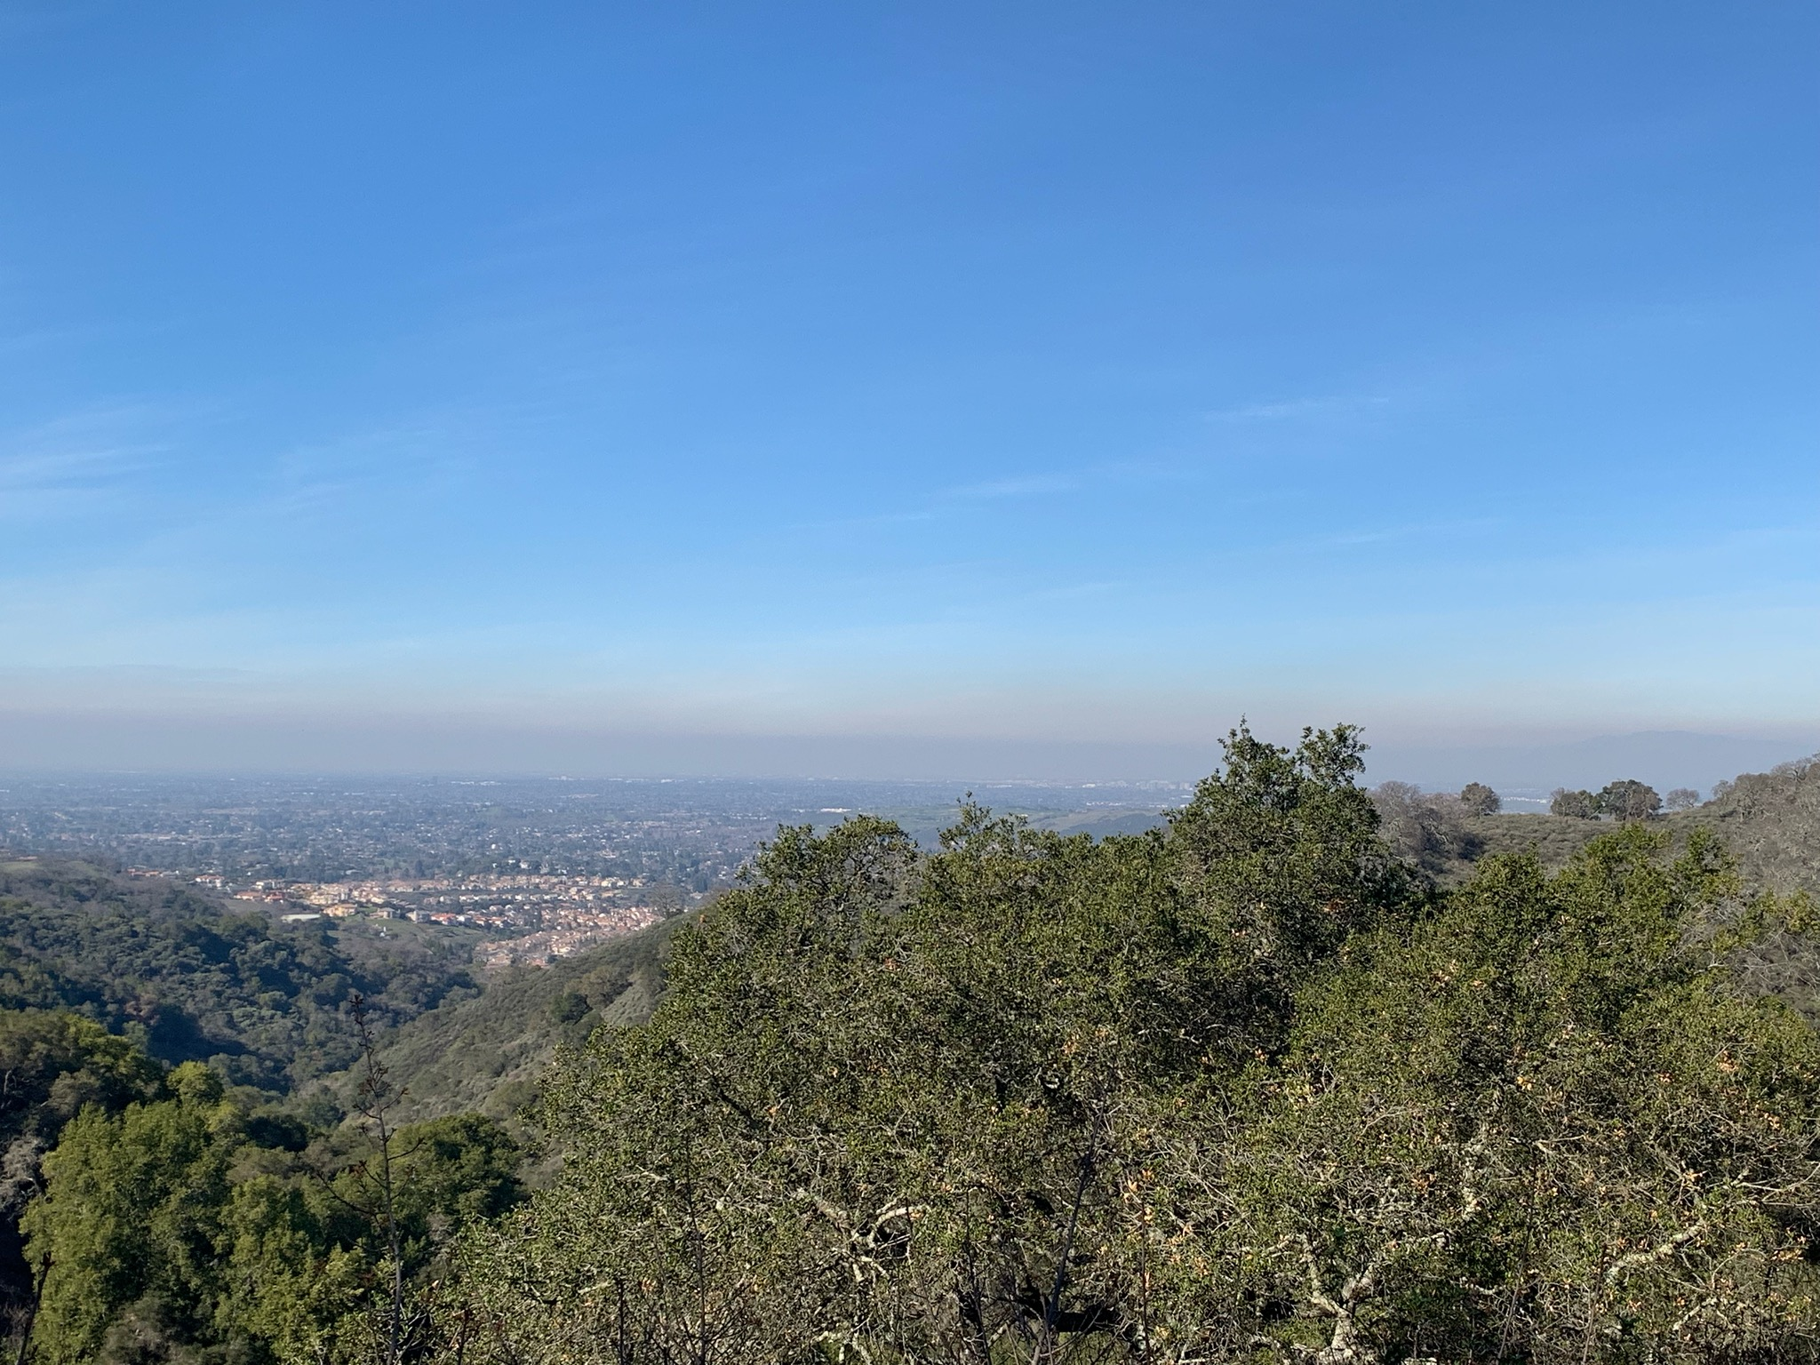
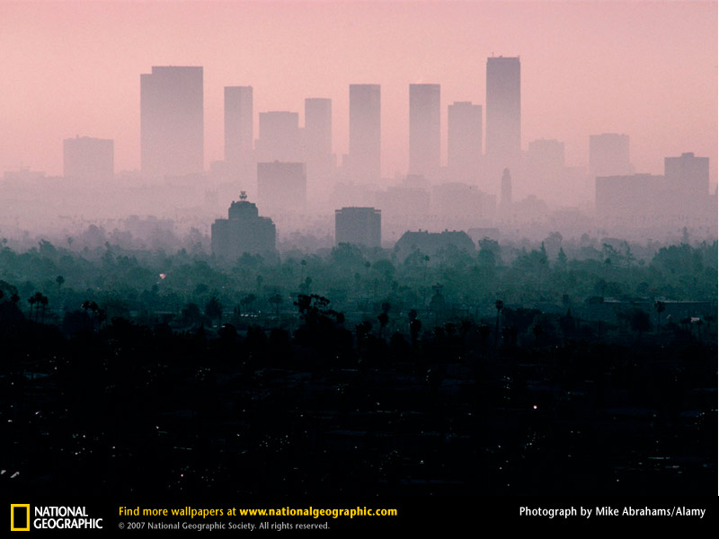
Ambient Air Pollution
Outdoor air pollution that spans broad areas.
Outdoor air, general population exposure
Concentrations can change very gradually from place to place (over 10s - 100 of kilometer)
Due to combined contributions of many emission sources
Summer smog layer over San Jose
Photochemical smog: Los Angeles
Notes:
The focus of previous course modules has been on what is termed “ambient air pollution”.
The photographs below were shown earlier in the course when defining this. The one on the left overlooks an ambient air pollution layer over San Jose, while the one on the right shows photochemical smog over Los Angeles.
To review, the key points about ambient air pollution are as follows:
First, it refers to outdoor air that spans broad areas. This can be seen from the photographs below … the pollution spanning across the city.
Second, as such, it is relevant for general population exposure irrespective of individuals or specific neighborhoods.
Third, concentrations can change gradually spatially over the city or city metropolitan area, however this change is gradual and takes place over relatively large distance scales – say over 10s of kilometers.
Fourth, ambient air pollution is the result of the total combination of the many emission sources across the city, rather than any one specifically. For example, ground-level ozone – an important ambient air pollutant – is the result of citywide emissions of Nox and VOCs. These emissions are the collective result of the many mobile and industrial emission sources within the city.

Slide 6
Example: Ambient Air Ozone Pattern across LA Basin
(Number of Days per Year Exceeding 8-hour ozone standard)
APPROX. 100 KM
Figure 2-4 of http://www.aqmd.gov/home/air-quality/clean-air-plans/air-quality-mgt-plan/final-2016-aqmp
Notes:
The slide below was shown in our previous lecture on ground-level ozone.
It shows the number of days of eight-hour average ozone standard exceedances across the Los Angeles Basin. We learned that much of the poor ozone air quality in Los Angeles, and hence exceedances of air quality standards, occur in the Eastern LA Basin. This is depicted on the graphic, with over 80 days of exceedances at most impacted areas in the eastern basin and much less days, 20 or less in the western and central basin.
This illustrates a key point from the previous slide that ambient air quality can change from place to place across the city, but the changes are gradual and over large distances. In this case, the distance between least and most affected locations in the LA Basin is around 100 km – quite a large distance in comparison to local air quality variations that we will cover shortly. In northwest LA within the San Fernando Valley one also sees higher exceedances and ozone levels, yet even here the higher levels span fairly uniformly across the valley.

Slide 7
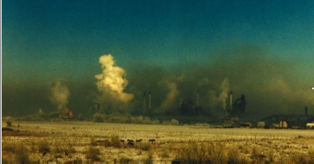
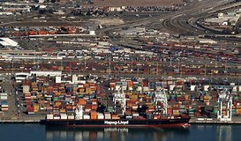
Local Air Pollution
Concerns exposure to individuals residing near specific source(s)
Concentration decreases strongly with distance from source (over 100s of meters – 10 km)
Examples of sources
  Industrial complexes, oil refineries, ports, railways, major roadways
Geneva Steel Mill (Utah)
Port of Oakland
Notes:
With this review of ambient air pollution, we can now proceed to distinguish this from local-scale air pollution.
As mentioned in the introductory slides, we are concerned in this case with air pollution affect more individually or at neighborhood scale. Because of this more local nature, air quality is more affected by emissions from specific sources.
Two examples are shown in the photographs below.
The one on the left is of the Geneva Steel Mill in Utah. You may recall this steel mill being mentioned when viewing the Arden Pope video on PM2.5 health effects as part of one of your writing assignments. It was a large steel mill in Utah that was the primary emission source in the area. A strike caused a shutdown of the facility, after which air quality improved. This is an example of a major industrial source that would strongly affect air pollution for those living close by.
The photograph on the right is of the Port of Oakland, which is a major local air pollution source due to the abundant ship and truck traffic into and out of the port. We learned that trucks emit diesel particulate – a particularly harmful type of combustion fine particulate. Ships also use bunker fuel – a heavy hydrocarbon fuel prone to air pollution emissions. There is much local concern in the community of West Oakland, within a couple miles from the port, about locally high air pollution disproportionately affecting citizens of the neighborhood.
We can now summarize key points distinguishing local air pollution.
First, it concerns exposure to individuals or specific neighborhoods, generally residing near a specific source or sources.
Second, whereas ambient air pollution concentrations change very gradually over large distances, local air pollution concentrations decrease very strongly with distance from the specific emission source or sources in question. This is due to the dispersion – or dilution – of air pollutants as they travel downwind. Generally, appreciable changes in air pollution concentrations in this case occur on the scales of 100s of meters out to, say, around a several kilometers – much smaller in distance than the larger distances of changes for ambient air pollution.
Third, local air pollution generally involves specific, local emission sources. Some important examples of local sources are here listed – which include major industrial complexes, oil refineries, ports, railways and major roadways.

Slide 8
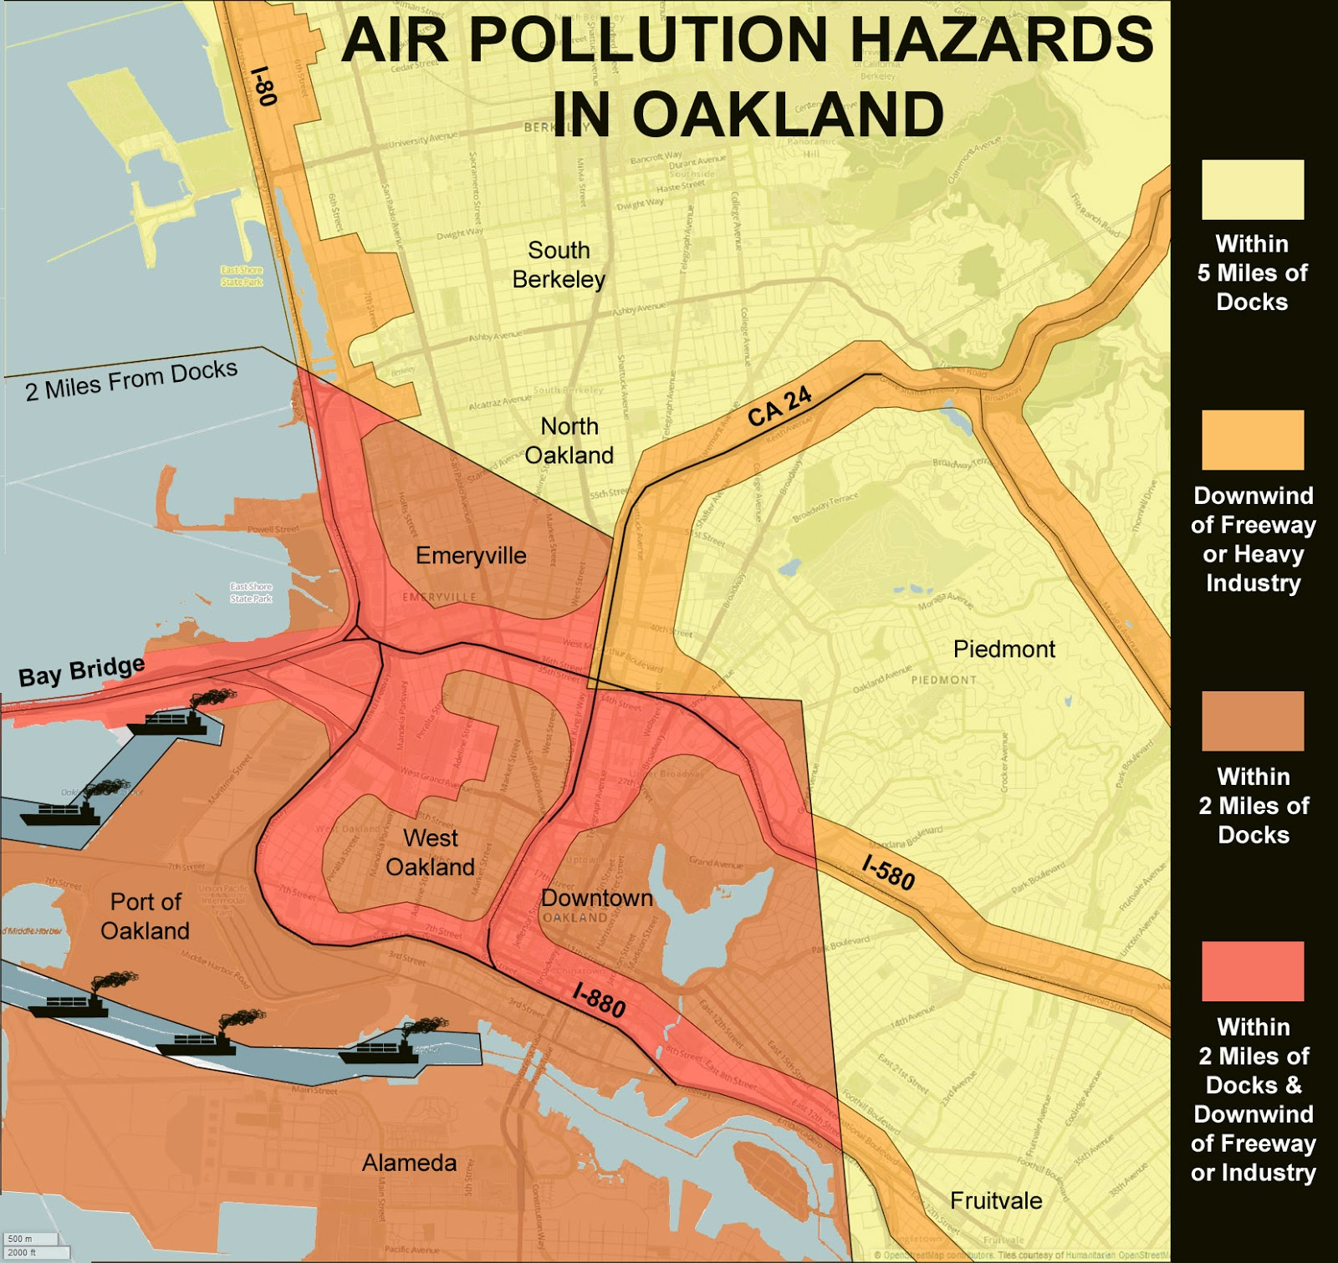
APPROX. 8 KM
(5 MILES)
Notes:
Local air pollution problems are encapsulated with this graphic of air pollution hazards locally in the West Oakland area.
Looking at the graphic, we see a map of Oakland area:
- Notice first the scale of the map – around 8 by 8 km (or 5 by 5 miles). We are therefore looking at neighborhood scale, rather than entire city scale as in the LA Basin ozone exceedance graphic showed earlier.
The port of Oakland is on the lower left of the graphic, depicted by the ships lining the port entrance.
The neighborhood of West Oakland is immediately across the I-880 freeway east of the Port by a mile or so.
The map is color shaded according to distances from the source and locations downwind of the freeways based on typical local winds.
The darkest colors (the dark orange shading) indicate the most hazardous areas – within two miles the Port and downwind of the freeway.
The lighter orange is the area within two miles of the Port regardless of proximity to freeways.
The beige colored areas are as the orange but within five miles of the port.
Although air pollution concentration are not depicted, the graphic illustrates main points of local air quality issues – that the distance scales are short, on the scale of individual neighborhoods within a few kilometers or miles from sources, and that individual sources and distance from these sources are the key considerations when determining air pollution concentration impacts.

Slide 9
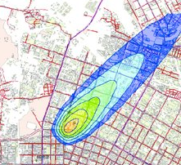
Local Air Pollution
(Air Pollution Concentration Contour Map for a single hour of emission from a single source)
APPROX. 10 KM
1 ppm
5 ppm
Wind direction
10 ppm
20 ppm
50 ppm
source
Notes:
We now highlight air quality concentration patterns from local sources more directly.
In this graphic we show a simple illustration of a plume of air pollution emitted from a single source for a single hour.
The source is depicted by the black ‘x’ on the graphic. The basemap shows a city area of approximately 10 km on the side.
The shadings on the map depict concentrations of the air pollutants emitted from the source over the hour – with different shading colors indicating varying ranges of concentrations decreasing with distance from the source, from higher values in orange near the source to lower values in blue further away from the source.
Further annotating the graphic, we can depict the wind direction, which in this case for the single hour depicted is from the southwest.
The wind direction dictates the direction of the plume, which blows downwind of the source from southwest towards the northeast.
The different color shadings then correspond to ever decreasing concentrations with distance from the source.
Near the source, for example, the yellowish-green contour level may signify the 50 ppm level. Areas within this contour line therefore are areas where the pollution concentration from the source for this hour are greater than 50 ppm. Going further downwind, we can then denote the lower concentration contours, for example the 20 ppm contour, the 10 ppm contour, the 5 ppm contour and the 1 ppm contour.
To explain more precisely, the light blue area between the 10 ppm and 20 ppm contours, for example, are areas where the concentrations due to source emissions for the hour are between 10 and 20 ppm. The total area enclosed by the 10 ppm contour, including the greens and orange contours, is then the area where concentrations are greater than 10 ppm.

Slide 10
Local Air Pollution
(Air Pollution Concentration Contour Map for a single hour of emission from a single source)
Assume contours indicate concentrations of hydrogen chloride due to an accident.
Level of concern for 1-hour exposure to HCl is around 20 ppm for lasting adverse health effects (see links below).
Area within 20 ppm contour is therefore where concentrations are greater than level-of-concern & serious adverse health effects may be anticipated due to emission.
Area within 20 ppm contour
20 ppm
https://www.epa.gov/aegl/hydrogen-chloride-results-aegl-program
https://www.epa.gov/aegl/about-acute-exposure-guideline-levels-aegls#assigned
Notes:
These types of visuals, assuming the information is available to calculate a concentration field to construct it, can then be used to infer where concentrations are above or below a level of concern for some adverse health outcome or other adverse effect.
For example, imagine the pollution plume in this visual corresponds to an accidental release of the air pollutant hydrogen chloride (HCl) from some industrial facility. Perhaps the accident resulted from a rupture of a liquid chlorine tank or pipeline, spilling the chlorine which rapidly volatizes into a toxic gas cloud of hydrogen chloride that blows downwind into the neighboring community.
From previous health studies, it is determined that the concentration level for a one-hour inhalation exposure to hydrogen chloride at which serious, lasting health problems can result is around 20 ppm. This comes from the EPA Acute Exposure Guideline Levels (or AEGLs), which give levels of concern for acute exposure for inhalation of various chemicals. Weblinks to learn further details about AEGLs are provided below for those interested.
Given 20 ppm as a level of concern for a 1-hour exposure, the area encompassed by the 20 ppm contour is therefore that where 1-hour average concentrations are greater than 20 ppm due to the release. This is therefore the area where serious, lasting health impacts may be anticipated due to the accident. Contrarily, areas beyond the 20 ppm contour are those where concentrations are less than 20 ppm, and therefore impacts may be irritating but not as serious or long lasting.
Emergency responders can use this information to prioritize evacuations due to the accident or to take other preventative measures. These type of contour maps are also commonly used in civil litigations, which often result after major environmental accidents, to settle claims.

Slide 11
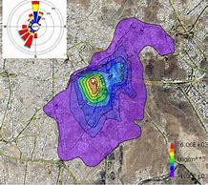
Local Air Pollution
(Air Pollution Concentration Contour Map for a year of emission from a single source)
Wind Rose
source
APPROX. 10 KM
Legend
Concentration (μg/m3)
Orange: 6000
μg/m3
Green: 1000
μg/m3
Purple: 100 μg/m3
Notes:
The graphic below is similar to that just shown, but this time depicting the average concentration of plumes from an emitting source over a year. This would be important for, say, chronic exposure … since in this case we are interested not in a particular hour but average exposure over a year due to emissions from the source.
The layout of the graphic is as before, with the source indicated by the ‘x’ and contours a decreasing concentrations with distance from the source emanating outward.
In the case of this graphic, the concentration levels corresponding to the contours are indicated by a legend on the graphic … with orange indicating 6000 ug/m3, green 1000 ug/m3 and purple 100 ug/m3.
The main distinction however is that instead of being for a single hour this graphic depicts the average concentration field over a year. Therefore, we do not have a single hour wind in a single direction as we had showed previously, but instead a wind rose of the wind frequencies over the year. We learned about wind roses in Lecture 7 – the student is referred back to this to review.
Looking at the wind rose, it is seen that most of the winds are from two directions – from the north and from the southwest sectors.
This helps to explain the shape of the pollution contour field. Since there is a high frequency of winds are from the north , the average pollution field can be seen to protrude moreso to the south compared to other directions, since plumes from the source blow from north to south relatively more frequently. There is also a protrusion to the northeast, based on the relatively higher frequency of winds from southwest, which blow plumes from the source to the northeast.
Wind roses are therefore very useful tools to determine directions from emission sources where local impacts due to continuous emissions from the source may be most pronounced.

Slide 12
Local Air Pollution
(Air Pollution Concentration Contour Map for a year of emission from a single source)
Legend
Concentration (μg/m3)
B
A
Orange: 50
Yellow: 20
C
Green: 10
Blue: 5
Purple: 1
Notes:
The graphic below is similar to that just shown, but this time depicting the average concentration of plumes from an emitting source over a year. This would be important for, say, chronic exposure … since in this case we are interested not in a particular hour but average exposure over a year due to emissions from the source.
The layout of the graphic is as before, with the source indicated by the ‘x’ and contours a decreasing concentrations with distance from the source emanating outward.
In the case of this graphic, the concentration levels corresponding to the contours are indicated by a legend on the graphic … with orange indicating 6000 ug/m3, green 1000 ug/m3 and purple 100 ug/m3.
The main distinction however is that instead of being for a single hour this graphic depicts the average concentration field over a year. Therefore, we do not have a single hour wind in a single direction as we had showed previously, but instead a wind rose of the wind frequencies over the year. We learned about wind roses in Lecture 7 – the student is referred back to this to review.
Looking at the wind rose, it is seen that most of the winds are from two directions – from the north and from the southwest sectors.
This helps to explain the shape of the pollution contour field. Since there is a high frequency of winds are from the north , the average pollution field can be seen to protrude moreso to the south compared to other directions, since plumes from the source blow from north to south relatively more frequently. There is also a protrusion to the northeast, based on the relatively higher frequency of winds from southwest, which blow plumes from the source to the northeast.
Wind roses are therefore very useful tools to determine directions from emission sources where local impacts due to continuous emissions from the source may be most pronounced.

Slide 13
Air Toxics
Notes:
Air Toxics

Slide 14
Air Toxics
Separate from criteria air pollutants
Long list of species (next slide …)
Increased risk of cancer (most important inhalation risk)
Synonyms …
  “Hazardous Air Pollutants” (HAPS)
  “Toxic Air Contaminants” (TACS)
  https://ww3.arb.ca.gov/toxics/toxics.htm
  https://www.epa.gov/urban-air-toxics/about-urban-air-toxics
  https://www.epa.gov/haps/what-are-hazardous-air-pollutants
Notes:
So far, the course has focused on “criteria air pollutants” - the seven pollutants that have ambient air quality standards, and are therefore designed to be protective of ambient air quality.
We now cover another class called air toxics, which tend to be relatively important for local scale air pollution issues since their emissions are often more due to specific isolated sources and therefore affect moreso communities living near these sources.
Air toxics consist of many species … we will see a listing of some common air toxics shortly.
Most air toxics are carcinogenic, and therefore the most important health risk due to inhalation of air toxics is increased risk of cancer.
A couple synonyms for air toxics are hazardous air pollutants – or HAPs – and toxic air contimants – or TACs.

Slide 15
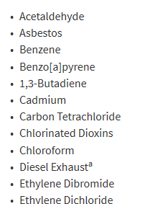

Air Toxics
(Main Species … many others)
https://oehha.ca.gov/air/general-info/toxic-air-contaminant-list-staff-reportsexecutive-summaries
Notes:
The following is a list of some of the common air toxics.
As you see, these consist of various esoteric species. However, they can be summarized within certain groups that are more familiar.

Slide 16
Air Toxics
(Main Species … many others)
VOC
VOC
VOC
VOC
VOC
VOC
https://oehha.ca.gov/air/general-info/toxic-air-contaminant-list-staff-reportsexecutive-summaries
Notes:
The first are various species that volatile organic compounds – or VOCs.
For example, benzene, 1-3 butadiene, toluene, xylene and others.
We learned earlier about VOCs in the context of them being ozone precursors, but many are also air toxics – potentially harmful directly due to their carcinogenic nature. Certain air pollution species therefore have multiple adverse effects that must be considered.

Slide 17
Air Toxics
(Main Species … many others)
Metal
Metal
Metal
Metal
Metal
https://oehha.ca.gov/air/general-info/toxic-air-contaminant-list-staff-reportsexecutive-summaries
Notes:
A second group is metals … cadmium, hexavalent chromium, arsenic, lead and nickel for example.
These are among the fine particulate class … but specific to species that consist chemically of metals.
Of these, hexavalent chromium – or chromium in the sixth rather than the more common third valence stage – is especially harmful.

Slide 18
Air Toxics
(Main Species … many others)
Particulate
Particulate
Particulate
Particulate
https://oehha.ca.gov/air/general-info/toxic-air-contaminant-list-staff-reportsexecutive-summaries
Notes:
There are also several air toxics that are complex carbon particulate species – for example benzopyrenes, dioxins and diesel particulate. These tend to be emitted from combustion of heavier hydrocarbon fuels. We had previously mentioned diesel particulate as especially harmful in our lecture on particulate air pollution in course Module 3.

Slide 19
Air Toxics
(Main Species Classifications)
VOCs
  “BTEX” complex: Benzene, Toluene, Ethylene, Xylene
  Aldehydes (Formaldehyde, Acetaldehydes)
  Various chlorinated species (e.g. Vinyl Chloride)
Fine Particulate
  Diesel Exhaust / Diesel Particulate Matter (DPM)
  Benzopyrenes
  Dioxins (PCBs, PCDs)
Metals
  Hexavalent Chromium especially
  Others: Nickel, Cadmium, Lead
Notes:
A summary of these main classes of air toxics is provided here.

Slide 20
MATES-IV
(Multiple Air Toxics Exposure Study)
(Metro Los Angeles, July 2012 – June 2013)
http://www.aqmd.gov/home/air-quality/air-quality-studies/health-studies/mates-iv
Notes:
Most air quality districts in California have active programs to reduce exposure to air toxics. Among the most complete city wide assessment efforts with respect to air toxics exposure is the Multiple Air Toxics Exposure Studies (or MATES) studies over the Los Angeles Basin, put together by the South Coast Air Quality Management District. Intensive measurements and modeling analyses of air toxics across the city are carried out every five years or so and summarized in reports. Among the main goals of the MATES studies is the assess distributions of air toxic concentrations across the city in order to identify areas of the city and neighborhoods most affected. The most recent is MATES-IV from July 2012 – June 2013.

Slide 21
Cancer Risk: Toxic Air Contaminants (TACs) in LA Basin (MATES-IV)
Increased cancer risk relative to baseline
(per million)
Freeways
Industrial Corridor
Industrial / Freeways
LAX
Freeways
Port of LA
Based on hypothetical 70-year exposure to all TACs based on year 2012 LA Basin Emissions
Computer model estimation
Notes:
Since the main inhalation risk due to air toxics is cancer, a central result of the MATES studies are the generation of maps depicting estimates of the increased cancer risk due to inhalation of air toxics across the basin.
The map below is for all toxic air pollutants combined, and expresses the increased risk of cancer above baseline due to inhalation of air toxics at different locations of the basin in number of increased cancers per million people. Peak increased risks are depicted by the dark purple, indicating increased risks of about 1000 extra cancers per million people above baseline. Lighter purples are about 500 extra cancers per million. Yellows are lower values. The underlying concentration field of air toxics used to calculate the risks on this map is based on measurements and modeling carried out in the MATES study. The risks depicted on this map assume a 70-year – or “lifetime” exposure to the underlying estimated air toxics concentrations.
Looking at the map, a main point that can be seen is the local nature of the risk.
One can see, for example, higher cancer risks in locations corresponding to many of the types of local sources mentioned earlier as examples.
For example, higher risk is seen over the Port of Los Angeles, the LAX airport, near sections of major freeways, and near industrial areas and corridors. This is because air toxic exposure tends to be more localized – due to specific sources - compared with typical ambient air pollutants such as ozone, NO2 and PM2.5. From an exposure point of view, cancer risks due to air toxics are therefore more dependent on proximity to these major emission sources.

Slide 22
Toxic Air Contaminant Health Risk Assessment
(required by California AB2588 “Toxics Hot Spots” Legislation)
Facility
Level of Concern
> 10 per million risk contour line
Residents living within area of this contour line must be notified of increased cancer risk due to facility emissions.
Main risk driver: Hexavalent Chromium
Estimated based on hypothetical 70-year exposure to current-day emission levels from facility
Notes:
Air districts are also required to manage risk of toxic air contaminant exposure from single emitting facilities through the California AB2588 Toxics Hot Spots regulation.
Seen here is an example of such an analysis from some industrial facility.
The facility outline is shown in black. Facilities are required to calculate increased risks of various adverse health effects due to exposure to the air concentrations resulting from their air toxic emissions. Since cancer risk is generally the main effect, we focus on this red outline, which is the contour where average annual concentrations of all air toxics combined are sufficiently high to produce a greater than 10 in million increased risk of cancer for someone exposed long-term to these concentrations.
The AB2588 regulation requires public notification of the increased risk for those within the 10 in a million contour. Therefore in this case, notification would be required for those living within the red contour. The other contours shown – in yellow and orange - refer to other requirements aside from cancer risk, which we will not cover.

