Slide 1
METR/ENVS 113 Lecture 12: Indoor Air Pollution
SJSU Spring Semester 2020
Module 5: Local & Indoor Air Pollution
Frank R. Freedman (Course Instructor)
Notes:
Hello, this is METR113 Lecture 12, Indoor Air Pollution. This is the second lecture of Course Module 5 – Local & Indoor Air Pollution

Slide 2
Lecture 12: Outline
Overview
Indoor Air Pollution: Sources
Indoor Air Pollution: Prevention and Control
Notes:
This final lecture of METR113 will cover indoor air pollution.
We will first give an overview of the topic.
We will then survey important common sources of indoor air pollution.
We will conclude with additional details about basic prevention and control measures to maintain healthy air in the indoor environment.

Slide 3
References / Acknowledgements
Is Your Indoor Environment Making You Sick?
Breathe California of the Bay Area
Presented by Dennis Achá, MPH
METR113 Fall 2012 Semester
Notes:
The contents of this lecture slide set were built from several previously presented material.
First, acknowledgement is given to Dennis Acha at Breathe California of the Bay Area, who presented a slide set to METR113 Spring 2012 on indoor air pollution. Much of the material in this presentation comes from Dennis’ presentation.

Slide 4
References / Acknowledgements
http://www.clallam.net/HHS/documents/Health_and_Indoor_Air_Quality.pdf
https://www.trane.com/commercial/Uploads/PDF/520/ISS-APG001-EN.pdf
https://www.epa.gov/sites/production/files/2014-08/documents/appenb.pdf
Notes:
In addition, content for this lecture slide set comes from material on the following links.

Slide 5
https://nchh.org/information-and-evidence/learn-about-healthy-housing/health-hazards-prevention-and-solutions/ventilation-and-indoor-air-quality/
https://www.cdc.gov/niosh/topics/indoorenv/hvac.html
https://www.epa.gov/indoor-air-quality-iaq/improving-indoor-air-quality
Notes:
Some other resources students can refer to in order to learn more about indoor air pollution and ways to ensure clean air in your home are provided here.

Slide 6
Indoor Air Pollution (Overview)
Notes:
Indoor Air Pollution - Overview

Slide 7
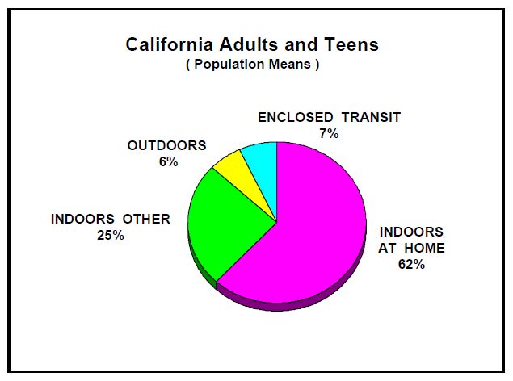
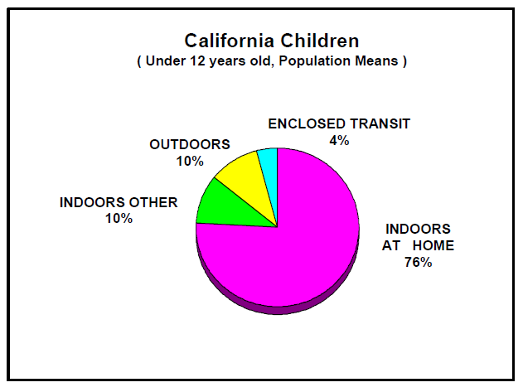
Time Spent Indoor vs. Outdoor
80 – 90% Spent Indoors (home, work, elsewhere)
http://www.arb.ca.gov/research/apr/reports/l3041.pdf
Notes:
The motivation for learning about indoor air pollution is rather clear – we spend lots of time indoors – including both the home and workplace. Our exposure to harmful air pollutants is therefore dependent on the air quality of our indoor environment
What may not be as clear is how much more time individuals spend indoors vs. outdoors.
The charts below show data compiled by California Air Resources Board to determine this.
On the left is a pie chart for Adults and Teens, on the right the same but for children.
As seen in both cases, we spend most of our time on average indoors at home, adults around 60% and children around 75% on average. A significant time is also spent indoors away from home, for example at work or school. Combine home and elsewhere, the data indicate that we spend on average 80 – 90% of our time indoors.
Indoor air quality is therefore extremely important in determining total exposure to air pollutants.
Yet, as we will see, certain air pollutants are more common indoors than others.
Throughout the remainder of this lecture, we will focus primarily on indoor air pollutants in homes.

Slide 8
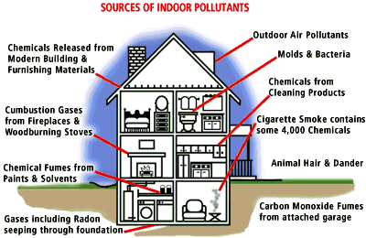
Where do indoor pollutants come from?
Notes:
So we proceed with a virtual tour around a fictitious home to identify common sources of indoor air pollution?
Starting at the upper right is outdoor air pollution. Depending on ventilation rates, outdoor air penetrates indoors such that, absent any indoor sources, concentrations of atmospheric gases indoors will match that outdoors. For example, carbon dioxide concentrations indoors will eventually reach around 400 ppm – the outdoor concentration - assuming no people, plants, pets are exhaling co2 and no other sources of co2 are present.
However, sources of various contaminants exist in the indoor environment and we can proceed to identify some one the main ones.
Proceeding clockwise around the home, we first encounter molds and bacteria. Mold in particular can be a problem in dark, moist areas … especially in locations where the outdoor is cool and humid. Molds release spores that can cause illness if inhaled.
Next, there are various chemicals that vaporize from cleaning products – either when stored or used.
Second hand smoke exists if there are smokers.
Pets hair and dander – or dead skin of pets similar to dandruff – can cause allergic reactions if inhaled.
Carbon monoxide fumes from any source of combustion within homes – including stoves, fireplaces, cars if there is an attached garage – can build up if ventilation is insufficient.
A gas called radon, formed by decay of radioactive elements in the earth, can infiltrate through basements and other seems into homes. Radon exposure poses long-term health risks if inhaled.
Chemicals from paints and solvents can vaporize into homes when used or stored.
Various smoke and other combustion gases can build up in concentrations from for example fireplaces and stoves.
Finally, the building material itself of homes can be a source of harmful gases – particularly formaldehyde.
This is a quick survey … we will discuss some of these in more depth shortly.

Slide 9
Notes:
The following slide organizes some of these indoor air pollutants according to the severity of adverse possible health effects they can cause.
On the left are possible lethal effects. Tobacco smoke of course is known to increase the risk of premature death.
Radon gas – which can penetrate from underground into homes – also has been linked to premature mortality.
Carbon monoxide is particularly dangerous since it is odorless and colorless, and can cause immediate death if concentrations are high enough – something we talked about earlier in this semester with respect to carbon monoxide.
Non-lethal, but sometimes serious or at least irritant, effects are associated with other indoor air pollutants, such as lead from paints in older homes that may have used paints containing lead, as well as the presence of mold/mildew, vapors of VOCs from paints, cleaning products and other sources.

Slide 10
Indoor Air Quality: Regulations
Nothing analogous to ambient air quality standards for outdoor air
Building codes for building materials & ventilation for newer structures
Smoke / carbon monoxide alarm requirements
CA Prop 65 warnings for household items (cleaning, paints, etc. …)
OSHA for workplace air.
Notes:
To conclude this overview with some points about regulations.
First, there are no regulations like outdoor air ambient air quality standards for indoor air.
Instead, indoor air quality is attempted to be maintained by various small regulations and advisory best practices.
For example, newly built and most modern structures are built to codes that require cleaner building materials and modern effective ventilation systems. This is in addition to many other code requirements for energy efficiency and other goals.
Home sales and apartments must ensure that smoke alarms are installed and operating at all times. These smoke alarms should also have CO detection capability in addition to smoke.
Household products – such paints, solvents, cleaning products – in California are all required to have Prop 65 warning labels if they contain substances known to be toxic, carcinogenic or associated with other health risks.
Also, various Occupational Safety and Health Agency (OSHA) regulations exist to ensure a clean workplace environment.

Slide 11
Indoor Air Pollution (Sources)
Notes:
Indoor Air Pollution - Sources

Slide 12
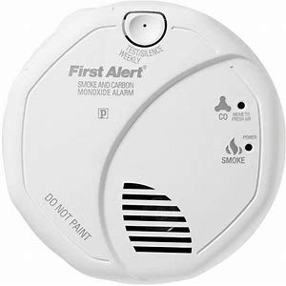
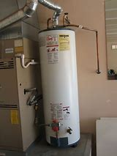
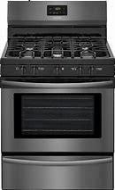
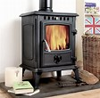
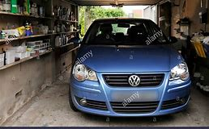
Sources of Poor Indoor Air Quality
Smoke alarm w CO sensor
Carbon monoxide – Fireplaces, stoves, cars in attached garages, water heaters, and other combustion sources in homes can emit carbon monoxide into homes. Ensure proper function of these equipment. Ensure proper ventilation especially if these sources are in enclosed places. Makes sure smoke alarms also have carbon monoxide sensors.
https://www.verywellhealth.com/carbon-monoxide-poisoning-causes-4161053

Slide 13
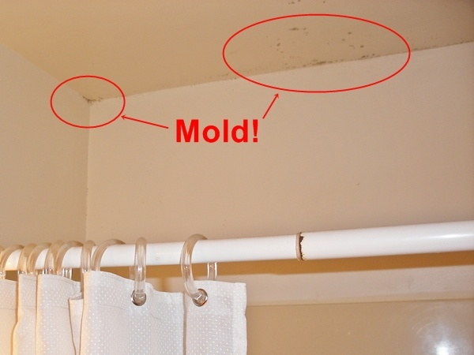
Sources of Poor Indoor Air Quality
Mold – Mold can cause allergic reactions through inhalation of spores and mycotoxins. Bathrooms are a common source of mold, but it can occur anywhere where humidity is high, and ventilation is poor. Using a ventilation fan or opening a window will help to control moisture and inhibit mold growth. Check also plumbing leaks.
https://www.medicinenet.com/mold_exposure/article.htm

Slide 14
Sources of Poor Indoor Air Quality
Dust mites – Dust mites feed off dead skin cells. They can trigger allergy and asthma attacks. Regularly vacuum soft surfaces such as carpeting, upholstery, stuffed toys and drapes. Wash pillows, blankets and bed sheets in hot water weekly.
https://www.healthline.com/health/dust-mites-bites#description

Slide 15
Sources of Poor Indoor Air Quality
Pet dander and hair – Pets can trigger allergy and asthma attacks due to dander and hair. Keep them out of the sleeping areas, and away from upholstered furniture, carpets, and stuffed toys. Vacuum and clean carpets, rugs, and furniture often.

Slide 16
Sources of Poor Indoor Air Quality
Volatile Organic Compounds (VOCs) – Many VOCs are toxic air contaminants. Common household cleaners release Volatile Organic Compounds (VOCs), both when used and stored. Keep all products away from children. Consider purchasing cleaners without VOCs. Check Prop 65 warning labels.

Slide 17
Sources of Poor Indoor Air Quality
Formaldehyde - Formaldehyde is a toxic air contaminant. It is widely used in composite wood products that have resins, and is in building materials and insulation, glues, permanent press fabrics, paints, lacquers, and other coatings. Formaldehyde is also released into the air from formaldehyde-containing personal care products, like some shampoos, soaps, haircare products, body washes, and nail polish. Check for formaldehyde-free products.

Slide 18
Sources of Poor Indoor Air Quality
Radon – Is a naturally occurring radioactive gas that can enter a home through cracks and openings in floors and walls that are in contact with the ground. Radon is among the leading causes lung cancer among non-smokers in the U.S. Testing your home is simple and inexpensive.
 | Zone 1 counties have a predicted average indoor radon screening level greater than 4 pCi/L (pico curies per liter) (red zones) | Highest Potential
 | Zone 2 counties have a predicted average indoor radon screening level between 2 and 4 pCi/L (orange zones) | Moderate Potential
 | Zone 3 counties have a predicted average indoor radon screening level less than 2 pCi/L (yellow zones) | Low Potential
Fix your home if you have a radon level of 4 pCi/L or more. You can test your home yourself. CA Dept. of Public Health # 1-800-745-7236.
https://www.epa.gov/radon

Slide 19
Indoor Air Pollution (Prevention & Control)
Notes:
Indoor Air Pollution – Prevention and Control

Slide 20
Preventative Measures / Controls
Notes:
We now give a few more details about indoor air pollution prevention and control.
Seen here are the four main preventative measures. Starting on the upper left is contaminant source control – which is simply the act of identifying sources of indoor air pollution in your homes, and then taking preventative measures to eliminate or reduce air contaminants from these.
The remaining three are measures to ensure the indoor air environment is not conducive to the build-up of sources and/or high indoor air contaminant concentrations regardless of sources.
On the upper right is humidity management, which is mainly important to reduce the likelihood of mold build-up.
On the lower right is filtration, which used to keep indoor air clean from particulate pollution penetrating from outdoors or adjacent rooms where dust and other particles may be generated.
Finally on the lower left is probably the most important preventative measure – a properly functioning ventilation system. For older homes this mainly means windows, however newer homes and practically all commercial buildings and workplaces have modern Heating, Ventillation and Air Conditioning – or HVAC - systems.

Slide 21
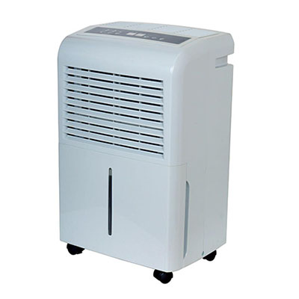
Humidity & Ventilation Control
Dehumidifier
Notes:
Some specifics on conditions for reducing mold growth are provided here.
For homes equipped with modern HVAC systems with temperature and humidity controls, proper functioning should be checked to verify values around those shown on this slide are maintained. A dehumidifier can also be purchased to maintain relative humidity levels is certain rooms of a home.

Slide 22
Basic Ventilation System
for further details …
Notes:
This slide gives a layout of the functioning of a typical building ventilation system.
The system works by recirculating indoor air, but pulling in a small percentage of outdoor air alongside it.
Typically 90% of air resupply is from the indoor air, and 10% from outdoor air. 20 cubic feet per minute per person is a typical setting applied for the air resupply rate to a room. Since this is per person, the settings on the ventilation system should be optimized with respect to either how many people are typically inside at any given time, or for a reasonable high value to ensure a margin of safety.

Slide 23
Particle Filtration
Notes:
For particle filtration, we see here a chart similar to one shown in an early lecture with the size of particles on the horizontal axis and types of particulate on the vertical. Note the horizontal axis ranging from sub-micron particles and 100 microns. 10 microns and smaller, the size cut for respirable particle that can penetrate more into lungs is around here on the plot.
On the bottom of the graphic is filter type. The key thing to notice is that common filters generally are not sufficient to filter out tiny sub-micron particles. We learned however that these sub-micron particles are most dangerous since they penetrate deepest into lungs. To ensure filtration of sub-micron particles, one would need a high-efficiency air filtration system. Electrical Precipitators are more expensive and complex systems – generally more used in commercial or industrial air space settings.

