Slide 1
METR/ENVS 113
Lecture 2: Atmospheric Radiation
SJSU Fall Semester 2020
Module 1: The Natural, Unpolluted Atmosphere
Frank R. Freedman (Course Instructor)
Notes:
Hello, this is METR113 Lecture 2, Atmospheric Radiation. This is the second lecture of Course Module 1 - The Natural, Unpolluted Atmosphere.

Slide 2
Outline
Fundamentals
  Radiation: Definition and Basic Properties
  Radiative Emission Spectra
  Solar versus Terrestrial Radiation
  Absorption of Radiation by Atmospheric Gases
Stratospheric Ozone Layer
Notes:
The outline of this lecture is as follows.
First, we will cover the fundamentals of atmospheric radiation.
This will span four main topics:
First, we will define and present some main properties of radiation to lay the basis for later lecture material.
We will then cover the radiative emission spectra. This describes wavelengths of radiative emissions from an object, from shortest to longest across the spectra. Within this, familiar terms such as “ultraviolet, visible and infrared” radiation will be defined.
After this, we can then distinguish particular properties of “solar radiation” – or radiation emitted by the sun that enters the earth’s atmosphere – and “terrestrial radiation” – or radiation emitted by the earth’s surface and atmosphere that propagates outward from the earth to space.
We will then present absorption of radiation by specific atmospheric gases, and its dependence on wavelengths of radiation for specific gases.
From covering these fundamental topics of atmospheric radiation, we can then proceed to covering the second main topic, which is the Stratospheric Ozone Layer.
We will describe what ozone is, how a high concentration layer of ozone forms in the stratosphere due to the specific interactions between ozone gas and sunlight, and why the ozone layer is important for maintaining a suitable environment for life at the surface.

Slide 3
Atmospheric Radiation
(Fundamentals)
Notes:
Atmospheric Radiation - Fundamentals

Slide 4
What is radiation?
Transfer of energy by propagation of electromagnetic waves.
Sometimes referred to as “particles” (“wave-particle” duality)
Among the three ways energy is transferred
  Conduction: molecular by molecule
  Convection: fluid motion
  Radiation: electromagnetic waves
Notes:
So what is radiation?
In simple terms, it is the transfer of energy by propagation of electromagnetic waves.
Sometimes, scientists prefer to refer to radiation in terms of particles instead of waves … to be more suitable for different behavioral aspects of radiation – however for this lecture describing radiation as waves is most appropriate. One can read on their own about the interesting topic of “wave-particle” duality with respect to radiation if desired.
Radiation is among three ways energy is transferred from one object to another.
The first way is “conduction”, which is the transfer of energy by molecule to molecule contact. An example of conduction of the heat you feel in your hand when holding a warm cup of coffee or tea.
The second way is by convection, which is the transfer of energy by fluid motion. An example of convection is how a convective oven cooks food, or how a convective space heater warms a room. Convection is also how heat is transferred throughout the atmosphere by air currents, wind, storms and other weather systems.
Finally, radiation transfers heat by propagation of electromagnetic waves. The interesting and unique thing about radiation, compared to conduction and convection, is that radiation does not require matter … that is electromagnetic waves can transfer from one object to another even if there is no form of matter between the objects. This is the reason radiation can transfer across outer space, for example from the sun to earth. Contrarily, conduction requires molecular contact for heat transfer, and therefore matter, and convection requires movement of a fluid, for example water or air, for heat transfer.

Slide 5
Properties of Radiation
Can transmit energy through a vacuum (e.g. outer space) as well as through matter (e.g. air, water, earth, objects).
All bodies with temperature greater than absolute zero (0 deg K) emit radiation
In a vacuum, all waves travel at speed of light (= 3.0 x 10⁸ m/s).
Energy is transmitted as waves of various wavelengths (or frequencies). Radiation of different wavelengths (or frequencies) are given different names (see next slides)
Shorter (higher frequency) waves are more energetic than longer (lower frequency) waves.
Warmer objects emit more radiation (across all wavelengths) than colder objects.
Notes:
We now highlight some main properties of radiation.
First, as we mentioned in the last slide, radiation can transfer in a vacuum as well as through matter.
Second, all bodies with a temperature greater than absolute zero emit radiation.
Third, in a vacuum radiative waves travel at the speed of light, which is 3 times ten to the eight meters per second, or 300 million meters per second.
Fourth, radiative energy is transmitted as waves of various wavelengths, or various frequencies as it also is expressed. Ranges of radiative wavelengths are given different names, as we will see on the next slides.
Fifth, shorter, higher frequency waves are more energetic per wavelength than longer, lower frequency waves.
Sixth and finally, warmer objects emit more radiation at all wavelengths than colder objects.

Slide 6
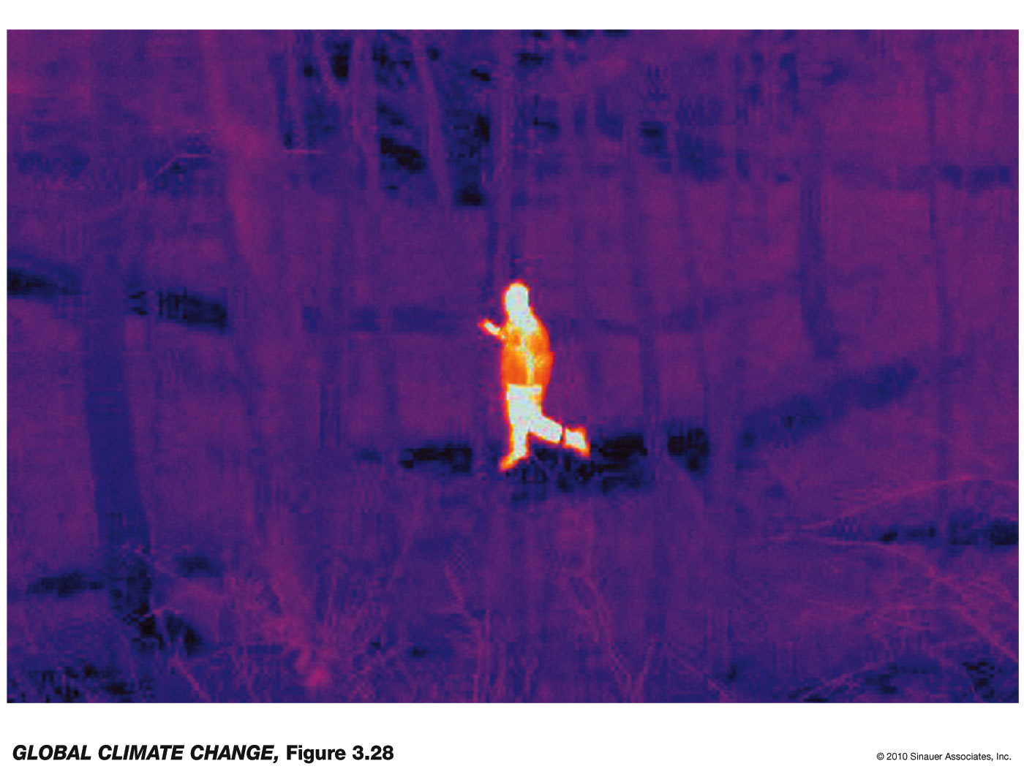
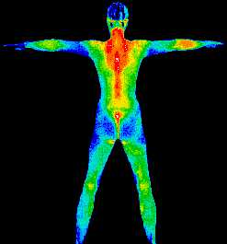
Infrared (“heat”) radiation from human body …
Warmer body parts (red, yellow) emit
more infrared energy than cooler (blue) parts
Practical Application - Infrared Camera for night-vision:
Person detected by infrared energy emissions
Notes:
The last point can be visualized through infrared camera images of the human body.
On the left is an image of the human body. The warmer parts of the body, around the neck, back and spinal areas shown here by the reds and yellows indicate warmer and thus more infrared radiation emission than the colder body extremities, shown by the blues.
On the right is a practical application of this – the infrared camera is used for night-vision. The infrared energy emission from the person in this image shows up clearly against the colder surrounding air. This enables the person to be detected, although visibility is poor or barely existent because it is night.

Slide 7
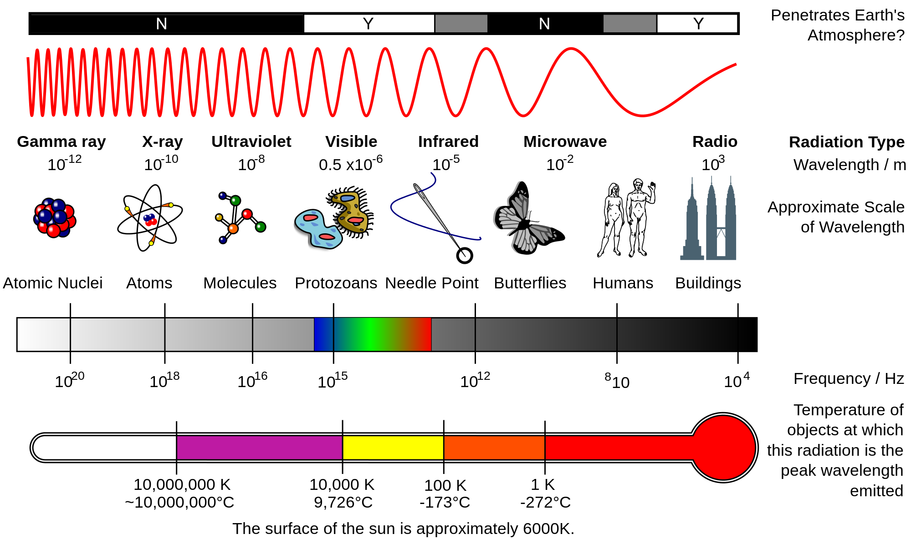
Radiative Emission Spectra
Notes:
Returning to the fundamentals of radiation, one of the main properties presented a couple slides ago is that the radiation emitted by an object is over a range of wavelengths. This slides illustrates this property.
At the top we indicate radiation wavelengths across increasingly longer wavelengths going left-to-right across the graphic. On the far left are the shortest wavelengths of radiation – gamma rays, x-rays and ultraviolet light. As presented a bit ago, these are the most powerful, energetic waves. On the far right are the longest wavelengths, infrared, microwaves and radio waves.
The wavelengths on this diagram span from as short as 10-12 m - – or one billionth of a millimeter - for gamma rays and similar types of very shortwave radiation, to as long as 100s of 1000s of meters, for microwave and radio waves.
In the middle of the horizontal is visible light, which our eyes can detect.
Seeing this, one is already familiar with this radiation in everyday life – from the x-rays that are part of normal medical procedures, to microwaves that are emitted by microwave ovens.
The middle graphic expresses this span in terms of frequency, in Hz, which is the number of waves that travel across a point per second. Since all waves travel at the speed of light, there will be more, and thus a higher frequency, of waves passing through a point for shorter waves, and vice-versa. Hence shorter wavelengths have high frequency, and longer wavelengths low frequency.
On the bottom graphic is an indication the temperature that an object would have to have to emit radiation primarily at these wavelengths. For example, the sun at around 6500 K, around here on the horizontal, emits primarily visible light. There will also be appreciable, although less ultraviolet and infrared emissions. We will discuss this more in later slides, comparing to earth emitted – or “terrestrial” – radiation.

Slide 8
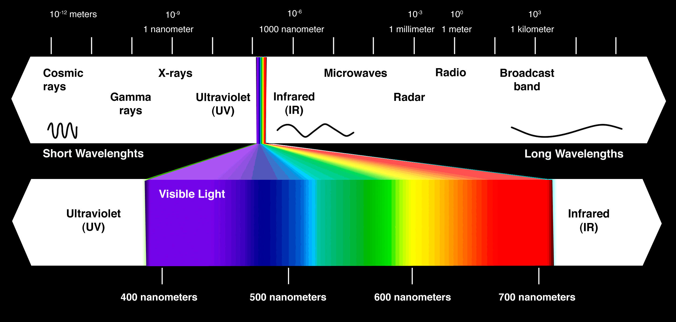
Radiative Emission Spectra
(focused on ultraviolet, visible and infrared)
“ROY G BIV” – Red, Orange, Yellow, Green, Blue, Indigo, Violet
Notes:
This graphic is as the previous, but emphasizes the ultraviolet, visible and infrared portion of the spectrum. We will focus primarily on these radiative waves in this class.
Visible light ranges from around 400 to 700 nanometers from blues to reds. 1000 nanometers is about one-one thousandth of a millimeter.
The familiar anacronym ROYGBIV spans the order of colors across the spectrum from reds-to-blues across the spectrum.

Slide 9
Summary: Radiation Fundamentals
Radiation is a form of energy emitted from a body or object
Propagates outward from object in the form of electromagnetic waves
Waves span a range of wavelengths
Short wavelengths are more powerful, and are emitted at higher temperatures
Long wavelengths are less powerful, and are emitted at cooler temperatures
Notes:
So some summary points of what we just covered,
Radiation is a form of energy emitted from a body or object
Propagates outward from object in the form of electromagnetic waves
Waves span a range of wavelengths
Short wavelengths are more powerful, and are emitted at higher temperatures
Long wavelengths are less powerful, and are emitted at cooler temperatures

Slide 10
Solar vs. Terrestrial Radiation
KEY POINTS
Warmer bodies emit more radiation than
cooler bodies at all wavelengths
Warmer bodies emit at shorter wavelengths
than cooler bodies
Green line (sun, ~ 6000 degrees K), emits
mostly in the visible spectrum. Will refer to this as “solar radiation”.
Red line (earth, ~ 300 degrees K), emits
mostly in the infrared spectrum. Will refer to this as “terrestrial radiation”.
“Sun”
“Earth”
Notes:
Moving forward, we now apply some of the basic concepts of radiation we just covered to the sun and earth.
This plot is depiction of the radiation emitted by objects of different temperatures as a function of wavelength of radiation.
The vertical axis is the radiation intensity in units Watts/m2/micrometer, which is a measure of how much radiation is emitted at a certain wavelength.
The horizontal axis is the wavelength of radiation in micrometers, which is 10-6 meters, or one-millionth of a meter, increasing in wavelength going right across the axis.
Plots for four temperatures are shown, and as seen the amount of radiation emitted as a function of wavelength behaves as we described earlier.
First, more radiation is emitted from an object of warmer temperatures compared to colder at all wavelengths.
Second, the wavelength of peak emission increases (that is gets longer) as temperature gets colder. That is, warmer objects emit shorter wavelengths.
We highlight the importance of this by drawing attention to two of these lines.
The green line, corresponding to emissions for an object at around 6000 K, is very close to what the sun emits. The surface of the sun in fact is around 5780 K, close to 6000 K. Looking closely at this line, it is seen that the wavelength of peak emission is in the visible part of the spectrum.
The red line, corresponding to emissions for an object at around 300 K, is very close to what the earth emits. The surface of the earth globally averaged in fact is around 280 K, close to 300 K. Looking closely at this line, it is seen that the wavelength of peak emission is in the infrared part of the spectrum, longer wavelengths than the visible light the sun peaks at.
So some key points,
Warmer bodies emit more radiation than cooler bodies at all wavelengths
Warmer bodies emit at shorter wavelengths than cooler bodies
The sun at around 6000 degrees K emits mostly in the visible spectrum. Will refer to emissions from the sun as “solar radiation”.
The earth at around 300 degrees K) emits mostly in the infrared spectrum. Will refer to emissions from the earth as “terrestrial radiation”.

Slide 11
What happens to radiation through the earth’s atmosphere?
Scattering
  Air molecules and clouds reflect or otherwise alter path of radiation
  Blue light more efficiently scattered by air molecules (why sky is blue)
  Clouds reflect all colors equally (why clouds are white)
Absorption
  Air molecules and clouds absorb radiation
  Reemitted to surface and to space as infrared radiation
  For gases, wavelength of absorption depends on wavelength
Transmission
  Some radiation not scattered or absorbed
  Sunlight travels directly to surface
  Terrestrial radiation from earth travels directly to space
Notes:
So we can now ask the question, what happens to radiation as it travels through the earth’s atmosphere, or any atmosphere for that matter.
These concepts apply to both sunlight as it travels from the top of the atmosphere downward towards the surface, and to terrestrial radiation from the earth as it travels upward from the surface towards the top of the atmosphere to outer space.
First, the gas molecules comprising air as well as the clouds in the atmosphere can scatter the radiation. This scattering can result in a reflection back to the space, in the case of solar radiation, or more subtly a change in path of the radiation in some other direction. In the case of air and visible sunlight, blue light from the sun is more efficiently scattered than reds – this is why the sky is blue. Clouds on the other hand reflect light equally across the color spectrum, and hence clouds are white.
Second, radiation can be absorbed by air gases and clouds. This absorbed energy then gets reemitted to space and the surface in the form of infrared energy, since air and clouds are at temperatures where mostly infrared energy is emitted. An important point that we will cover in more depth in the next slide concerns absorption of radiation by atmospheric gases. In this case, the amount of absorption of radiation depends on wavelength of radiation. This is an important concept, as we will cover in the next slide.
Finally, some radiation is neither scattered or absorbed, and therefore is transmitted unaltered directly to the surface for sunlight, and to outer space for terrestrial radiation.

Slide 12
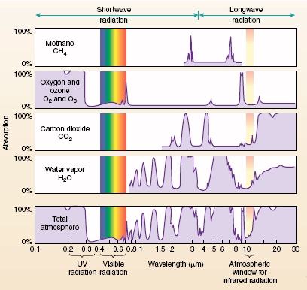
Absorption of Radiation by Atmospheric Gases
Solar
Terrestrial
KEY POINTS
Plot indicates the percentage of radiation
passing through various gases that is absorbed
by the gas depending on the wavelength of
radiation.
Visible light (“solar”) generally passes through
gases without much absorption.
Substantial amount of infrared radiation
(between 1 – 30 microns) absorbed by CO2 and H2O.
Acts to keep radiation from earth within atmosphere,
keeping planet warmer than it otherwise would be
(“greenhouse effect”).
O2 (atmospheric oxygen) and O3 (ozone) absorb
most of the ultraviolet radiation (0.1 – 0.3 microns).
this occurs in stratosphere (see next slides).
Notes:
The absorption of radiation by atmospheric gases and its dependence on wavelength is shown here for selected important gases, and for the total atmosphere, in this graphic. This is rather complicated graphic, so we will spend some time to describe how to interpret it.
The top four panels depict the percentage of radiation passing through certain gases that gets absorbed by the gas. The vertical axes are the percentage absorbed, ranging from 0 to 100%. The horizontal axis is the wavelength of radiation, spanning the ultraviolet, visible and infrared part of the spectrum.
The four gases depicted from top to bottom are: methane (CH4), the combination of oxygen (O2) and ozone (O3), carbon dioxide (CO2), and water vapor (H2O).
The bottom panel is what we call the “total atmosphere” – which is the combined effect of these as well as other gases not shown on the graphic.
The key point from this graphic is that absorption of radiation by gases is strongly dependent on wavelength of radiation. For example for Carbon Dioxide, shown here in the middle, no radiation is absorbed for ultraviolet and visible light, but at certain wavelengths within the infrared portion all or most of the radiation is absorbed.
Other gases have similar behavior, but the spectrum looks different in that a different set of wavelengths are absorbed predominantly.
In fact, each gas has its own absorption signature in terms of which wavelengths are absorbed.
Looking more closely now we can see some important consequences.
First, we notice that the visible light emitted by the sun is not absorbed much by atmospheric gases, and therefore much of it passes through to the earth’s surface either as direct transmission or indirectly after scattering to the surface by gases.
Much of the earth, or terrestrial radiation, on the other hand is absorbed by atmospheric gases. The main gases responsible are water vapor, carbon dioxide and methane. These are called “greenhouse gases”, since they act to trap, through absorption, infrared radiation from the earth within the atmosphere, keeping the earth warmer than it otherwise would be.
Also, we point out that much of the ultraviolet radiation from the sun, powerful shortwave radiation, is absorbed by oxygen and ozone. This occurs in the stratosphere as we will discuss shortly, and provides a shield blocking this powerful, damaging radiation from reaching the surface.
So some key points:
- The plot indicates the percentage of radiation passing through various gases that is absorbed by the gas depending on the wavelength of radiation.
Visible light (“solar”) generally passes through gases without much absorption.
Substantial amount of infrared radiation (between 1 – 30 microns) absorbed by CO2 and H2O. This acts to keep radiation from earth within atmosphere, keeping planet warmer than it otherwise would be (“greenhouse effect”).
O2 (atmospheric oxygen) and O3 (ozone) absorb most of the ultraviolet radiation (0.1 – 0.3 microns) this occurs in stratosphere (see next slides).

Slide 13
Further Reading …
http://www.physicalgeography.net/fundamentals/7f.html
https://scied.ucar.edu/carbon-dioxide-absorbs-and-re-emits-infrared-radiation
https://www.earthobservatory.nasa.gov/features/RemoteSensing/remote_04.php
Notes:
Some links for further reading on these points are provided here.

Slide 14
Stratospheric Ozone Layer
Notes:
Stratospheric Ozone Layer

Slide 15
Absorption of Radiation: Oxygen (O₂) and Ozone (O₃)
Solar
Terrestrial
Recall One of the Key Points …
O2 (atmospheric oxygen) and O3 (ozone) absorb most of the ultraviolet radiation (0.1 – 0.3 microns).
This occurs in stratosphere (see next slides).
Notes:
Returning to the earlier slide on absorption of radiation by atmospheric gases, we highlight one of the key points – the absorption of short wavelength ultraviolet radiation by oxygen and ozone gas in the atmosphere.
This occurs in the stratosphere, and has several important consequences.
One is the formation of the stratospheric ozone layer and stratospheric temperature inversion, discussed in the previous lecture.
The other main consequence is the prevention of ultraviolet radiation from reaching the surface, where it can be damaging to surface life since this radiation is so powerful. This is because oxygen and ozone in the stratosphere are absorbing this radiation.
We will now cover these topics in more detail.

Slide 16
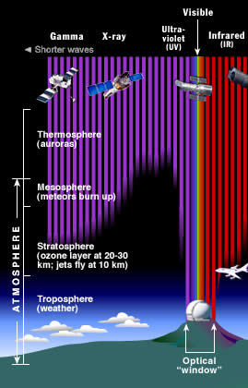
Absorption of Sunlight in Stratosphere
KEY POINTS
Practically all high energy, short solar wavelengths (gamma, x-rays, ultraviolet) do not reach the surface.
This is because of absorption of this radiation by O₂ (atmospheric oxygen) and O₃ (ozone) absorb most of the shortwave and ultraviolet radiation (0.1 – 0.3 microns). This occurs in stratosphere. Details of process on next slides.
Protective of life at surface since these are very high energy, damaging wavelengths.
Visible light not absorbed since O₂ and O₃ do not absorb visible light. Visible light therefore reaches ground.
Notes:
This graphic illustrates how shortwave radiation from the sun is absorbed in the stratosphere and does not reach the surface.
The graphic is a vertical cross section of the atmosphere spanning the four atmospheric layers: Troposphere, Stratosphere, Mesosphere, and Thermosphere.
The horizontal spans very short gamma and x-rays, through ultraviolet, and visible and longer infrared radiation.
The key points from this graphic are as follows:
First, it can be seen that practically all high energy, short solar wavelengths (gamma, x-rays, ultraviolet) do not reach the surface.
This is because of absorption of this radiation by O₂ (atmospheric oxygen) and O₃ (ozone) absorb most of the shortwave and ultraviolet radiation (0.1 – 0.3 microns). This occurs in stratosphere.
This is protective of life at surface since this prevents these very high energy wavelengths from reaching the surface.
Visible light, however, is unaffected since it is not absorbed by O₂ and O_{3.} Visible light therefore reaches ground.

Slide 17
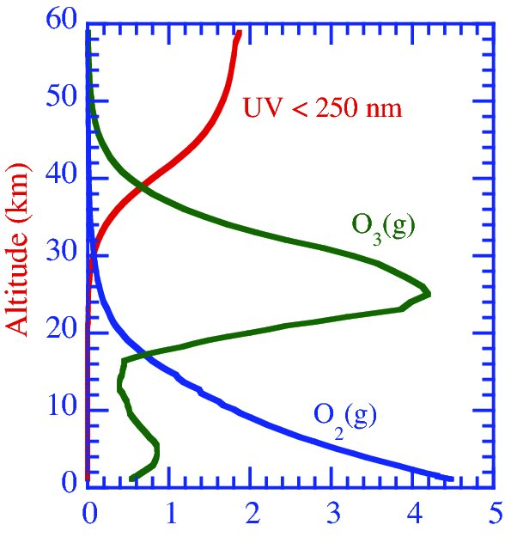
Stratospheric Profiles: Ultraviolet, O₂ and O₃
KEY POINTS
Removal of ultraviolet radiation by O₂ and O₃ as sunlight penetrates further into the stratosphere.
Ozone maximum at ~ 30 km above surface
Ozone forms from absorption of ultraviolet radiation. Specifics on next slide.
“ozone layer” at around 30 km
Increasing to right
Notes:
More specifics on this process is shown here. The vertical axis is altitude increasing upward to 60 km, around the top of the stratosphere.
The horizontal is an indicator of levels of ultraviolet radiation and O2 and O3 gas concentration, increasing to the right.
The key points from this are
The removal of ultraviolet radiation by O₂ and O₃ as sunlight penetrates further into the stratosphere. This is seen by the red line, where ultraviolet is largely removed from the radiation stream by 30 km above the ground.
Second, an ozone concentration maximum forms as a result of the ultraviolet absorption at around 30 km. This is the stratospheric ozone layer discussed in the last lecture and earlier in this. We will cover more specifics on how the ozone layer forms shortly.

Slide 18
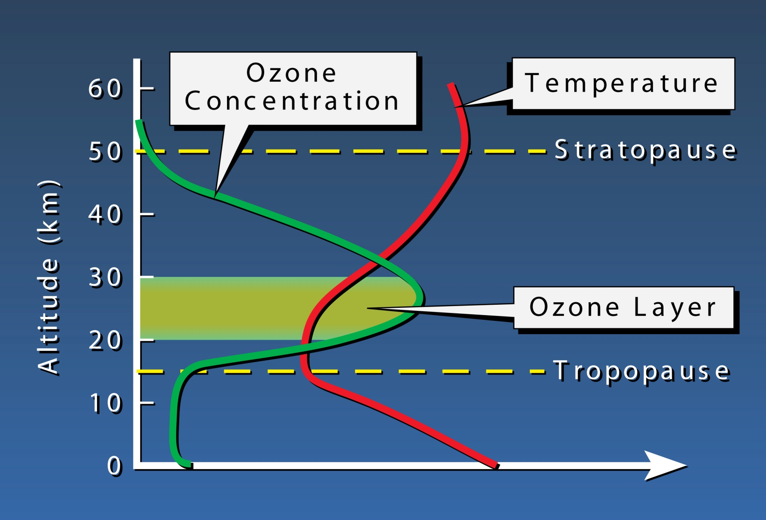
Stratospheric Profiles: O₃ and Temperature
Maximum ozone concentrations occur in the stratosphere, with a peak in the lower to middle stratosphere. Formation of ozone layer causes a global-scale temperature inversion to form.
Stratospheric temperature inversion
(warm air atop cold)
Notes:
Another key consequence of absorption of shortwave ultraviolet light in the stratosphere is the formation of the stratospheric temperature inversion.
Temperature is depicted by the red line in this plot, which like the last slide is a vertical cross section of the atmosphere extending up to 60 km.
Within the stratosphere temperature increases in value with height, which again is a temperature inversion.
The base of the inversion corresponds closely to the where the ozone layer is.

Slide 19
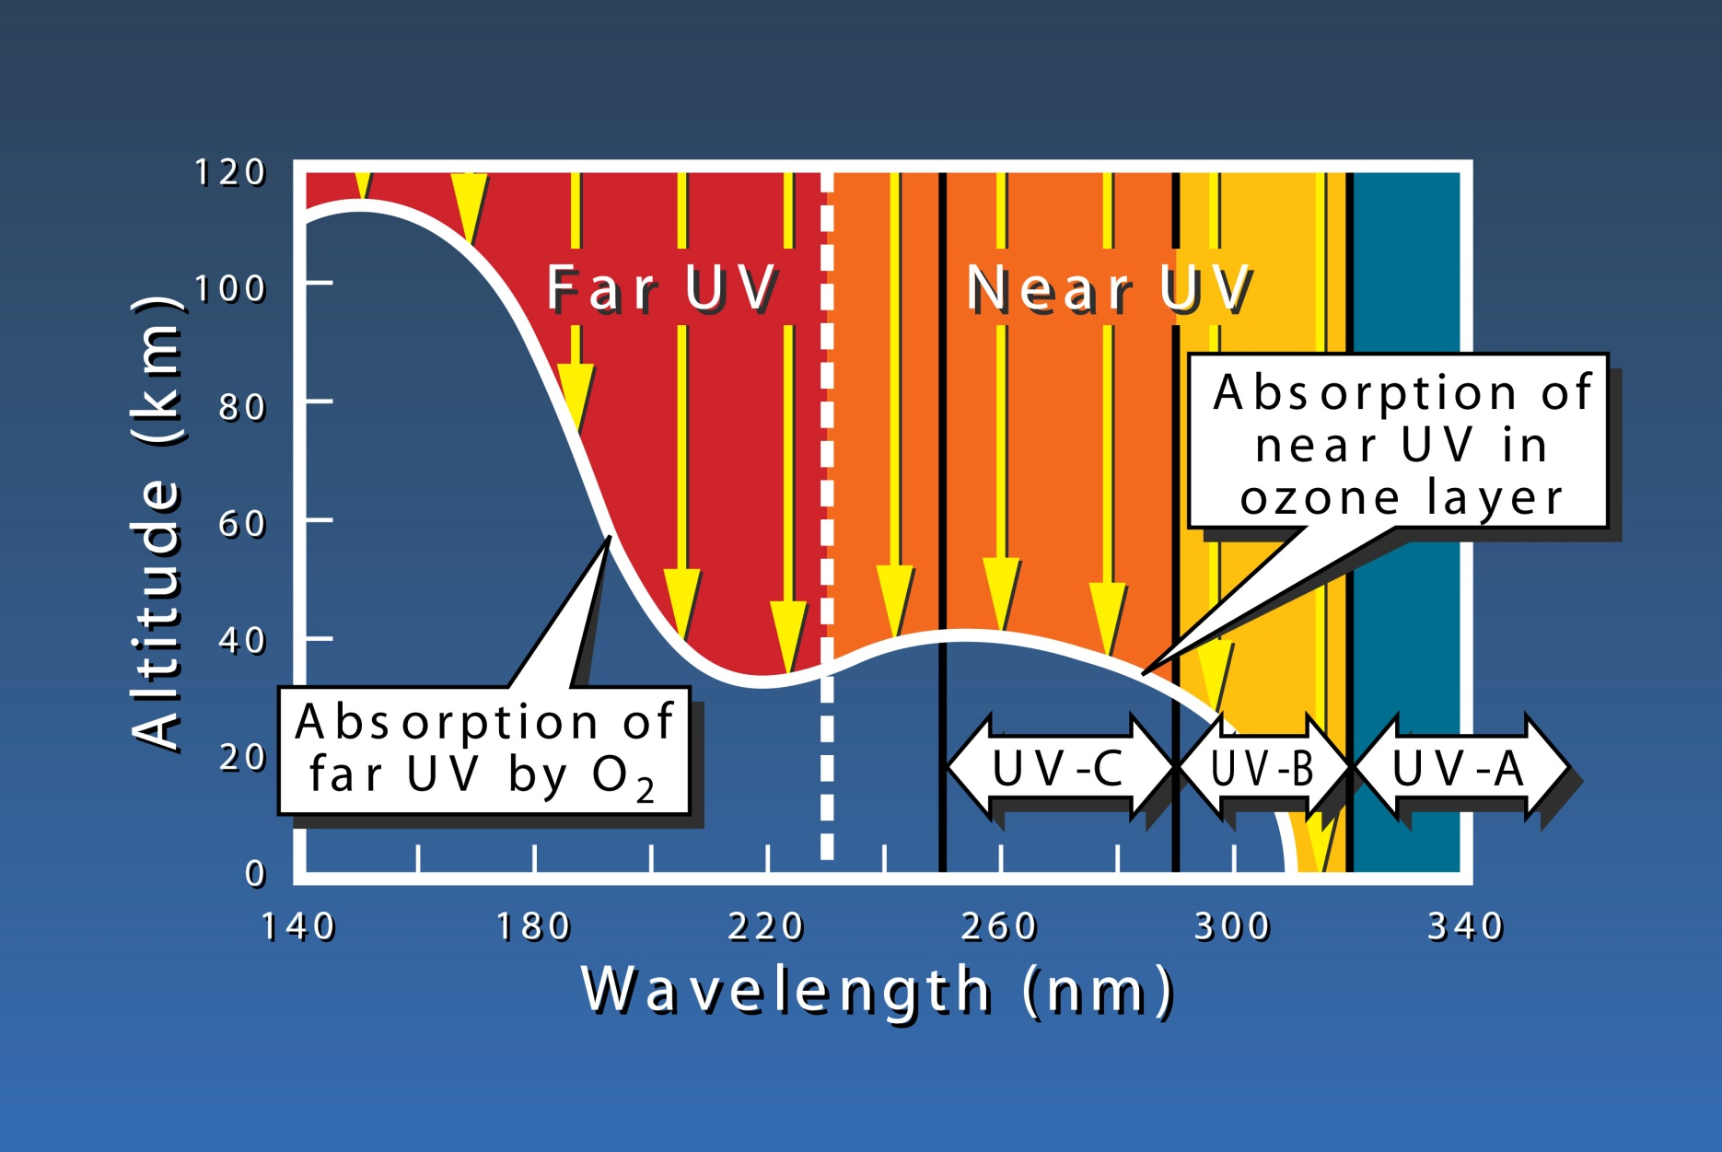
Stratospheric Profiles: O₃ and Temperature
The overlying ozone absorbs UV solar radiation, filtering it from the solar spectrum and preventing the most harmful UV-C rays from reaching the ground. Some UV-B, and most UV-A radiation penetrates to the surface.
Notes:
The beneficial effect of the uv absorption and ozone layer in the stratosphere is highlighted in this slide.
UV radiation can be divided into “near-UV”, the longer wavelength portion of uv closest in wavelength to visible light, and “far-UV”, the shorter wavelength portion of uv radiation. “near-UV” can be further subdivided into UV-A, B and C.
The far UV portion is absorbed oxygen, where as the near UV portion mainly by ozone.
Collectively, the effect is the prevent these powerful solar wavelengths from reaching the surface, since they are absorbed in the stratosphere.
This protects life at earth’s surface and lower atmosphere from these damaging rays.

Slide 20
Stratospheric Ozone Formation
O₂ + ultraviolet sunlight → O + O
(O₂ absorbs ultraviolet sunlight and breaks up O₂ into two separate oxygen atoms)
O₂ + O → O₃
(O₂ recombines with O formed from reaction above to form ozone, O₃)
O₃ + ultraviolet sunlight → O₂ + O
(O₃ absorbs ultraviolet sunlight and breaks up O₃ into O₂ and O)
These reactions occur in stratosphere
Three main consequences
  Creation of “ozone layer” in stratosphere.
  Stratospheric temperatures increase due to absorption of ultraviolet sunlight by O₂ and O₃. Causes stratospheric temperature inversion (warming of air with height in stratosphere).
  Ultraviolet sunlight does not penetrate in great amount to surface. Protects life at surface from damaging ultraviolet sunlight.
Notes:
So what is the specific chemical reactions of this process?
In red font text are the three main chemical reactions involved. Reactants are on the left side of the arrow, and products are on the right. Notice that products of one reaction can be reactants of another.
Describing each of these reactions ...
- First, as sunlight propagates downwards into the upper atmosphere and stratosphere, the oxygen that is newly encountered absorbs the far-UV portion of sunlight. This breaks the oxygen molecule (O2) into two separate oxygen atoms (O). We call a separate oxygen atom “free oxygen”.
- Further down, peaking in the stratosphere, some of this free oxygen reacts molecular oxygen in the air (O2) to form O3 … ozone.
Once formed in the stratosphere, this ozone in turn absorbs the near-UV portion of ultraviolet light, dissociating the ozone molecule into molecular oxygen (O2) and free oxygen (O).
This a basic description of the chemistry, and there are many other factors not discussed that can provide more details about the variation of ozone levels according to times of year and locations around the globe.
Also not discussed here is the important topic you may have heard about concerning ozone depletion, often termed the “ozone hole”, which relates to how human produced chemicals called CFCs can cause reduction and even depletion in some cases of ozone levels in the stratosphere. Fortunately, regulation several decades ago phasing out CFCs have been successful in controlling ozone depletion in recent years.
But highlighting again the three main consequences of these chemical reactions.
The creation of “ozone layer” in stratosphere.
The creation of the stratospheric temperatures increase due to absorption of ultraviolet sunlight by O₂ and O₃. This causes stratospheric temperature inversion (warming of air with height in stratosphere).
The prevention of ultraviolet sunlight from reaching the surface. This protects life at surface from damaging ultraviolet sunlight.

Slide 21
Further Reading …
https://www.ozonelayer.noaa.gov/
https://aura.gsfc.nasa.gov/ozone.html
Notes:
Some links for further reading on these points are provided here.

