Slide 1
METR/ENVS 113 Lecture 3: Atmospheric Carbon, Nitrogen and Sulfur Cycles
SJSU Fall Semester 2020
Module 1: The Natural, Unpolluted Atmosphere
Frank R. Freedman (Course Instructor)
Notes:
Hello, this is METR113 Lecture 3, Atmospheric Carbon, Nitrogen and Sulfur Cycles. This is the third lecture of Course Module 1 - The Natural, Unpolluted Atmosphere.

Slide 2
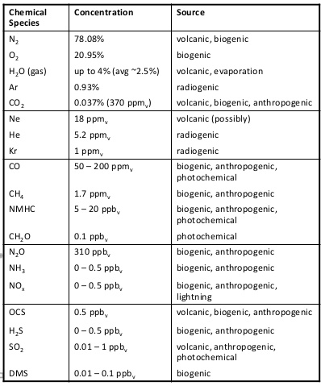
From Lecture 1: Composition of Atmosphere
Nitrogen (N₂) and Oxygen (O₂): 99% of Dry Atmosphere
Water Vapor (H₂O): 1 – 4%
Carbon Dioxide (CO₂) – Greenhouse Gas (GHG)
Ar, Ne, He, Kr – “Inert Gases” (non-reactive)
Carbon Monoxide (CO) – From combustion, air pollutant
Methane (CH₄) – Strong GHG
“Non-Methane” Hydrocarbons (NMHC); a class of air pollutants
Ammonia (NH₃) – An air pollutant, industry & agriculture
Nitrogen Oxides (NO_{x}) – From combustion, an air pollutant
Hydrogen Sulfide (H₂S) – An air pollutant, rotten egg smell
Sulfur Dioxide (SO₂) – From coal combustion, an air pollutant
Notes:
To motivate this lecture, we return to a slide from Lecture 1 showing the composition of gases in the atmosphere.
Outside the main gases - nitrogen, oxygen and water vapor - there are several trace gases that were pointed out. Among these are several important air pollutants, which are noted in the blue font, and two important greenhouse gases - carbon dioxide and methane – in red font.
Scanning the elements that comprise the chemical compounds, one can see common elements:
Nitrogen, for example in Nitrogen Dioxide and Ammonia
Carbon, for example in carbon dioxide, methane and carbon monoxide, and
Sulfur, for example in sulfur dioxide and hydrogen sulfide.
These elements are combined with hydrogen and/or oxygen in various ways.

Slide 3
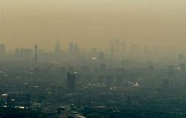
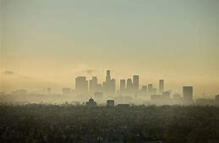
Nitrogen Dioxide (NO₂)
Unknown city …
Los Angeles
NO₂ absorbs violet/blue sunlight, remaining colors filter through … brownish
Notes:
Among the species noted on the previous slide is Nitrogen Dioxide (NO2), which is a part of NOx. This slide shows a visual of NO2 – the familiar brown, hazy cloud of air pollution gas that often blankets major cities. Los Angeles is a typical example, shown on the right on a polluted day.
The brownish color of nitrogen dioxide is because this gas absorbs violet/blue sunlight – letting the other yellows/red pass through which in combination appear brown.
The high levels of nitrogen dioxide in urban areas are mainly because of emissions of this gas from tailpipes of automobiles, among some other sources. The nitrogen comprising the NO2 that gets emitted comes primarily from the nitrogen (N2) in the air that gets pulled into the combustion chamber of the vehicle. The high heat within the combustion chamber converts some of this N2 into NO2.

Slide 4
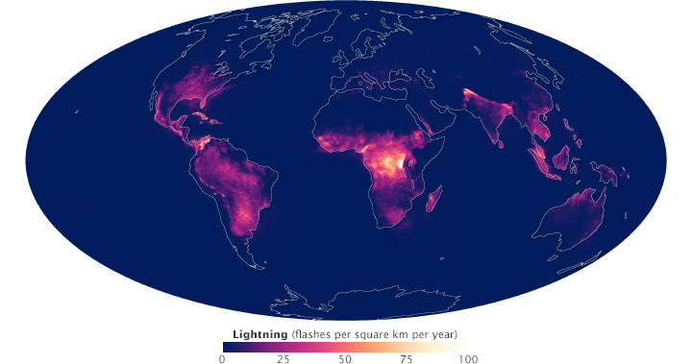
A natural source of NO2: Lightning Strokes (1995 – 2011, flashes per square km per year)
Notes:
Nitrogen Dioxide however also has some natural sources. Among these are lightning strikes. This strong source of heat within the lightning beam converts some N2 into NO2. The image in this slide is a map of the frequency of lightning strikes around the world, expressed as inumber of strikes per sq km per year.
So in understanding air pollution, it is important to appreciate that an air pollutant gas can be formed due to both human (“anthropogenic”) and natural processes.
Formation of NO2 within the combustion chamber of a motor vehicle is one example of an anthropogenic source of NO2.
Lightning is one example of a natural source of NO2.

Slide 5
Outline
Nitrogen Cycle
Sulfur Cycle
Carbon Cycle
Natural, Background Concentration Levels (absent air pollution)
Notes:
So in this lecture, we will give a very basic overview of the natural cycling within the earth-atmosphere system of these three important elements: nitrogen, sulfur and carbon. We will understand better the physical processes and chemical compounds associated with these elements as they cycle around the earth system. From this natural cycling, natural – or “background” – concentration levels of these compounds - in absence of strong air pollution – occur in the atmosphere.
This lecture will provide a background for further focus on air pollution in the next module.
The outline below shows how the lecture is organized.

Slide 6
Nitrogen Cycle
Notes:
Nitrogen Cycle

Slide 7
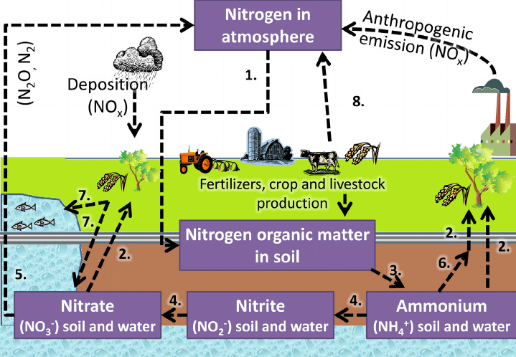
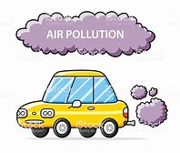
Atmosphere
(primarily N2)
Anthropogenic
Natural
Soil / Earth / Plants
(“Fixated” nitrogen, bio-available)
(nitric acid (HNO3), ammonia (NH3),nitrites, nitrates, ammonium ions for plant uptake
Notes:
Shown here is a visual of the nitrogen cycle through the earth system.
The main reservoir of nitrogen is the atmosphere In the air in the form of its diatomic molecule N2, which as we learned comprises around 78% of air.
Nitrogen however is also a requirement for life, involved very much in the biochemistry of plant growth and protein formation. Nitrogen in the form of N2, as it is stored in the atmosphere, however, is a very stable molecule and cannot be utilized directly by plants.
Instead, natural processes within the nitrogen cycle act to convert nitrogen as N2 into other “fixated” compounds that can be processed by living organisms.
Among these fixated nitrogen compounds are NOx, nitric acid, ammonia, and a variety of ions of nitrogen subsequently formed by these.
These processes by which fixated nitrogen is produced span the various ways a small part of the nitrogen in the air becomes chemically transferred to these various compounds as part of the nitrogen cycle,
This includes …
- the reaction with water vapor and absorption into rainwater that leads to nitric acid,
- lightning which leads to NO2, and
- microorganisms in soil, which convert nitrogen into nitrites and outgas a portion to the air in the form of ammonia.
The ammonia nitrogen-based fertilizers used in modern agriculture are a human method of, in effect, providing fixating nitrogen for plant growth.
Finally, we note in the upper right that anthropogenic air pollution sources – automobiles, trucks, factory combustion emissions – provide nitrogen oxides (NOx) to the air, which can be considered an unintended human method of fixating nitrogen from N2 to NOx. As we learned a bit ago, Nox in the form of NO2 is among the air pollutant species.

Slide 8
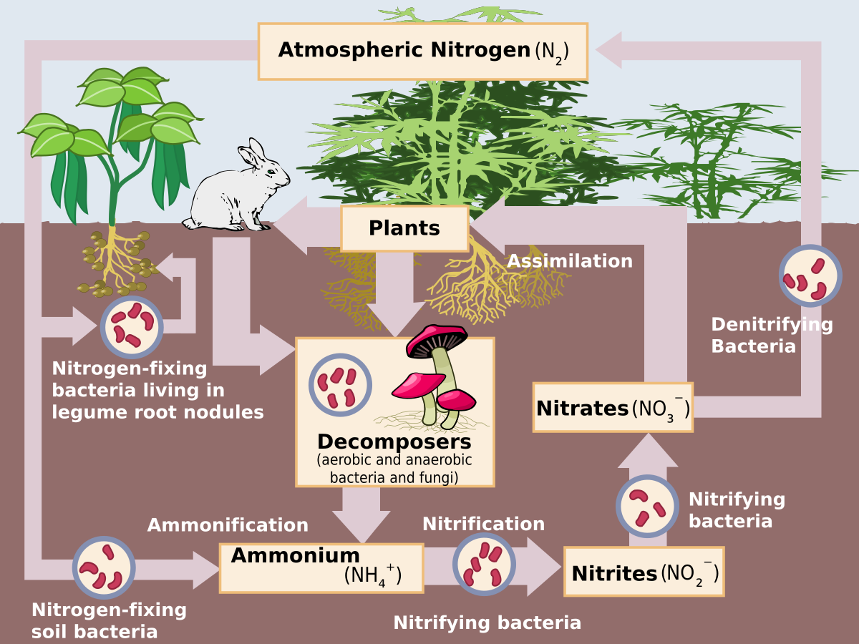
Nitrogen Fixation (2) (Fixated Nitrogen -> Nitrogen Ionic Compounds for Plant Uptake) (NO2 & HNO3 -> Nitrites, Nitrates, Ammonium)
https://en.wikipedia.org/wiki/Nitrogen_assimilation
Notes:
This slide gives a more detailed view of nitrogen fixation within the soil by microorganisms.
The details on this slide do not need to be known for the upcoming quiz, but it is still shown to support and broaden understanding of the previous slide material.

Slide 9
Sulfur Cycle
Notes:
Sulfur Cycle

Slide 10
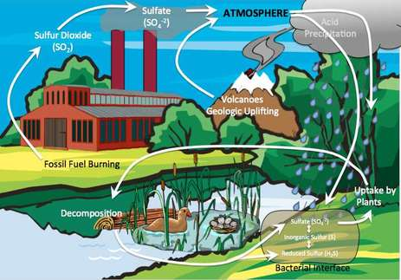
Formation of sulfate particles
Natural
(Volcanoes)
Anthropogenic
Coal Combustion
Sulfur as SO2
Acid Rain
(Sulfur as Sulfuric Acid, H2SO4)
Biodegradation
(Sulfur as H2S)
(“rotten egg smell”)
Notes:
Shown here is a visual of the sulfur cycle through the earth system.
Unlike nitrogen, there is no large repository of sulfur in the air. Instead various sources emit sulfur into the air, maintaining trace air concentration levels of sulfur in various species.
From an air pollution perspective, sulfur dioxide (SO2) enters the air mainly from coal combustion – historically and is still among the primarily ways of generating electricity.
Natural sources of SO2 also exist however, most importantly volcanoes.
Once in the air over several days, SO2 converts to sulfate particles and within precipitation can dissolve into sulfuric acid. High levels of SO2 dissolution into rainwater in fact can cause rainwater to be high in acidity, leading to “acid raid” which you may have heard of.
The main repository of sulfur in the earth-atmosphere system, instead, is in the earth and living organisms. Degradation of living matter then releases sulfur to the air in the form of SO2 and also various “reduced” compounds, for example hydrogen sulfide (H2S), which has a familiar rotten egg smell. Landfills, wastewater treatment and composting facilities, in fact, can produce large emissions of smelly sulfur gas as organic matter decomposes within these facilities. Students in this class may be familiar with these smells driving along H880 and H237 near Milpitas and Fremont, where many such facilities exist.

Slide 11
Carbon Cycle
Notes:
Carbon Cycle

Slide 12
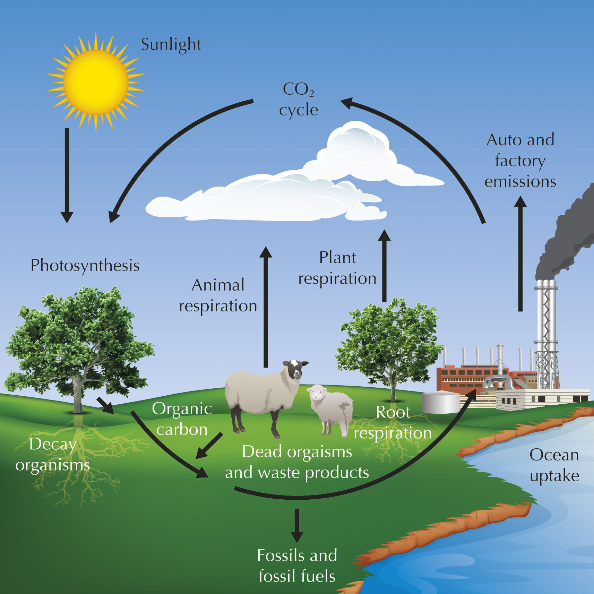
Anthropogenic
Fossil Fuel Combustion
Carbon released to air mainly as Carbon Dioxide - CO2
Other compounds:
Carbon Monoxide (CO)
Smoke Particles
Hydrocarbon Gases
Natural
(Photosynthesis)
(Respiration)
(CO2 & CH4)
Natural
Oceanic Removal
Earth, Oceans, Plants
(Main repository of carbon)
Notes:
Shown here is a visual of the carbon cycle through the earth system.
The main repository of carbon – in many different chemical compounds - is the earth, oceans and plants. Carbon is stored in all living matter. Carbon buried deep underground over millions of years, in fact, provides the fossil fuel resource in the form of oil, natural gas and coal that modern society has powered itself by over the industrial era.
In the air, carbon is mainly in the form of carbon dioxide (CO2) – at trace levels of a few hundred ppm over the last thousands of years. The maintenance of this small, background CO2 level in the air arises from roughly an equal balance between photosynthesis removing CO2 from the air and respiration releasing CO2 back to the air. Oceanic removal processes also are involved in this natural cycling.
We also note, methane (CH4) – another carbon containing compound and important greenhouse gas – is released from biological degradation, livestock and other agricultural emissions. Levels of methane in the air are currently at trace values of around a couple ppm, 100 times less than CO2.
In terms of air pollution, the main source of additional carbon in the air is due to fossil fuel combustion, for example from automobiles and other mobile sources, and industrial factories, powerplants and other stationary sources. Combustion releases carbon to the air mainly as CO2. This is not an air pollutant in the traditional sense since it does not pose a health hazard to breath at normal concentrations encountered.
Instead, the main carbon-based air pollutants due to combustion, in terms of respiratory hazards, are carbon monoxide (CO), smoke particles and various hydrocarbon gases. We will cover these in more details later in the semester. Concentrations of these other species in air are much less than CO2.

Slide 13
Natural Background Concentrations in Air (Current-Day, remote Areas … away from major air pollution sources)
Pollutant | Natural Background Concentrations | Source
Carbon Dioxide (CO₂) | 410 ppm | Mauna Loa (Hawaii) https://www.esrl.noaa.gov/gmd/ccgg/trends/
Carbon Monoxide (CO) | 50 – 120 ppb | http://www.euro.who.int/__data/assets/pdf_file/0020/123059/AQG2ndEd_5_5carbonmonoxide.PDF
Nitrogen Dioxide (NO₂) | 0.2 – 5 ppb | http://www.euro.who.int/__data/assets/pdf_file/0017/123083/AQG2ndEd_7_1nitrogendioxide.pdf
Sulfur Dioxide (SO₂) | < 1 ppb | http://www.temis.nl/products/so2.html
Notes:
The natural processing of carbon, nitrogen and sulfur through the earth system gives rise to small, trace levels of chemical species associated with air pollution in nature. That is, in most cases there is a natural non-zero concentration level of a species in the air even if no major air pollution source exists nearby. In environmental science terminology, these natural levels are called “background” concentration levels.
Background levels of four species noted in previous slides are shown here.
Background concentration levels of carbon dioxide are currently around 410 ppm, with levels increasing over recent decades as we will show shortly.
The next three species are among the main air pollutants we will cover later in the class.
Carbon Monoxide background concentrations are around 100 ppb.
Nitrogen Dioxide background concentration are a few ppb.
And Sulfur Dioxide levels in fact are quite small in the background air, less than 1 ppb.
Memorizing precise values is not important. Instead the focus is on two main points:
First that a non-zero background concentration level of species exists independent of any major air pollution source.
And second that these background levels are usually very small, often in the ppb range or less.
The previously presented slides describe the main processes by which these small levels exist in the air through cycling of the nitrogen, sulfur and carbon in these species within the earth atmosphere system. The student should be familiar with th main processes presented on these slides.

Slide 14
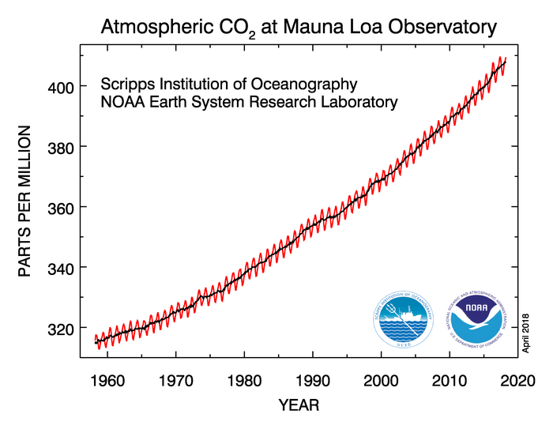
winter max
summer min
CO2 drops in spring; lowest value in summer
Photosynthetic CO2 removal from atmosphere during spring and summer plant growing season
CO2 rises in fall; highest value in winter
Plant growing season ends, plant respiration and biomass decay releases CO2 to air.
Red: Monthly CO2 concentrations
Black: Monthly CO2 concentrations removing effects of photosynthesis
https://www.esrl.noaa.gov/gmd/ccgg/trends/
Notes:
As just mentioned, carbon Dioxide concentrations in the air have been strongly increasing over the industrial era as a result of fossil fuel combustion.
This slide shows CO2 from the Mauna Loa observatory atop the Mauna Loa volcano on the big island of Hawaii (11,000 ft asl). Being so high in elevation and in the middle of the Pacific Ocean, Muana Loa is a place where clean, remote air can be sampled, away from cities for example.
Along the vertical axis is air concentrations in ppm, and along the horizontal is year starting in the 1950s, when measurements began, to current day.
There is other monitoring of CO2 further in the past from indirect methods … which are not shown on this slide.
Looking at the graphic, one can see the steady rise in CO2 levels, increasing from around 320 ppm in 1960 to current day values of 410 ppm. In fact, levels were fairly steady at 280 ppm for much of the last thousands of years prior to the industrial era. Fossil fuel combustion over the industrial era then proceeded to release much additional carbon to the air over the next couple centuries and continues to today. This has raised CO2 concentration levels in the year steadily over this period.
The additional CO2 in the air is in turn being found to be the primary driver for the global temperature rise and climate change we are experiencing. This topic will not be covered much further in this class … METR112 instead is dedicated to global climate change. Global climate change, however, is a related topic, and important to bring up here for context as we further study traditional air pollutants – those that directly cause human health problems during respiration.
The right side of this graphic explains the reasons for the annual rises and drops in CO2 levels indicated by the jagged behavior of the red line on the left-hand graphic. During spring and summer, CO2 levels drop by a few tens of ppm due to photosynthesis removing CO2 from the air during plant growth. In fall and winter, contrarily, when the growing season ends, CO2 levels rise by a few tens of ppm as plant biomass dies off and carbon is released back to the atmosphere, and as respiration exceeds photosynthesis due to reduced plant growth during

Slide 15
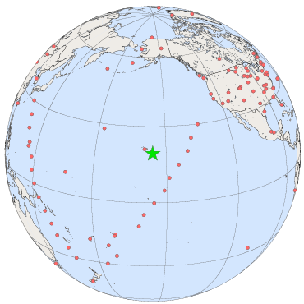
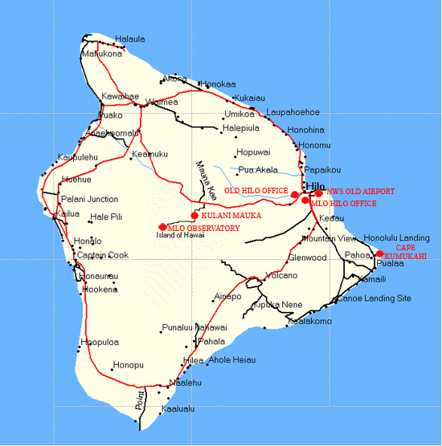
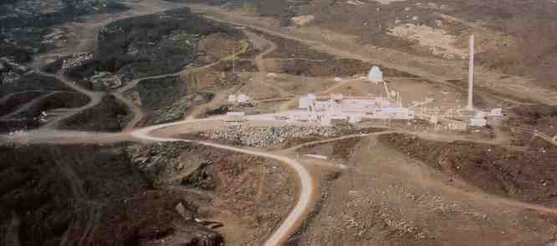
Mauna Loa Observatory
North Slope
Of Mauna Loa
Volcano.
~ 11,000 ft ASL
Atmospheric CO2 measurements
since mid- 1950s
https://www.esrl.noaa.gov/gmd/ccgg/trends/
Notes:
Information about the Mauna Loa Observatory, where natural background levels of Carbon Dioxide and other atmospheric trace gases are routinely monitored, is shown on this slide …

