Slide 1
METR/ENVS 113 Lecture 4: Ambient Air Pollution (Part 1)
SJSU Fall Semester 2020
Module 2: Outdoor Air Pollution
Frank R. Freedman (Course Instructor)
Notes:
Hello, this is METR113 Lecture 4, Ambient Air Pollution – Part 1. This is the first lecture of Course Module 2 – Outdoor Air Pollution

Slide 2
Outline
Air Pollution: Definitions
Formal Definition
Ambient Air Pollution
Air Pollution: Concentration, Duration and Health Effects
Acute versus Chronic Health Effects & Exposure
Long-term versus short-term exposure
Levels of Concern for Health Effects
Air Pollution: Regulation (next lecture)
Notes:
The outline of this lecture is as follows.
We will first formally define air pollution. This is important to frame the topic for better understanding how air pollution is typically viewed, studied and regulated in the professional community. In doing this, we will define the term ambient air pollution.
We will then cover how air pollution health effects occur as a result of the combination of the concentration and duration of air pollution exposure. This will introduce the topic of acute versus chronic health effect, long versus short-term exposure, and levels of concern for concentrations, which depend on exposure time. Levels of concern are concentrations beyond which health effects can be anticipated.
The topic of air pollution regulation, following from these topics, will be covered in next lecture.

Slide 3
Air Pollution: Definitions
Notes:
Ambient Air Pollution - Definitions

Slide 4
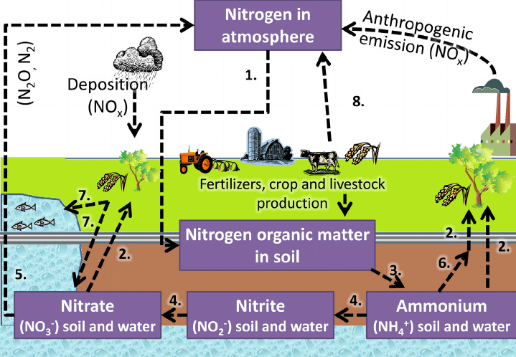
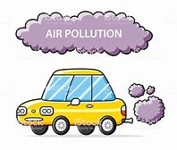
Lightning
A natural source of NO_{x}
Combustion from Industry and Automobiles
An anthropogenic source of NO_{x}
Notes:
To provide context, we first revisit some slides from Lecture 3.
Shown here is a visual of the nitrogen cycle through the earth system. If you recall, a main nitrogen related air pollutant is NOx – or oxides of nitrogen. Nitrogen Dioxide (NO2) is the main component of NOx that directly impacts human health.
One of the points made in this slide is the distinction between natural and anthropogenic (or human caused) emission sources of these pollutants.
In the case of NOx, lightning is a natural source due to the intense heating of the air column within a lightning beam – which convert a small portion of the N2 and O2 in this air into NOx.
Fuel combustion within units of industrial sources (factories, oil refineries) and within the engines of mobile sources such as cars and trucks is an example of an anthropogenic source. Similar to lightning, the intense heat of combustion, through chemical reactions, converts a portion of the N2 and O2 in the combustion air into NOx.

Slide 5
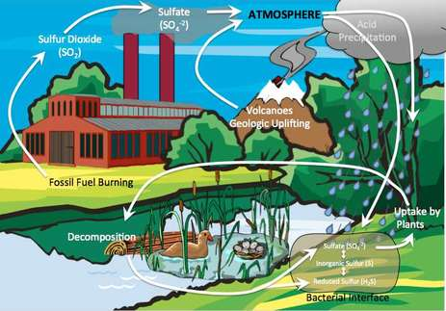
Coal Combustion
An anthropogenic source of SO₂
Volcanoes
A natural source of SO₂
Notes:
Also in Lecture 3 we presented a visual of the sulfur cycle through the earth system. If you recall, a main sulfur related air pollutant is SO2 – or sulfur dioxide.
Volcanoes are a natural source of sulfur dioxide, during eruptions ejecting into the atmosphere large plumes of sulfur from the earth into the atmosphere in the form of SO2.
SO2 emissions from coal combustion power plant stacks are an anthropogenic source.

Slide 6
Natural Background Concentrations in Air (Current-Day, remote areas … away from major air pollution sources)
Pollutant | Natural Background Concentrations | Source
Carbon Dioxide (CO₂) | 410 ppm | Mauna Loa (Hawaii) https://www.esrl.noaa.gov/gmd/ccgg/trends/
Carbon Monoxide (CO) | 50 – 120 ppb | http://www.euro.who.int/__data/assets/pdf_file/0020/123059/AQG2ndEd_5_5carbonmonoxide.PDF
Nitrogen Dioxide (NO₂) | 0.2 – 5 ppb | http://www.euro.who.int/__data/assets/pdf_file/0017/123083/AQG2ndEd_7_1nitrogendioxide.pdf
Sulfur Dioxide (SO₂) | < 1 ppb | http://www.temis.nl/products/so2.html
Notes:
We then emphasized the concentration levels of these species that on average exist around the globe due just to natural sources. We call this the natural background concentration. Notice that there is a small but non-zero concentrations of NO2 and SO2 that typically exists in the atmosphere.
For NO2, this is in the range of around 0.2 – 5 ppm.
For SO2, it is less than 1 ppb.

Slide 7
Air Pollution: General Definition
Buildup of naturally or anthropogenically emitted gases and/or particles in air concentrations sufficiently high to cause, or produce excessive risk of, damage to human health, plants, animals, other life forms, ecosystems, structures, or works of art.
KEY POINTS OF DEFINITION
Includes both natural and anthropogenic emission sources
Build-up of concentrations sufficiently high to cause damage, or excessive risk, of damage
Damage is broad … spanning several forms (human health, environment, etc …). Primary focus of METR113, however, is human health.
Notes:
So with this lead-up, we can define air pollution.
There are several variations … however the following succinctly covers the main aspects.
Reading here … Air pollution is … *** read definition on slide ***
Unpacking this definition, the key parts are first …
1. 2. 3.
1. Wildfires smoke impacts on population, for example, is a natural emission.
2. “Excessive” suggests a concentration “level of concern” or “threshold” above which risks exist, and below which are negligible.
3. Focus on human health

Slide 8
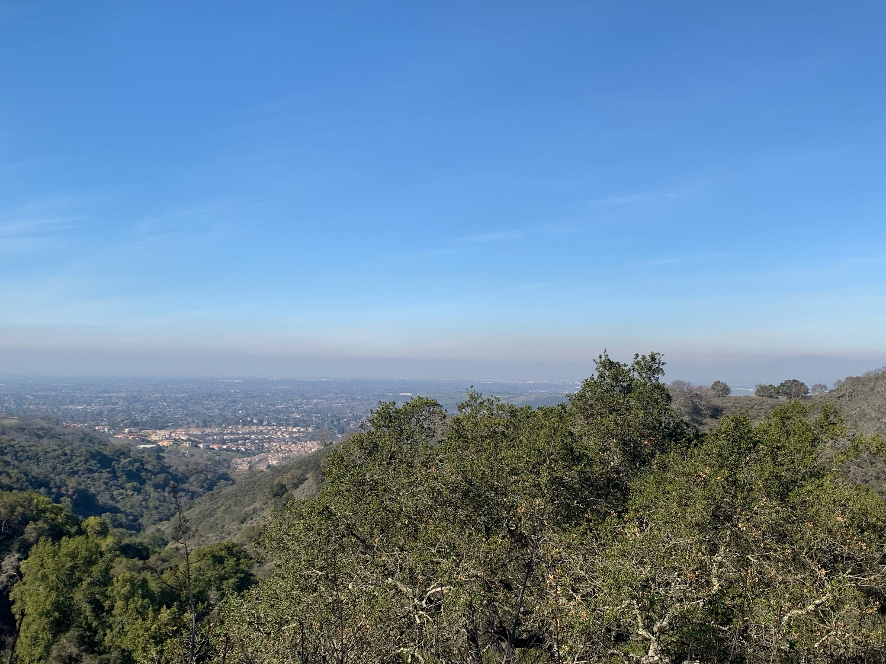
Ambient Air Pollution: General Definition
“Ambient Air”: Outdoor air to which the general population across an area is exposed.
Example of ambient air pollution: Summer smog layer San Jose
Notes:
The focus of most air pollution regulations is on what is termed the “ambient air pollution”. Or in other words, air pollution in the ambient air.
This can be visualized in this photograph overlooking San Jose on a summer day. One sees a blanket of brownish polluted air spanning the city. Being so spatially broad, the general population of the city is therefore exposed to the polluted air, regardless of specific address or neighborhood. This is ambient air pollution … air pollution the spans an entire region due to emissions spread over the area. This is instead of air pollution emitted from a specific, very close local source, which affects just those close by - for example if one lives on a busy road with lots of trucks going by.
Also, ambient air is outdoor air, and therefore indoor air pollution is not included.

Slide 9
Air Pollution in Urban Area: Los Angeles (Another image of “ambient air pollution”)
Notes:
Here is another visual of ambient air pollution, this time the urban air pollution haze so common to Los Angeles.

Slide 10
Air Pollution: Concentration, Duration & Health Effects
Notes:
Ambient Air Pollution – Concentration, Duration and Health Effects

Slide 11
Air Pollution: General Definition
Buildup of naturally or anthropogenically emitted gases and/or particles in air concentrations sufficiently high to cause, or produce excessive risk of, damage to human health, plants, animals, other life forms, ecosystems, structures, or works of art.
KEY POINTS OF DEFINITION
Includes both natural and anthropogenic emission sources
Build-up of concentrations sufficiently high to cause damage, or excessive risk, of damage
Damage is broad … spanning several forms (human health, environment, etc …). Primary focus of METR113, however, is human health.
Notes:
Returning to the definition of air pollution, we can recall the three main parts.
The first and third are fairly clear … that both natural and anthropogenic sources can cause air pollution, and that the damaging, or potentially damaging, effects of air pollution can take many forms. As we mentioned, this class is focused on adverse effects on human health.
The second point however requires further explanation … that concentration levels must be high enough to be, or present an excessive risk of being, damaging.
This implies what is called in the air pollution world a “level of concern” or “threshold” above which adverse health effects can be anticipated, and below which such effects may not be anticipated. Of course, there is not a unique, single level of concern that applies across the board across the population … since individuals have varying levels of susceptibilities to adverse effects of environmental exposure to contaminants. For this reason, levels of concern are generally set to apply to portions of the population that are most susceptible or sensitive … for example elderly and children.
We will now examine this topic further …

Slide 12
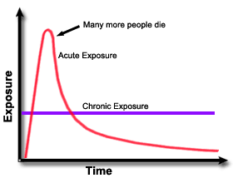
Adverse Health Effects Due to Air Pollution (Acute vs. Chronic Health Effects)
Acute Health Effects
Concentration exceeds level of concern on short-term basis. Acute, episodic health effects may be expected.
Due to short-term (< 24 h) exposure of an unhealthy concentration level of an air pollutant. Causes short-term health effects.
Examples: Lung / throat irritation, asthma exacerbation, episodic respiratory symptoms, hospitalizations, death.
Examples of events: bad air pollution episodes, major wildfires, industrial accidents.
Implies a “level of concern” or “threshold” above which concentrations levels cause such effects.
level of concern
(short-term effects)
Concentration
Notes:
The adverse effects of environmental exposure are often divided into two classes: acute and chronic. The next two slides will clarify the difference.
The graph on the inset illustrates a generic time trend of contaminant concentration an individual or population may be exposed to. The vertical axis is the concentration level increasing upward, and the horizontal is time, elapsing further in time going right across the axis.
We first focus on acute health effects.
Acute health effects and exposure are due to short-term exposure. For air pollution, this can be a single hour, day or several days for example. An example could be the exposure to air pollution during a particular day or days when air pollution concentrations are high, for example the high amount of smoke in the air during the major wildfire episode during November 2018.
This is illustrated on the graph as the short period of relatively high concentration near the left portion of the horizontal. Also indicated is a dashed line corresponding the level of concern for short term exposure to this contaminant. The period of time when the concentration exceeds this level of concern for short-term, acute effects are therefore when acute health effects may be anticipated for sensitive individuals. Other times, when concentration levels are less than this level of concern, are when such effects may not be anticipated. These levels of concern are determined by health effects research, and continue to be more accurate and comprehensive as our scientific understanding of the health effects of contaminants advances.
With this lead-up, we can now make some explicit points about acute health effects and exposure.
*** Read bullets one by one ***

Slide 13
Adverse Health Effects Due to Air Pollution (Acute vs. Chronic Exposure)
Chronic Health Effects
Long-term (annual to lifetime) exposure of an unhealthy amount of air pollutant. Causes risk of long-term health effects.
Examples: Respiratory or cardiovascular disease, cancer.
Due to exposure to long-term, average concentration levels above a level of concern.
Examples: Living in a very polluted city or area for a long period of time. Lifetime exposure in a workplace.
Average concentration exceeds level of concern for chronic health effects. Chronic health effects may be expected.
Concentration
level of concern
(long-term effects)
Notes:
We now focus on chronic health effects.
Chronic health effects and exposure are due to long-term exposure. For air pollution, this is generally regarded as multi-year to lifetime exposure to a concentration level.
An example could be the exposure to poor air quality in the city your have lived most of your life. It is important to note that concentration in this case applies to average levels over a long period … not focusing on the day to day ups and downs in concentrations.
This is illustrated on the graph by the purple line, which indicates the average concentration over period of time shown on the entire period of the horizontal axis. Some of the time during this overall period concentrations are higher, and some of the time concentrations are lower. But on average they are at the level indicated by the purple line.
The dashed line indicated here is the level of concern for long term exposure to this contaminant. As seen, the average concentration indicated by the purple line exceeds this level of concern for long-term, chronic health effects, are therefore chronic health effects may be anticipated for sensitive individuals.
With this lead-up, we can now make some explicit points about chronic health effects and exposure.
*** Read bullets one by one ***

Slide 14
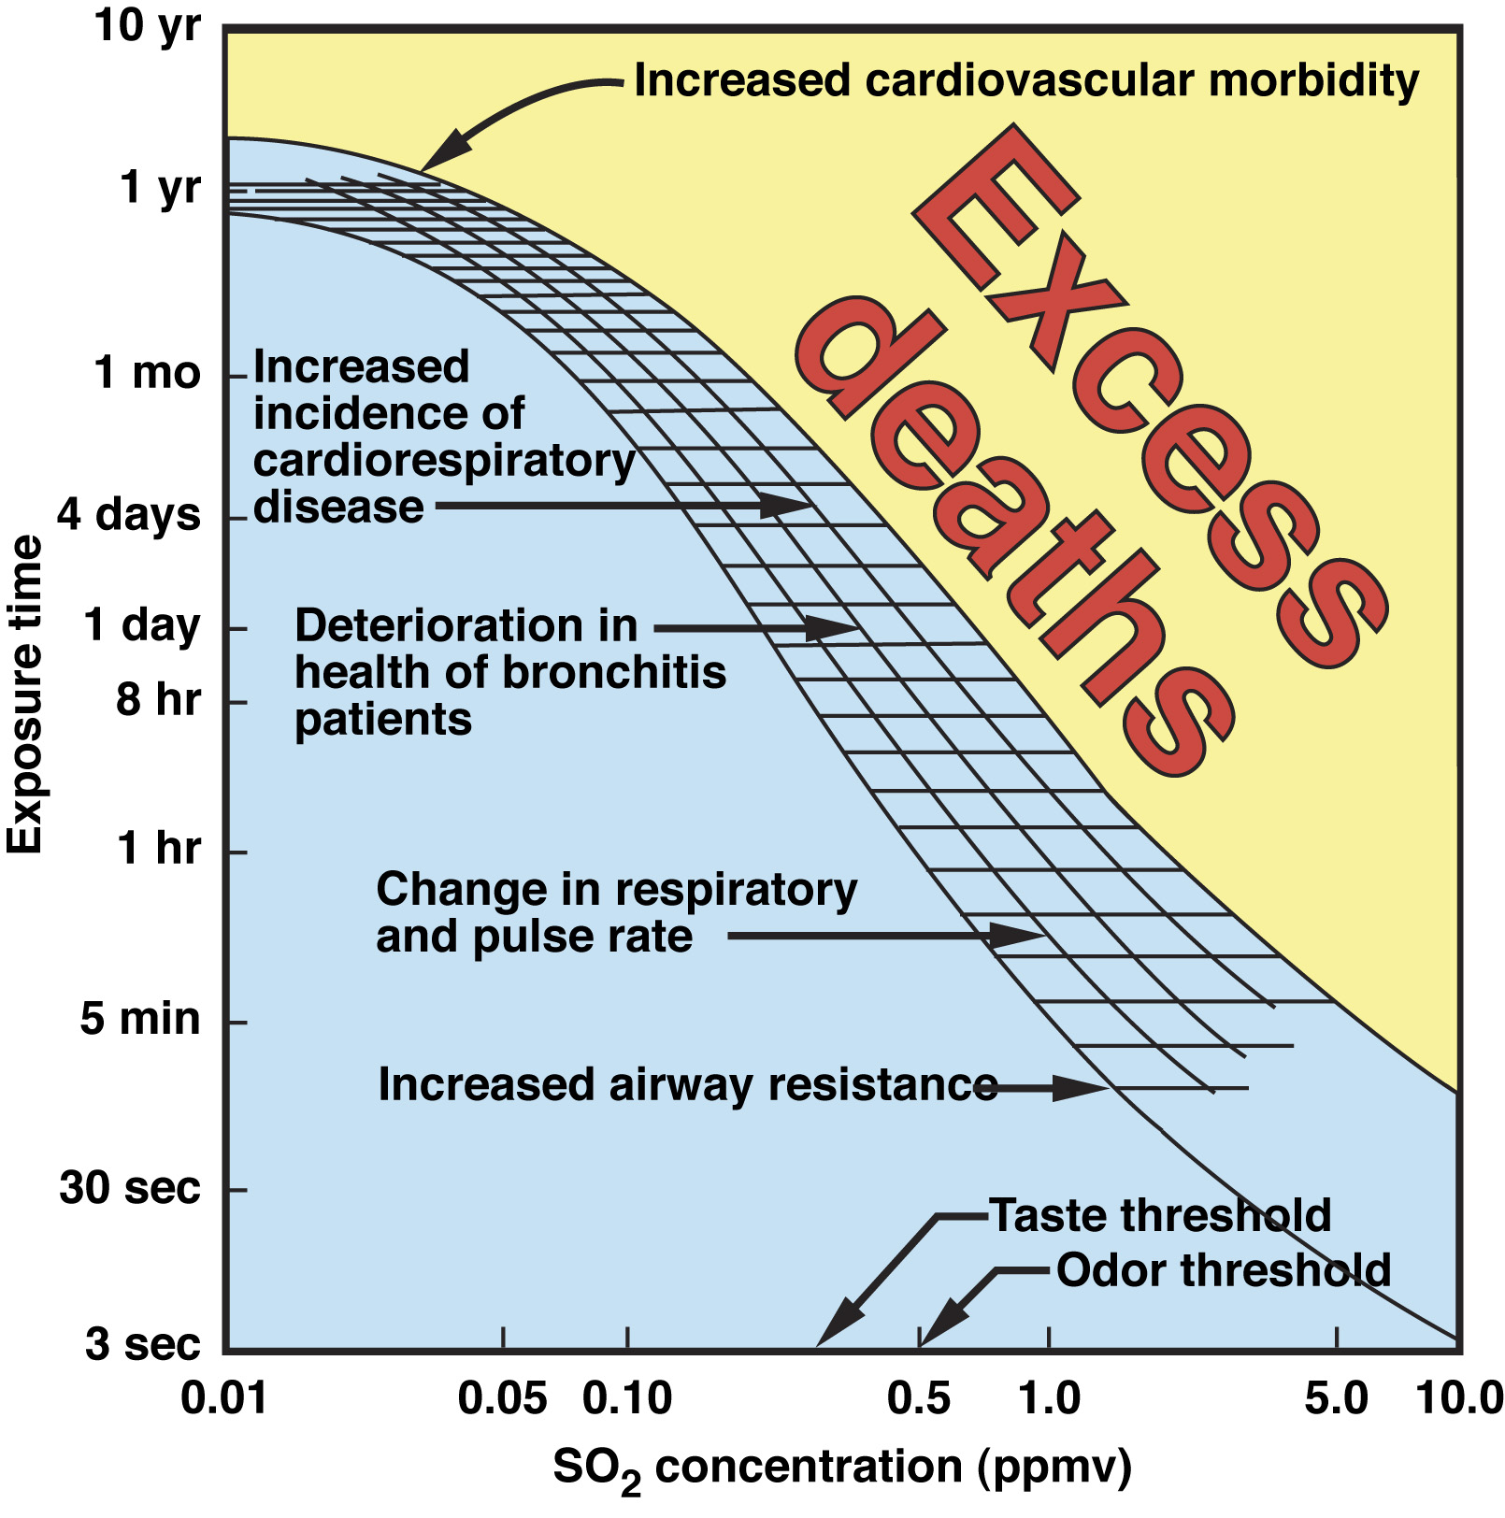
Illustration: Sulfur Dioxide (SO₂)
Mortality
Adverse Health Effects
No Adverse Health Effects
Notes:
We can illustrate these points by example for common air pollutions. Here we show are depiction for Sulfur Dioxide (SO2).
The horizontal axis is the concentration of SO2 in parts-per-million, ranging from 0.01 ppm to 10 ppm. The vertical axis is the exposure time, ranging from 3 seconds to 10 years.
We indicate three areas within the body of the graph.
The light-blue area are where the paired concentration and exposure durations are such that adverse health effects are not anticipated. Notice that this area corresponds to lower concentration levels and exposure times, as we would expect.
The light-blue hatched area is where paired concentration and exposure times increase to the point where adverse health effects begin to occur. These effects range from short-term, acute effects such as increased airway resistance – which would trigger difficulty or pain when breathing. Since this is an acute effect, it corresponds to short duration exposures to relatively high concentration levels.
Effects then range to chronic effects such as increased risk of cardiorespiratory disease and morbidity. Notice that these effects begin to occur due to longer-duration exposure to smaller concentration levels, compared to what causes acute health effects.
Finally the beige area indicates concentration and exposure durations that can lead to increased risk of mortality. These are the high concentration parts of the plot. Short-term exposure to very high concentration could cause instantaneous death. Longer exposure duration to smaller concentrations can create a long-term risk of premature mortality.
Explaining further by example, if a person or population were exposed to 1 ppm of SO2 for 30 seconds, no adverse health effects would be expected. However as the duration of exposure to 1 ppm becomes longer, health effects begin to occur. A 1-hour exposure would lead to increasing incidence across the population of breathing problems and pulse rate. If an average exposure to 1 ppm lasted for a month or year, then excess mortality among the population may be expected.
Likewise going along the horizontal, a 1-hour exposure to 0.1 ppm of SO2 should not lead to adverse effects. However as the exposure beyond 1 to 10 ppm, health effects may be anticipated, and more seriously so, as concentrations increase.
This emphasizes the general point from last two slides that acute health effects generally relate to short-term exposure to high concentration levels, and long-term chronic health effects to long term exposure to lower concentration levels.

Slide 15
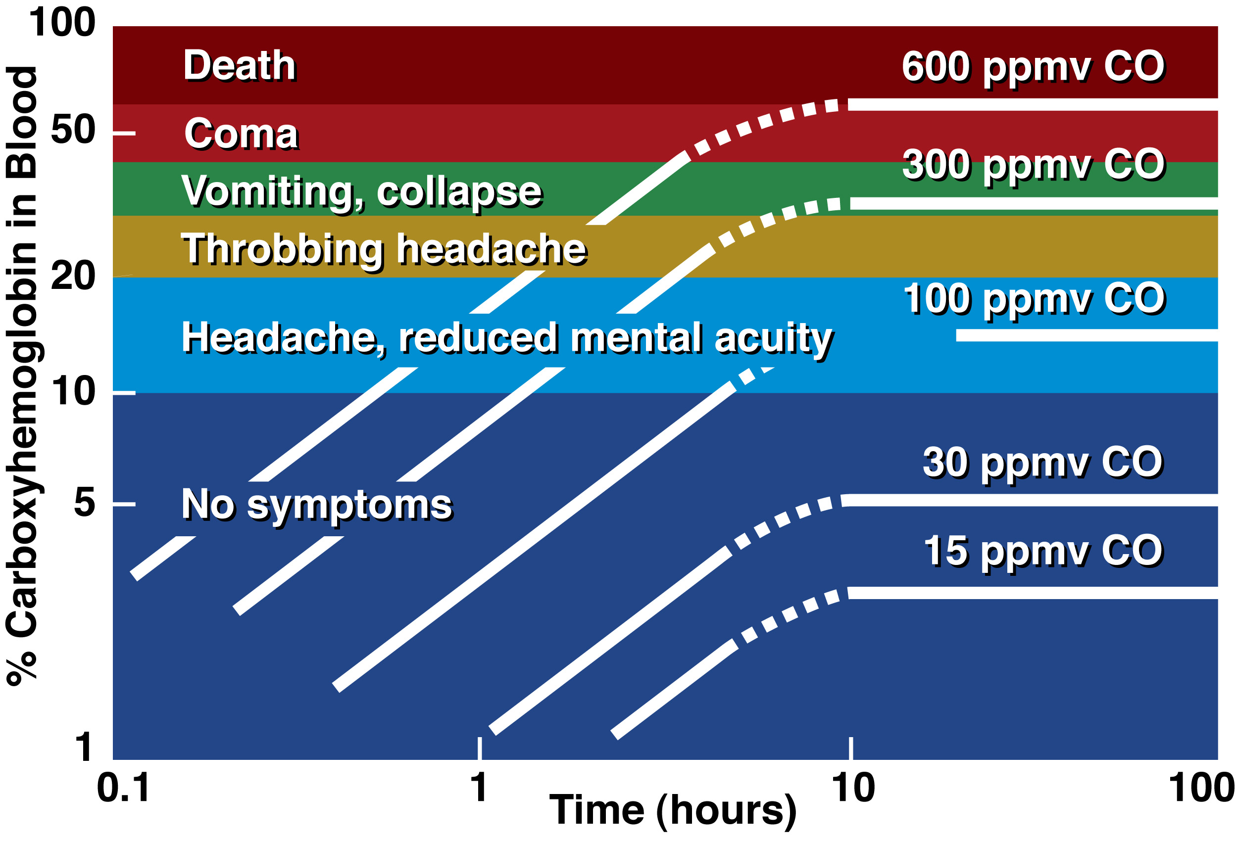
Illustration: Carbon Monoxide (CO)
Concentration Levels
(15 to 600 ppm)
Short-term, acute health effects
(No Symptoms to Death)
Exposure Duration
(0.1 – 100 hours)
Notes:
A similar plot, organized a bit differently, is shown here for Carbon Monoxide (CO).
The horizontal axis is the duration of exposure in hours, ranging from 0.1 hours (or several minutes) to 100 hours (or several days). The vertical axis is the percent carboxyhemoglobin in the blood, which builds up in the blood as exposure to carbon monoxide increases, and causes health effects. The various health effects are color coded vertically up the plot, from blue corresponding to no symptoms to red corresponding to comas and death.
Concentration levels are indicated by the white lines on the plot, ranging from 15 to 600 ppm.
Reading the plot, a 600 ppm exposure to CO for only several minutes would not yield symptoms, however as duration of exposure increases a 600 ppm exposure leads to a risk of headaches and collapsing if exposure is for an hour, to collapse and possible death if exposure were for several hours. Likewise increasing effects occur as the concentration level increases for a fixed duration of exposure.
As with SO2 in the previous slide, the same health effect can occur with a short-term exposure to a high concentration level, or a long-term exposure to a lower concentration level. For example, headaches or reduced mental acuity can occur with a 1 hour exposure to 600 ppm, or a 10 hour exposure to 100 ppm. Interestingly with CO after a certain duration of exposure, the percent carboxyhemoglobin in the blood does not change if continuously exposed to a concentration level.
In fact, each pollutant has its own unique version of this sort of plot.
The short-term health effects on this plot apply very strongly to indoor air pollution, where carbon monoxide leaks from stoves, natural gas vents, fireplaces and other combustion sources within houses and structures can cause build CO up to high concentrations indoors if not detected. Since CO is odorless, indoor areas and residences should therefore be equipped with a smoke detector that also detect CO.

