Slide 1
METR/ENVS 113 Lecture 5: Ambient Air Pollution (Part 2)
SJSU Fall Semester 2020
Module 2: Outdoor Air Pollution
Frank R. Freedman (Course Instructor)
Notes:
Hello, this is METR113 Lecture 5, Ambient Air Pollution – Part 2. This is the second lecture of Course Module 2 – Outdoor Air Pollution

Slide 2
Previous Lecture
Air Pollution: Definitions
Formal Definition
Ambient Air Pollution
Air Pollution: Concentration, Duration and Health Effects
Acute versus Chronic Health Effects & Exposure
Long-term versus short-term exposure
Levels of Concern for Health Effects
Air Pollution: Regulation
Notes:
This lecture will pick up from where we left off on Lecture 4. In Lecture 4, we presented a formal definition of air pollution, and discussed the topic of concentrations, exposure duration, levels of concern, and acute versus chronic health effects related to air pollution.
We will now cover the basic framework in which ambient air pollution is regulated, following from these considerations.

Slide 3
This Lecture
Air Pollution: Definitions
Formal Definition
Ambient Air Pollution
Air Pollution: Concentration, Duration and Health Effects
Acute versus Chronic Health Effects & Exposure
Long-term versus short-term exposure
Levels of Concern for Health Effects
Air Pollution: Regulation
Notes:
This lecture will pick up from where we left off on Lecture 4. In Lecture 4, we presented a formal definition of air pollution, and discussed the topic of concentrations, exposure duration, levels of concern, and acute versus chronic health effects related to air pollution.
We will now cover the basic framework in which ambient air pollution is regulated, following from these considerations.

Slide 4
Outline
Air Pollution: Regulation
Historical Context
Clean Air Act 1970
Ambient Air Standards & Criteria Air Pollutants
Implementation & Air Quality Agencies
Successes & Current Challenges
Notes:
Among the sub-topics to be covered are as follows:
We will provide a historical perspective of air pollution regulation, which culminated in the major Clean Air Act of 1970 regulations.
From this, we will introduce the topics of ambient air quality standards and criteria air pollutants.
We will then summarize how clean air act regulations are implemented, and the national, state and local area air quality agencies involved.
Past successes in controlling air quality following from these regulations, and current, remaining challenges will then be summarized.

Slide 5
Outline
Air Pollution: Regulation
Historical Context
Clean Air Act 1970
Ambient Air Standards & Criteria Air Pollutants
Implementation & Air Quality Agencies
Successes & Current Challenges
Notes:
Turning first to historical context …

Slide 6
Donora, Pennsylvania, October 29, 1948
Copyright Photo Archive/Pittsburgh Post-Gazette, 2001. All rights reserved
Notes:
Seen here is a picture of the town of Donora, Pennsylvania on October 29, 1948. Donora, which is about 30 miles south of Pittsburgh, was among many industrial Midwest towns during this era. Donora contained many steel mills, smelters, and coal fired power plants. The town is situated in a valley along a river, along which barges would transport raw and finished goods to and from entry ports, mills, and markets.
Although one may not have guessed it … this picture was taken at noontime …

Slide 7
Donora, Pennsylvania, October 29, 1948 … Noontime!
Copyright Photo Archive/Pittsburgh Post-Gazette, 2001. All rights reserved
Notes:
Seen here is a picture of the town of Donora, Pennsylvania on October 29, 1948. Donora, which is about 30 miles south of Pittsburgh, was among many industrial Midwest towns during this era. Donora contained many steel mills, smelters, and coal fired power plants. The town is situated in a valley along a river, along which barges would transport raw and finished goods to and from entry ports, mills, and markets.
Although one may not have guessed it … this picture was taken at noontime on this day. Stagnant high-pressure meteorological conditions were present on this day over the area, and associated with this very weak winds and strong temperature inversions that limited dilution of air pollution emissions from the mills, smelters, and smokestacks in the town. A major air pollution episode thus occurred, which lasted several days from October 27 through 31.
This picture was taken at noontime on the third day of the episode. Smoke, sulfur dioxide and other air pollutants built up in concentrations so much that visibility was reduced to the point that the day appeared as night, as one can tell by the street lamps on in the foreground of the photo.
20 deaths occurred during the episode, and around 40% of the town of 14,000 experienced respiratory problems. Fifty more death subsequently occurred after the event ended.
The Donora episode focused much national attention on the increasing problem of poor air quality in the U.S. … especially pertaining to these “killer smog” events. Air pollution regulation was highly motivated by the severity of the Donora event.

Slide 8
Donora, Pennsylvania, October 29, 1948 … Noontime!
About the incident …
Major air pollution episode over five days (27-31Oct)
Emission sources: Major industrial sources (steel and iron mills and smelters, coal fired power plants, boilers and furnaces)
Meteorological Conditions: Strong high pressure, prolonged stagnant air conditions, temperature inversions
Air Pollutants: Smoke, SO₂ gas, others
Health Effects: 20 deaths, estimated 40% of town experiences serious respiratory problems. 50 more deaths occurred within a month after event.
https://en.wikipedia.org/wiki/1948_Donora_smog
Copyright Photo Archive/Pittsburgh Post-Gazette, 2001. All rights reserved
Notes:
Some highlights of the episode are provided here. Note that both the combination of many pollution sources, the lack of regulation and with it current-day air pollution control equipment, and favorable meteorological conditions for the build up of air pollution concentrations caused the event.

Slide 9
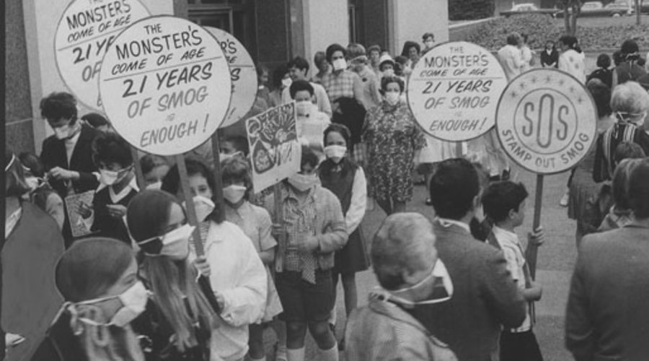
Los Angeles (1950s, 1960s)
Key Points
Increasingly bad air pollution in Los Angeles area
Major air pollution sources (motor vehicles & industry)
High sunlight and summer-time inversions (“photochemical smog”)
Photochemical smog – ground-level ozone (O3) and related species
Motivated regulations
Hollywood Citizens News Collection, Los Angeles Public Library
Notes:
Another area around the country during this time that had been drawing attention related to poor air quality was Los Angeles.
Rather than in Donora, where smoke and SO2 gas from factories caused an intense incident, the poor air pollution affecting Los Angeles then, and still affects today, was something called “photochemical smog”. Photochemical smog is a mix of ozone gas and related compounds that builds up on hot, summer days in the presence of abundant sunlight. One can tell from the photo on the left that photochemical smog is a daytime problem.
The emission sources producing photochemical smog are also a bit different that in Donora, mainly due to uncontrolled tailpipe emissions at this time from automobiles as well as hydrocarbon gas vapors from chemicals involved in the petroleum refining, and various industries spreading across the LA Basin associated with the post WWII population growth of greater LA. Ozone pollution concentration levels were much worse during this era, reaching around 10 times current-day air pollution standards for ozone.
As a result of the persistent air quality problems associated with photochemical smog in LA, the first air quality agencies in the country were established in Los Angeles, tasked with developing and enforcing regulations to control air pollution concentrations and emissions.

Slide 10
Outline
Air Pollution: Regulation
Historical Context
Clean Air Act 1970
Ambient Air Standards & Criteria Air Pollutants
Implementation & Air Quality Agencies
Successes & Current Challenges
Notes:
Ensuing from these early air pollution problems, air pollution regulation in the U.S. culminated in the Clean Air Act of 1970, and with it the development of Ambient Air Quality Standards for Criteria Air Pollutants.

Slide 11
Clean Air Act & National Ambient Air Quality Standards
Clean Air Act 1970
First major nationwide air quality regulation
Established creation of Environmental Protection Agency (EPA)
National Ambient Air Quality Standards (NAAQS)
Thresholds for ambient air concentrations for “criteria air pollutants”.
Air concentrations must be less than NAAQS to comply with Clean Air Act.
NAAQS values are established …
based on health effects research.
to be protective for sensitive populations with adequate margin.
California has independent standards, alongside NAAQS.
https://en.wikipedia.org/wiki/National_Ambient_Air_Quality_Standards
Notes:
Here we will itemize the major provisions of the Clean Air Act of 1970.
It was established in 1970, as the first major nationwide air quality regulation. The Environmental Protection Agency was established at this time as the enforcement body for the act, and as well for the Clean Water Act which followed a couple years later.
Among the major parts of the Clean Air Act legislation was the development of National Ambient Air Quality Standards … pronounced “NAAQS” as an abbreviation. These are a set of air concentration thresholds that the pollution concentrations cannot exceed at monitoring stations across an area. These are similar to the levels of concern that were a topic of Lecture 4, but specifically designed for regulatory purposes. The NAAQS standards apply to specific air pollutant species called “criteria air pollutants”. We will list the criteria air pollutants on the next slide.
The NAAQS concentration standard values are established based on health effects research as values that if not exceeded would be protective to human health for sensitive populations with adequate level of safety. NAAQS values are periodically updated as more health effects research findings become available.
Alongside NAAQS, California has its own a set of ambient air quality standards.

Slide 12
Clean Air Act 1970: Criteria Air Pollutants
NAAQS are set for seven “criteria” air pollutants
Ozone (O₃)
Sulfur Dioxide (SO₂)
Nitrogen Dioxide (NO₂)
Carbon Monoxide (CO)
Particulate Matter less than 10 μm (PM₁₀)
Particulate Matter less than 2.5 μm (PM_{2.5})
Lead (Pb)
https://en.wikipedia.org/wiki/National_Ambient_Air_Quality_Standards
Notes:
So what are the specific criteria air pollutants?
There are seven.
First, there is ozone (O3). We discussed stratospheric ozone in Lecture 2, where we learned that this gas has a beneficial effect when in the stratosphere in blocking ultraviolet radiation from reaching the surface. However, if ozone gas is formed at the surface it is harmful if inhaled at sufficiently high concentrations. Ozone is the major constituent of the photochemical smog shown earlier for Los Angeles. We will cover ground-level ozone air pollution in depth in a future lecture.
Another is Sulfur Dioxide (SO2), which as we mentioned in previous lectures is connected to coal combustion.
Another is Nitrogen Dioxide (NO2), also mentioned in previous lectures and shown in photographs as the brown gas covering cities due the absorption of blue sunlight by this gas. Nitrogen Dioxide is a portion of NOx … and is a major part of air pollution from motor vehicles and other combustion sources.
Another is Carbon Monoxide, also mentioned earlier and a major part of motor vehicle and other combustion emissions.
Then there are two pollutants related to particulate … PM10 and PM2.5. These are not specific species, but rather represent the total mass concentration of particles in the air less than certain sizes. PM10 is the total mass concentration of all particles in the air less than 10 micrometers in diameter. Likewise, PM2.5 is the total mass concentration of all particles in the air less than 2.5 micrometers in diameter. A micrometer is about 1/60th of the diameter of a human hair … and thus both PM10 and PM2.5 refer to very tiny particles. Especially for PM2.5, these particles are so tiny that they can penetrate deep into lungs without being trapped in nasal and throat passages, therefore causing more serious health problems if concentrations are high enough. We will cover PM10 and PM2.5 more in future lectures.
Finally, there is lead, which is particulate metal. In terms of air pollution, lead is not as much a problem nowadays since leaded gasoline, which was common in the 1970s and earlier, has been phased out. Lead is still an important water pollutant however. The recent Flint Michigan water crises is an example of lead pollution in water that was recently in the news.

Slide 13
Ambient Air Quality Standards: Gaseous Pollutants
California NAAQS
Ozone
1-hour average 90 ppbv --
8-hour average 70 ppbv 70 ppbv
CO
1-hour average 20 ppmv 35 ppmv
8-hour average 9 ppmv 9 ppmv
NO₂
1-hour average 180 ppbv 100 ppbv
annual average 30 ppbv 53 ppbv
SO₂
1-hour average 250 ppbv 75 ppbv
24-hour average 40 ppbv --
Notes:
The NAAQS and California air quality standards are listed here for the gaseous criteria air pollution species. You don’t have to memorize the precise values in the table, but rather familiarize yourself with the main concepts.
As seen, there are two parts to a standard for a given species … the concentration value for the standard and the averaging time it refers to.
For example, ozone has both a 1-hour and an 8-hour standard in California. The 1-hour standard is 90 ppb, and the 8-hour standard is 70 ppb. The federal NAAQS standard for ozone is only an eight-hour standard, at 70 ppb.
What this means is that concentrations of ozone at monitoring stations around an area cannot exceed 90 ppb for any hour, and 70 ppb averaged over eight hours. We will spell this out more explicitly in the next slides.
Other pollutants have their own unique standards and averaging time. For example, NO2 has both a 1-hour and annual standard, with different values for California and nationally.
Recalling, the concept of averaging time was presented in Lecture 4 in connection with acute versus chronic health effects. The longer averaging time standards, for example the annual standard for NO2 of 53 ppm, is designed to guard against long-term health effects of NO2, since long-term average exposure is at issue for chronic health effects.
Hourly standards, on the other hand, are more stringent standards, since they can guard against both short and long-term adverse health effects. For example, if concentrations are lower than a 1-hour standard every hour or every year, then both acute and chronic health effects are guarded against.

Slide 14
Ambient Air Quality Standards: Particulate Pollutants
PM_{2.5}: (particles smaller than 2.5 μm)
NAAQS (annual): 12 μg/m³
NAAQS (24-hour): 35 μg/m³
PM₁₀: (particles smaller than 10 μm)
California (annual): 20 μg/m³
California (24-hour): 50 μg/m³
NAAQS (24-hour): 150 μg/m³
Notes:
The NAAQS and California air quality standards are listed here for the particulate criteria air pollution species PM2.5 and PM10.
PM2.5 has a NAAQS annual standard of 12 micrograms per cubic meter and a daily (24-hour) standard of 35 micrograms per cubic meter. PM10 has 24-hour NAAQS of 150 ug/mg, and a set of California standards as well.
Micrograms per cubic meter is a way of expressing mass concentration, similar to ppm or ppb. In the case of PM2.5 and PM10, it refers to the mass of total particulate in the air per cubic meter less than 2.5 and 10 micrometers, respectively.

Slide 15
Applying ambient air quality standards (Example 1: CA 1-hr ozone standard = 90 ppb)
“The concentration of ozone measured at air quality monitoring stations across an air district averaged over 1 hour cannot exceed 90 ppb.”
If ozone concentration does not exceed standard at all monitoring stations, air district is in “attainment” of the 1-hour ozone standard.
If ozone concentration exceeds at any monitoring station, air district is in “non-attainment” of the 1-hour ozone standard.
https://www.epa.gov/green-book
Notes:
The following examples make more explicit, and provide further details, on the application of ambient air standards.
We first take 1-hour California ozone standard of 90 ppb.
This means that …
Therefore if … the air district is in “attainment” of the 1-hour CA ozone standard … and therefore meets the requirements for the regulation.
On the other hand, if .. the air district is in “non-attainment” of the 1-hour CA ozone standard … and therefore does not comply with the regulation.
These standards are checked against air pollution measurements at monitoring stations across air districts taking place continuously, every hour of the year.
We will discuss more about air districts and monitoring stations in coming slides.

Slide 16
Applying ambient air quality standards (Example 2: NAAQS 24-hr PM2.5 Standard = 35 μg/m³)
“The concentration of PM2.5 measured at air quality monitoring stations across an air district averaged over 24 hours cannot exceed 35 μg/m³ .”
If PM2.5 concentration does not exceed standard at all monitoring stations, air district is in “attainment” of the 24-hour PM2.5 standard.
If PM2.5 concentration exceeds at any monitoring station, air district is in “non-attainment” of the 24-hour PM2.5 standard.
https://www.epa.gov/green-book
Notes:
We next take the 24-hour PM2.5 NAAQS standard of 35-micrograms per cubic meter.
This means that …
Therefore if … the air district is in “attainment” of the 24-hour national PM2.5 standard … and therefore meets the requirements for the regulation.
On the other hand, if .. the air district is in “non-attainment” of the 24-hour national PM2.5 standard … and therefore does not comply with the regulation.

Slide 17
Applying ambient air quality standards (Example 3: CA annual NO2 standard = 30 ppb)
“The concentration of nitrogen dioxide measured at air quality monitoring stations across an air district averaged over one year cannot exceed 30 ppb.”
If NO2 concentration does not exceed standard at all monitoring stations, air district is in “attainment” of the annual NO2 standard.
If NO2 concentration exceeds at any monitoring station, air district is in “non-attainment” of the annual NO2 standard.
https://www.epa.gov/green-book
Notes:
As a final example, we take the annual California NO2 standard of 30 ppb.
This means that …
Therefore if … the air district is in “attainment” of the annual CA NO2 standard … and therefore meets the requirements for the regulation.
On the other hand, if .. the air district is in “non-attainment” of annual CA NO2 standard … and therefore does not comply with the regulation.

Slide 18
Interpreting the standards: SO2
California NAAQS
Ozone
1-hour average 90 ppbv --
8-hour average 70 ppbv 70 ppbv
CO
1-hour average 20 ppmv 35 ppmv
8-hour average 9 ppmv 9 ppmv
NO₂
1-hour average 180 ppbv 100 ppbv
annual average 30 ppbv 53 ppbv
SO₂
1-hour average 250 ppbv 75 ppbv
24-hour average 40 ppbv --
Notes:
We mentioned that these standards are based on health effects research and are designed to be protective for sensitive individuals. We attempt to make this point more clear now. We will first look at SO2, specifically the 1-hour NAAQS standard of 75 ppb and California 24-hour standard of 40 ppb.

Slide 19
Natural Background Concentrations in Air (Current-Day, remote areas … away from major air pollution sources)
Pollutant | Natural Background Concentrations | Source
Carbon Dioxide (CO₂) | 410 ppm | Mauna Loa (Hawaii) https://www.esrl.noaa.gov/gmd/ccgg/trends/
Carbon Monoxide (CO) | 50 – 120 ppb | http://www.euro.who.int/__data/assets/pdf_file/0020/123059/AQG2ndEd_5_5carbonmonoxide.PDF
Nitrogen Dioxide (NO₂) | 0.2 – 5 ppb | http://www.euro.who.int/__data/assets/pdf_file/0017/123083/AQG2ndEd_7_1nitrogendioxide.pdf
Sulfur Dioxide (SO₂) | < 1 ppb | http://www.temis.nl/products/so2.html
Notes:
First, we remind ourselves that the natural background of SO2 is generally 1 ppb or less. The ambient air standards of 75 ppb for 1-hour and 40 ppb for 24 hour just mentioned are therefore much higher than natural background air. This is because the standards refer to concentration that would be experienced in urbanized, industrialized or otherwise populated areas – where anthropogenic sources would exist.

Slide 20
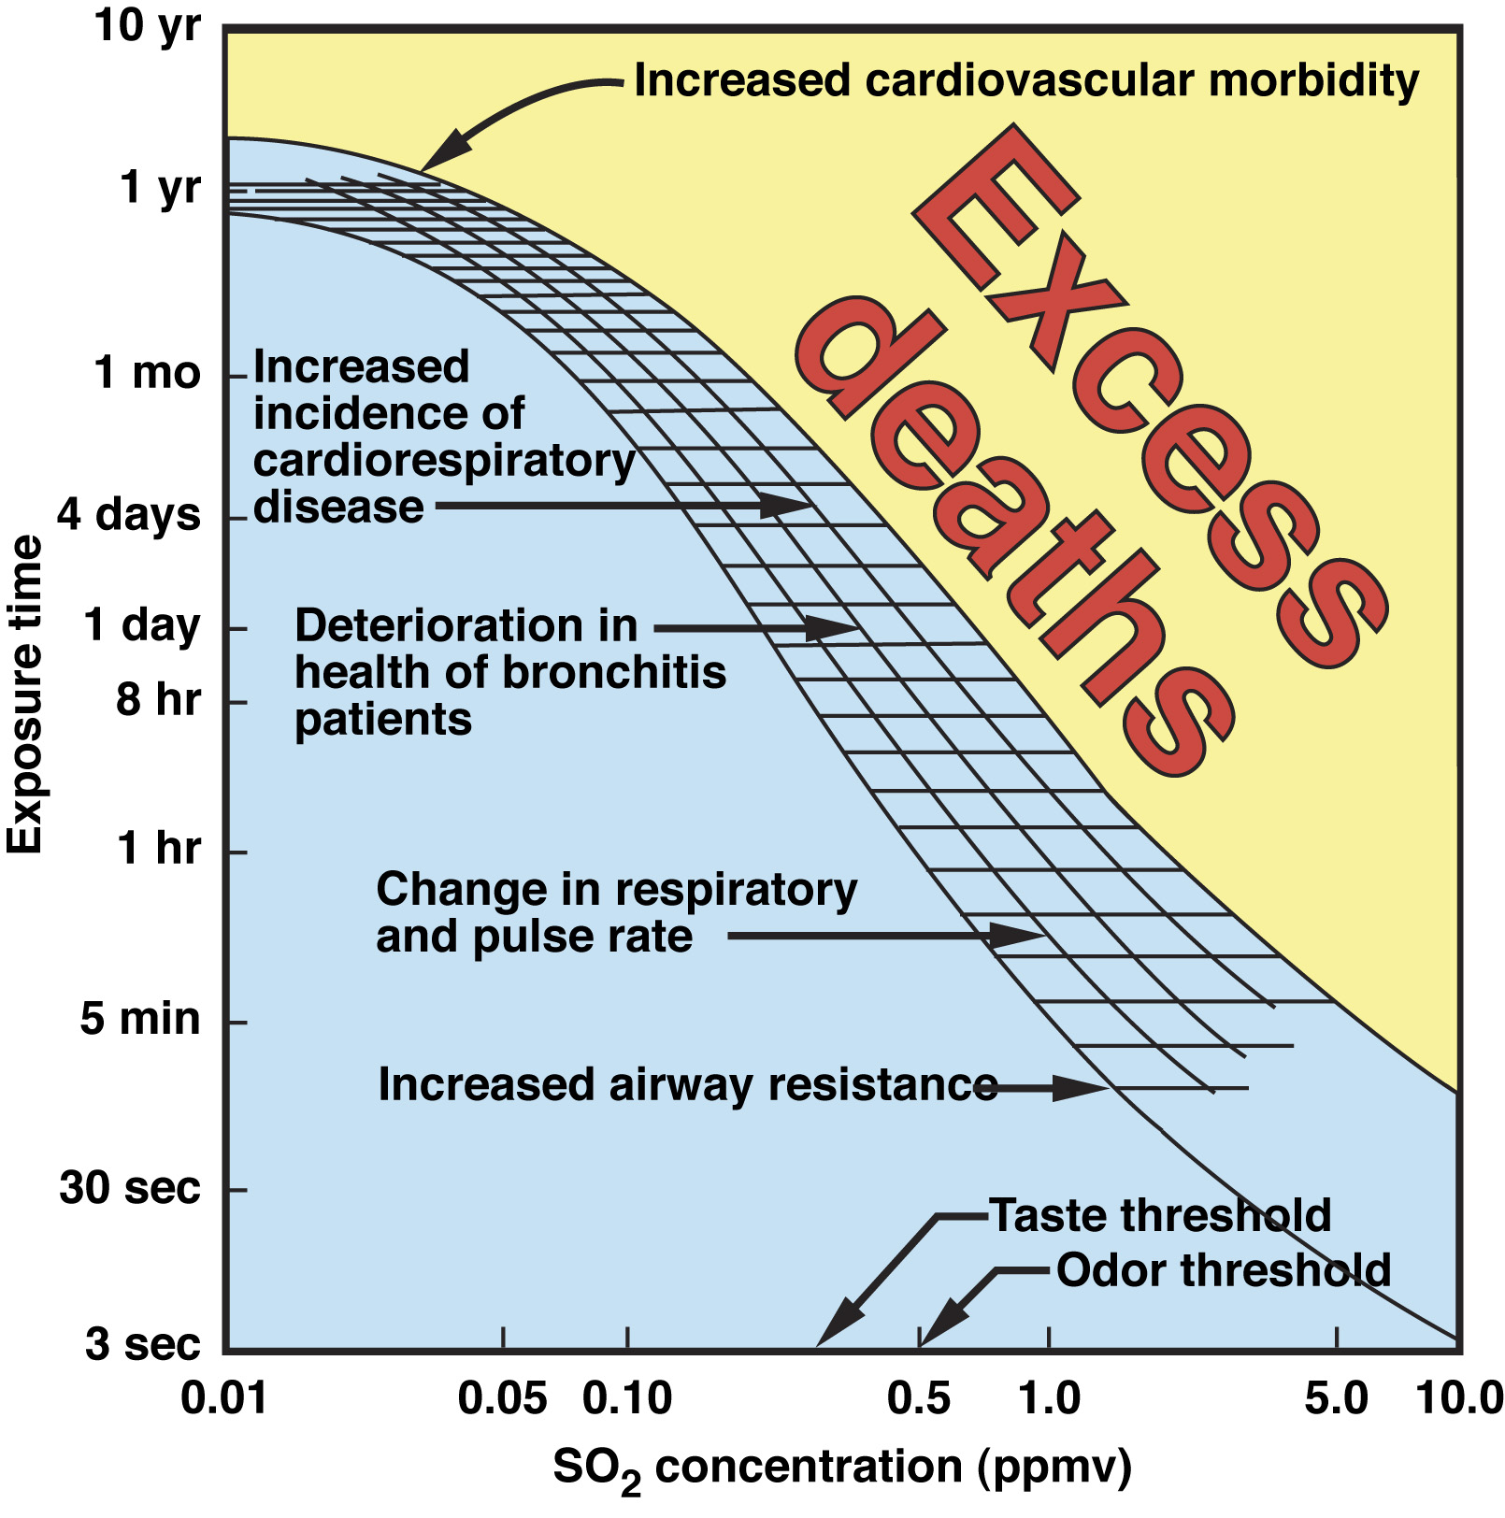
Illustration: Sulfur Dioxide (SO₂)
Mortality
Adverse Health Effects
No Adverse Health Effects
Note: 1 ppm = 1000 ppb
Notes:
In terms of levels of concern for health effects, recall the slide shown in Lecture 4 for the health effects of SO2 depending on exposure concentration and duration. We can now superimpose the ambient air standards for SO2 on this plot to get an idea for the rationale behind them.

Slide 21
Illustration: Sulfur Dioxide (SO₂) 1-hour NAAQS plotted.
1-hour exposure at 75 ppb SO2 (= 0.075 ppm) (NAAQS 1-hour std.)
1-hour exposure at 250 ppb SO2 (= 0.25 ppm) (CA 1-hour std.)
Note: 1 ppm = 1000 ppb
Notes:
Here we roughly estimate the location on this plot of the 1-hour SO2 NAAQS of 75 ppb.
Along the horizontal axis we pick off 75 ppb on the horizontal axis, which equals 0.075 ppm. Along the vertical axis we pick off a 1-hour exposure duration.
We see the location of this point is within the blue part of the graphic. This is in the “no-effects” portion of the graphic, with abundant margin away from the point of higher concentration along the horizontal axis where short-term health effects, associated with 1-hour exposure, begin to occur at around 0.5 ppm. This highlights that the ambient air standards are low enough in concentration to be very protective, aimed at sensitive populations, and designed with adequate margin away from higher concentration levels where health effects may more readily occur among populations.
Note that this can also be concluded using the higher, more lenient California 1-hour SO2 standard of 250 ppb. As seen, this data point is also well within the blue portion of the plot.

Slide 22
Illustration: Sulfur Dioxide (SO₂)
24-hour exposure at 40 ppb SO2
Note: 1 ppm = 1000 ppb
Notes:
We can carry out the same exercise with the 24-hour California standard of 40 ppb.
Along the horizontal axis we pick off 40 ppb, which equals 0.04 ppm. Along the vertical axis we pick off a 24-hour exposure duration.
We see the location of this point is within the blue part of the graphic, within the no-effects” portion of the graphic, with abundant margin away from the point of higher concentration along the horizontal axis where health effects associated with 24-hour exposure begin to occur, beyond 0.1 ppm or 100 ppb.

Slide 23
Interpreting the standards: CO
California NAAQS
Ozone
1-hour average 90 ppbv --
8-hour average 70 ppbv 70 ppbv
CO
1-hour average 20 ppmv 35 ppmv
8-hour average 9 ppmv 9 ppmv
NO₂
1-hour average 180 ppbv 100 ppbv
annual average 30 ppbv 53 ppbv
SO₂
1-hour average 250 ppbv 75 ppbv
24-hour average 40 ppbv 140 ppbv
Notes:
We can carry out this exercise for another pollutant CO, using the graphic for this pollutant shown in Lecture 4. CO has a 1-hour NAAQS standard of 35 ppm and an 8-hour standard of 9 ppm.

Slide 24
Natural Background Concentrations in Air (Current-Day, remote areas … away from major air pollution sources)
Pollutant | Natural Background Concentrations | Source
Carbon Dioxide (CO₂) | 410 ppm | Mauna Loa (Hawaii) https://www.esrl.noaa.gov/gmd/ccgg/trends/
Carbon Monoxide (CO) | 50 – 120 ppb | http://www.euro.who.int/__data/assets/pdf_file/0020/123059/AQG2ndEd_5_5carbonmonoxide.PDF
Nitrogen Dioxide (NO₂) | 0.2 – 5 ppb | http://www.euro.who.int/__data/assets/pdf_file/0017/123083/AQG2ndEd_7_1nitrogendioxide.pdf
Sulfur Dioxide (SO₂) | < 1 ppb | http://www.temis.nl/products/so2.html
Notes:
We remind ourselves that the natural background of CO is generally around 100 ppb or less. The ambient air standards of 75 ppm for 1-hour and 40 ppm for 24 hour just mentioned are therefore much higher than natural background air. This is because the standards refer to concentration that would be experienced in urbanized, industrialized or otherwise populated areas – where anthropogenic sources would exist.

Slide 25
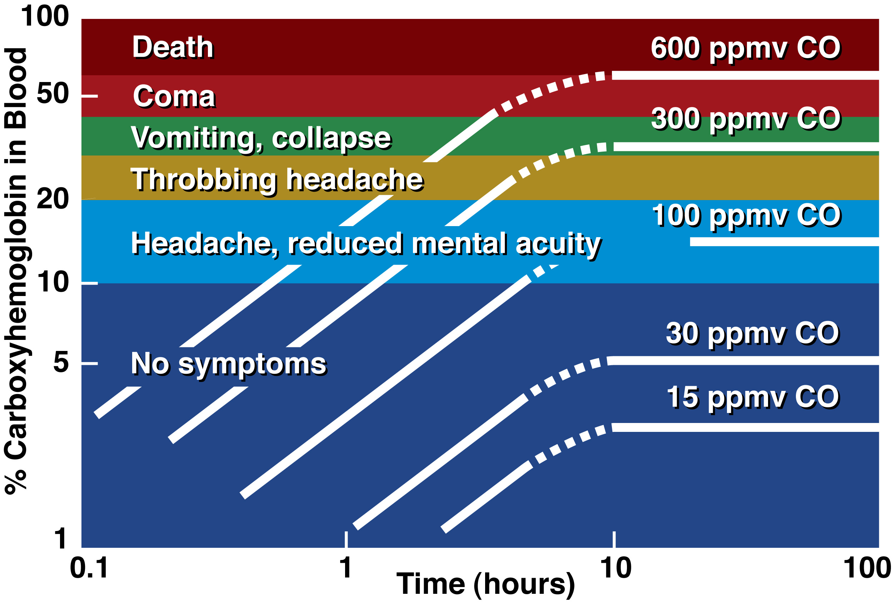
Illustration: Carbon Monoxide (CO), NAAQS standards plotted.
1-hour exposure at 35 ppm
8-hour exposure at 9 ppm.
Note: 1 ppm = 1000 ppb
Notes:
In terms of the health effects graphic for CO presented in Lecture 4, we plot points corresponding to the standards .. the 1-hour standard of 35 ppm, and the 8-hour standard of 9 ppm.
Plotting these two ambient air standards on this chart, we get the same message.
The standards are set well within the range of no symptoms with adequate margin from points of higher concentrations where health effects start to occur. Again, the ambient air standards are protective.

Slide 26
Outline
Air Pollution: Regulation
Historical Context
Clean Air Act 1970
Criteria Air Pollutants & Ambient Air Standards
Implementation & Air Quality Agencies
Successes & Current Challenges
Notes:
We now discuss implementation of these standards …

Slide 27
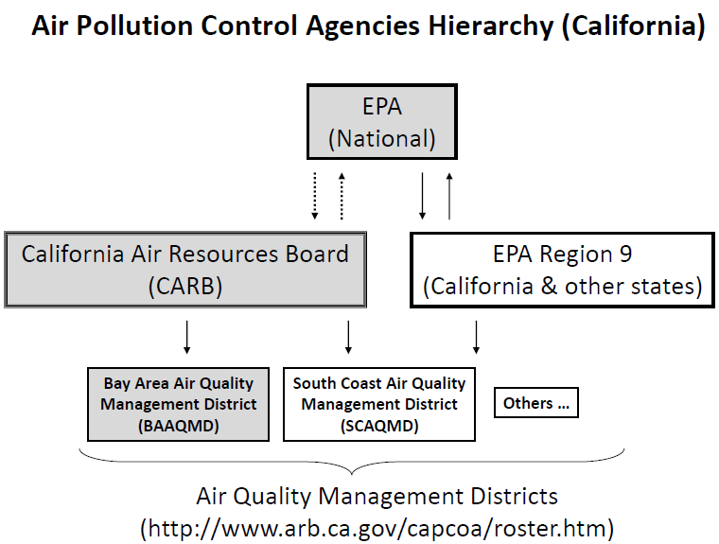
Notes:
A basic chart or the organization of the air quality agencies tasked with enforcing the Clean Air Act and other air pollution regulations is shown here.
It is the job of these agencies to manage air quality regulations across their jurisdictions.
Agencies are organized from EPA at the national level, to state agencies, to local agencies for regional metropolitan areas.
We particularly highlight EPA at the national level, the California Air Resources Board (CARB) at the state level for California, and various “air quality management districts” (AQMDs) at the local level in California, each tasked with regulating different areas of the task.
The “Bay Area Air Quality Management District” (BAAQMD) is the local AQMD for the Bay Area. The “South Coast Air Quality Management District” (SCAQMD) is the agency for the Los Angeles area.

Slide 28
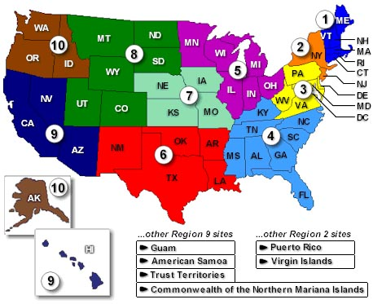
10 EPA Regions
Notes:
EPA is divided into various regions across the country. California is located within EPA Region 9.

Slide 29
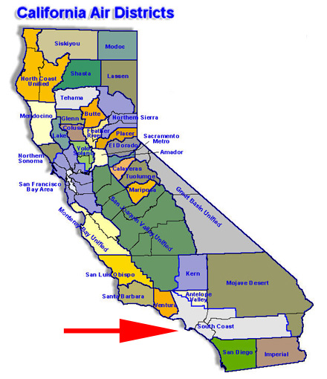
California’s 35 local Air Districts
Bay Area Air Quality
Management District
(BAAQMD)
(Bay Area Air Basin)
San Joaquin Valley Air Quality Management District
(South Central Valley)
South Coast Air Quality Management District
(SCAQMD)
(Los Angeles Air Basin)
Notes:
California has 35 local Air Districts.
Highlighted in are three major ones in California, where air quality can be especially poor from time to time:
Th BAAQMD for the SF Bay Area.
The SCAQMD for the Los Angeles ara.
And the SJAQMD for the southern San Joaquin Valley … which includes the cities of Bakersfield and Fresno among others.

Slide 30
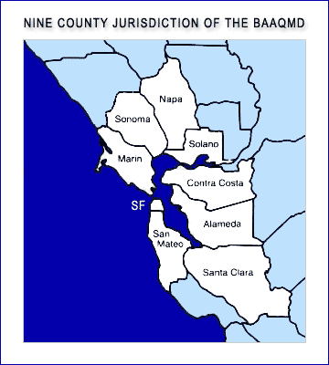
Bay Area Air Quality Management (BAAQMD) District
Notes:
The BAAQMD covers a nine-county jurisdiction, reaching as far south as Gilroy in Santa Clara County and as far north as San Rosa in Sonoma County.

Slide 31
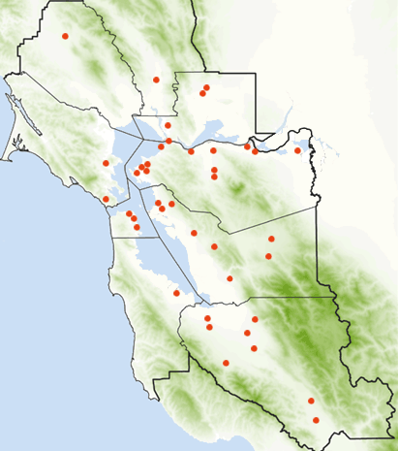
Bay Area Air Quality Management District
Air Pollution Monitoring Sites …
(https://www.baaqmd.gov/about-air-quality/air-quality-measurement/ambient-air-monitoring-network)
Compliance in the Bay
Area with NAAQS and
California state ambient
air pollution standards
are checked at these sites.
Notes:
To check measured concentrations of criteria air pollutants against ambient air quality standards, air districts set up monitoring stations around their jurisdiction. The point of these stations is to be located to sample ambient air, representative of what the broad population is exposed to. However, since ambient air concentration levels can vary across the air quality management district jurisdiction, multiple air quality monitoring stations are needed.
Seen here by the red dots on this map are the stations operated by the BAAQMD. There are many monitoring sites around the Bay Area.

Slide 32
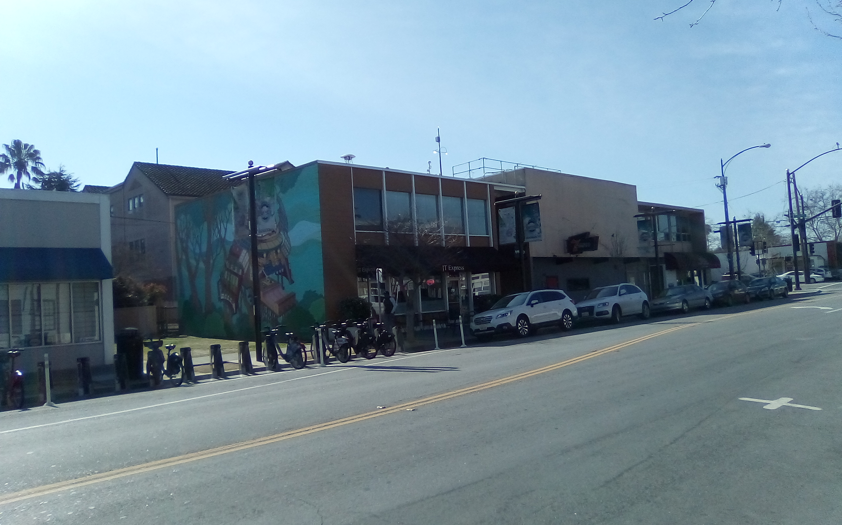
San Jose: 4th and Jackson St.
(BAAQMD Air Pollution Monitoring Site)
Air Quality monitoring equipment
Intersection
4th and Jackson
Jackson St,
Notes:
The local air quality monitoring station in San Jose is at 4th and Jackson St., in Japantown … close to SJSU.
A photograph from street level looking up at the station is shown here. Jackson St. is in the foreground and its intersection with 4th St. in the background on the right side of the photograph.
Atop the buildings you can see various monitoring equipment that sample concentrations of criteria air pollutants among others of interest. These measurements are taken hourly and checked to see if standards are met.

Slide 33
Outline
Air Pollution: Regulation
Historical Context
Clean Air Act 1970
Criteria Air Pollutants & Ambient Air Standards
Implementation & Air Quality Agencies
Successes & Current Challenges
Notes:
We turn now to the successes and current challenges of the ambient air quality regulations. We will examine certain criteria air pollutants individually.

Slide 34
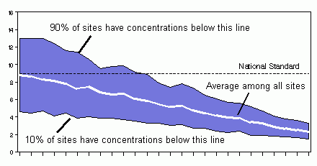
Improvements in U.S. Air Quality since EPA Clean Air Act Regulations (Example: 8-Hour Average Carbon Monoxide Concentration)
Concentration (ppm)
1980
1990
2000
2005
Notes:
We start with carbon monoxide, among the outdoor air pollutants highly associated with automobile emissions.
Specifically we look here at the annual trend of the 8-hour average carbon monoxide concentration across sites in the U.S.. The vertical axis is concentration in ppm, the horizontal is year from 1980 to 2005, with each tick mark a single year. The white line tracks the average 8-hour CO concentration over all monitoring sites across the country, while the upper and lower bounds of the blue shading are 90th and 10th percentile of the 8-hour CO concentrations across these sites. The black dashed line is the 8-hour NAAQS standard of 9 ppm.
Carbon monoxide was among the early success stories of the Clean Air Act. From the plot, it can be seen that by 1980, half the sites had 8-hr CO concentrations lower than the standard. By 1990 and after, nearly all sites had met the standard. Today urban ambient air CO concentrations across the country are practically always less than the ambient air standards. As mentioned earlier, however this is not to imply that CO is not something to still pay attention to … especially pertaining to indoor air pollution.

Slide 35
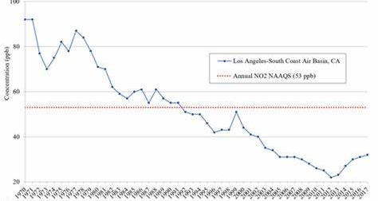
Improvements in U.S. Air Quality since EPA Clean Air Act Regulations (Example: Annual Average Nitrogen Dioxide Concentration, Los Angeles Basin)
Notes:
Another traffic related pollutant is NO2. This plot shows the trend over 1970 to 2017 of the highest annual average NO2 concentrations among monitoring sites in the Los Angeles Basin.
The vertical axis is NO2 concentration in ppb, the horizontal is year from 1970 to 2017.
The red dashed line is the annual NO2 NAAQS standard of 53 ppb.
From the plot, it can be seen that by the early 1990s, annual NO2 standards at the site with highest concentration in the LA Basin became lower than the standard. Since this is a plot of the maximum annual NO2 concentration among all stations, all stations in the LA Basin had therefore complied with the annual NO2 NAAQS by the early 1990s. The South Coast Air Basin (which includes LA and surrounding areas) therefore went from “non-attainment” to “attainment” status for annual NO2 in the early 1990s, and remains so today.

Slide 36
Catalytic Converter
Technology in response to Clean Air Act regulations
Standard equipment on all gasoline powered automobiles since mid-1970s
Reduces CO, NOx and hydrocarbon air pollutants
Notes:
A main reason for the success in reducing ambient air CO and NOx concentrations subsequent to the introduction of the Clean Air Act was the advent of the catalytic converter. This is a device, shown here on the graphic, through which automobile exhaust passes after leaving the engine block and before leaving the tailpipe. The impetus to developing the catalytic converter was the Clean Air Act, which necessitated a means for the auto industry to reduce air pollution emissions to comply with the regulation.
The catalytic converter is now standard equipment on all gasoline powered automobiles since the 1970s. The passage of the exhaust through the device reduces tailpipe emissions of carbon monoxide, nitrogen oxides and other hydrocarbon air pollutants.

Slide 37
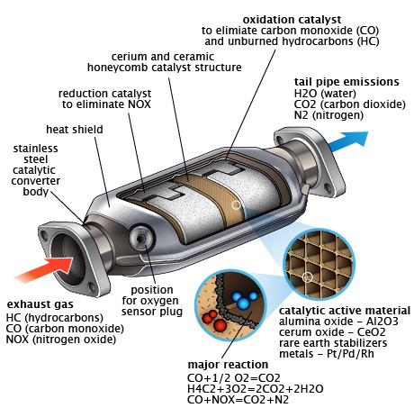
H2O, CO2, N2 out …
CO, NOx, HCs in …
http://www.dwrefining.com/wp-content/uploads/2013/02/Catalytic_Converter.jpg
Notes:
The catalytic converter works as follows:
On the left of the diagram is an indication of the inflow of exhaust from the combustion chamber. On the right is the outflow of the cleaned exhaust air.
The combustion gases are rich in carbon monoxide, hydrocarbon gases and NOx. Inside the device is a honeycomb mesh of rare various rare metals such as palladium, rhodium and more standard metals such as aluminum. This exhaust flows through this metal mesh within the device. The metal mesh then acts to catalyze (or speed up) chemical reactions that convert much of the carbon monoxide in the exhaust gas to carbon dioxide, which is not harmful if inhaled, and much of the NOX to molecule nitrogen N2, which also is unharmful if breathed. Hydrogen in the hydrocarbon gases comes out as water vapor. As a result, much of the harmful air pollutant gases get transferred to non health harming gases upon exhaust from the tailpipe.
The catalytic converter is an example of how technology evolved in response to the clean air act to improve air quality. Similar examples of technologies exist for other pollutants, which are not discussed here.

Slide 38
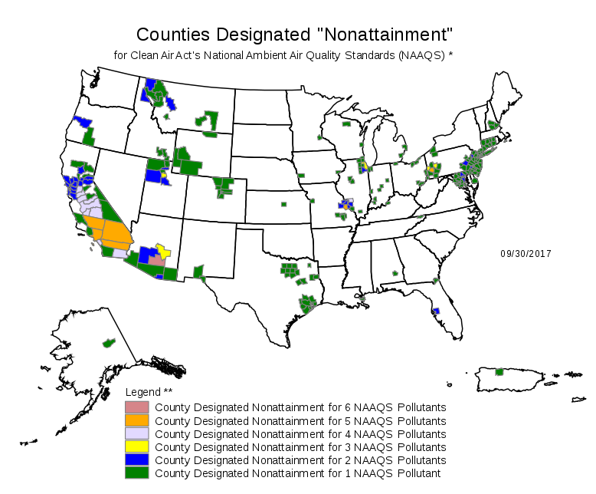
https://en.wikipedia.org/wiki/National_Ambient_Air_Quality_Standards
Notes:
While there has been much improvement with respect to many pollutants, particularly CO and NOx, there are still challenges going forward.
This chart shows the current attainment status of air district across the country, color coded according to how many of the NAAQS pollutants non-attainment status is for. As seen, there are still several districts that have non-attainment status. California in particular can be seen to still be in non-attainment across much of the state.

Slide 39
annual
standard
Current non-attainment areas for ozone (O3) and annual PM2.5 in California
Notes:
Focusing in on California, we point out here more clearly the areas of the state and pollutants that are in non-attainment.
The left plot shows the attainment status with respect to the 8-hour ozone standard. These range from marginal to extreme non-attainment. The LA and Southern San Joaquin valleys are the areas of extreme non-attainment. Recall that ozone is a major part of photochemical smog, which we presented a slide on in connection to LA earlier in this lecture. There has been much improvement in controlling ozone levels over the years, but as seen here ozone levels on bad air pollution days continue to exceed ambient air standards across much of the state.
On the right, we see the other main pollutant for which non-attainment exists: PM2.5 … which as we recall refers to particulate matter less than 2.5 micrometers in diameter. This is very small size particles, from smoke and other sources, that can pass deeply into lungs and affect health. Again, LA and the southern San Joaquin valley are the areas of non-attainment. The chart on the right refers to the annual PM2.5 standard. Other areas of the state are in non-attainment for the 24-hour PM2.5 standard.
The situation in California is as in much of the rest of the U.S. … the main pollutants for which non-attainment still exists are ozone and PM2.5
The next course module will focus on these two pollutants to learn more about why these pollutants are especially challenging to control, and current efforts in place to improve air quality and reach attainment with respect to ozone and PM2.5

Slide 40
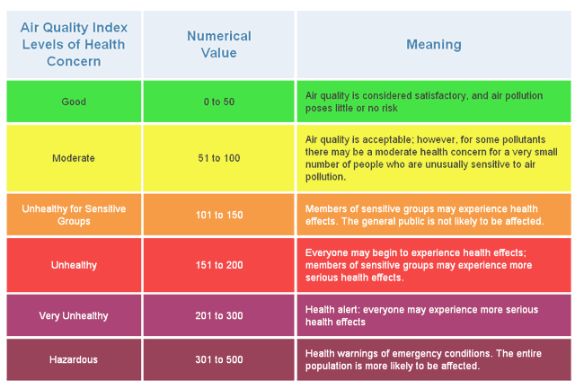
Air Quality Index (AQI)
(Common Way Air Quality Communicated to Public)
(Value of 100 set to divide “unhealthy” from “clean” air)

