Slide 1
METR/ENVS 113 Lecture 6: Air Pollution Emissions
SJSU Fall Semester 2020
Module 2: Outdoor Air Pollution
Frank R. Freedman (Course Instructor)
Notes:
Hello, this is METR113 Lecture 6, Air Pollution Emissions. This is the third lecture of Course Module 2 – Outdoor Air Pollution

Slide 2
Outline
Air Pollution Emissions: Basic Concepts
Definitions
Emissions → Concentrations → Impacts
Air Pollution Emissions: Sources & Processes
Stationary vs. Mobile
Combustion: Major Anthropogenic Emission Process
Others: Fugitive, Evaporative, Dust, Wildfires, etc …
Notes:
The outline of this lecture is as follows.
We will first cover the basic concepts of air pollution emissions. We will distinguish between the emissions from the pollution sources, the air concentrations at specific locations, or receptors, resulting from these emissions as they blow downwind and are subjected to various atmospheric processes along the way, and the assessment of health or regulatory impacts based on these resulting concentration levels.
We will then cover some basic source classifications and processes of air pollution emissions.

Slide 3
Air Pollution Emissions (Basic Concepts)
Notes:
Air Pollution Emissions – Basic Concepts

Slide 4
Air Pollution Emissions
Emissions: The amount of pollutant coming from a pollution source over some time.
Annual emissions: tons per year, pounds per year, etc …
Other ways: pounds per day, kilograms per day, grams per second, milligrams per second.
Emissions per unit area per time: mg per square km per day, tons per acre per year
Care must be taken to understand what a reported emission number means (read the footnotes and other “fine print”).
Notes:
Air pollution emissions are the amount of pollutant coming from a pollution source over some amount of time. That is, it is a rate at which pollution comes from a source.
The key points of this are that emissions come from specific sources, for example the smokestack of a factory, or the tailpipe of an automobiles. As a rate, emissions are expressed as amount of an air pollution compound per time, for example tons of SO2 per year from a smokestack, or pounds per day of NOx from a tailpipe.
Sometimes this will be expressed as amount per area per time, for example mg of hydrocarbon vapors per square kilometer per day. In this example, if we are referring the gas stations across a city, the emissions quantify the mg of hydrocarbon vapors due to all filling stations over a square km per day. Emissions expressed in this manner, per area, generally represent the rate of estimated emissions aggregated over all emission sources over the area.
The meaning of a given emission number often is detailed, so one needs to pay special care when interpreting an emission number, reviewing any definitions, footnotes or other fine print provided.

Slide 5
Air Pollution Concentrations
Concentration: The amount of pollution per amount of air.
Parts per Million (ppm), Parts per Billion (ppb)
# of molecules of pollutant compound per million (billion) molecules of air
Example - 40 ppbv of O₃: “ for every billion molecules of dry air, 40 of them are ozone molecules
Applicable to gases
Mass concentrations
mass of pollutant gas or particles per volume of air
Example - 150 μg/m³ of airborne dust = “150 micrograms of dust per cubic meter of air”
Applicable to both gases and particulates
Notes:
Air pollution concentrations, instead, represent the amount of pollutant compound per amount overall air.
There are two main ways air pollution concentrations are typically expressed.
The first, which we have presented throughout preceding lectures, is parts-per-million or parts-per-billion. This is the number of molecules of a pollutant per million – if ppm – or billion – if ppb – molecules of air. For example, 40 ppb of ozone (O3) indicates that there are 40 molecules of ozone per billion molecules of air. Expressing air pollution as ppm or ppb is applicable only for gaseous air pollutants.
The other main way is as mass concentration. This is the mass of the pollutant compound per volume of air. For example, 150 micrograms per cubic meter of airborne dust indicates that there are 150 micrograms of dust within a cubic meter of air at the location in question. . Whereas ppm or ppb are applicable only for gases, expressing air pollution as mass per volume, for example micrograms per cubic meter, is applicable for both gaseous and particulate air pollution.

Slide 6
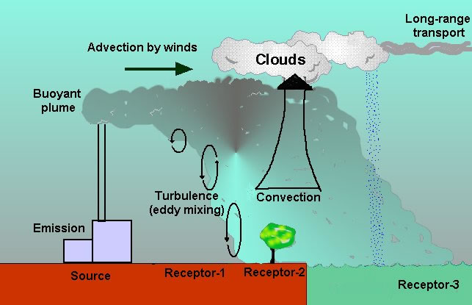
Depiction: Emissions → Concentrations
(Example, pollution emitted from a smokestack)
Wind transport
emissions
Precipitation
(washout)
chemical reactions
Various processes that determine concentrations and location and time of impact
emission source
ground-level concentrations at particular locations (“receptors”)
Notes:
This slide attempts to make more clear the distinction between emissions and concentration. As well, other related points can be made.
The slide shows an example of air pollution emitted from a smokestack. The smokestack is indicated on the left part of the diagram. Emissions from the stack are indicated. This highlights that emissions are always from some source. In this case, we may imagine the arrow coming from the smokestack representing a certain rate that pollution is coming from the stack … for example a certain amount of pounds of SO2 gas per day.
Once emitted, the pollution then moves with the wind, disperses and can be subjected to various other atmospheric processes. This results in a certain concentration level of the pollutant depending on time and location. In air pollution jargon, the locations where pollution is measured or is otherwise of interest for health concerns, for example a school or other public place, are called “receptors”. This image indicates three receptors. The concentrations of pollutant is generally different across receptors, and depend on the specifics of how the pollution was emitted and the processes these emissions were subjected to as they traveled downwind.
The rest of the graphic illustrates the collection of processes that affect pollution once emitted, and therefore determine the precise concentration at various receptors. These processes include transport from the wind, dispersion in the air due to turbulence gusts, eddies, updrafts and downdrafts, chemical reactions that react the pollutant emitted into other species, absorption of pollutant into cloud water and later washout by precipitation, and further downwind transport to far locations from the wind. Because these processes are all occurring simultaneously, and some more important than others for a particular situation, the concentrations resulting from a given emissions can depend strongly on meteorological conditions and other factors. Professionals in the field develop expertise and sophisticated methods of taking these effects into account when understanding and regulating air pollution.

Slide 7
Addressing Air Pollution Problems: Three Steps
(Emissions -> Concentrations –> Impact Assessment)
1
2
3
determine emissions
determine concentrations
determine impacts
Determine emissions from source(s).
Determine concentrations at locations of interest resulting from emissions from source.
Determine impact at locations of interest by comparing concentrations to some relevant standard, threshold or level of concern.
Notes:
In addressing air pollution problems, for example taking steps for an air district to come into compliance with regulations, or better understanding sources causing population exposure, air pollution professionals generally keep in mind these three steps as a sequential process.
First, emissions come from the source.
Second, concentrations are determined as a result of these emissions.
Third, the health or regulatory impacts of these concentrations are assessed.
This graphic aims to emphasize this “forward in time” approach. The air pollution profession is generally divided into categories of individuals, sub-agencies or branches that have expertise in either of these three divisions.

Slide 8
Air Pollution Emissions (Sources & Processes)
Notes:
Air Pollution Emissions – Sources & Processes

Slide 9
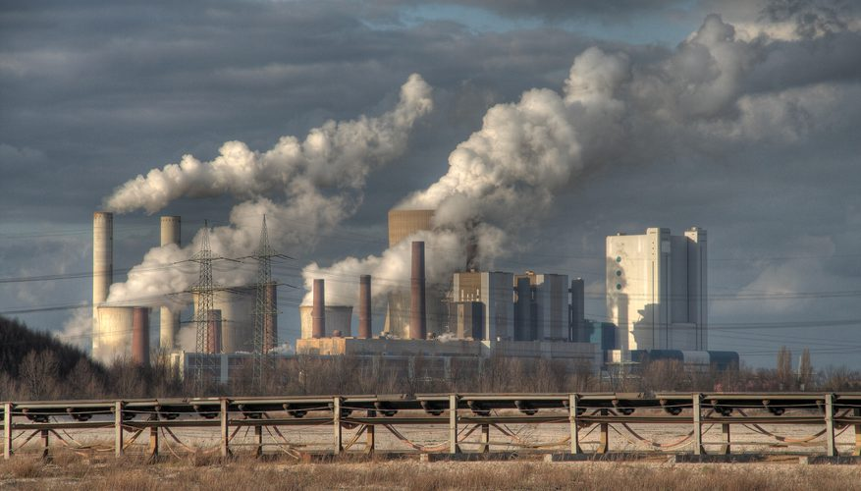
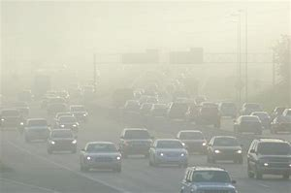
Emission Source Categories: “Stationary” versus “Mobile”
Stationary Source: Fixed in Space
Major stationary sources are large factories, refineries, industrial facilities
Mobile Source: Moving in Space
Usually refers to motor vehicles (cars, trucks, routine traffic)
A large stationary source
mobile source
Notes:
Emission sources are commonly divided into two classes: Stationary and Mobile.
As the name implies, stationary sources are those that are fixed in space. The graphic on the left shows a large, stationary sources – a large industrial factory. Within this source, there are several individual sources – or emission units. The emission units comprise each point within the facility where air pollution is emitted. For example, the individual smokestacks in the picture on the left are emission units.
Mobile sources are those moving in space – which generally refer to traffic related sources such as cars, trucks, trains, buses, etc … The graphic on the right shows this.

Slide 10
Emission Processes (Several others … here just a sampling of common processes)
Combustion
Fugitive
Evaporative
Dust
Wildfires
Notes:
We now cover some individual emission processes, which are classifications for ways by which air pollution is formed and released at the source. A listing of those we will cover in this lecture are seen below. Combustion is the most important, common way air pollution is formed anthropogenically, and therefore we will cover this in more depth. The others we will cover more briefly.

Slide 11
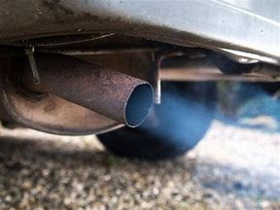
Combustion
Automobile tailpipe emissions.
An example of a “mobile source”.
Combustion of gasoline and diesel fuel
A major industrial facility.
An example of a “stationary source”.
Many industrial boilers, ovens, engines …
Fired by combustion of hydrocarbon fuel stocks.
Notes:
We first cover combustion. This is the technical term for burning something.
In most instances this specifically means burning a hydrocarbon substance. These substances are used as fuel for some purpose.
This image shows common combustion air pollution sources:
Major factories fire their equipment with a large variety of hydrocarbon fuel sources: coal, petroleum based liquid fuels such as diesel fuel, coke – a derivative from crude oil, and others.
Mobile sources combust gasoline or diesel in internal combustion engines.

Slide 12
“Combustion” is burning something …
For example …
Burning gasoline in automobiles
Burning diesel in trucks
Burning jet fuel in airplanes
Burning coal in power plants
Burning natural gas (methane, CH₄) in power plants and residences.
Burning wood in homes and controlled burns.
Burning crops and other biomass for agriculture.
Burning residual oil (bunker fuel) to power ships
Burning coke in a refinery.
Underlined “fuels” above are all carbon-based fuels (hydrocarbon fuels). All except wood & biomass are fossil fuels … derived from crude oil or natural gas extracted from earth.
Notes:
We provide further details on this slide.
A listing of common hydrocarbon fuels are shown in the first bullet. These include gasoline and diesel motor vehicle fuels, jet fuel for planes, coal for power plants, natural gas (which is primarily methane) for industrial and residential use, and wood for home heating. Other less known exams are crop burning for agricultural purposes, burning residual oil in ships, and coke in industrial facilities and refineries.
As mentioned, these are all examples of hydrocarbon fuels. A hydrocarbon is some molecule comprised of both carbon and hydrogen. All of the above except wood and biomass are “fossil fuels” … derived from crude oil or natural gas extracted deep underground the earth. The term “fossil” is because these raw fuel sources underground are formed from organic matter from the distant past – millions of years ago – that has been degraded, broken down and subjected to high pressures from the overlying earth above over the passage of time to today. In this sense, they are “fossil” based.

Slide 13
Emissions from Combustion (1)
ENERGY +
CO₂, H₂O, CO, NO_{x}, SO₂,
unburned hydrocarbon gases (“vapors”) and particulates (“smoke”) +
Excess Air
Air + Fuel +
High Temperature
Combustion
Basic Chemical Reaction
main products
other products
C_{m}H_{n} + N₂ + O₂ → CO₂ + H₂O + other products (CO, SO₂, NO_{x}, Particulates, etc …)
+ (N₂ + O₂)
Fuel
excess air
Air
Products
Notes:
So how do air pollution emissions form from combustion? The next two slides will cover this.
This slide shows the basic chemistry of combustion, with reactants and products.
The one on top shows a basic schematic, while the one on bottom is more detailed.
Looking at the top, the basic idea is that air and fuel, when subjected to sufficiently high temperatures – around a few thousand degrees Fahrenheit or more – chemically reacts, and as a result releases heat energy and several other chemical compounds as by products. The energy released from combustion sustains the high temperatures required to maintain combustion provided a steady supply of fuel exists.
Air pollution is among the list of products of the basic chemical reaction of combustion. Spanning this list, we see carbon dioxide (CO2), water vapor, and several of the species that we have identified in this class as common air pollutants. Finally, some air is released that is not consumed in the combustion process.
The bottom, more detailed, depiction of the chemical reaction makes this more clear.
We indicate a hydrocarbon fuel by a basic, generic chemical compound CmHn, where m and n can be any number unique to the particular hydrocarbon fuel. For example, if m = 1 and n = 4 we have C1H4 or CH4 … which is methane. We then denote air by its two main constituents O2 and N2.
We then denote the products of combustion into two classes …
The main products are carbon dioxide (CO2) and water vapor (H2O). These comprise the main products that are created from the carbon, hydrogen, and much of the oxygen in the original hydrocarbon fuel molecules and air. However, due to the variability and particular characteristics of the combustion process at any given instance or situation, other products can be formed in lesser amounts. These include our common air pollutants carbon monoxide, sulfur dioxide, nitrogen oxides, smoke particulate, unburned hydrocarbons from the original fuel and others. Also the portion of air that is not fully consumed in the combustion process is passed out as N2 and O2.

Slide 14
Emissions from Combustion (2)
Complete Combustion: All carbon and hydrogen in fuel and oxygen in air is reacted to carbon dioxide (CO₂) and water vapor (H₂O). Requires a 14.7 to 1 ratio of air to fuel (“stoichiometric ratio”).
Incomplete Combustion: Some carbon/hydrogen/oxygen goes to other products (carbon monoxide, various “unburned” hydrocarbon gases, smoke particles, etc …). Fuel-rich conditions are ratios less than 14.7 to 1. Fuel-lean conditions are ratios greater than 14.7 to 1.
Carbon based air pollutants (CO, smoke, unburned HCs) tend to favor fuel-rich conditions.
A small portion of the nitrogen in air is converted to nitrogen oxides (NO_{x} = NO + NO₂). Tends to favor fuel-lean conditions.
Sulfur in fuel is mainly converted to sulfur dioxide (SO₂). Mostly associated with coal since coal has high sulfur content.
Notes:
This slide provides further explanation. We saw in the previous slide that combustion of a hydrocarbon fuel results in various chemical products of reaction which depend on the characteristics of the combustion process. We can distinguish situations further by looking at complete versus incomplete combustion.
Complete combustion is a theoretical condition in which all of the carbon in the hydrocarbon fuel is converted to CO2 and all of the hydrogen in the fuel to water vapor (H2O). As a result, since all of the carbon is in CO2, no other carbon byproducts would be produced … specifically there would be no carbon monoxide (CO), no smoke, and no unburned hydrocarbons. For most fuels, complete combustion requires a ratio for the mass of air to the mass of fuel equal to around 14.7 … that is, by mass, there is 14.7 more air than fuel in the combustion chamber. This is called the “stoichiometric ratio”.
Incomplete combustion is when combustion takes place in conditions other than stoichiometric, which is generally the case since it is almost always impossible in practice to maintain the stoichiometric ratio at all times during combustion.
Fuel rich conditions are those when the ratio is less than 14.7 (stoichiometric) and therefore there is more fuel relative to air than that for stoichiometric combustion. Fuel lean conditions are those when the ratio is greater than 14.7, and therefore there is more air relative to fuel than that for stoichiometric combustion.
In fuel-rich conditions, since there is excess fuel, there tends to be other carbon products besides CO2 produced, specifically CO, smoke and unburned hydrocarbons.
In fuel-lean conditions, there is more excess air and generally higher combustion temperatures, which tends to favor higher NOx production and little if any CO, smoke or unburned hydrocarbons.
Finally, any sulfur in the fuel will generally be reacted to sulfur dioxide (SO2) regardless of air-fuel conditions. Coal is the hydrocarbon fuel most associated with high sulfur content, and therefore most associated with SO2 emissions as we have said in previous lectures. Some diesel fuels also contain high sulfur, and in fact California has regulations to require low-sulfur diesel fuels in trucks registered in the state.

Slide 15
Clean Air vs. Combustion Gas
Clean Air
Nitrogen (75%)
Oxygen (20%)
Water Vapor (1 – 4%)
Carbon Dioxide (0.04%)
Combustion Gas (Exhaust Gas - released to air after combustion)
Nitrogen (70%)
Oxygen (0-6%)
Water Vapor (~ 10%)
Carbon Dioxide (10 – 15%)
Other products (trace amounts): CO, SO₂, NO_{x}, Particulates, unburned HC gases.
Notes:
From these points, we can look at a very basic, general comparison between the composition of clean air versus the composition of the exhaust combustion gas directly exiting a combustion source.
Clean air is mainly comprised of nitrogen, oxygen and water vapor. We also indicate the small percentage of carbon dioxide (around 400 ppm).
Exhaust combustion gas, on the other hand, has a different breakdown. We present here a typical breakdown. The main thing to note is the reduction in oxygen levels, completely to zero if combustion is complete and all oxygen is consumed, an increase in carbon dioxide, which is the main product of the combustion reaction burning the carbon-based fuel. Water vapor percentages also rise since water vapor is natural product of combustion as well.
Finally, we note the trace percentages of the various by products of combustion associated with air pollution – CO, NOx, SO2, Particulates, unburned HCs, etc …
Again, this is a very basic breakdown. A specific breakdown depends very much on the specifics of the combustion process, fuel burned and other factors.
Much air pollution regulatory effort is aimed at developing technologies that manage the combustion process and conditions in ways to minimize the amount of these trace air pollution species emitted.

Slide 16
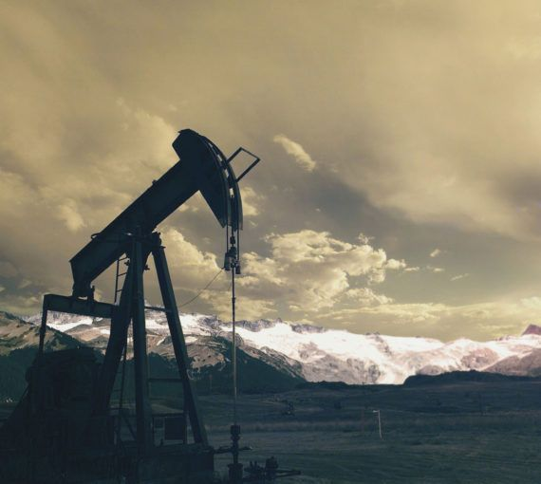
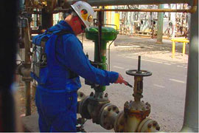
Fugitive
Oil extraction facility
Gases escape to air during processing.
An example of “fugitive” emissions.
An industrial facility
Gases escape to air during operations.
Another example of fugitive emissions.
Notes:
We now turn to other emission processes, which we will cover in less detail.
One of these is “fugitive” emissions.
These collectively comprise any process by which pollutants get emitted to the atmosphere as a result of escapes through equipment. These could be leaky valves, vents, pipelines or any other of a multitude of equipment within facilities. Fugitive emissions generally refer to gases, however fugitive dust particulate can also occur … for example escapes of particulate matter during excavation, mining or construction.
Shown on this slide are some photos of common fugitive emission sources. Oil extraction, indicated by the left photo, is a common source of fugitive gas emissions, and much recent attention due to air pollution concerns is paid to communities living near oil extraction facilities. There is also considerable attention paid to fugitive methane releases from oil extraction facilities for climate change concerns, since methane is a strong greenhouse gas.
The photos on the right depict some common ways fugitive emissions occur due to the flow of materials through industrial facilities.

Slide 17
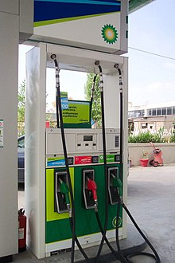
Evaporative
Gasoline is very evaporative (“volatile”)
Organic hydrocarbon gasoline vapors readily escape to atmosphere.
A major source of “volatile organic compounds” (VOCs)
An industrial facility
Gases escape to air during operations.
Another example of fugitive emissions.
Notes:
Evaporative emissions are similar to fugitive emissions, but particularly centered on vaporization of liquid hydrocarbon and other compounds exposed to air.
Another, more technical, term for evaporation is “volatization”.
The class of air pollutants called Volatile Organic Compounds (VOCs) are a subset of hydrocarbon compounds especially prone to release to the atmosphere through evaporative emissions. Any industrial facility dealing with liquified chemicals, generally hydrocarbon, are possible sources of evaporative emissions and VOCs. The most readily identifiable example for students in this course may be a gas station, where filling of fuel results in some of the gasoline evaporating into the air. We can smell this … the familiar sweet, oily smell of gasoline.
Other examples familiar to students are paints and household chemicals.

Slide 18
Volatile Organic Compounds (VOCs)
Organic hydrocarbon* compounds with relatively low boiling points. (50-200 °C)
They readily evaporate into the air.
Gasoline and other hydrocarbon fuels
Indoor Sources: adhesives, solvents, building materials, paints, tobacco smoke, room deodorizers, cooking, carpets, cleaning agents, upholstery
“BTEX”: Benzene, Toluene, Ethene, Xylene
Others: formaldehyde, acetone (nail polish remover
Alcohols: ethanol, methanol
* A hydrocarbon is chemical compound containing hydrogen (H) and Carbon (C).
Notes:
This slide presents further details on VOCs – or volatile organic compounds.
We particularly note the BTEX compounds … benzene, toluene, ethene and xylene … which are carcinogens.
VOCs, as we will learn, also play an important role in the formation of photochemical smog. This will be covered in the next course module.

Slide 19
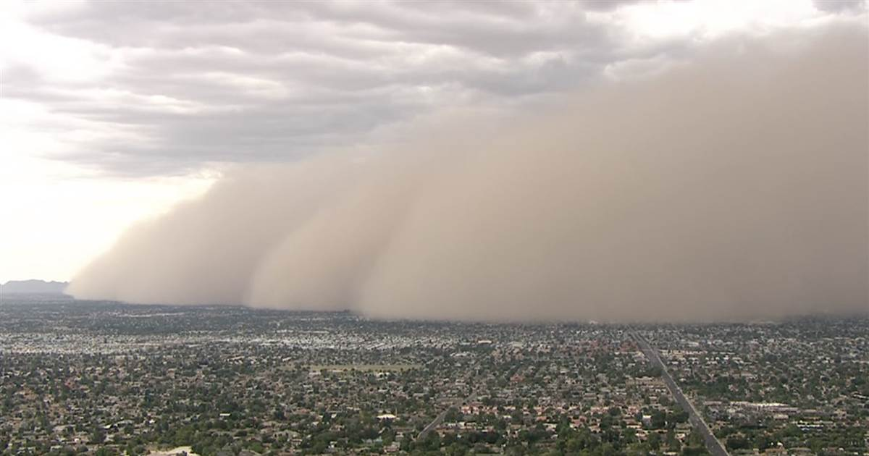
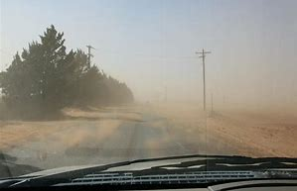
Dust
Construction / agricultural equipment.
Kicks up dust to air.
An example fugitive dust emissions.
A major “haboob” windblown dust event in Phoenix, AZ
Windblown dust
An increasingly important problem in U.S. Southwest
Requires sustained winds > 10 mph.
Many health problems associated w windblown dust.
Dust can reduce visibility as well
Notes:
Windblown and fugitive dust is another important air pollution process. The photographs show examples of this … the dust kicked up during construction activity in the upper left photograph … or by strong winds, which are seen in the other two photographs.
Fugitive dust poses health risks. If inhaled, it can cause breathing difficulties. Also, a fungus living in the soil called coccidioidomycosis, if inhaled, can cause a very serious long-term sickness called “valley fever”, which is growing in incidence in recent years in the southwestern U.S. and California. Inhalation of fugitive and windblown dust is thought to be among the main causes of valley fever.

Slide 20
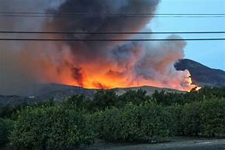
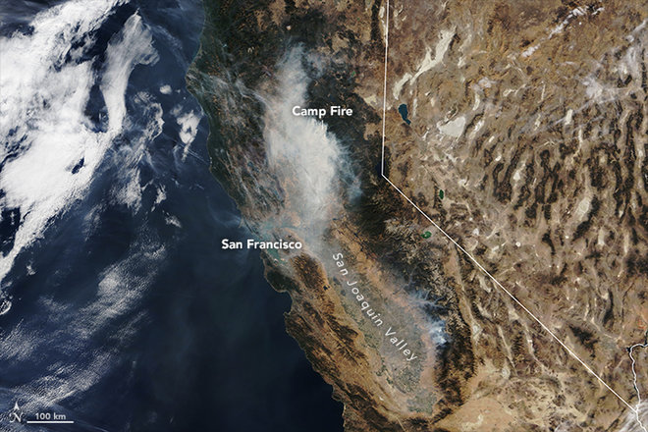
Wildfires
Satellite image of Camp Fire (Northern California, Nov 2018)
Wildfire smoke
Notes:
Finally, we note wildfires … which are becoming more and more serious and frequent as climate warms. This is a major natural combustion source, which produces many pollutants - the most important of which being smoke.
Being such large events that consume much biomass, the effects of wildfire smoke span large areas and affect many people. PM10 and PM2.5 levels during major wildfire events are generally many times higher than the ambient air standards for PM10 and PM2.5
The photograph on the left shows the black smoke associated with wildfires, and the photograph on the right is taken from space of the major Camp Fire wildfire of November 2018, which affected a wide area of Northern California for a couple weeks.

