Slide 1
METR/ENVS 113
Lecture 7: Air Pollution Meteorology
SJSU Fall Semester 2020
Module 3: Outdoor Air Pollution (Ozone and PM2.5)
Frank R. Freedman (Course Instructor)
Notes:
Hello, this is METR113 Lecture 7, Air Pollution Meteorology. This is the first lecture of Course Module 3 – Outdoor Air Pollution (Ozone and PM2.5)

Slide 2
Module 3: Outline
Air Pollution Meteorology (Lecture 7)
Outdoor Air Pollution – Ground Level Ozone (Lecture 8)
Outdoor Air Pollution – PM2.5 (Lecture 9)
Notes:
This course module will comprise three lectures. The two following this one will be on Ground Level Ozone and PM2.5 – one lecture for each pollutant. These two pollutants are those of most concern today in terms ambient air quality.
This lecture will be on air pollution meteorology – covering various meteorological factors that affect how high air pollution concentrations are once emitted from a source.
This will provide some background that will help understand ozone and PM2.5 pollution.

Slide 3
Lecture 7: Air Pollution Meteorology (Outline)
Air Pollution Meteorology: Processes & Variables
Focus Topic 1: Winds and Pressure Systems
Focus Topic 2: Temperature Inversions
Notes:
The outline of this lecture is as follows.
We will first cover basic processes that occur in air that affect air pollution processes, and the meteorological variables that these processes depend on.
We will then focus on two specific meteorological aspects.
The first is the effects of winds and pressure systems on air pollution concentrations.
The second is temperature inversions, a topic covered earlier in connection with the stratosphere. This time we will focus on temperature inversions that occur close to ground level, and therefore affect air pollution concentrations.

Slide 4
Air Pollution Meteorology
(Processes & Variables)
Notes:
Air Pollution Meteorology – Processes and Variables

Slide 5

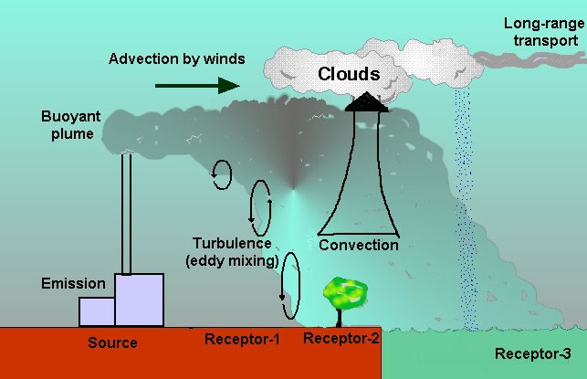
Processes that Affect Pollution Emitted from a Source
(Example, pollution emitted from a smokestack)
wind transport
chemical reactions
Precipitation
(washout)
Various processes that determine concentrations and location and time of impact
dilution / mixing
Notes:
We begin by reviewing a slide from a previous lecture, where the concepts of emissions from sources and concentrations at downwind receptors was introduced.
Once an air pollutant is emitted, the concentration that results downwind is determined by various processes.
The most obvious is the movement with the wind, the particular direction of transport depending on the wind direction. This is the most clear example of meteorological effects on air pollution.
Several other processes however are seen on the graphic, all of which dependent in some way on meteorological conditions.
Dilution and mixing within the cleaner surrounding air as pollution travels downwind occurs due to gustiness and turbulence within the air. The rate of dilution is dependent on wind speed and temperature – more specifically whether a temperature inversion is present.
Chemical reactions can occur that react emitted pollutants to other species. The rates of chemical reactions are dependent on meteorological factors such as temperature, humidity and cloud coverage.
Pollutants can also be cleansed from the air by absorption in precipitation.
Finally, some pollutants with long atmospheric lifetimes – that don’t chemically react or are absorbed in cloud or rainwater readily - can remain in the air long-terms and be transported by the winds great distance.

Slide 6
Processes & Meteorological Variables: Summary (1)
Wind Transport
  Air movement. Transports air pollution downwind away from emission source.
  Meteorological Variables: Wind Speed, Wind Direction, Pressure
Dilution / Mixing
  Caused by “turbulence” (wind gustiness) in the air
  Mixes polluted air with adjacent cleaner “unpolluted” air
  Pollution spreads out, covers greater area as mixing increases
  Peak air concentrations are reduced as mixing increases
  Meteorological Variables: Wind speed, temperature (day vs. night), temperature inversions, high versus low pressure systems
Notes:
The next three slides cover each of these processes, providing more details.
First, wind transport … *** read bullets ***

Slide 7
Processes & Meteorological Variables: Summary (2)
Chemical Reactions (gas phase)
  Reactions of an emitted species with others in the air
  Reduces concentrations of emitted species
  Can form new pollution species as products of chemical reactions (“secondary air pollutants”).
  Example air pollutants: Ground-level ozone, photochemical smog
  Meteorological Variables: Temperature and Sunlight
Chemical Reactions (aqueous phase)
  Reactions involving air species in presence of liquid water in air (haze, fog, clouds)
  Gaseous air pollutants dissolve and dissociate into ionic compounds in liquid water.
  Can form new pollution species as products of chemical reactions (“secondary air pollutants”).
  Example air pollutants: nitrate & sulfate PM2.5, acid fog, acid rain.
  Meteorological Variables: Humidity, cloud coverage, precipitation
Notes:
This slide covers chemical reactions, splitting the topic into gas and aqueous phase reactions.
*** read bullets ***

Slide 8
Processes & Meteorological Variables: Summary (3)
Atmospheric Removal (“Washout”, “Scavenging”, “Wet Deposition”)
  Removal of air pollutants from air due to absorption into precipitation (rain, snow, etc …)
  Affected pollutants: Particulate (PM2.5, PM10, etc …) and gases that are subject to aqueous phase chemistry (e.g. SO2, NO2).
  Meteorological Variables: Precipitation
Long Range Transport
  Movement long distances (100s of kilometers or more) with wind transport
  Affected pollutants (1): Relatively inert species, those that do not chemically react readily in air (gaseous or aqueous).
  Affected pollutants (2): Species that are emitted through depth of troposphere. Examples, wildfire smoke, volcanic eruptions.
  Meteorological Variables: Wind speed and wind direction throughout troposphere.
Notes:
*** read bullets ***

Slide 9
Air Pollution Meteorology
(Focus Topic 1: Winds and Pressure Systems)
Notes:
Air Pollution Meteorology: Focus Topic 1 – Winds and Pressure Systems

Slide 10
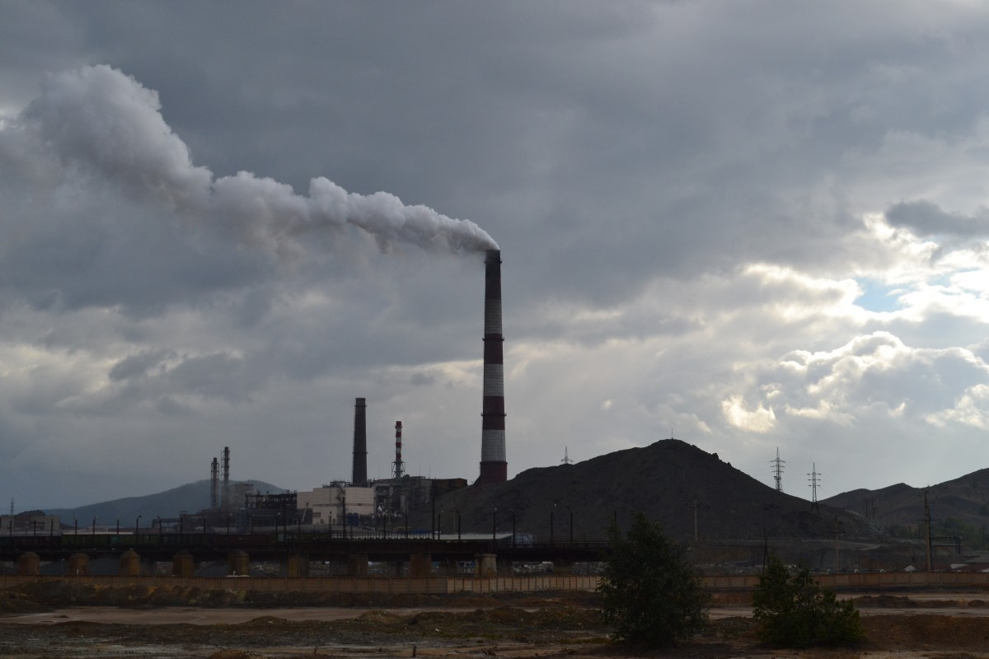
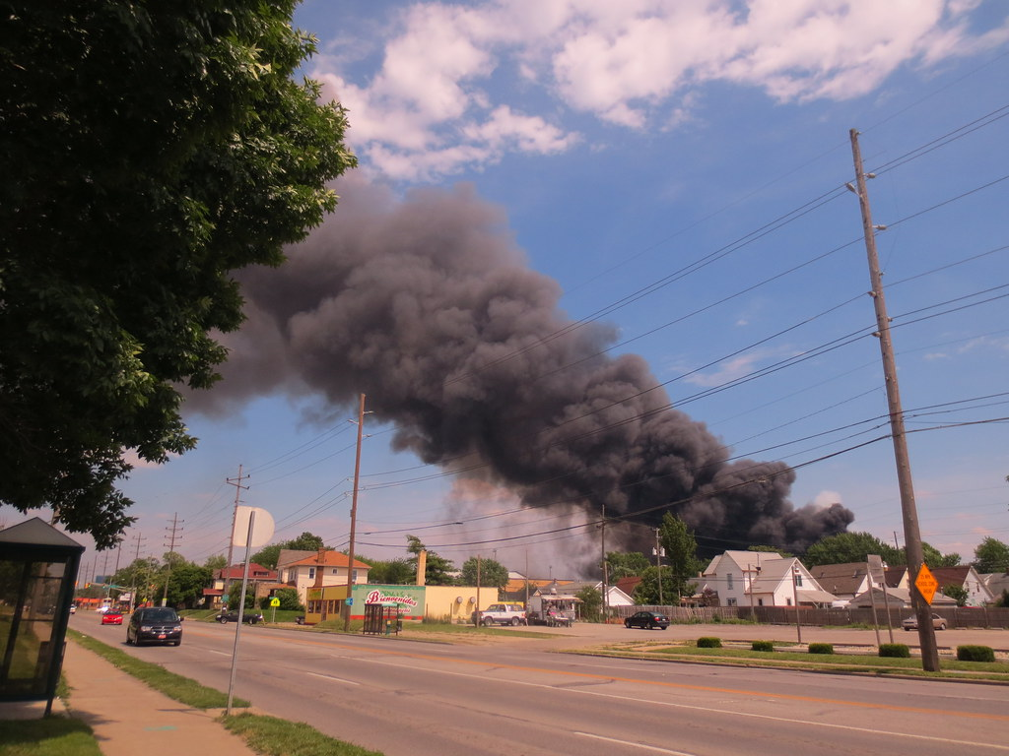
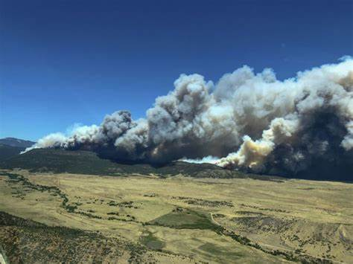
Wind Direction & Air Pollution Transport
wind direction
wind direction
wind direction
Pollution from a smokestack emission
Pollution from an industrial accident
Wildfire smoke
Notes:
Winds primarily affect air pollution by determining the direction that pollution blows in the wind. This is determined by the wind direction.
Seen here are three images depicting this.
The left is pollution from a smokestack, in which the pollution plume travel with the wind is from right to left across the image upon emission from the stack.
The middle image is of an industrial accidents, where again the smoke from the fire blows in the wind right to left across the image.
The right image is of a wildfire, in which plume travel is from left to right with the wind.
While simple conceptually, a major challenge in these situations, especially for the situation of industrial accidents or fires, is to anticipate changes in winds that may occur during these types of events, since wind direction can change with time and therefore affect populations located at different locations from the incident at different times.

Slide 11
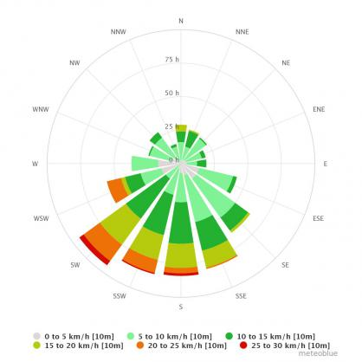
Wind Rose
Wind Rose: Example 1
Winds blow most frequently from SW, SSW, S and SSE
Fastest winds from SSW and SW
Way of depicting winds measured at a location over long periods of time
Depicts the frequency of winds of certain speeds from certain wind directions
Length of flag – how frequently wind blows from direction that flag is pointing towards
Hatches along flag – subdivides frequency according to wind speed.
Notes:
To assess longer period exposure, for example over a year, the changes in winds hour by hour over the year need to be simply summarized in some way for further analysis.
The most common way this is done is through a “wind rose”.
A wind rose is a graphical depiction of the hour by hour winds measured at a location over a long period of time – for example a year.
It depicts, using flags organized around a circle, the frequency of winds of certain speeds from certain directions. The directions around the circle indicate the wind direction. The radial distance from the center of the circle indicates the frequency of winds from that direction. Hatches along the flags indicate different wind speeds for winds along a certain direction.
The best way to explain this is through example.
On the right is an example of a wind rose of hourly winds from a certain location over some period of time.
Around the circle are the different directions the wind can come from, from N at the top, spanning across NE, E, SE, S, SW, W, NW going clockwise around the circle.
The flags radiating from the center of the chart indicate a given frequency of hours in which the wind blows FROM that direction. The longer the flag, the more hours over the year, or whatever time period is considered, the wind blows from that direction.
With this example, the highest frequency of winds occur for SW winds, from the SW blowing to the NE. The flag in this case radiates beyond the concentric circle of 75 hours … meaning that for more than 75 hours the wind is from the SW.
Contrarily one can see that winds from the N, NE, and NW are much less frequent.
Based, on this … an air pollution meteorologist analyzing annual or longer-term pollution exposure in this location can assume that pollution transport will generally be due to winds from the SW and other southerly sectors. This means pollution will blow generally from South to North.
Also, as seen on the chart, the faster winds, indicated by the orange and red hatches along the flags, are also generally from the SW and S. Winds from other directions, on the other hand, are associated with lower speeds.

Slide 12
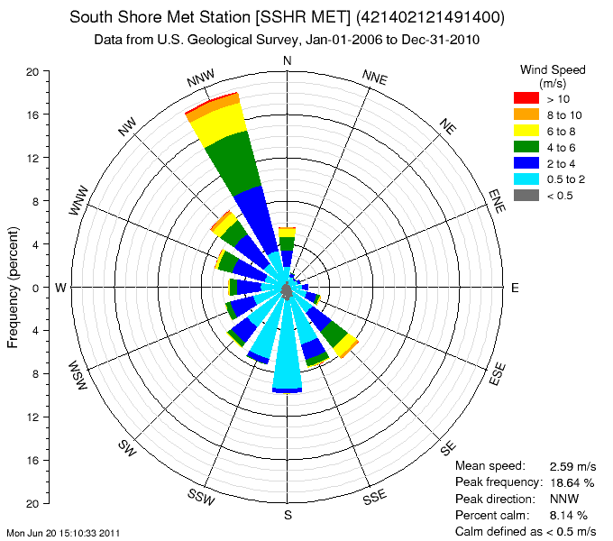
Wind Rose
Wind Rose: Example 2
Winds blow most frequently from NNW
Fastest winds from NNW
Secondary peak frequency from SSW, S, SSE, SE
Weak winds from SSW and S
Way of depicting winds measured at a location over long periods of time
Depicts the frequency of winds of certain speeds from certain wind directions
Length of flag – how frequently wind blows from direction that flag is pointing towards
Hatches along flag – subdivides frequency according to wind speed.
Notes:
This slide shows another example of a wind rose of hourly winds from a certain location over some period of time.
With this example, the highest frequency of winds occur for NNW winds. The flag in this case radiates close to the outer concentric circle … associated with 20% of the hours of the year.
Contrarily one can see that winds from the NE, NNE and E almost never occur.
There is also a secondary peak occurrence of winds from the SE through SW sectors.
Based, on this … an air pollution meteorologist analyzing annual or longer-term pollution exposure in this location can assume that pollution transport will often occur with winds from the NNW, blowing pollution to the SSE. There will also be plume transport frequency to the north due to southerly winds that occur during certain times.
Also, as seen on the chart, the faster winds are generally from the NNW. Winds from the S, SSW and SW other the hand, are associated with weak wind speeds.

Slide 13
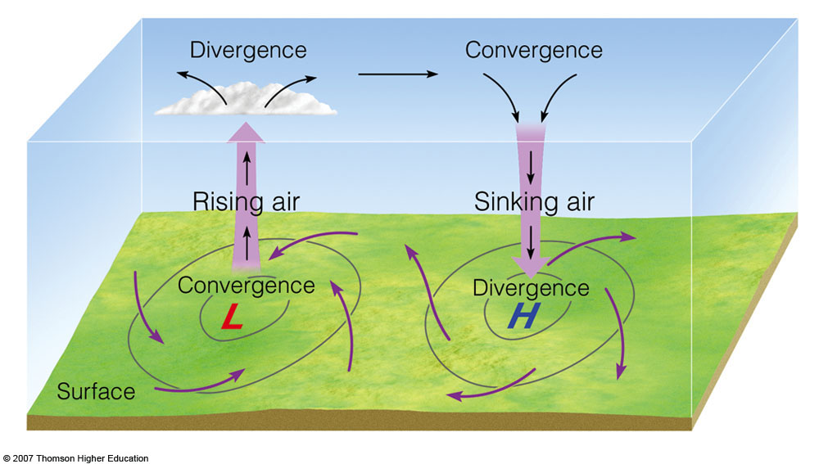
Winds Around Surface High and Low Pressure
Key Points:
Winds typically blow from high to low pressure.
Sinking air associated with high pressure. Causes temperature inversions that trap air pollution (slides explaining this to come …).
High pressure generally associated with weaker winds, and stagnation periods
High pressure typically worse for air pollution
Notes:
Winds are intimately tied to atmospheric pressure systems. Recalling from Lecture 1, atmospheric pressure is the weight of the atmosphere overlying a given area – the more weight the higher the pressure.
Shown on this image is a simple view of the relationship between air motion and pressure systems that typically occurs.
Winds typically blow away from high pressure and towards low pressure. This is depicted by the arrows directed concentrically outward from the high pressure center, and towards the low pressure system center.
Also seen is the typical vertical motion associated with each.
For low pressure, air motion typically slowly rises upward. In a sense, the inward air motion into the low pressure system “squeezes” air upward.
For high pressure, air motion typically slowly sinks downwards. This slow sinking motion associated with high pressure systems is called “subsidence”. In a sense, the outward air motion away from high pressure is replaced with air brought downwards.
The subsidence associated with high pressure often gives rise to the creation of a temperature inversion layer capping the atmosphere near the surface. This “subsidence inversion”, as it is called, tends to trap air pollutants in the layer beneath it, since temperature inversions inhibit vertical mixing of air. We will show this in more detail later in the lecture.
Key points summarizing what was just said is provided here …

Slide 14
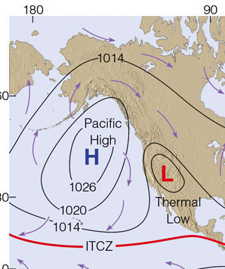
Typical Surface Pressure for summer off California Coast
PACIFIC HIGH
(offshore)
Onshore windflow
Thermal Low
(inland valleys)
Notes:
Pressure patterns strongly drive summertime flow over California … which as we will discuss in the next lecture is related to how ozone air pollution, common during summer months, is transported by the wind.
Seen here is a depiction.
During summer, a strong high pressure system called the “Pacific High” is typically situated offshore of California. Winds blow clockwise around and concentrically away from this system. Inland, strong summertime heating creates a shallow low pressure system inland. The resulting “pressure gradient” – or contrast over distance from strong high pressure offshore to strong low pressure inland - causes strong northwesterly winds. These blow inland through topographic gaps of the Bay Area inland towards the California Central valleys. In Southern California, a strong onshore wind occurs regularly across the LA Basin dring summer, moving polluted air further east and northeast as we will see in the next lecture.
The regular onshore summer winds bring cool marine air inland. Because of its regular occurrence, Mark Twain presumably said upon visiting the west coast …
“The coldest winter I ever spent was summer in San Francisco” ….

Slide 15
Typical Summertime Daytime Wind Pattern (Bay Area)
Key Points:
Example of typical bay area summer
wind flow patterns.
Wind travels generally onshore, forced
by Pacific High offshore towards
thermal low covering inland valleys.
Moves pollutant towards and get trapped in inland valleys
Notes:
A depiction of the effects of this summertime onshore wind flow across the San Francisco Bay Area is seen here.
The green arrows are typical wind directions as the summer, onshore sea breeze travels inland through topographic gaps towards inland valleys. Air pollution emitted within the Bay Area from traffic and stationary sources get caught up in this wind. Some of it gets trapped in inland valley while some makes it further inland … affecting for example Central Valley air quality.
Some key points summarizing this are provided here …

Slide 16
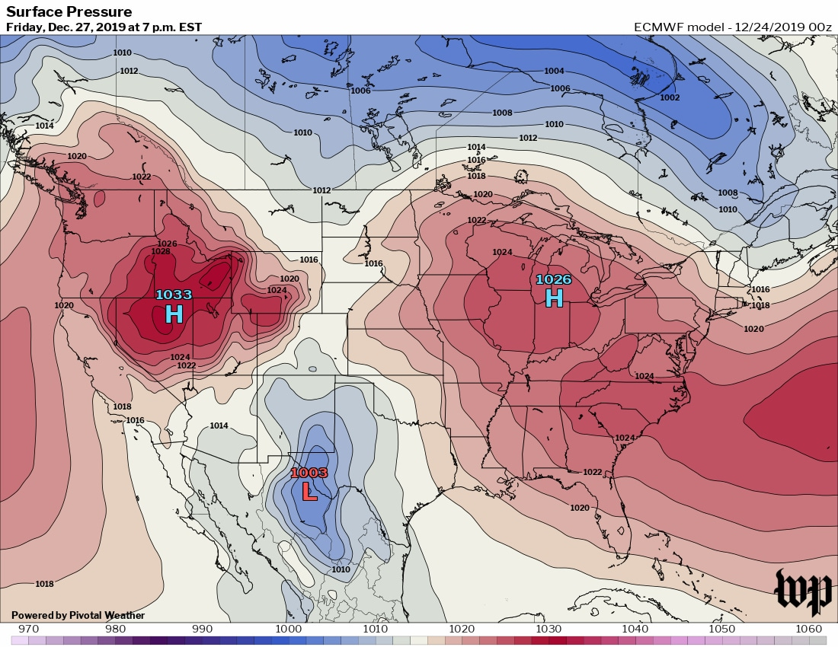
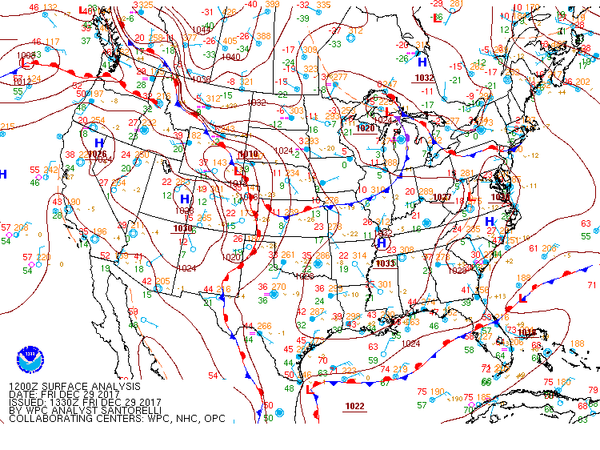
High Air Pollution Episodes: Stagnation Periods
December 27, 2019: Broad area of high pressure affecting Eastern U.S.
High wintertime PM2.5 episode
December 29, 2017: Broad area of high pressure affecting Western U.S.
High wintertime PM2.5 episode
https://www.washingtonpost.com/weather/2019/12/24/stagnant-air-brings-unhealthy-pollution-levels-washington/
https://www.bakersfield.com/news/air-district-blames-atmospheric-stagnation-for-wintertime-pollution-spikes/article_acb6f950-1da5-11e8-a175-77fd45139ccc.html
Notes:
Another key effect on air pollution related to pressure systems are “stagnation episodes”.
These occur when high pressure systems become large, spanning a very broad area, and stay fixed in place for days to weeks at a time. During these situations winds can become very weak within the pressure center, which limits air pollution transport away from source areas and dispersion with cleaner air. High air pollution episodes can therefore result. Typically, stagnation episodes are most associated with wintertime and give rise to periods of very high particulate air pollution, for example of PM2.5.
Seen here are two recent examples of wintertime stagnation episodes. On the left is an episode last winter in the Eastern U.S., the broad area of high pressure giving rise to this is depicted here. Notice how broad the system and spatially expansive the system is …. this leads to weak winds and low pollution dispersion.
On the right is an episode a couple years earlier during winter in the Western U.S., the broad area of high pressure giving rise to this is depicted here. Again, notice how broad the system and spatially expansive the system is.

Slide 17
Air Pollution Meteorology
(Focus Topic 2: Temperature Inversions)
Notes:
Air Pollution Meteorology, Focus Topic 2 – Temperature Inversions.

Slide 18
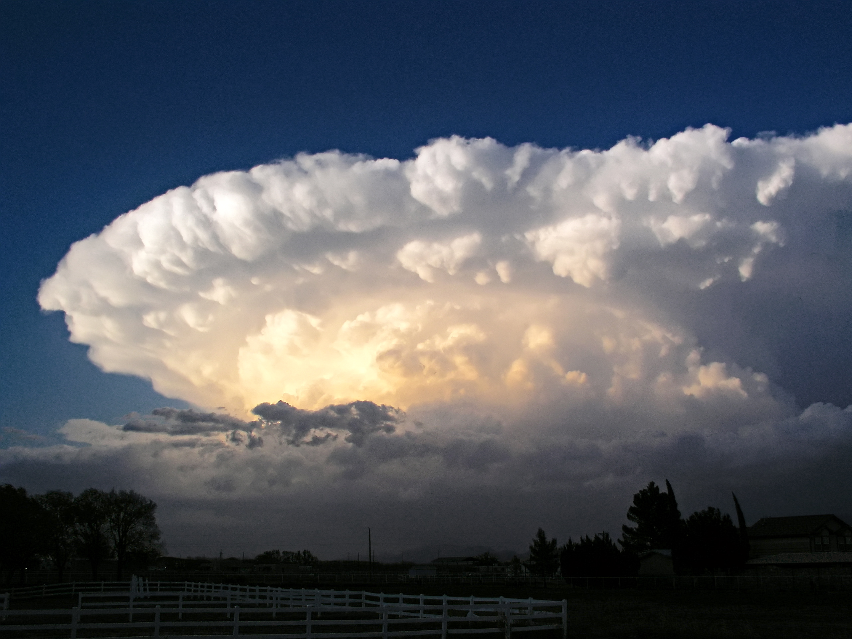
Stratospheric Temperature Inversion and Tropopause
(from Lecture 1 …)
Temperature increases w height
(“temperature inversion”)
lower stratosphere
“tropopause”: ~ 10 km above surface
cumulus nimbus cloud
(thunderstorm)
troposphere
Temperature decreases w height
Notes:
In Lecture 1 we introduced the topic of temperature inversion in connection to one specific example – the stratospheric temperature inversion.
Recalling, a temperature inversion is a layer of air in which temperature increases upward – rather than the more usual behavior where temperature is lower going upward in the atmosphere.
Within the stratosphere, temperature increases with height due to the absorption of sunlight by ozone gas. But temperature inversions can exist elsewhere for other reasons – and we will see examples in coming slides.
A characteristic of temperature inversions is that vertical motion is strongly inhibited. Hence the thunderstorm cloud in this image, and weather systems in general, do not grow further once it reaches the tropopause and encounter the stratospheric inversion. Weather systems therefore stay confined to the troposphere.

Slide 19
Inversions at low elevations (near surface) that affect air pollution
Notes:
For air pollution, we are concerned not with the stratospheric inversion but instead inversion layers that form closer to the ground – within, say, the lowest 100s to 1000 meters from the surface.
Visuals of this are seen on the slide.
On the left is a typical image of southern California pollution. One sees dirtier air confined below the base of a shallow, bur present, temperature inversion.
On the right is a black and white image showing pollution and haze within a ground-based inversion hugging the surface.

Slide 20
Temperature Inversions
1. Ground-based inversions (wintertime)
2. Subsidence inversions (summertime)
Notes:
The slides to follow will present two types of temperature inversions important for air pollution purposes.
Ground-based inversions … which are most important during wintertime, and …
Subsidence inversions .. Which are most important during summertime

Slide 21
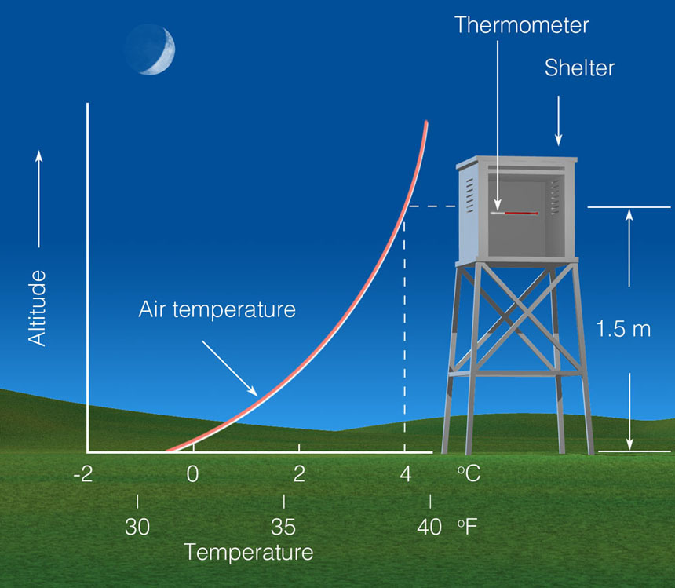
1. Ground-Based (Radiation) Inversions
Key Points
Caused by sustained, infrared radiational cooling of the surface.
Develop most strongly during long nights (wintertime) during clear skies.
Ground-based inversion is shallow – within lowest 100s of meters above surface.
Traps wintertime pollution emissions … leading to high concentrations.
Common during stagnation episodes mentioned earlier.
Notes:
The first type of inversion we will present is the ground-based inversion. These typically form, and become increasingly strong and persistent, during multi-day periods during wintertime clear sky conditions. The stagnation episodes covered earlier a very conducive to the formation of these types of inversions.
The graphic depicts a sketch of the situation. During nights with clear skies, infrared radiation emitted by the earth’s surface escapes readily to space, not being trapped by clouds or water vapor. Little heat is therefore trapped within the lower atmosphere, and air temperature near the ground cools rapidly. The near-ground air thus becomes colder than the air above. Persistent periods of clear skies, wintertime conditions lead to stronger and stronger ground based inversions with each evening.
The depth of this surface-based inversion is shallow – usually within the lowest hundreds of meters above the surface.
Wintertime pollution, from auto traffic, residential fuel combustion and other smoke sources, can therefore build up to very high concentrations since the polluted air becomes trapped within this shallow inversion layer.
Key points summarizing these points are provided here …

Slide 22
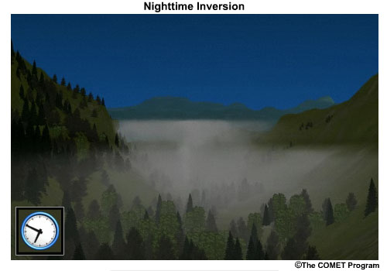
Example: Nighttime Radiation Inversion w cold air trapped in valley
(“Cold Air Pools”)
6:50 am
Notes:
A special example of ground-based radiation inversions is shown on this slide – the situation when cooled air near the surface due to infrared cooling of the surface pools within valleys. These are called “cold air pools” and can exacerbate high pollution episodes since the polluted air then not only is trapped within the inversion – but also on the side by the walls of the valley. Wintertime air pollution episodes within the California Central Valley are another example where these cold air pools are a major factor adversely affecting wintertime air quality.

Slide 23
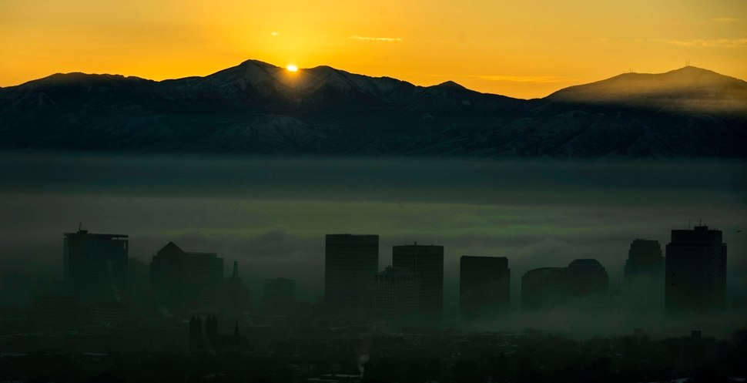
Example: Urban pollution trapped within wintertime ground inversion
(Salt Lake City, Utah)
Steve Griffin, Salt Lake Tribune
Notes:
Another example is shown on this slide – the pollution trapped near the surface in wintertime in Salt Lake City, Utah.
One sees the polluted air within and the cleaner air above the inversion layer.
Salt Lake City commonly experiences high PM pollution during wintertime associated with these conditions.

Slide 24
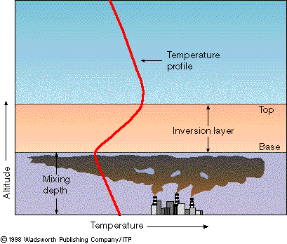
2. Subsidence Inversion
Sinking air associated with high pressure
causes an “inversion layer”.
Pollution trapped
below inversion
Notes:
The second type of inversion we will present is the subsidence inversion. These typically form, and become increasingly strong and persistent, during summertime in California, as well as other similar geographic locations.
The graphic depicts a sketch of the situation. On the left, we present again a graphic from an earlier slide of sinking air associated with high pressure. As mentioned when presenting this slide in detail earlier, the sinking motion – called subsidence – forms a temperature inversion in a shallow layer of air overriding the lower atmosphere.
The graphic on the right illustrates this. Notice that instead of the ground-based inversion, which is based at the surface, the subsidence inversion base is above the surface. Typically the base of the inversion, or where the temperature first begins to rise with height going upward from the surface, is between 500 to 1000 meters above the surface. The “mixing depth” is a term for the layer of polluted air beneath the inversion within which pollution emitted from the surface is trapped.

Slide 25
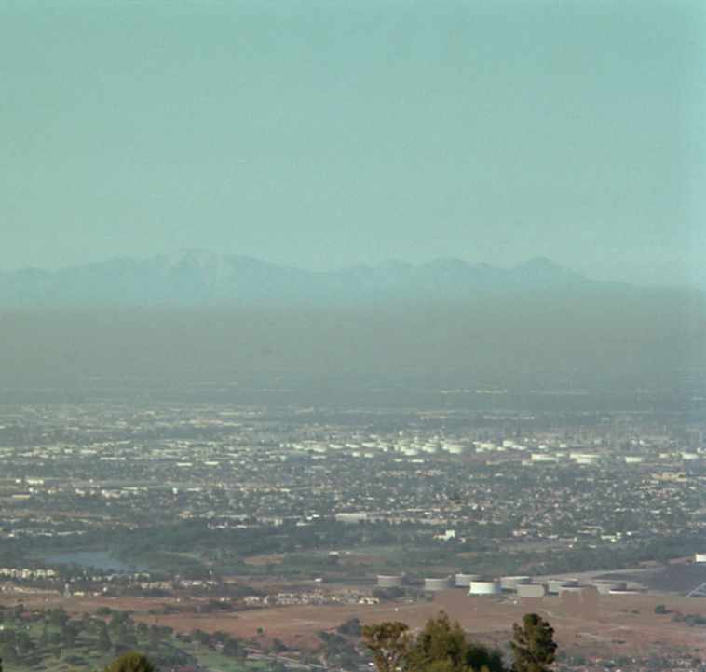
Example: Summertime air pollution trapped below subsidence inversion
Photograph looking over LA Basin
Red line:
plot of temperature w height
Sinking motion due to high pressure commonly leads to subsidence inversions in summertime California
subsidence inversion
base of inversion
Air pollution trapped
within “mixing depth” below inversion
Notes:
As mentioned, the most relevant example for purposes of this class is summertime in California.
This slide illustrates this briefly.
On the left is a visual of the Pacific-High pressure system offshore of the California presented earlier. The Pacific High is a persistent summertime weather feature of California. Subsidence associated with it forms subsidence inversions.
On the right is a photograph overlooking the Los Angeles Basin on a summer day. Notice again how the pollution emitted at the surface is trapped within the mixing depth below the base on the inversion. For equal emissions, air pollution concentrations will be higher on days when the mixing depth is shallower and the subsidence inversion base is closer to the ground, since there is a shallower depth of air to contain the pollutant.
This is the case because the emissions become trapped in a shallower layer.

