Slide 1
METR/ENVS 113
Lecture 8: Ground-level Ozone
SJSU Spring Semester 2020
Module 3: Outdoor Air Pollution (Ozone and PM2.5)
Frank R. Freedman (Course Instructor)
Notes:
Hello, this is METR113 Lecture 8, Ground-Level Ozone. This is the second lecture of Course Module 3 – Outdoor Air Pollution (Ozone and PM2.5)

Slide 2
Lecture 8: Ground-Level Ozone (Outline)
Overview
  Health Effects
  Historical Perspective
  Ozone through the Atmosphere: Stratospheric vs. Ground-Level Ozone
Formation Mechanism
  Ground-Level Ozone: A secondary pollutant
  Precursors: NOx and VOCs
  Photochemical Formation Reactions
Regulatory Efforts and Emission Controls
  Briefly … more on Practice Quiz 3 (Short Answer)
Notes:
The outline of this lecture is as follows.
We first give an overview. We will summarize the main adverse health effects. We will then present a historical perspective for appreciating ozone’s importance in air ollution. We will then review how ozone is distributed vertically throughout the atmosphere – distinguishing between ozone in the stratosphere, ozone in the troposphere – away from pollution sources, and ground level ozone in urban areas, which is the focus of this lecture.
We then cover the formation processes of ground level ozone. These involve a series of chemical reactions involving sunlight – termed photochemical reactions – which form ozone from precursor nitrogen oxide (Nox) and volatile organic compound (VOC) emissions. Nox and VOCs were among pollutants covered in earlier lectures.
We then present some efforts to control Nox and VOC emissions aimed at reducing concentrations in the future.

Slide 3
Ground-Level Ozone
(Overview)
Notes:
Ground-Level Ozone - Overview

Slide 4
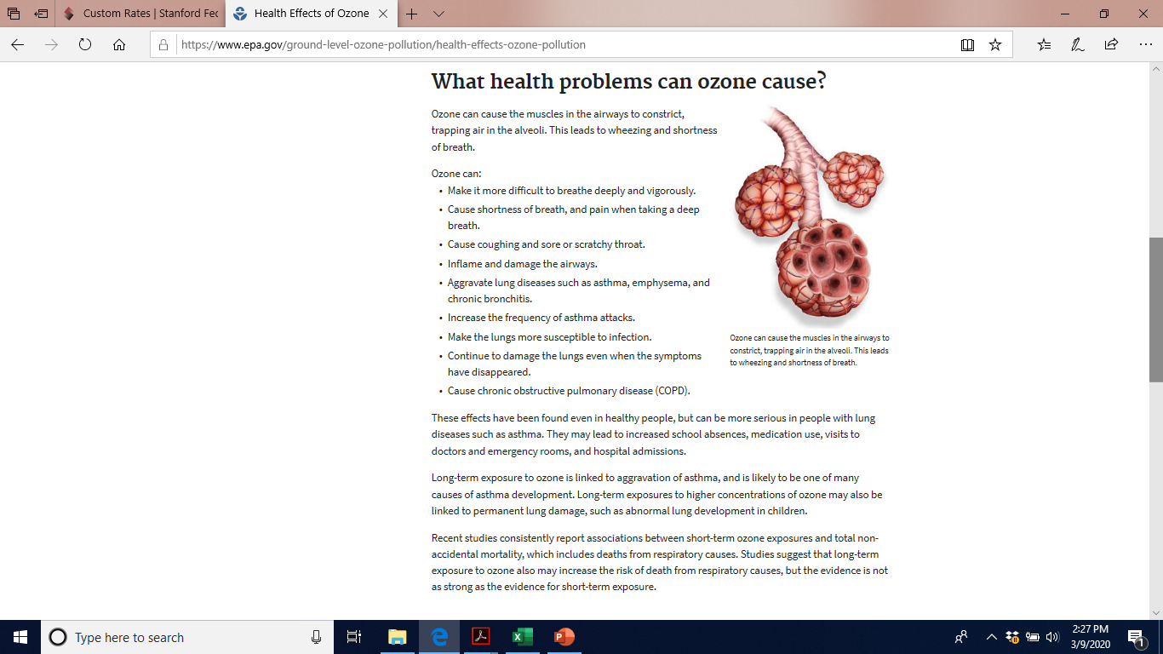
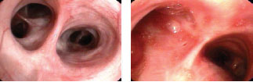
Ozone (O₃): Adverse Health Effects from Inhalation
Key Points: Health Effects of Ozone Inhalation
A lung irritant, inflames lung airway passages. Air becomes trapped in alveoli.
Mainly short-term, episodic, acute effects.
Shortness of breath, asthma exacerbation, increases susceptibility to respiratory illness.
See next slide
Normal lung airway
Inflamed lung airway due to ozone exposure
https://www.epa.gov/ground-level-ozone-pollution/health-effects-ozone-pollution
https://www.epa.gov/ozone-pollution-and-your-patients-health/health-effects-ozone-general-population
Notes:
This slide summarizes the main health effects from inhalation to high concentrations of ozone. The graphics are taken from the EPA websites shown on the bottom.
Ozone, if inhaled in high enough concentrations, can inflame the passages of the airways, leading to trapping of air in alveoli – the tiny sacs of the airways deep in the lungs that bring air in contact with the bloodstream.
This causes a series of short-term, episodic, acute adverse health effects. These include shortness of breath, asthma exacerbation, and increased susceptibility to any number of respiratory illnesses due to the inflamed state of the lungs and airways.
The images on this graphic illustrate this …
On the left is a visual of air passages terminating at alveoli, with some explanatory notes beneath.
On the right are photographs of normal versus inflamed lung airways, the latter due to ozone exposure. Notice how restricted air passages are on the right image compared with normal image on the left.
Key summarizing points are provided here and on the next slide.

Slide 5
https://www.epa.gov/ozone-pollution-and-your-patients-health/health-effects-ozone-general-population

Slide 6
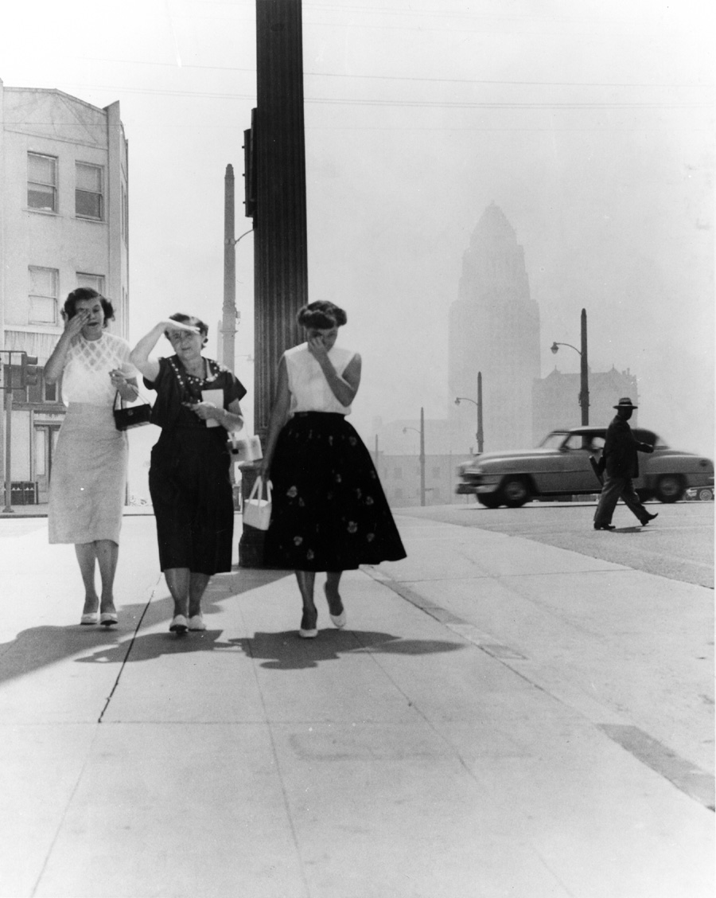
Historical Perspective: Los Angeles (1950s, 1960s)
CARB Formed
(California agency)
US EPA
Clean Air Act (1970)
1-hr ozone = 680 ppb in 1955
Highest ever recorded
(Current standard = 90 ppb)
Hollywood Citizens News Collection, Los Angeles Public Library
Notes:
The historical perspective leading to regulating ozone in the U.S. is from photochemical smog air quality problems that occurred mainly in the Los Angeles area in the 1950s and 1960s. Other parts of the country also had, and continue to have, ozone pollution events, however Los Angeles given its size and unfavorable geographic and meteorological setting is especially susceptible.
The image on the left is a photograph taken on a bad ozone day. The hazy, polluted air and woman in the foreground rubbing their eyes depicts the air quality on the day.
One the right is a timeline of some key events surrounding the problem. The timeline shows the creation of various regulatory agencies in LA, California and the U.S. motivated to control ozone and photochemical smog pollution.
Also we note in 1955 a 1-hour concentration of ozone at 680 ppm was recorded in the LA area. This is the highest ever recorded, and is several times higher than the current 1-hour ambient air standard of 90 ppb. Much work has been done to bring ozone levels to lower levels today compared to back then, however as we will see regulatory exceedances still exist.

Slide 7
Recall from Lecture 5
Ambient Air Quality Standards
California** Federal*
Ozone
1-hour average 90 ppbv --
8-hour average 70 ppbv 70 ppbv
CO
1-hour average 20 ppmv 35 ppmv
8-hour average 9.0 ppmv 9.0 ppmv
NO₂
1-hour average 180 ppbv 100 ppbv
annual average 30 ppbv 53 ppbv
SO₂
1-hour average 250 ppbv 75 ppbv
24-hour average 40 ppbv 140 ppbv
* Federal standards are set by Environmental Protection Agency (EPA) as “NAAQS” (National Ambient Air Quality Standards).
** California standards are set by the California Air Resources Board.
Notes:
Quickly, we review the key ambient air standards for ozone set by EPA and California.
There are both 1 and 8-hour standards, the 1-hour standard at 90 ppb and 8 hour standard at 70 ppb.
These standards are over short averaging times (1 and 8 hour), which indicates that these are set to respond to the short-term, acute nature of ozone inhalation health problems – which were summarized a couple slides back.

Slide 8
Ozone (O₃) Concentration vs. Height (Troposphere & Stratosphere)
Stratospheric Ozone (“good ozone”)
Where ultraviolet sunlight is absorbed.
Beneficial effect to surface life.
See Lecture 2
Ground-Level Ozone (“bad ozone”)
Forms in urban areas, typically summertime
A “secondary pollutant” – not emitted, but formed in the atmosphere due to chemical reactions involving sunlight (“photochemical reactions”)
Also called photochemical smog
Ozone emission precursors: NOx and VOCs
Notes:
To conclude this overview, it is important to understand the typical vertical profile of ozone gas in the earth’s atmosphere.
We studied, earlier in Lecture 2, that ozone has a beneficial effect to life at the surface since ozone absorbs ultraviolet sunlight. This occurs in the stratosphere, roughly 20 – 50 km above the surface, where ozone concentrations are highest. The stratospheric ozone layer is indicated on this graphic. Ozone in the stratosphere is often called “good ozone” since it has a beneficial effect.
Ground-Level Ozone on the other hand is often called “bad ozone” because of the harmful effects of ozone if inhaled. We depict ground level ozone at the bottom of the graphic – called “smog” ozone on the body of the plot. Notice that the concentration levels, while elevated compared to small, background levels through the troposphere, are still much smaller than stratospheric levels.
Ozone, whether created in the stratosphere, troposphere or at ground-level, is formed “photochemically” – that is from chemical reactions with other gases involving sunlight.
In the stratosphere, as we learned in Lecture 2, oxygen gas absorbs ultraviolet light which breaks the molecule into free oxygen. This free oxygen then combines with other O2 molecules to form the ozone O3 molecule.
Ground-level ozone, on the other hand, forms from a different set of photochemical reactions. These involve photochemical reactions involving nitrogen oxides (NOx) and VOCs – two air pollutants studied in earlier lectures. Both NOx and VOCs are emitted from pollution sources, whereas ozone is formed photochemically from chemical reactions involving these emitted gases. We therefore say that ozone is a “secondary pollutant”, since it is not emitted directly but rather forms from other pollutants that are emitted. The NOx and VOCs that form ozone are called “ozone precursors”.

Slide 9
Ozone Air Pollution: Summary
Primary Pollutant: Emitted from a source
Secondary Pollutant: Formed from chemical reactions in atmosphere
Ozone is a secondary pollutant.
  Formed from chemical reactions between NOx and VOCs, which are emitted.
  Chemical reactions to form ozone require sunlight … i.e. the reactions are “photochemical reactions”
  Hence, the term “photochemical smog” is synonymous.
  Nox and VOCs are called “ozone precursors” …
Notes:
To summarize these basic concepts, this slide is presented.
We distinguish between a primary pollutants – which are emitted directly from a source – and a secondary pollutant – which forms in the atmosphere by chemical reactions involving primary pollutants and other compounds in the air.
Ozone is a secondary pollutant.
Its primary, pre-cursor gases involved in its formation are Nox and VOCs.
For these reactions to occur, sunlight is required, and high temperatures are favorable. Hence, hot summertime conditions are most associated with ozone air pollution events.

Slide 10
Ground-Level Ozone
(Formation Mechanism)
Notes:
Ground-Level Ozone – Formation Mechanism

Slide 11
Chemical Reactions: Tropospheric Ozone
Formation of NO2
2NO + O₂ → 2NO₂
NO₂ + sunlight → NO + O
O₂ + O → O₃
NO + O₃ → NO2 + O₂
Dissociation of NO2 to free oxygen
through absorbing sunlight
Creates ozone
Destroys ozone
Equilibrium btw creation and destruction of ozone
Roughly constant background tropospheric ozone concentrations from 10 – 40 ppb.
Lower at night since sunlight goes away to create free oxygen.
Notes:
Details of the photochemical reactions for ground-level ozone will now be covered.
We start first with those for ozone in the troposphere. As we have mentioned, natural background levels of air pollutant species exist that are non-zero in concentration. For ozone, natural background concentrations in the troposphere are around 10 – 40 ppb. Note that this is much, much lower than the values found in the stratosphere … comprising the ozone layer, and lower than air pollution ground-level ozone.
The chemical reactions below for tropospheric ozone set the stage for understanding the higher values found at ground level in polluted urban areas. While we list these in a particular sequence, these in fact all occur simultaneously.
First, nitrogen oxide that naturally exists in the troposphere reacts with atmospheric oxygen (O2) to form Nitrogen Dioxide. Again, the concentrations of NO2 would be small, background levels … much smaller than in urban areas.
The next two reactions we are familiar with.
NO2 absorbs sunlight …. Particularly the violets and blue visible light … which dissociates the molecule back NO and a free oxygen O. Recall the brown cloud of polluted air shown in earlier lectures, which was associated with nitrogen dioxide pollution.
Next, the free oxygen then combines with atmospheric oxygen to form ozone (O3). This is the same reaction that forms ozone in the stratosphere forming the ozone layer. The only difference is the manner in which the free oxygen is formed.
Once formed, ozone then can react with NO to form NO2 and an O2 molecule.
The third reaction creates ozone while the fourth destroys ozone. An equilibrium, in which the creation and destruction rates roughly equal each other, eventually is reached, which leads to roughly constant background ozone levels in the troposphere at around 10 – 40 ppb.
Values are lower night when sunlight is gone, and the second reaction that forms the required free oxygen for the third reaction is not present.

Slide 12
Chemical Reactions: Ground-Level Ozone
2NO + O₂ → 2NO₂
NO + VOC → NO₂
NO₂ + sunlight → NO + O
O₂ + O → O₃
NO + O₃ → NO2 + O₂
Formation of NO2
(complicated set of reactions btw NO & VOCs. Result is to create additional NO₂)
Dissociation of NO2 to free oxygen
through absorbing sunlight
Creates ozone
Destroys ozone
Equilibrium btw creation and destruction of ozone
More NO2 to create free oxygen due to urban emissions of extra NO_{X} and VOCs.
Ground-level ozone concentrations in urban air is higher … can reach ~ 100 ppb or higher.
Notes:
The higher concentrations of ozone at ground-level in urban areas result from two things: the addition of higher emissions of nitrogen oxides in urban areas, and secondly the very important addition of Volatile Organic Compounds (VOCs), also emitted in urban areas, to the chemical reactions. Recalling from Lecture 6, VOCs are vapors of liquid hydrocarbons – gasoline, fuels, paints and many other industrial chemicals – that are present in urban air.
Seen here is the list of the reactions for ground-level ozone formation, similarly structured as those in the previous slide for tropospheric ozone.
The first two reactions show how the NO2 is formed. The first reaction is the same as we saw on the previous slide … the only difference is that there is more NO in urban air because high emissions of Nox in urban areas are present, and hence more NO2 is formed.
The second reaction is new. This is a representation of a collection of many reactions between NO and the various Volatile Organic Compound (VOCs) species that are emitted. Essentially, VOCs react with NO to form NO2. The end result is that, compared with natural tropospheric conditions, much more NO2 is created in urban air – through enhanced emissions of NO and the presence of VOCs in the urban air.
The remaining reactions are as the last slide,
- NO2 absorbs sunlight and dissociates into free oxygen
- Ozone is formed as free oxygen combines with molecular oxygen
- And ozone is destroyed by reaction with NO.
The end result is as before … an equilibrium is reached where ozone concentrations reach a certain level … however in this case of urban air at higher levels than in natural background tropospheric air due to the additional emissions of NOx and presence of VOCs.
Warm, sunny summertime conditions are favorable for this reaction, in which cases O3 can reach 100 ppb or higher.

Slide 13
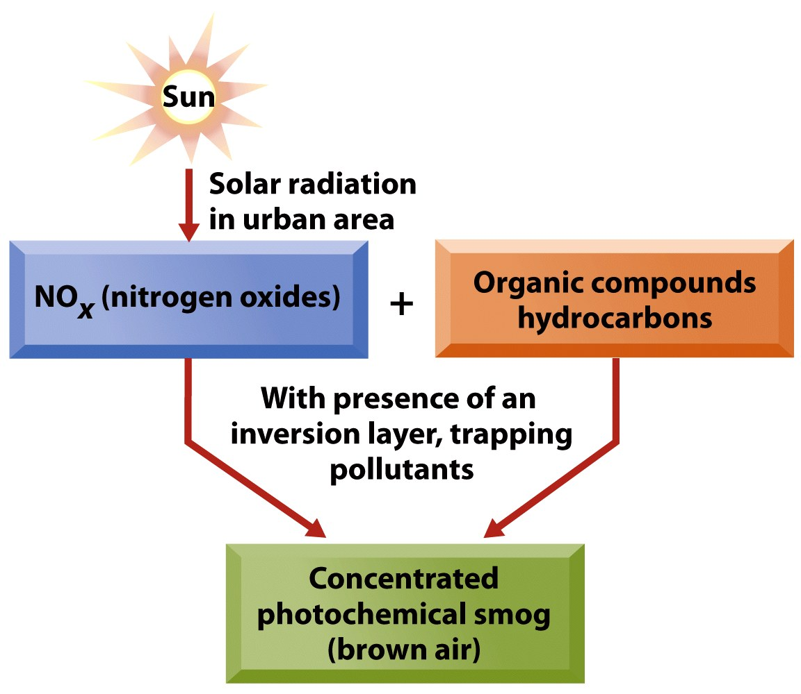
Ground-Level Ozone Formation: Conditions for Bad Episodes
1. Sunlight & Warm Temperatures
2. High Precursor Emissions
(NO_{x} and VOCs)
3. Unfavorable geography and meteorology
Result: High Ozone (O₃) & Photochemical Smog
Notes:
This graphic summarizes the points on ground-level ozone formation in urban areas, emphasizing what leads to conditions for bad ground level ozone.
First, sunlight and warm temperatures are required – hence summertime is what is typically referred to as “ozone season” by air pollution professionals.
Second, high pre-cursor emissions of Nox and VOCs are required.
Third, ozone concentrations are highest in unfavorable geographic and meteorological settings … with topographic trapping and inversion layers. We will see shortly how Los Angeles is one such setting.
The end result, when all conditions come into sync, can be bad summertime, photochemical smog episodes.

Slide 14
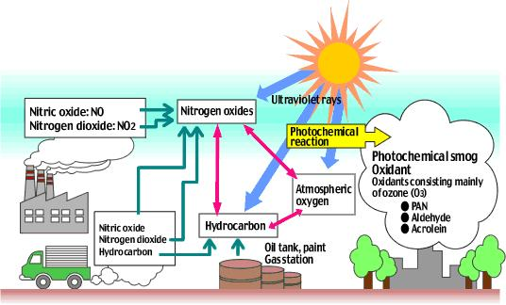
Photochemical Urban Smog
(Pictorial summary highlighting emission sources & chemical reactions)
Basic Chemical Reaction
Hydrocarbons (VOCs) + NOx + sunlight
→ photochemical smog (ground-level ozone, O3)
Sunlight
Emissions
Chemical and photochemical reactions
Reactive
s
Precursor NOx & VOC emissions
Notes:
Another pictorial summary is provided here ...
The types of emission sources responsible for the pre-cursor NOX and VOC emissions are indicated by the turquoise arrows, while the magenta arrows are chemical reactions in the atmosphere that occur with these emission species as reactants.
Combustion sources from both stationary and mobile sources are primarily responsible for NOx emissions. Hydrocarbon VOC emissions also come from mobile sources as unburned gas vapors, and as well from various other industrial and household sources where liquid hydrocarbons are utilized.
The middle of the graphic illustrates pictorially the photochemical reactions that take place involving sunlight and these emission species.
The right side of the graphic illustrates the products of the photochemical reactions … enhanced ground level ozone and other photochemical smog constituents.

Slide 15
Ground-Levels Ozone Formation: Typical Diurnal Cycles
Diurnal variation of emissions of NO & VOC (cars & industry)
+ Diurnal variation of sunlight …
Emissions of NO and VOCs highest in morning
Chemical reactions more active as day proceeds (more sunlight and higher temperatures)
Ozone highest in mid-late afternoon
NO
+ VOC
NO₂
O₃
Conc
sunrise
sunset
time
Notes:
Another important part of ground-level ozone formation is the diurnal cycle … that is the progression through a typical daytime cycle of these processes.
This graphic sketches the build-up and drop of the various species involved from sunrise to sunset along the horizontal axis.
Emissions are high throughout the day but often peak in morning hours associated with rush hour road traffic.
The chemical reactions that form NO2 from these emissions then proceed more strongly as concentrations of precursor gases from emissions build-up. As a result, there is often a time lag of a few hours between peak NO and VOC concentrations/emissions and peak NO2 concentrations.
As sunlight and temperature becomes stronger during the day and NO2 concentrations grow, ozone formation then becomes more active, which again leads to a few-hour time lag between peak NO2 and peak O3. The end result is that ozone in urban areas is typically highest in mid afternoon hours, around 2 – 3pm.
Once sunlight disappears into the evening, ozone levels then drop down.

Slide 16
Case Study: Los Angeles
(Summertime ground-level ozone)
(non-attainment area for O3)
Notes:
The following slides will illustrate these concepts further by looking at a case study of Los Angeles – an area where ozone episodes are common in summer months. Through this we will see how the interplay of emissions, chemistry, meteorology and geography lead to particular ozone patterns during strong episodes.

Slide 17
NOx emissions highest in LA City Center (“western LA Basin”)
(Emissions spread across basin, but centered on major roadways since NOx is dominated by motor vehicle emissions)
Notes:
This map illustrates the pattern of Nox emissions on a typical weekday in Los Angeles. The map is color coded according to emissions in moles per day.
Notice the emissions are spread out over the basin. From a careful view of the pattern, however, one can see that higher values along major roadways. Since NOx emissions are largely from motor vehicles … this makes sense.

Slide 18
VOC emissions highest in LA City Center (“western LA Basin”)
(A bit more uniform across basin compared to NOx – sources more varied, less centered on motor vehicles)
Notes:
This map illustrates the pattern of VOC emissions on a typical weekday in Los Angeles. The map is color coded according to emissions in moles per day.
Notice the emissions are spread out over the basin, a bit moreso than seen with NOx. In particular, less of a roadway signal is seen for VOC emissions than for NOx. This is because there are a wider range of urban sources responsible for VOC emissions, being less centered on mobile sources compared to Nox.

Slide 19
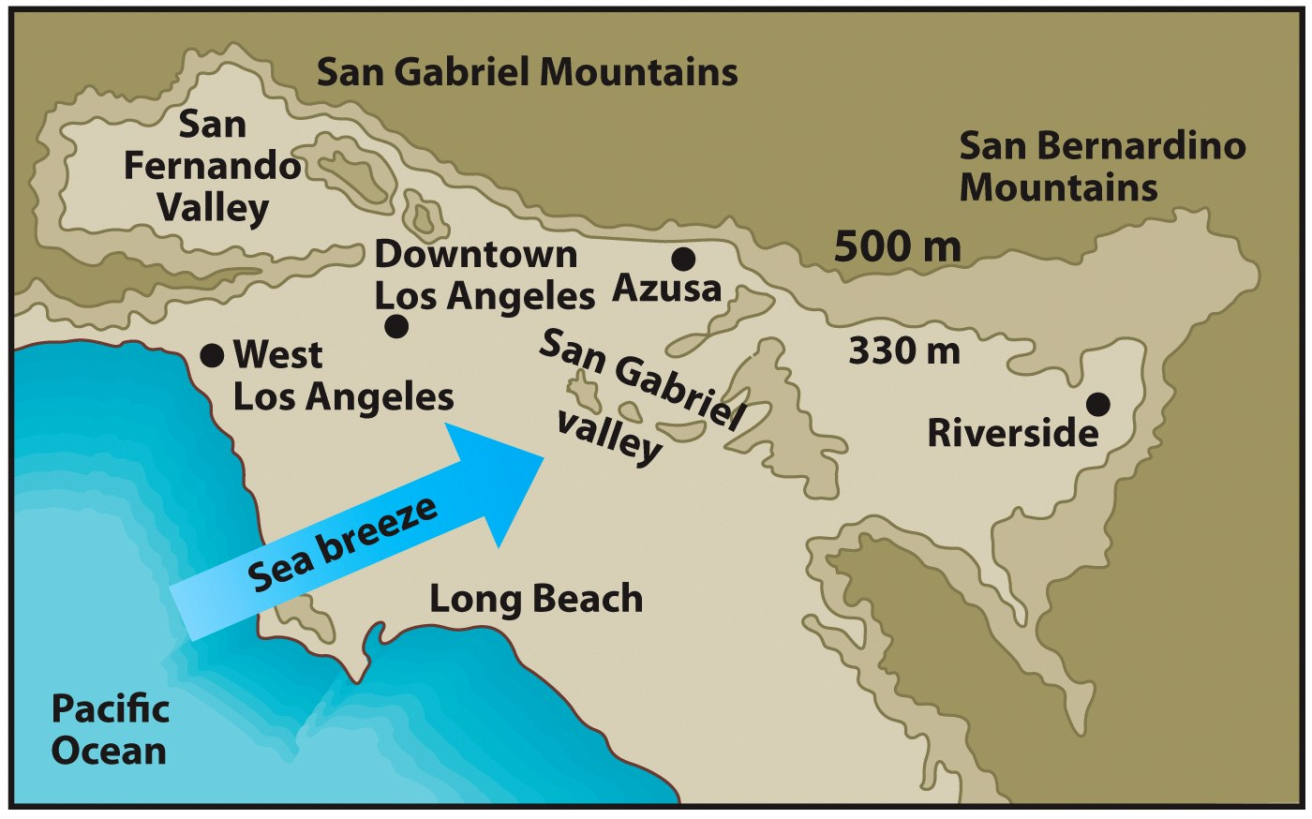
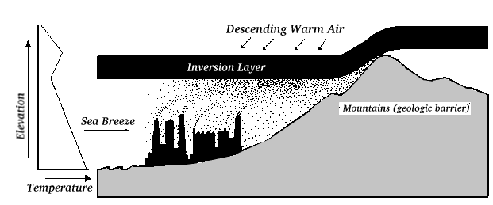
Typical Summertime Daytime Wind Pattern (Los Angeles area)
High mountains bounding LA Basin to north and east
Pollution blows inland and is bounded atop by subsidence inversion layer & on sides by topography
Summer sea breeze
Blows NOx and VOCs emissions inland
Notes:
The graphic on this slide illustrates the typical daytime, summertime wind flow and topography of the Los Angeles Basin.
The upper left is a visual looking down horizontally, while the bottom right is a vertical cross section, looking from the side.
A sea-breeze, blowing from the ocean inland, typically develops over the basin on summer days. This onshore sea-breeze is driven by the combination of the Pacific High pressure system offshore, and inland heating, as discussed in Lecture 7.
This sea breeze acts to blow emissions of Nox and VOCs inland over the basin … from west to east.
High mountains bound the basin on the north and east … which prevents pollutants from penetrating further inland areas.
The subsidence inversion prevents dispersion upward.
The end result is that pollutant become increasingly trapped both vertically and horizontally as they travel eastward across the basin.

Slide 20
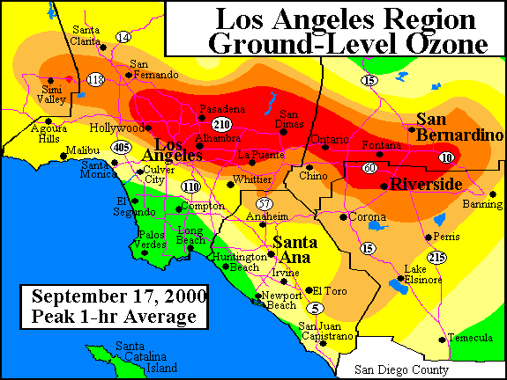
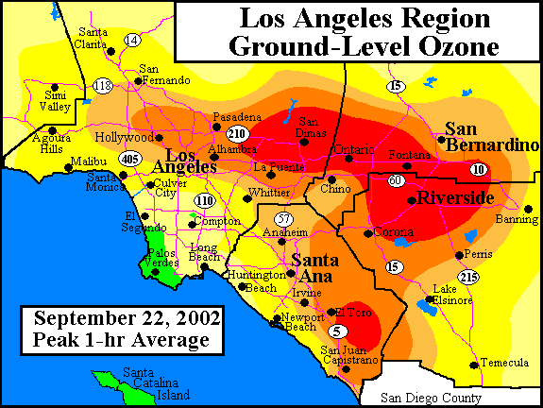
Ground-Level Ozone: Air Pollution Episodes in Los Angeles Basin
(peak 1-hour concentrations for two example days …)
≤ 60 ppb
60 - 125 ppb
> 125 ppb
Notes:
The resulting pattern of ground-level ozone concentration for two example days of poor ozone air quality in the Los Angeles Basin are shown on this graphic.
The two days are Sept 17, 2000 on the left and Sept 22, 2002 on the right. Each map graphically depicts through color shading the highest (“peak”) hourly ozone concentration that occurred during the day. Green shaded areas are where peak hourly ozone concentration were less than 60 ppb, reds greater than 125 ppb, and yellow and orange shading are values between 60 and 125 ppb.
The key thing to notice are the areas of the LA Basin where ozone concentrations are highest. These occur in inland locations. This is because of eastward wind travel discussed on the previous slide combined with the time lag between when peak pre-cursor Nox and VOC emissions occur – in mid to late morning – and when the sunlight and photochemical reactions are strongest that form ozone from these emissions, which culminates in peak ozones in mid afternoon.
Since the emitted species and chemical reactions act on air that is flowing inland with the sea-breeze, by the time ozone forms at its highest value mid afternoon the polluted air mass has traveled in the wind eastward to inland locations. Ozone and other photochemically produced air pollutants are therefore at highest concentration at the shown inland locations – Riverside, San Bernardino and other inland Los Angeles areas.
The topographic bounding from surrounding mountains to the north and east then trap the polluted air from further eastward transport, hence leading to building up in the Eastern LA Basin.
An important thing to note from this is that the area where emissions are strongest – within the western Los Angeles basin centered more in the city center – and where concentrations are highest – inland in eastern LA Basin locations – are not the same. This is typical of ozone air pollution generally, and indicates that the location where emissions need to be controlled to reduce concentrations is often not the same as where concentration impacts are highest and need to be controlled. This causes interesting regulatory problems, since the jurisdictions where emissions are controlled is not always the same as where concentrations need to be reduced.

Slide 21
Ground-Levels Ozone Formation: Typical Diurnal Cycles
NO
+ VOC
NO₂
O₃
Peak ozone in late afternoon
Conc
Low ozone at night
sunrise
sunset
time
Western LA Basin
(where emissions of NO & VOC are highest)
Eastern LA Basin
(sea breeze winds blow precursor NO & VOC inland)
(chemical reactions occur during travel … form NO2 then O3)
(O3 highest inland … eastern LA Basin)
Notes:
The point from the previous slide related to inland travel of air pollutants associated ozone formation in the LA Basin is made more explicit by revisiting the slide previously shown in the lecture on the diurnal cycle of pre-cursors and ozone.
Recall the time lag discussed previously, whereby NOx & VOC precursors peak in morning hours and ozone in late afternoon. These time lags are due to the combined effects of when emissions tend to be highest in the day, when sunlight and temperature are highest in early afternoon, and the time it takes for chemical reactions to proceed. The end result is peak ozone in mid to late afternoon.
Mapping this is space in the LA Basin. NO & VOCs are highest in morning in the western LA Basin and due to the sea breeze and the time lags just discussed, the peak ozone that then forms later in the afternoon occurs in inland locations … as the polluted mass travels in time inland with the sea breeze.

Slide 22
Ground-Level Ozone
(Regulatory Efforts & Emission Controls)
Notes:
Ground-Level Ozone – Regulatory Efforts and Emission Controls

Slide 23
Number of Days per Year Exceeding 8-hour ozone standard
(Year 2015; Federal and State 8-hour ozone standard = 70 ppb)
Figure 2-4 of http://www.aqmd.gov/home/air-quality/clean-air-plans/air-quality-mgt-plan/final-2016-aqmp
Notes:
Ozone is among the criteria air pollutants in which ambient air standards have to be met. As we have mentioned in previous course material, ozone is among the criteria air pollutants that air districts across the country continue to be in non-attainment.
The situation in year 2015 across the LA Basin in terms of compliance with the 8-hour ozone standard of 70 ppb is shown on this graphic.
Shown on the map are shadings of the number of days during 2015 when the 8-hour standard was exceeded. The black dots on the map are the monitoring stations across the LA Basin that concentrations are checked against the ambient air ozone standards.
Notice how the map of exceedances closely aligns with where ozone concentrations are typically highest across the basin.
Specifically, from 40 to over 60 days per year of eight-hour ozone exceedances occur in most affected portions of the Eastern LA Basin … around the areas of San Bernardino and Riverside. These days almost always occur during summer, which consist of around 90 days for 3 months times 30 days. This implies 40 to over 60 exceedances out of 90 days per summer, ad therefore almost every day or every other day there is an ozone exceedance in the Eastern LA basin.
Further west, we see less exceedance, between zero and 20 per year. This is because the sea breeze pushes the polluted air eastward. So although there are more emissions in the western basin, there are less exceedances of concentration standards.

Slide 24
Implementation Plan
(South Coast Air Quality Management District, SCAQMD)
(http://www.aqmd.gov/home/air-quality/clean-air-plans/air-quality-mgt-plan/final-2016-aqmp)
State Implementation Plans (SIP) are required from
all air districts that are non-attainment areas for a
particular criterial air pollutant and averaging time.
The South Coast Air Basin is non-attainment with
respect to both 1-hour and 8-hr ozone. SCAQMD
therefore is required to submit a SIP for ozone.
Notes:
As a result of the exceedances shown on the previous slide, the South Coast Air District … which covers the LA Basin … is a non-exceedance area with respect to 8-hour ozone. Air districts that exceed standards must then develop, together with state and other agencies, a very comprehensive plan … called a State Implementation Plan (or SIP) … where a plan by which air pollution emissions will be reduced to lower concentrations is developed and communicated to the public.
The web link for the South Coast Air Quality Management District SIP for 1 and 8-hour ozone is shown here.

