Slide 1
METR/ENVS 113
Lecture 9: Particulate Matter & PM2.5
SJSU Fall Semester 2020
Module 3: Outdoor Air Pollution (Ozone and PM2.5)
Frank R. Freedman (Course Instructor)
Notes:
Hello, this is METR113 Lecture 9, Particulate Matter & PM2.5. This is the third lecture of Course Module 3 – Outdoor Air Pollution (Ozone and PM2.5)

Slide 2
Outline
Overview
  Fine Particulate: Definition
  Health Effects (brief)
  Concentration Patterns & PM2.5 Regulatory Attainment Status
Composition
  Composition: PM10 vs. PM2.5 vs. Ultrafine
  Primary vs. Secondary PM2.5
Emission Sources: Combustion PM
Notes:
The outline of this lecture is as follows.
We will first give an overview, where we will define fine particulate and briefly summarize the health concerns of fine PM exposure. More details on health effects will be provided in Module 4 during our study of air pollution epidemiology. We will also look at the concentration patterns and attainment status of PM2.5 pollution locally, across the U.S., and globally.
We will then go into further detail on PM composition. We will distinguish between PM10, PM2.5 and Ultrafine particulate, and primary vs secondary PM2.5.
We will then conclude by briefly describing main emission sources of PM generated by combustion sources.

Slide 3
Fine Particulate Air Pollution
(Overview)
Notes:
Fine Particulate Air Pollution - Overview

Slide 4
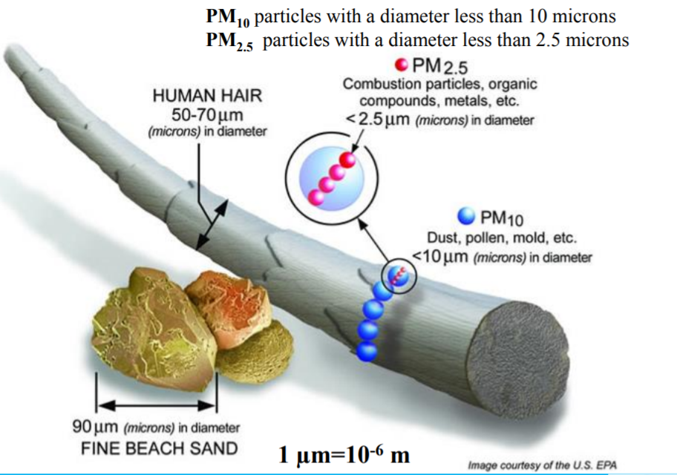
What is Particulate Matter (PM)?
Main Points
Very tiny particles
Suspended in air – can travel in air much like a gas
Respirable – can penetrate deeply into lungs
Notes:
We begin with a basic description of particulate air pollution.
There are several terms used to describe this. Broadly the name “particulate matter” – or PM – describes particles in the air that are small enough to stay suspended, and therefore are able to blow in the wind much like it were a gas. Large particles, instead, would be heavy enough to not stay suspended and therefore would settle to the ground due to gravity very soon after being emitted.
The precise particle sizes associated with PM pollution are illustrated by the graphic shown below.
Since these particles are small in size, we generally refer to particle sizes in micrometers. 1 micrometer is 1 millionth of a meter, and 1 thousandth a millimeter
A common upper bound of particle size where particles stay suspended in air is 10 micrometers in diameter. We call the mass concentration of PM pollution for particles smaller and up to 10 micrometer PM10. Likewise, we call the mass concentration of PM pollution for particles smaller and up to 2.5 micrometer PM2.5. Both PM10 and PM2.5 are among the criteria air pollutants – where ambient air concentration standards exist.
To get an idea of the size of 10 and 2.5 micrometer particles, it is common to reference this to something more familiar – like a human hair. This is indicated on the graphic. The typical width of a human hair is between 50 – 70 micrometers. Also shown on the graphic is a grain of beach sand – at about 90 micrometers in size. Overall, 50 – 100 um is similar to the size of fog droplets and small rain drops..
10 micrometers – the rough upper bound of suspended, respirable particles in the air - is therefore about 1/6 this size of the width of a human hair, and PM2.5 is even smaller than this – around 1/20th.
PM10 and PM2.5 air pollution is therefore comprised of very tiny particles. They stay suspended in air and can travel long distances in the wind. PM2.5 is also so tiny it can penetrate deeply into lungs and cause adverse health effects if inhaled..

Slide 5
Aerosol & “particle size”
Aerosol: the ensemble or group of solid, liquid, or mixed phase particles suspended in air.
Aerosol size is typically measured by its “diameter”. This is an approximate size assuming aerosol is a sphere.
More precisely, it refers to something called the “aerodynamic” diameter
Technical details (if interested … not on exam) https://en.wikipedia.org/wiki/Aerosol#Aerodynamic_diameter
Idealized spherical particle
“actual particle”
Notes:
More details on these definitional matters are provided on this slide. PM are “aerosols” – a term we introduced back in lecture one. Aerosols are particles that stay suspended in air.
Since the precise size of PM particles is so important, it is useful to give a better idea of what we mean by “particle size”. By particle size, for example a particle size of 2.5 micrometers, we are referring to the diameter of a spherical particle. PM particles however are generally not spherical, as we will see in electron microscopy images on a later slide. Therefore, one needs to imagine a non-spherical particle morphed into a sphere in a manner where the overall volume stays the same. This is shown on this graphical inset – the actual particle shown by the solid line and the imaginary spherical one of same volume by the dashed line.
A more precise, technical definition of particle diameter is “aerodynamic diameter”. Details on this can be read about on the Wikipedia page weblinked below for those interested.

Slide 6
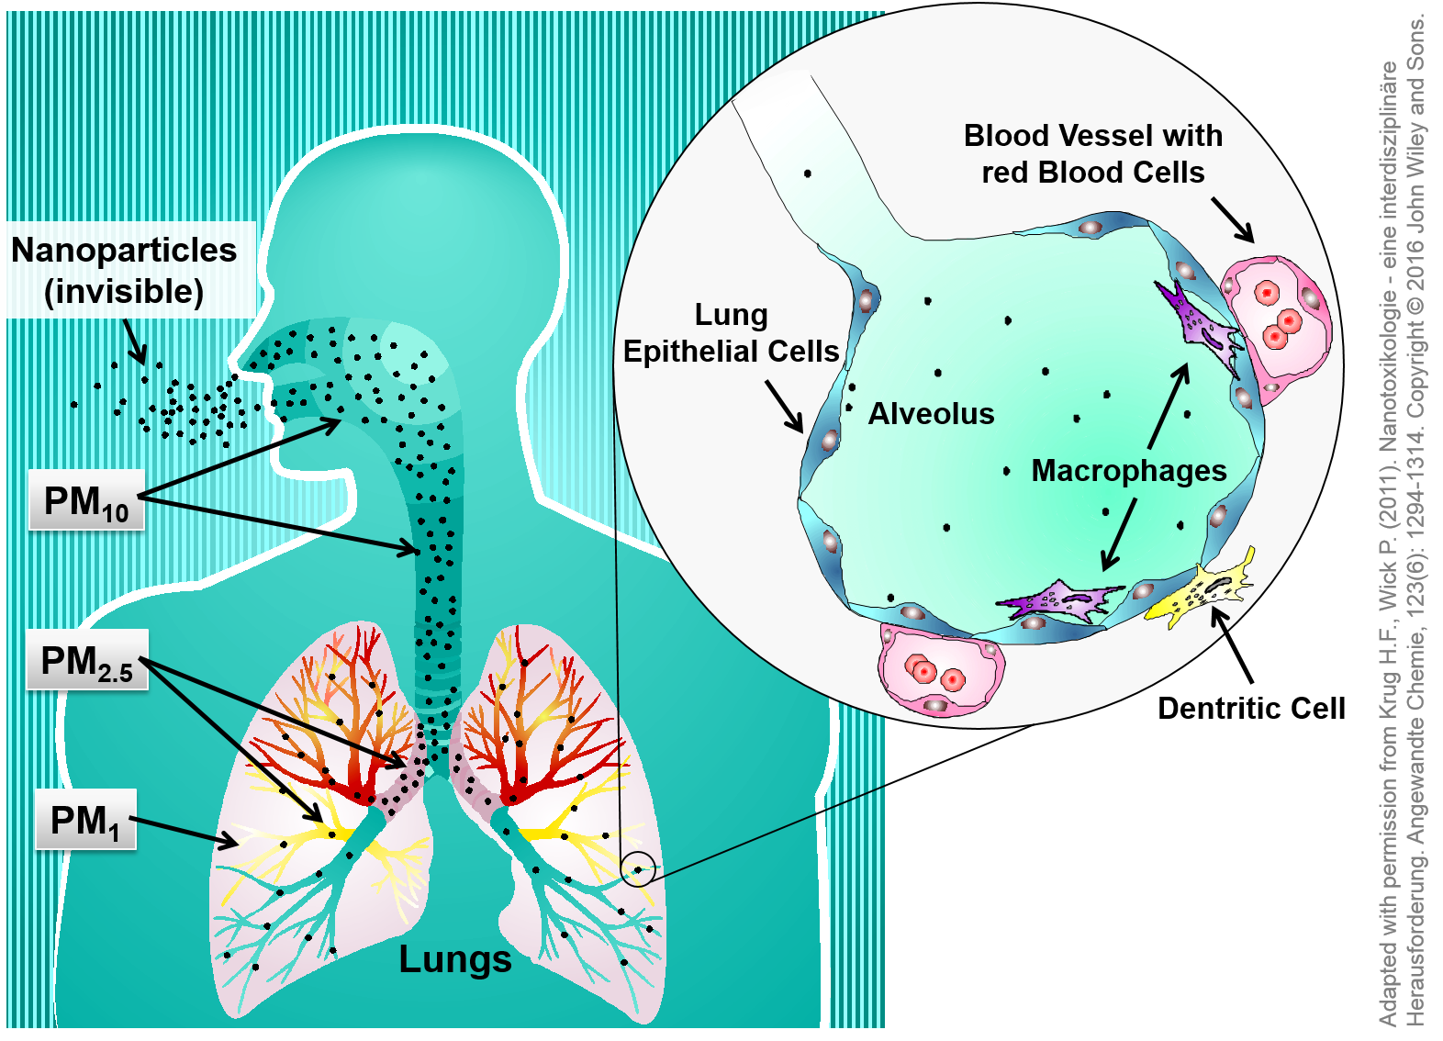
Health Effects, Particle Size & Lung Penetration
Particle sizes < 1 μm are called “ultrafine” – most dangerous since penetrate deeply into lungs
Notes:
The size of PM particles directly relates to health impacts since the smaller the particles the more deeply they can penetrate into the lungs. This graphic illustrates this.
As we mentioned a couple slides back, 10 micrometers is a rough size up to and below which particles are suspended in air and inhalable. Recall the term PM10 is all particles less than or equal to 10 micrometers in diameter.
Referring to the graphic, once inhaled the larger size fraction of PM10 is more likely to be captured by the upper respiratory tract – the nasal passages and throat. This can cause respiratory irritation and generally short-term, acute health problems.
However more serious, longer term health impacts are felt due to the smaller particles. Specifically, the PM2.5 fraction can penetrate through the upper respiratory tract into the lungs, irritating lung tissue. Even more dangerous impacts are for smaller particles, PM1.0 … 1 micrometer or less … which can penetrate all the way to the alveoli – the tiny sacs terminating bronchiole that reach the blood/air barrier. There is even evidence of these very tiny particles pass into the bloodstream, causing more systematic chronic health effects. We will learn more about this in Module 4 when we study the epidemiological research of PM health effects. Particles less than 1 micrometer in size are termed “ultrafine”, which are the most dangerous.
In general, the smaller the particle size the more dangerous the associated health effects.

Slide 7
Further Reading: PM Health Effects
https://ww2.arb.ca.gov/resources/inhalable-particulate-matter-and-health
https://en.wikipedia.org/wiki/Particulates#Health_effects
https://oehha.ca.gov/air/press-release/press-release-air/study-finds-long-term-exposure-ultrafine-particle-air-pollution
More details also in Module 4.
Notes:
Further reading on PM health effects is provided in these links. As mentioned, we will also cover this topic in more detail in module 4.

Slide 8
Ambient Air Quality Standards: PM10 and PM2.5
PM_{2.5}: (particles smaller than 2.5 μm)
Federal (annual): 12 μg/m³
Federal (24-hour): 35 μg/m³
PM₁₀: (particles smaller than 10 μm)
California (annual): 20 μg/m³
California (24-hour): 50 μg/m³
Federal (24-hour): 150 μg/m³
Both 24-hour and annual standards to protect against both acute and chronic health impacts
Notes:
As mentioned, PM10 and PM2.5 are both criteria air pollutants, and therefore have ambient air standards. These are listed here.
Notice that both short-term – 24 hour – and long-term – annual – standards exist. Notice also that the annual standards are lower in concentration threshold value than the 24-hour standards. For example for PM2.5, the 24 hour standard is 35 micrograms per m3 while the annual is less – 12 micrograms per m3.
The standards are therefore designed to be protective of short-term high daily episodic exposure that can cause acute health effects, and lower concentration sustained exposure that can cause chronic health effects.

Slide 9
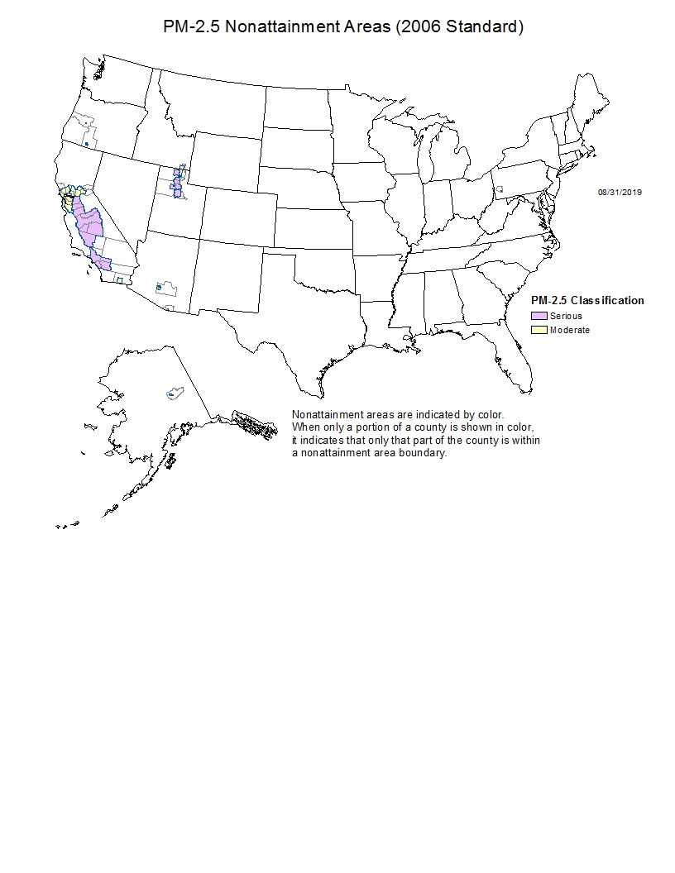
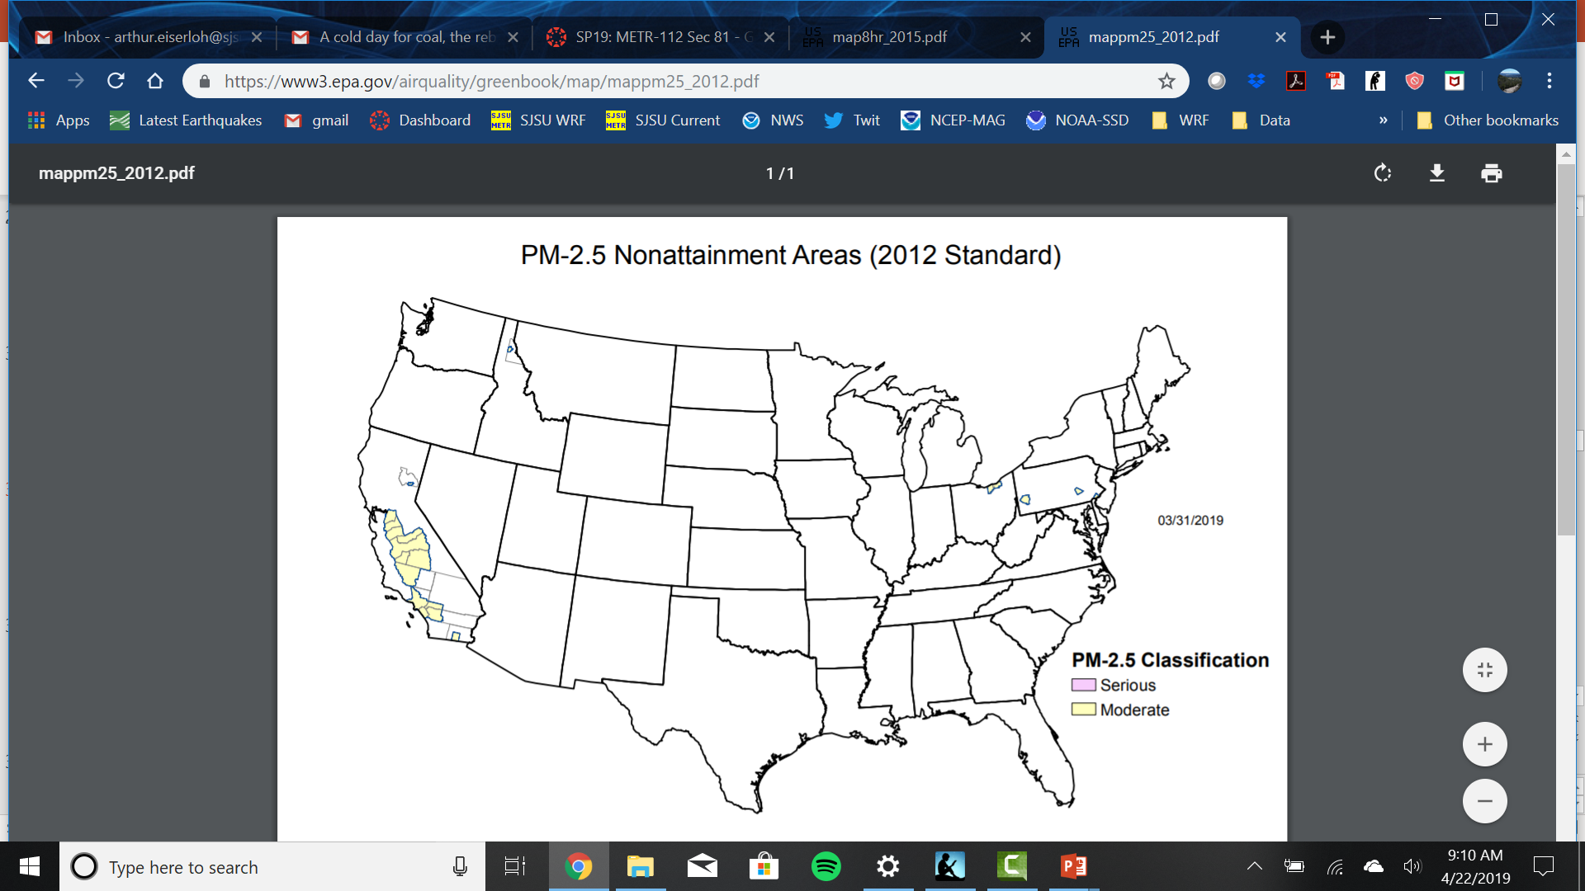
Current PM2.5 non-attainment areas (California)
Daily
Annual
Bay Area
San Joaquin Valley
Sacramento
San Joaquin Valley
Los Angeles Metro
Los Angeles Metro
Imperial Valley
Imperial Valley
Annual ambient air standard = 12 ug/m3
Daily ambient air standard = 35 ug/m3
Notes:
The current attainment status of PM2.5 ambient air quality standards across California is shown on this slide. The different color shadings indicates air districts with serious versus moderate non-attainment.
On the left is the attainment status for the 24-hour standard. There are five air districts in non-attainment of the 24 hour standard: the Bay Area, Sacramento, San Joaquin Valley, Los Angeles (South Coast) and Imperial Valley.
On the right is the situation for the annual standard. There are three air districts in non-attainment of the annual standard: San Joaquin Valley, Los Angeles Metro (South Coast Air District) and Imperial Valley.
Non-attainment is therefore more widespread with some serious non-attainment districts in California for the short-term standard. This is because of episodic periods when meteorological stagnation events during winter occur – which can cause short-term periods, days or perhaps a week or so, of very poor PM air quality.
However, areas where sustained exposure to poor PM air quality also occur. The San Joaquin and Imperial Valleys are both agricultural valley settings prone to poor PM air quality. Los Angeles, due to its size, multitude of emission sources, and unfavorable geopgraphic setting, is also prone to sustained high PM concentrations in certain areas of the air district.

Slide 10
Annual PM2.5 Concentration Map (U.S.)
U.S. Industrial Midwest
(“Pittsburgh”)
San Joaquin Valley
Monterrey & Mexico City (Mexico)
Green (< 10 ug/m3)
Yellow (10 - 15 ug/m3)
Orange (15 - 35 ug/m3)
Red (> 35 ug/m3)
Notes:
A map of current measurements of annual averaged PM2.5 concentrations across the U.S. is shown on this slide. The symbols are colored according to concentration ranges, as shown on the legend.
As seen, much of the country has maintained PM2.5 concentrations less than 10 micrograms per m3 … complying with annual standard of 12 micrograms per m3.
Areas of higher annual PM2.5 are indicated on the plot … for example the CA Central Valley as discussed in the last slide, and also areas of the industrial Midwest where sulfate PM2.5 is common. We will discuss this more in later slides.
Notice also the much higher values in Mexican cities – where emission controls are less stringent. Mexico City in particular has very poor air quality due to its size and unfavorable setting, surrounded by mountains.

Slide 11
Annual PM2.5 Concentration Map (global)
Eastern Europe
China / India
U.S.
Various global major cities
Green (< 10 ug/m3)
Yellow (10 - 15 ug/m3)
Orange (15 - 35 ug/m3)
Red (> 35 ug/m3)
Notes:
A map of current measurements of annual averaged PM2.5 concentrations across the world is seen on this slide. The symbols are colored according to concentration ranges, as shown on the legend.
As seen, very high annual PM2.5 concentrations exist in China and India. This was something students in this class learned about on the last assignment – where videos of the situation in India and China were viewed. Several other areas of high concentrations are also seen – in Eastern Europe and across other major cities in the developing world. Again, rapid growth, industrialization and motor vehicle use, coupled with lack of emission controls, lead to this situation.

Slide 12
Fine Particulate Air Pollution
(Composition)
Notes:
Fine Particulate Air Pollution – Composition

Slide 13
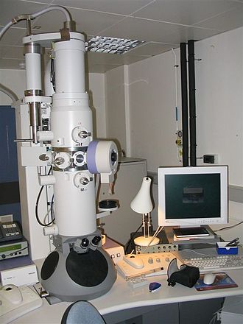
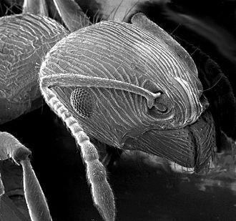
Electron Microscopy (EM)
an ant viewed from electron microscope
(example illustrating magnification power of EM)
https://en.wikipedia.org/wiki/Electron_microscope
Notes:
Electron microscopy is a commonly used scientific measurement technique for viewing very small object not detectable to the human eye. A weblink for those interested in learning more about the technique is provided below. The electron microscope image on the right of an ant illustrates the fine detail obtainable from the technology.

Slide 14
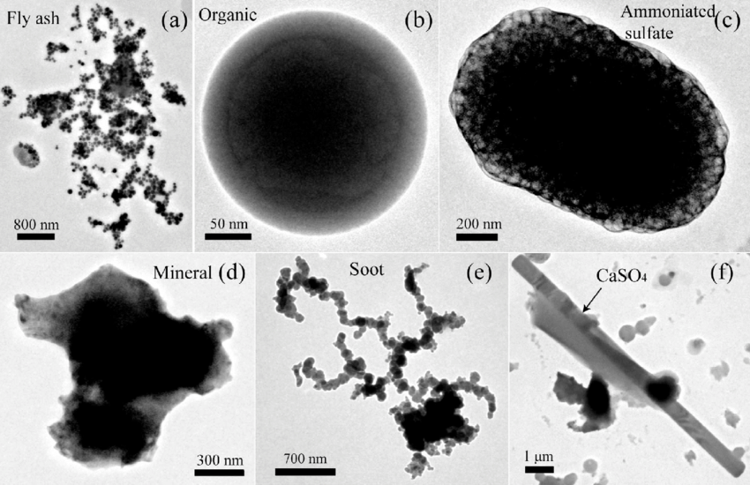
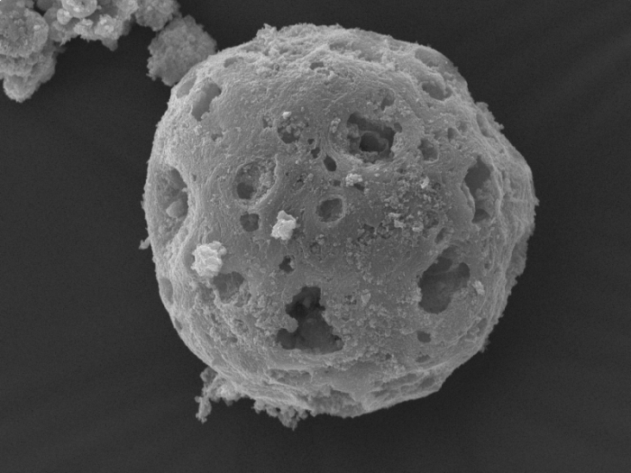
Ash
Organic Carbon
Ammonium Sulfate (“secondary PM”)
Fine Particulate
(“sub-micron”, < 1 μm)
(electron microscope images)
Mineral Dust
Black Carbon (“Soot”)
Individual soot particulate (3000 x blow-up)
Notes:
Electron microscope images of various individual fine particulate aerosols are shown on this slide. All of the particles seen here are around 1 micrometer in size or less. There are size bars on each image to gauge precise sizes of each.
The level of detail of the images is impressive. More substantially, one sees the variety shapes and types of fine particulate aerosols that can exist in a given sample of air. These can be almost perfectly spherical, for example for the organic carbon seen on the middle top and and soot/smoke particles on the lower right. The individual soot particle shown is a part of a branches of a conglomerated particles comprising a smoke aerosol.
Other particle types seen are ash on the top left, ammonium sulfate on the top right – a form of secondary particulate as we will discuss later – and mineral dust on the lower left. The variety of particle shapes, sizes and composition in the fine PM mix make the subject of understanding and characterizing fine PM a challenging task for air pollution researchers and regulators. Much is to still to be learned of how PM health effects depend on the composition of PM. Since different types of PM arrive from different emission sources, understanding PM composition is also important for regulating PM.

Slide 15
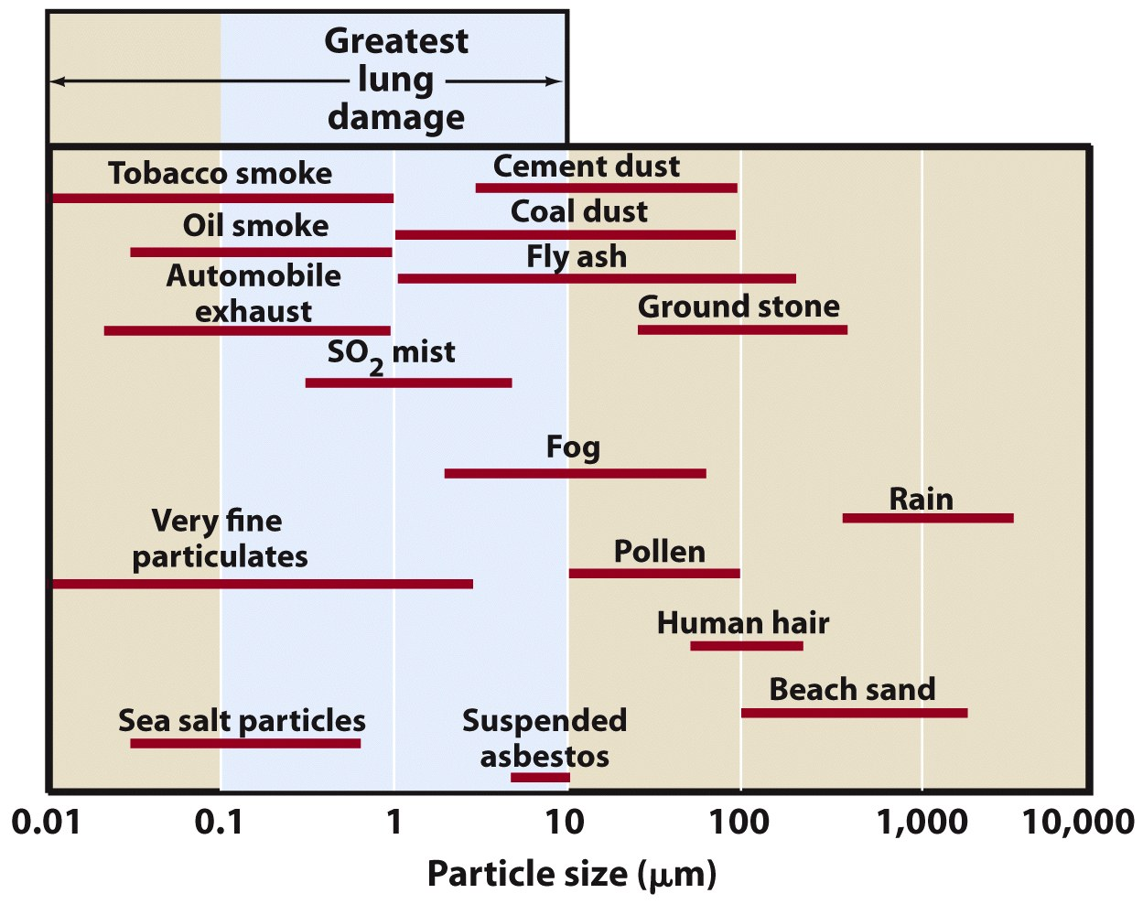
Notes:
A chart of PM composition organized according to particle size is shown on this slide. The particle size on the horizontal axis ranges left to right across the axis from sub-micron particles out to very large, non-aerosol sizes. Various types of particulate are shown on the body of the graphic, with the length of red line underneath each type spanning the approximate range of particle size associated with each type of particle.

Slide 16
PM10
PM2.5
Notes:
We can mark off the PM10 and PM2.5 ranges within this graphic. Note that both PM10 and PM2.5 include particulate smaller, up to the indicated size, hence we mark off each with boxes spanning the entire range smaller and up to the size for each.

Slide 17
PM10
Dust
(primary particulate)
(various types)
(typically within PM10 more than PM2.5)
Combustion particulate
(primary particulate)
(carbonaceous)
(smoke, soot, others)
Secondary Particulate
(Sulfates, Nitrates, “SO2 mist”)
(Secondary Organic Aerosol)
Notes:
Within the PM10 range one can summarize the composition according to three main classes.
First, the larger size portion of PM10 is comprised of dust. This generally comprises any fine dust, soil, crustal material, large ash or char. Such material generally originates naturally from windblown dust, or anthropogenically from construction, mining activity, road dust, close to large fires, or other manners.
Second, smaller size portions consist of “combustion particulate”. This is smoke, soot or other carbonaceous (carbon-containing) particulate from any combustion source – such as fires, or motor vehicle and industrial fuel combustion.
Third, there is a class of fine particulate called “secondary particulate”. We learned about what a secondary pollutant is in the last lecture explaining ozone, which is not emitted directly but is formed from precursor NOX and VOC emissions. Ozone is therefore a secondary pollutant … not directly emitted but formed photochemically from other emissions. Likewise, there are PM aerosol types that are secondary. These include sulfates, nitrates, SO2 mist, secondary organic aerosols and others. The formation process of these is complex and will not be covered in great detail here. However, as with ozone, precursor gas emissions are associated with each of these secondary aerosols. We will cover this shortly.
Finally, note the types of particles that are not included … which are larger than the size associated with PM10 and PM2.5. This includes coarse dust greater than PM10, pollen and sand. While not technically part of PM10 and PM2.5, pollen of course causes health problems and allergic reactions – and is of concern for this reason.

Slide 18
PM2.5
Combustion particulate
(primary particulate)
(carbonaceous)
(smoke, soot, others)
Secondary Particulate
(Sulfates, Nitrates, “SO2 mist”)
(Secondary Organic Aerosol)
Notes:
Shifting over to PM2.5, we see that dust is largely eliminated from the composition mix – leaving combustion PM and secondary particulate. When talking about the very small particle sizes that can penetrate deeply into lungs, we therefore are not too concerned with dust. Rather, combustion and secondary PM are of most concern with respect to PM2.5 and more hazardous, smaller ultrafine particulate.

Slide 19
PM2.5 Composition: Combustion vs. Secondary
Combustion PM2.5 (Carbonaceous)
  Fine particulate emitted during combustion.
  Very small particle size (< 1 μm … “sub-micron”)
  Various sub-types, terms: Smoke, Soot, Black Carbon, Elemental Carbon, Organic Carbon, tar, etc ...
  Directly emitted from source (“primary particulate”)
Secondary PM2.5
  Fine particulate formed from chemical reactions
  Very small particle size (< 1 μm … “sub-micron”)
  Various sub-types: Sulfates, Nitrates, Ammonium Nitrate, Secondary Organic Aerosol
  Not directly emitted from source. Forms from chemical reactions from gaseous precursor emissions
  See next slide: gaseous pre-cursors for main secondary PM2.5 species
Notes:
So summarizing … when referring to PM2.5 there are two main classes of composition types.
First, there is combustion PM2.5. It is fine particulate emitted directly from combustion sources – tailpipes, smokestacks, etc … - and is therefore “primary” particulate, emitted directly. Most of this is “sub-micron” in size, less than 1 micrometer, and therefore able to penetrate deeply into lungs. On the third bullet one can see various types and names given for combustion PM25. Most familiar to students is smoke and soot, which we see emitted from combustion sources as black smoke. The other names, black carbon, elemental carbon, etc … are more technical terms air pollution professionals use to be more precise about chemical makeup of various combustion PM types. In this class we will just to refer to all of these collectively as combustion PM2.5
Second, there is secondary PM2.5. This is fine particulate not directly emitted from sources, but rather formed from chemical reactions in the atmosphere from other pollutant gases that are emitted – similar to ground-level ozone studied in the last lecture. The pollutant gases that are emitted that chemically form into secondary PM2.5 are called precursors. Like combustion PM2.5, secondary PM2.5 are very small sub-micron particulate that penetrates deeply into lungs. Among the main types of secondary PM2.5 are nitrates, sulfates and secondary organic aerosol.

Slide 20
Secondary PM2.5: Precursors & Formation Conditions
Nitrates
  Precursors: Nitrogen Oxides (NOx), Ammonia (NH3)
  Formation: Aqueous chemistry. Favors high humidity environment.
Sulfates
  Precursors: Sulfur Dioxide (SO2), Ammonia (NH3)
  Formation: Favors high humidity environment (aqueous chemistry)
Secondary Organic Aerosol (SOA)
  Precursors: Volatile Organic Compounds (VOCs)
  Formation: Favors hot, sunny weather (photochemical … similar to ground-level ozone)
  Relatively little known … active area of research
Notes:
A bit more detail about secondary PM2.5 is presented on this slide. We distinguish between three broad types – nitrates, sulfates and secondary organic aerosol. For each we indicate the main precursor gases for its formation, and a summary of the chemical formation mechanism.
Nitrates are formed from emissions of nitrogen oxides (Nox). Ammonia gas also leads to a particular type of nitrate called ammonium nitrate. Nitrates form from aqueous phase chemistry, and therefore favor a high humidity environment.
Sulfates are formed from emissions of sulfur dioxide (SO2) and other sulfur gases. Ammonia gas also leads to a particular type of sulfate called ammonium sulfate. Sulfates also form from aqueous phase chemistry, and therefore favor a high humidity environment.
Secondary Organic Aerosol form from emissions of volatile organic compounds (VOCs). They form from photochemical reactions involving sunlight – similar to ground-level ozone. SOAs therefore prefer hot, sunny weather. Little is known about the details of SOAs – so we will not cover these further.

Slide 21
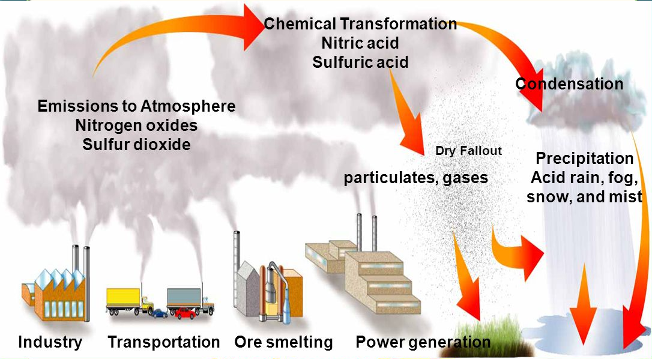
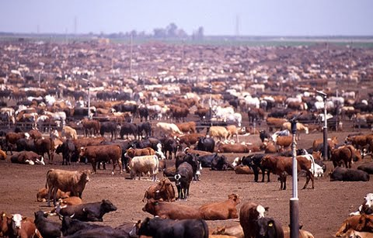
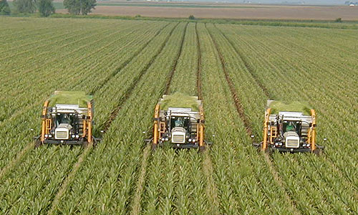
Nitrates & Sulfates: Summary of Formation Process
Ammonia
Secondary particulate
sulfate, nitrate, ammonium
Agricultural
Notes:
Focusing on nitrates and sulfates, the next few slides give an overview of the aqueous chemistry that leads to their formation.
Seen here is a graphic where the process of emissions of precursor gases through the chemical formation into nitrate and sulfate particulate is pictorially summarized.

Slide 22
NOx and SO2 Emissions (Precursors)
Ammonia
Secondary particulate
sulfate, nitrate, ammonium
Precursors
NH₃
SO₂, NO_{x}
Emission Sources
Agricultural
Notes:
Tracking this process, we see on the bottom left emission sources of precursor gases. These include industrial stationary, mobile and agricultural sources. These emit the main precursor gases SO2, Nox, Ammonia (NH3) and other compounds that can play a role.

Slide 23
Chemical Reactions in Air to Nitric Acid (HNO3) and Sulfuric Acid (H2SO4) and Absorption into liquid H2O
Chemical Reactions
H₂SO₄, HNO₃
Acidic Fog, Mist, Rain
Ammonia
Secondary particulate
sulfate, nitrate, ammonium
Agricultural
Notes:
Once in the air, these precursor gases in the presence of high humidity can chemically react to acidic compounds, which in turn dissolve and dissociate into ions in liquid water in the air – haze, fog and cloud droplets. The hydrogen ions produced during dissolution of these compounds in these drops leads to increased acidity of fog, clouds and rain. This is the cause of “acid rain”, which students may be familiar with.

Slide 24
Further chemical reactions
(Nitric Acid to Nitrate PM2.5)
(Sulfuric Acid to Sulfate PM2.5)
Chemical Reactions
Ammonia
Secondary particulate
sulfate, nitrate, ammonium
SO₄²⁻, NO₃⁻, NH₄⁺
Agricultural
Notes:
The ions of nitrogen and sulfur produced in this way then combine into solid particles with various other ionic species in the air or within the droplets to form tiny particles, which we call nitrates and sulfates. For example, the combination of the negative nitrate and sulfate ions with the positive ammonium ion leads to ammonium nitrate and ammonium sulfate. These particles can exist as a mist, containing some liquid water around and within the particle, or dry - without H2O, remaining left behind in the air after the cloud, fog or haze droplets evaporate.

Slide 25
PM2.5 Composition in CA
(cold wintertime high pollution days)
Carbon
(combustion)
(primary)
Nitrate
(Secondary)
Nitrate
(Secondary)
Carbon
(combustion)
(primary)
Sulfate
(Secondary)
Sulfate
(Secondary)
San Jose
(4th and Jackson St.)
Bakersfield
(California Ave.)
Mix of primary combustion based PM2.5
and secondary nitrate in Bay Area
Larger nitrate contribution in
Southern San Joaquin Valley
Notes:
Given this summary of PM2.5 composition, we can now look at some examples of the compositional mix of PM2.5 in air samples. This is called PM2.5 “speciation” in the air pollution professional world.
We show on this slide two examples for California on high wintertime PM2.5 days. On the left is a sample from the San Jose 4th and Jackson air monitoring site, on the right from Bakersfield California Ave – in the southern San Joaquin valley. The way to interpret these is to imagine collecting a sample of PM2.5 particulate, sending it to the lab to distinguish the chemical make-up of particle, classify the various chemicals into groups, and presenting the results on a pie chart.
Looking at those presented here, we see that the samples are predominantly made up combustion PM2.5 and secondary PM2.5.
In San Jose, the proportions of each are roughly equal – a little over half combustion PM2.5 and a bit less than half nitrates and sulfates, nitrates more predominant.
In Bakersfield, a larger percentage is nitrates, with much but lesser amounts of combustion PM2.5.
These charts are illustrative of the complexity of PM2.5 speciation and the variations that can occur from site to site. The speciation of PM2.5 is important for air pollution regulators, since this chemical make-up of PM2.5 then indicates the which emission sources to prioritize in developing regulations to reduce emissions and concentrations in the air.

Slide 26
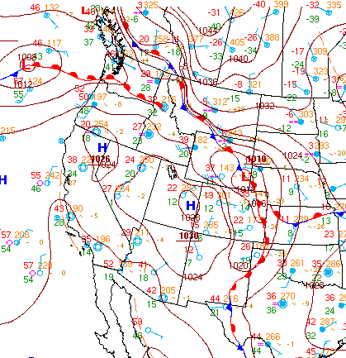
High PM2.5 Episodes in California: Stagnation Period
Meteorology
Weak Winds
Cold Temperatures
Ground-based inversion Layers
High Relative Humidity / Fog
PM2.5 Effect
High episodic PM2.5 (combustion and nitrates)
Emission Sources:
  Primary PM: Smoke & carbon aerosol from residential heating and other combustion sources (woodsmoke, cars, trucks, factories)
  Secondary PM: combustion (NOx) & agricultural (NH3) precursors for nitrate
Broad area of high pressure
https://www.bakersfield.com/news/air-district-blames-atmospheric-stagnation-for-wintertime-pollution-spikes/article_acb6f950-1da5-11e8-a175-77fd45139ccc.html
Notes:
Highlighting again the conditions for poor wintertime PM2.5 in California, we again emphasize the importance of high pressure systems and stagnation events. We revisit a graphic from Lecture 7 of a particular recent event. The weather map on the left shows the broad area of high pressure covering the western U.S. and California.
Meteorologically, this leads to very weak winds and low dilution of emissions, very cold temperatures, ground-based inversion layers and high relative humidity and fog.
The effects of this on PM2.5 are high episodic PM2.5 with both combustion and secondary makeup. The primary combustion PM2.5 results from smoke emitted from residential heating – often woodsmoke from people heating their homes – and normal stationary and mobile combustion sources. The secondary PM2.5 is mostly nitrates, with the precursor Nox emissions from mobile and stationary sources, and ammonia from agricultural emissions – largely fertilizers and livestock.
Until the high-pressure system breaks down, these conditions persist - leading to an increasing build-up of PM2.5 pollution over days. Stagnation periods unfortunately usually last several days or even perhaps beyond a week.

Slide 27

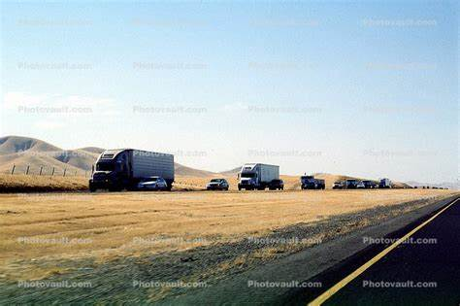
California Central Valley wintertime PM2.5
Ground-Level Fog (“Tule Fog”)
Ground-Level Temperature Inversion
(High humidity, low winds, little dilution)
(agricultural emissions of ammonia NH3)
Mobile Source Emissions
(Trucks, Diesel PM Emissions)
(Trucks, NOx Emissions)
Notes:
We mentioned the California Central Valley, primarily the southern San Joaquin valley, as a region where wintertime PM2.5 is high. We see here a graphic of this to highlight details. On the left is a photograph of the familiar “Tule Fog” of the Central Valley. This is a ground based fog that forms during periods of cold, clear sky conditions. The fog is contained within a shallow ground-based temperature inversion – where cooler air settles near the bottom. The conditions of cold air and high humidity favor nitrate PM2.5
Agricultural emissions of ammonia, and the abundant NOx from trucks traversing the valley (seen on the right) provide the precursor emissions for nitrates and ammonium nitrate.
Also, trucks emit abundant combustion PM2.5 directly. A sub-class is “diesel particulate”, emitted from combustion of diesel fuel within diesel engines. It turns out that long-term exposure to diesel PM is particularly harmful with respect to increased risk of cancer.

Slide 28
PM2.5 Composition in U.S. Industrial Midwest
(Measurements from Pittsburgh, PA)
Organic carbon
Ignore stars
PM_{2.5} (μg/m³)
Jul Aug Sep Oct Nov Dec Jan Feb Mar Apr May Jun
2001 2002
Courtesy Spyros Pandas “Atmospheric Aerosol From the Source to the Receptor Insights from the Pittsburgh Supersite
Notes:
We turn now to another region: the U.S. Industrial Midwest. Shown here is graph of PM2.5 speciation for sampling at Pittsburgh PA over roughly a two year period. Each bar along the horizontal is a particular month over the two-year period, and the bars are hatched according to PM2.5 make-up. The vertical axis is the monthly average PM2.5 concentration in micrograms per cubic meter.
The main thing to notice, which distinguishes these samples from those in California presented earlier, is the relative abundance of sulfate PM2.5 … the green portion of the bars. Also different from California, the highest concentrations occur in summer, mainly due to the increasing importance of sulfates in the speciation mix. This is because the high humidity environment required for secondary sulfate aqueous chemical formation occurs mostly in summer due to humid air flow from the Gulf of Mexico. Combustion PM2.5, indicated in the red as organic carbon, is fairly constant throughout the year by comparison.

Slide 29
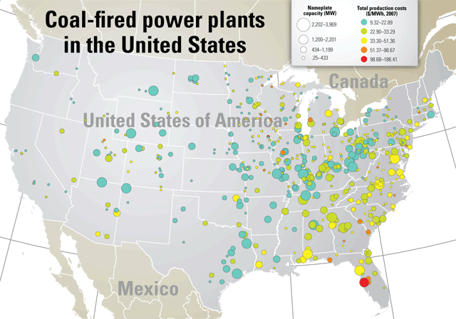
Pittsburgh
Coal Fired Power Plants
Precursor source of SO2 gas
Forms sulfate PM2.5
http://www.powermag.com/map-of-coal-fired-power-plants-in-the-united-states/
Notes:
The reason for the higher sulfate proportion in PM2.5 in the U.S. Midwest is because of the presence of many coal fired power plants, which emit much precursor sulfur dioxide. This is highlighted on this slide. The bubbles map are coal fired power plants. The larger the bubble the greater the energy producing capacity of the power plant. The coloring of symbols is according to dollar cost per kWh of electricity production.
To recall, the town of Donora, where the major air pollution episode occurred in 1947 that caused deaths and motivated the Clean Air Act, is close to Pittsburgh – about 100 km south.

Slide 30
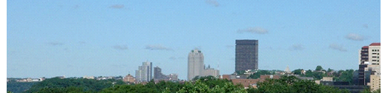
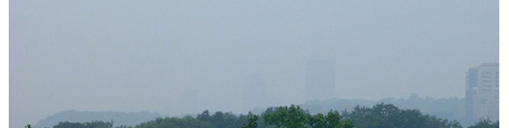
Visual of high PM2.5
(Pittsburgh, PA)
July 2, 2001
PM_{2.5}=4 μg m⁻³
“low PM2.5 day”
July 18, 2001
PM_{2.5}=45 μg m⁻³
“high PM2.5 day”
Courtesy Spyros Pandas “Atmospheric Aerosol From the Source to the Receptor Insights from the Pittsburgh Supersite
Notes:
The haze of summertime sulfate PM2.5 in Pittsburgh is seen on the bottom photograph on this slide for a particular day. PM2.5 concentrations were 45 micrograms per m3 on the day of the bottom graphic. By comparison, a clean day – 4 ug/m3 – is seen on top.

Slide 31
Fine Particulate Air Pollution
(Emission Sources; Combustion PM)
Notes:
Fine Particulate Air Pollution – Emission Sources of Combustion PM

Slide 32
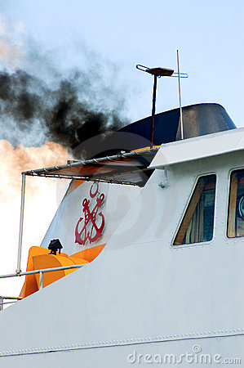
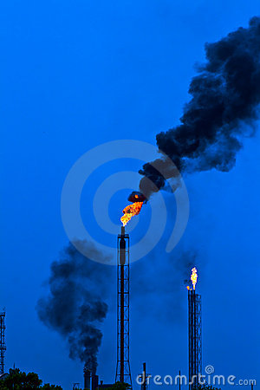
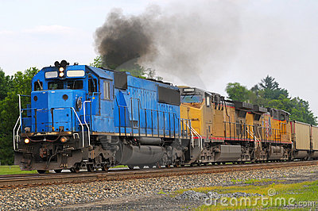
Combustion Particulate: Sources
(“smoke”, “soot”, black carbon, elemental carbon, organic carbon)
Srecko/Kenneth Sponsler/Efired/Dreamstime.com.
Notes:
We conclude this lecture with some photographs that highlight some aspects of combustion PM emission sources. As seen in these images, this is largely the black smoke emitted from combustion sources. Its black color is a consequence of absorption of all visible light wavelength, and there a black color.
Recall that although the visual may inply these are large particles, since they are so dark and black, the particles emitted by combustion are extremely small – ultrafine sub-micron particles. They are therefore very harmful if inhaled.
Also recalling from our study of combustion physics from an earlier lecture, smoke results from incomplete combustion. Smoke is therefore comprised of unburned or partially burned fuel constituents. Chemically, the make-up can be a simple as pure carbon – called elemental carbon – or a complex mixture of tar and other organic compounds – called organic carbon. The chemical make-up of combustion PM and its effects on health is actively being studied by researchers.

Slide 33
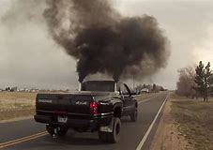
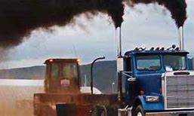
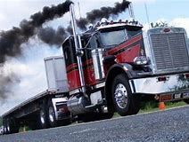
Diesel-Fired Trucks: Especially harmful source of combustion PM
Diesel Particulate Matter (DPM)
is a strong carcinogen …
Notes:
From this research, it is being found that diesel smoke emissions, largely from trucks, are a particularly harmful, carcinogenic form of combustion PM2.5. California regulators are taking active steps to reduce particulate emissions from trucks – phasing in engine retrofitting so engines are modernized and have advanced emission control equipment. Also, cleaner and lower sulfur containing diesel fuels have been developed to reduce particulate and pre-cursor gas emissions from diesel engines.

Slide 34
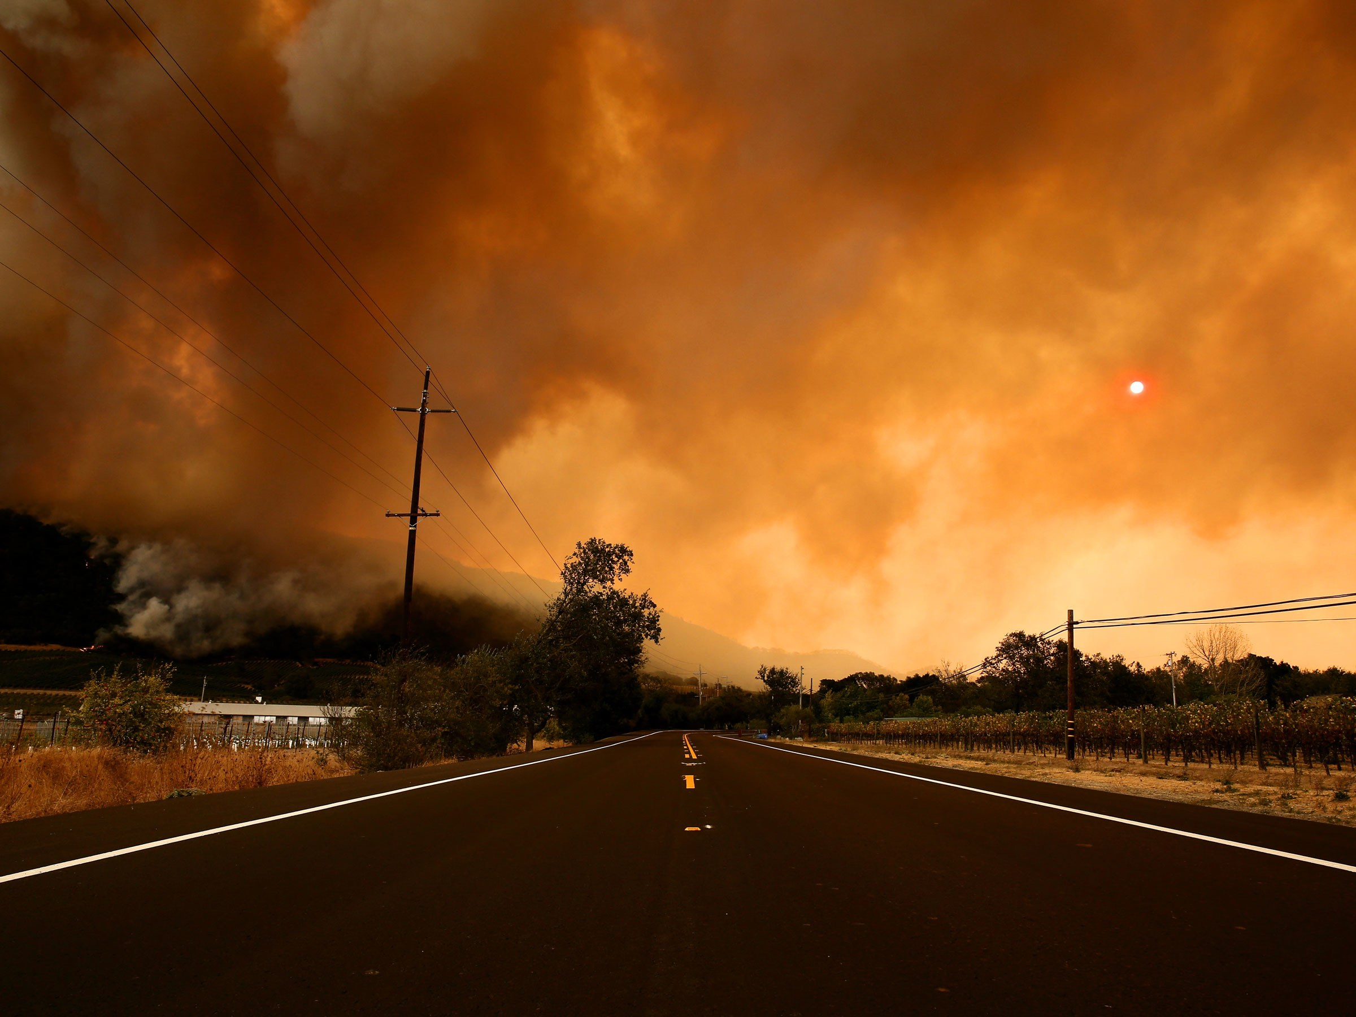
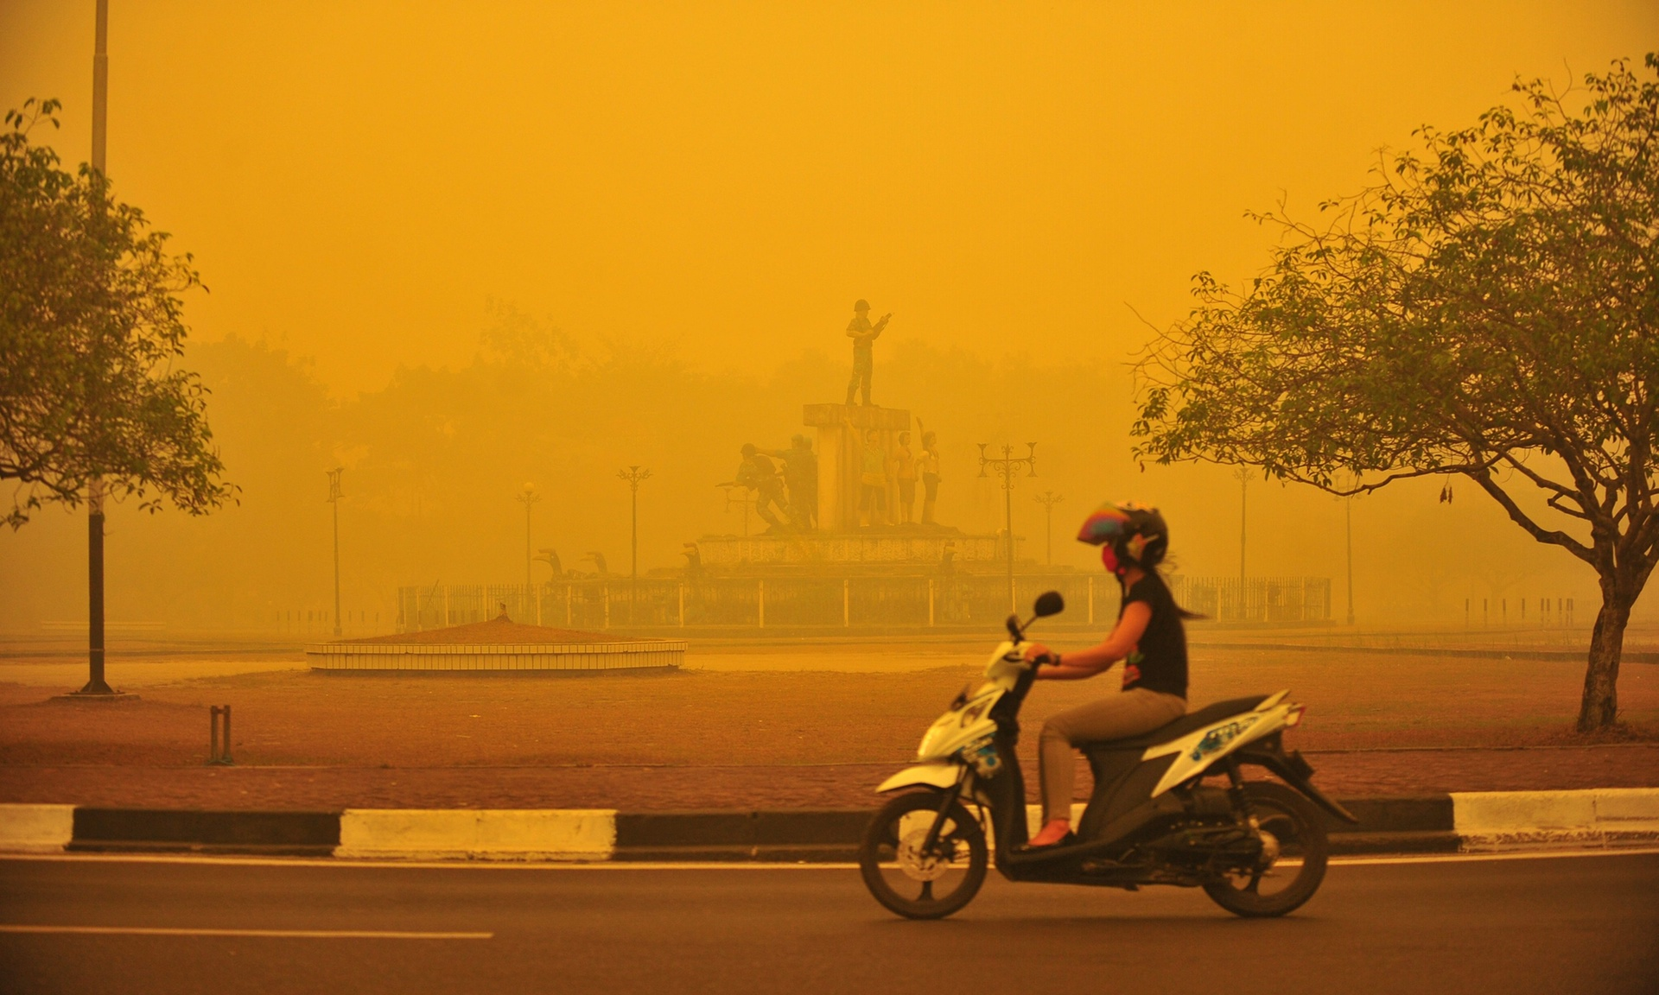
Biomass Combustion: Another large source especially globally
Wildfires
Agricultural Burning
http://www.theguardian.com/world/2015/oct/26/indonesias-fires-crime-against-humanity-hundreds-of-thousands-suffer#img-1
Tubbs Fire (Napa Valley Fires), October 2017
Notes:
Another main source of combustion PM is biomass burning. This can come in the form of natural wildfires, an example seen from a photograph of our recent October 2017 Napa Valley fires in Northern California. Another example, seen on the right, is agricultural and forest burning, which is often done to clear space for agricultural crop production and/or to dispose of waste biomass.
Aside from being a hazard to human health if inhaled, particulate emissions from these sources span large areas, can inject particulate deep into the troposphere and be transported long distances downwind. Biomass combustion is therefore of concern for long-range global transport, and is an important contributor to the global particulate levels affecting climate change.

