Slide 1

Critical Assessment of Dispersion Modelling after Six Decades of Development
Steven Hanna
Hanna Consultants, Kennebunkport, Maine, USA
Presented at 12th International Conference on Air Quality – Science and Application
Thessaloniki, Greece
9-13 March 2020
hannaconsult@roadrunner.com P198 AQ2020 Hanna

Slide 2
Acknowledgements
Research sponsored by U.S. Defense Threat Reduction Agency
Thanks to my first boss, Frank Gifford, at the Atmospheric Turbulence and Diffusion Lab in Oak Ridge, TN, for emphasizing the need to be aware of the history of our field, and to use proper attribution in references

Slide 3
Brief history of dispersion modeling older than six decades (pre-1960)
Prior to WW1 – Major air pollution episodes cause many health effects. Little work on dispersion models.
1910s through 1930s - New dispersion research (theory and field studies) was spurred by the use of chemical weapons by both sides in WWI
1940s and 1950s – Studies of plume rise, dispersion, and wet and dry deposition were spurred by the use of atomic bombs in WWII (started as analytical models)
1950s – Dispersion of routine and accidental releases of chemical, biological, and radiological pollutants (analytical formulas)

Slide 4
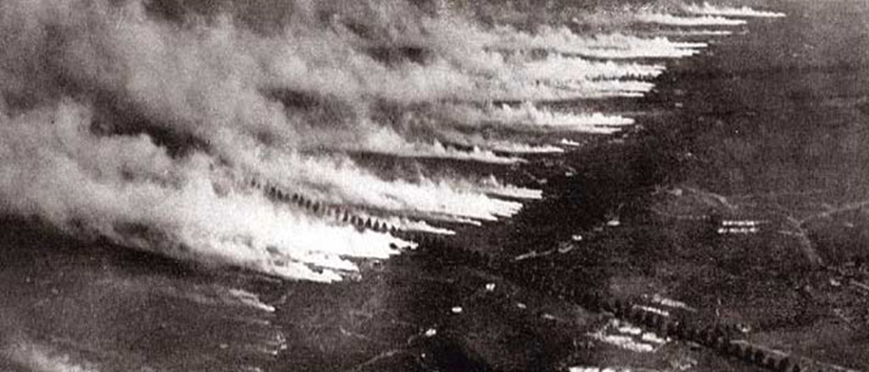
WW1 Chemical Attack (105 years ago)

Slide 5
Examples of chemical agent use in WW1
April 22, 1915 - The German military launches the first large-scale use of chemical weapons in war at Ypres, Belgium. 170 metric tons of chlorine gas in cylinders are buried along the front. More than 1,100 people die.
May, 1918 - U.S. research on mustard gas moves to Edgewood Arsenal run by the newly created Chemical Warfare Service.
June, 1918 - The Allies begin using mustard gas.
November 11, 1918 - World War I ends with 90,000 to 100,000 fatalities caused by chemical weapons, primarily from phosgene.

Slide 6
Dispersion models for chemical agents 1910-1950
Analytical models (e.g., G.I. Taylor’s and L.F. Richardson’s equations)
Near-surface point sources
Few field experiments were available for development and evaluating models

Slide 7
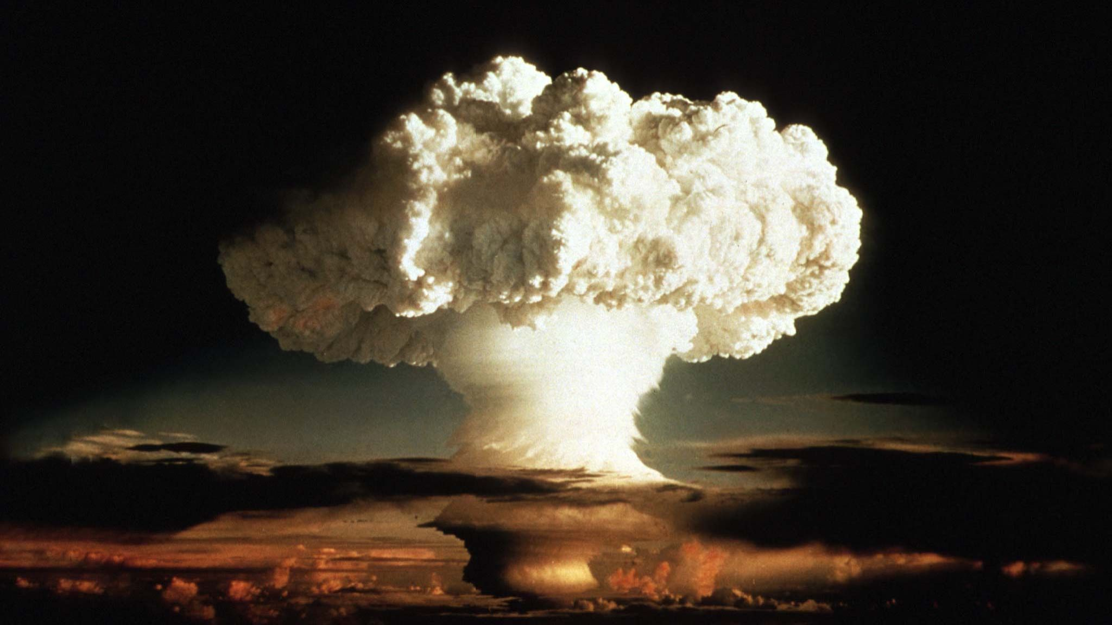
1940s through present – Modeling of plume rise, transport and dispersion, and wet and dry deposition of radiological pollutants

Slide 8
Issues for dispersion models for radiological pollutants from large buoyant releases
  The extremely buoyant puff rises through the troposphere; the resulting plume can be in the stratosphere
  Subsequent long-range transport around the world
  Fallout due to dry deposition and wet removal (This is the major dose-delivery mechanism)

Slide 9
Dispersion models for chemical agents and other pollutants 1950-1960
Gaussian plume models
Dispersion (sigma) parameterizations based on new field experiments such as Prairie Grass (1956, sponsored by US DOD)
Advanced analytical K models (e.g., Calder)

Slide 10
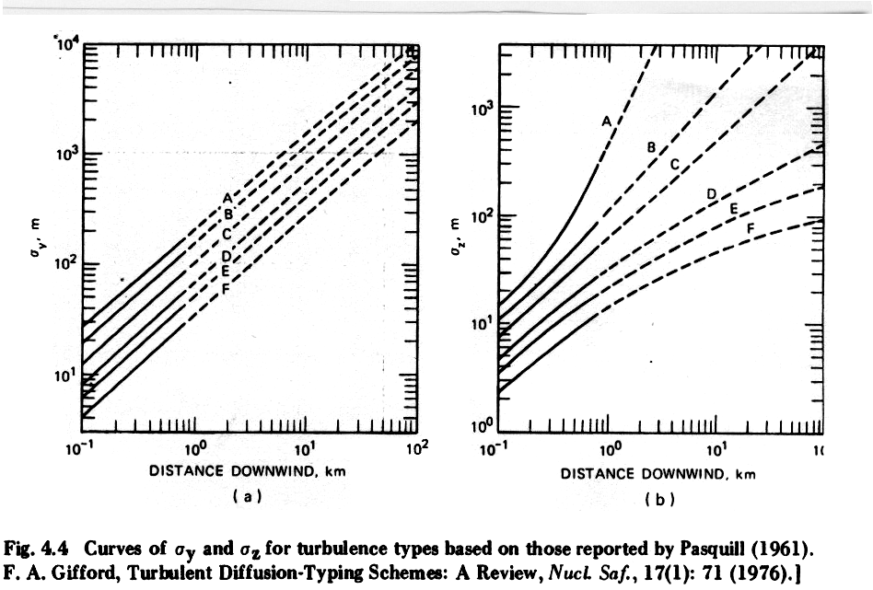
Pasquill-Gifford σ curves from 1961 (still widely used)

Slide 11
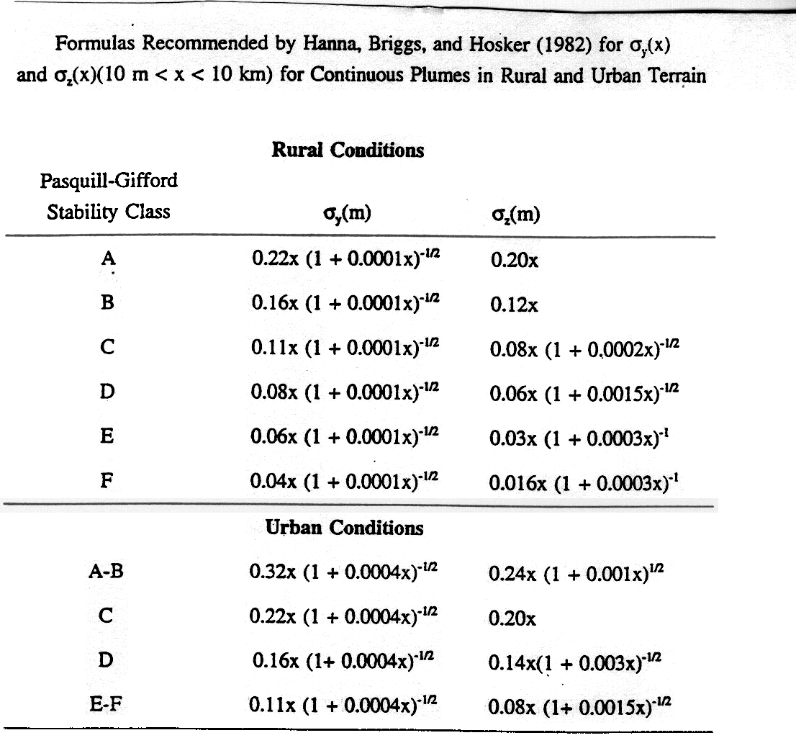
1970s – Briggs σ formulas for rural and urban

Slide 12
Dispersion models for chemical agents and other pollutants 1980 - present
Lagrangian puff models couple diagnostic mass-consistent wind models with puff dispersion models
In 1990s, Lagrangian particle models (LPDM) were able to be run on computers in reasonable times.
Now there are Eulerian grid models, coupled with weather forecast models (e.g., WRF or ECWMF)

Slide 13
European Tracer Experiment (ETEX)
Intended to test Lagrangian puff models and Eulerian models for Chernobyl-type large radiological releases. Spurred by model problems following Chernobyl accident
Two PFT (perfluorocarbon tracer) puff releases took place without prior warning to modelers
About 20 modelers then had to spring into action and provide real-time simulations of the cloud.

Slide 14
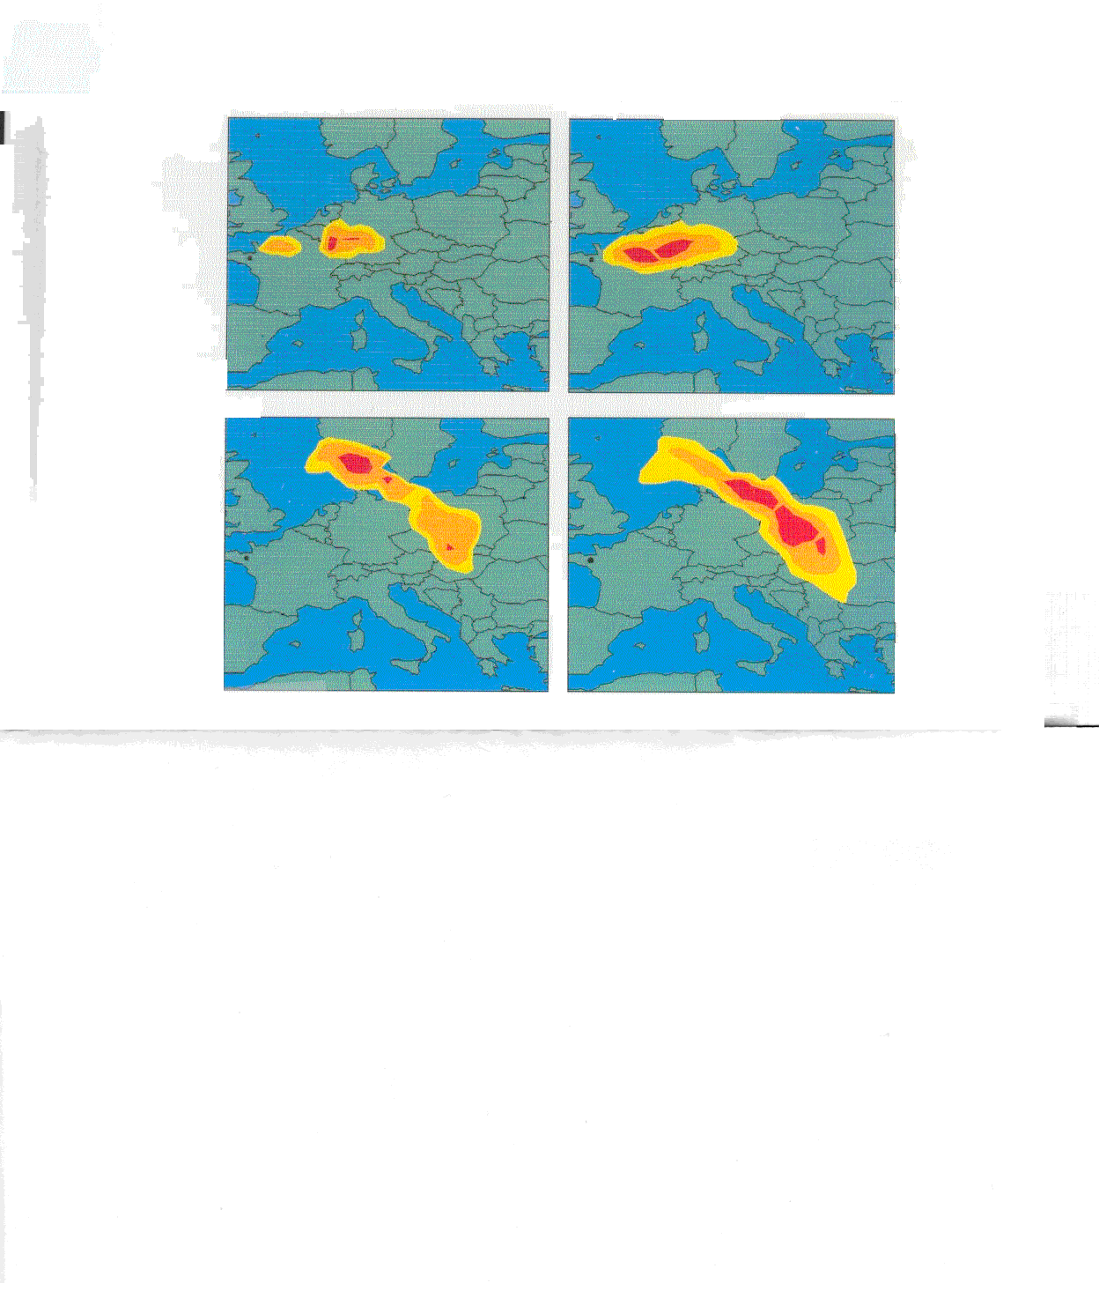
Colors for C contours vary from one plot to the next
ETEX observed tracer cloud 24, 36, 48, and 60 hrs after puff release of PFT in NW France. Puff became distorted because it was in an occluded front

Slide 15
1970s - present
Studies of pollutant dispersion spurred by 1972 Clean Air Act in the US and similar in other countries
Industrial short range dispersion (initially analytical models (Turner’s workbook) morphing to AERMOD, ADMS and other Gaussian-based models) are required to be run.
Regional dispersion (Lagrangian puff models such as CALPUFF and SPRAY and 3-D Eulerian models such as CMAQ and MARS). Sophisticated chemistry and aerosols treatment.

Slide 16
Models for General Applications (besides routine air pollution releases)
Many Lagrangian models (e.g., HYSPLIT) for major single sources such as volcanoes, wild fires, and large chemical accidents
Expansion of region domain to global
Linkages of all dispersion models with WRF

Slide 17
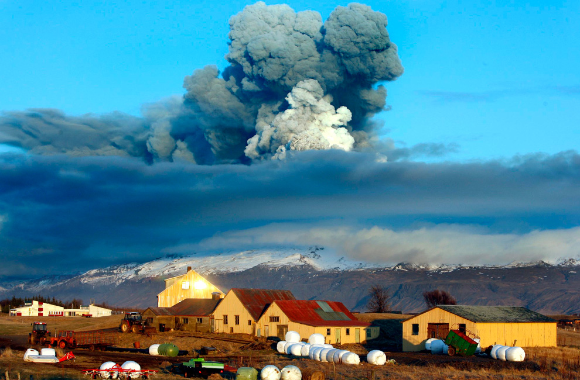
Pinatubo Volcano
Iceland's Eyjafjallajokull volcano April 16, 2010
What is the mass release rate and buoyancy flux? Observed plume rise?

Slide 18
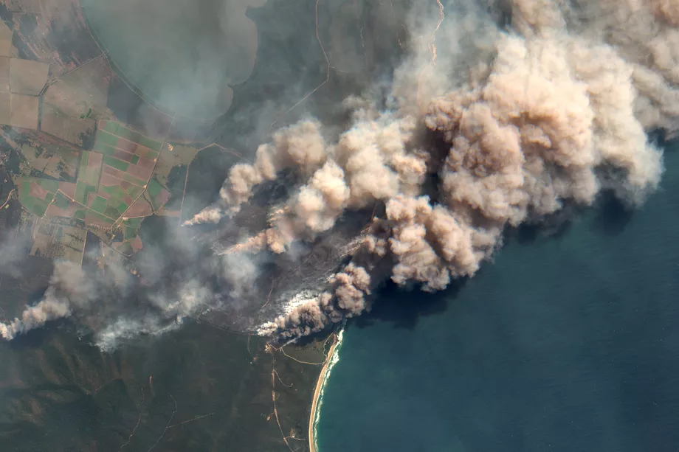
Australian bush fires January 2020
What is the mass release rate and buoyancy flux? Observed plume rise?

Slide 19
EPA era air pollution models - initial focus on industrial stacks (e.g., ISC)
Continuous point sources (stacks and vents)
Importance of plume rise
Downwash due to adjacent structures
Regulations required assessment of max concentration, usually within 10 km
No concern with downwind transport and affects on regional air pollution

Slide 20
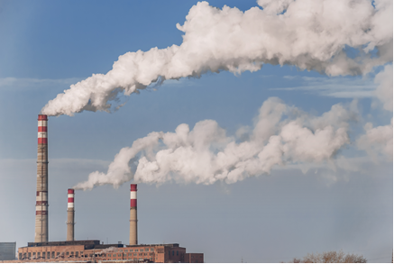
“Classical” bent over plume rise of buoyant stack plumes in moderate wind

Slide 21
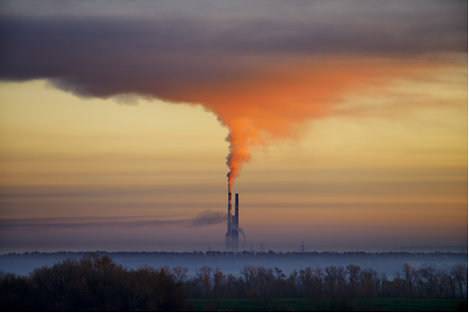
“Classical” plume rise of buoyant stack plume on stable morning with light winds

Slide 22
1980s through present – Increased Concern with Very Hazardous Chemicals (often denser than air)
Bhopal (1984) accident generated renewed development of dispersion models for accidental releases
Integral slab models were first developed (HEGADAS, SLAB, DEGADIS)
Lagrangian puff and and particle models with detailed meteorology (e.g., SCIPUFF, MSS)
Various CFD models (e.g., FLACS)

Slide 23
Hazardous gas scenarios
Major releases of chlorine and other chemicals from storage tanks
Models must account for dense gas effects
1980s and 1990s – Field experiments (Thorney Island, Desert Tortoise etc.)
2000s – EU experiments and model improvements concerning two phase releases from pressurized tanks
Recent large field experiments (Jack Rabbit) involving many tons of chlorine

Slide 24
Jack Rabbit II Chlorine Releases (2015 and 2016)
Trial 6:
90°
downward
Trial 7:
45°
downward
Trial 8:
90°
upward
Trial 9:
90°
downward
Source: Utah Valley University

Slide 25
Regional Air Quality Modeling
1980’s – Acid rain models (3D Eulerian models; included chemistry)
1990’s – Regional ozone modeling – built on regional acid rain models
In US, CMAQ now used for a wide range of pollutants. Also CAMx used.
Linked with WRF in US
Similar model systems in other countries
Multi-year international AQMEI comparison of these models (published by Galmarini et al)

Slide 26
Real-time regional air quality modeling
Now NOAA makes daily forecasts of regional air pollution in the US.
The next page gives an example prediction by CMAQ for a major US ozone episode in 2017.
Similar operational systems in Europe (e.g., MEMO-MARS)

Slide 27
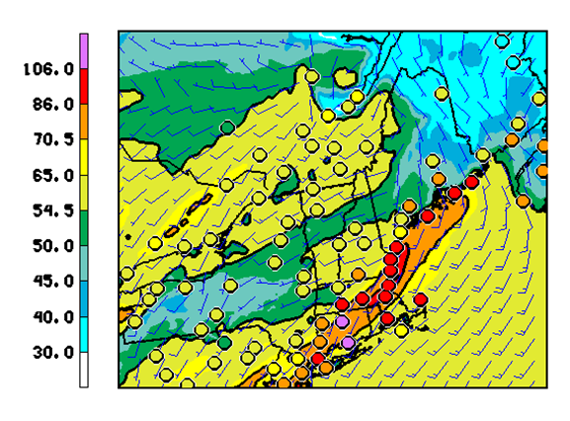
Ozone in ppb
NCEP CMAQ forecasts of maximum daily ozone for 17 May 2017, a day with 40 C afternoon temperatures. Forecasts are solid colors. Observations are small circles (added by NWS afterwards). http://www.emc.ncep.noaa.gov/mmb/aq/cmaq/web/html/max.html

Slide 28
The future (Steve’s guess)?
Linked NWP and Eulerian grid models with ever-smaller grid sizes.
WRF’s and CMAQ’s grid sizes are steadily decreasing, and their domain is being increased to global.
Eventually I expect that these model systems will be used for most pollutant sources and scales, from local to regional concerns.
Local plume scales will be absorbed into CMAQ (a WRF version with 1 m grid size is now being tested).

