Slide 1
Fire Plume Modeling
Frank Freedman
EnviroComp, Inc.
San Jose State University
Short Course on Introduction to Air Pollution Modeling, Wessex Institute
November 15, 2023

Slide 2
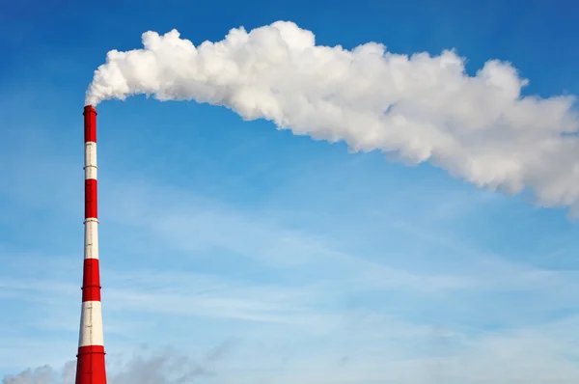
Industrial Plumes vs. Large Fires
Gaussian Models
Fire Models
Notes:
Penetration through the top of the ABL
Trapped in inversion layer

Slide 3
Talk Outline
Part 1: Background
Fires: Photos & Diagrams
Fire Modeling: Basic Inputs & Parameters
Modeling Goals and Strategies
Part 2: CFD Modeling of Fires using FDS
Model Description, Setup, I/O
Pool Fire Test Case (Neutral Atmospheric Stability)
Pool Fire Test Case (Stable Atmospheric Stability)
Part 3: Modeling with BUOYANT
Non-CFD: Steady-State Plume Model with fire plume rise model
Test Cases: How much of fire plume resides in ABL?

Slide 4
Part 1: Background

Slide 5
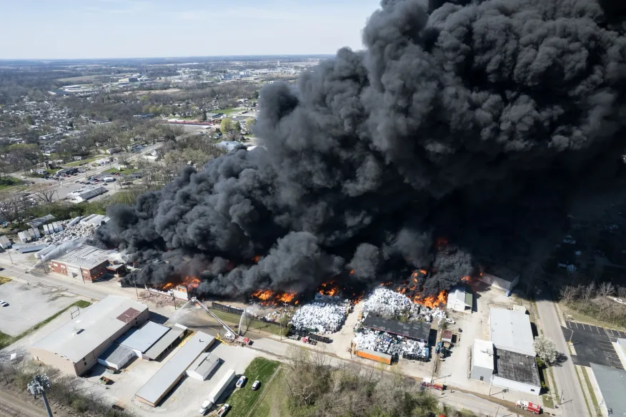
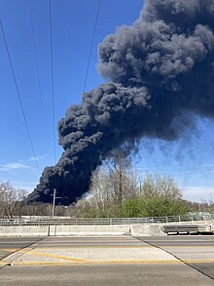
Large Industrial Fires
Heat and Mass Fluxes
Buoyancy Flux = Heat Release Rate x Area of Release
Plume Rise, Plume Buoyancy, Clean Air Entrainment
Constituents: Carbon Dioxide, Smoke, Trace Metals, others
Notes:
Buoyancy
Buoyancy Flux
Large Areal Coverage & Mass Flux
Heat of Combustion (Higher / Lower Heating Value) – Energy per mass (mole)

Slide 6
Large Industrial Fires
Plume Rise through the Atmospheric Boundary Layer?
Penetration into the inversion capping the ABL
Notes:
Penetration through the top of the ABL
Trapped in inversion layer

Slide 7
Fire Dispersion: Physics & Modeling (1)
Kukkonen et al (2022); https://gmd.copernicus.org/articles/15/4027/2022/

Slide 8
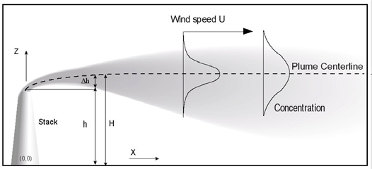
Steady-State Gaussian Plume Model
Dispersion in weak to modestly strong ambient ABL turbulence
Weak to modest plume rise (Δh)

Slide 9
Fire Dispersion Physics & Modeling (2)
Kukkonen et al (2000); https://link.springer.com/chapter/10.1007/978-1-4615-4153-0_55
Notes:
Enhanced buoyancy
Induced circulations

Slide 10
Fire Modeling: Basic Inputs & Parameters (Emissions)
Heat & Mass Release Rate
qHc = ΔHc x mfuel
where:
qHc = the heat release rate (kJ/s = kW)
ΔHc = the heat of combustion (MJ/kg)
mfuel = the mass flow rate of the fuel (g/s)

Slide 11
Fire Modeling: Basic Inputs & Parameters (Emissions)
Example: Pool Fires
Heat of Combustion
Mass Release Rate
(Infinite-diameter pool)
Yields
(mass released per mass fuel burned)
Kukkonen et al (2022); https://gmd.copernicus.org/articles/15/4027/2022/
Notes:
where qm,inf is the mass burning rate per unit area of an
infinite-diameter pool

Slide 12
Fire Modeling: Basic Inputs & Parameters (Meteorological)
Dispersion
Wind Speed
Atmospheric Stability
Boundary Layer Depth, Height of Inversion Base
Atmospheric Lapse Rate above Boundary Layer
Particle Formation, Chemistry, Deposition
Humidity
Precipitation

Slide 13
Desired Features in Fire Dispersion Model
Simple but effective inputs to characterize source characteristics
Mass and heat release
Constituents
Proper handling of plume rise
Enhanced buoyancy
Entrainment of ambient air into rising fire plume
CFD directly simulates, plume models must parameterize
Capturing induced circulations
Fire-driven circulations due to strong buoyant convection
Need CFD for this

Slide 14
Fire Dispersion Models: Options
Computational Fluid Dynamics (CFD)
Fire Dynamics Simulator (FDS, https://www.nist.gov/services-resources/software/fds-and-smokeview
Full 3-D solutions for Navier-Stokes equations
Full suite of embedded models for fire physical processes (pyrolysis, combustion, phase change, chemistry, etc …)
Near-Field (within 1-km from source)
Gaussian Dispersion Models designed for fires
BUOYANT (https://gmd.copernicus.org/articles/15/4027/2022/)
Steady-state w/ Embedded fire plume rise model
Far-Field (beyond 1-km from source)

Slide 15
Highlight: Near vs. Far-Field Modeling
Near Field, CFD
Far Field, Gaussian Fire
Notes:
Enhanced buoyancy
Induced circulations

Slide 16
Part 2: CFD Modeling using FDS (near-field dispersion)

Slide 17
Fire Dynamics Simulator (FDS): Basics
U.S. National Institute of Standards and Technology (NIST)
https://www.nist.gov/services-resources/software/fds-and-smokeview
Computational Fluids Dynamics (CFD)
Full Physics: Various physical processes, sub-models and configurations
Indoor and outdoor capabilities
Simulates fire generation/spread and dispersion of reactants/smoke
Rectangular grid (relatively simple mesh generation …)

Slide 18
Fire Dynamics Simulator (FDS) Installation & Execution
Windows executable (no compilation necessary)
Command line interface (no GUI)
Enter inputs into text file
Smokeview graphics to view output

Slide 19
FDS Test Runs: Grid & Fire Inputs
Grid
25 x 25 x 25 m resolution over 2000 x 1000 x 1000 m domain (80 x 40 x 40)
Surface “pool” fire of 150 x 150 m centered at (x, y, z) = (1000,500,25)
Fire Inputs
Single-step mixing controlled combustion
Fuel is propane
Heat Release Rate = 250 kW/m2
Corresponds to a fuel consumption rate of about 0.005 kg/m2/s
Set 10% of reactants to be smoke (by mass)

Slide 20
FDS Test Runs: Meteorological Inputs
Wind: Boundary layer background flow of about 2 m/s
Neutral Case: Set lapse rate to adiabatic (stability class D)
Stable Case: Set lapse rate to isothermal (stability class E or F)
Compare output for neutral vs. stable

Slide 21
FDS Test Runs: Procedure
14400 seconds integration time (= 4 hours)
“Turn on” fire @ t = 7200
0 < t < 7200: “spin up” period to bring background wind to quasi steady-state
7200 < t < 14400: “fire period”
After period of build-up of fire @ t = 7200, new “fire-affected” quasi steady-state is reached by around t = 8400.
Plots to be shown are @ t = 14400 (final time)

Slide 22
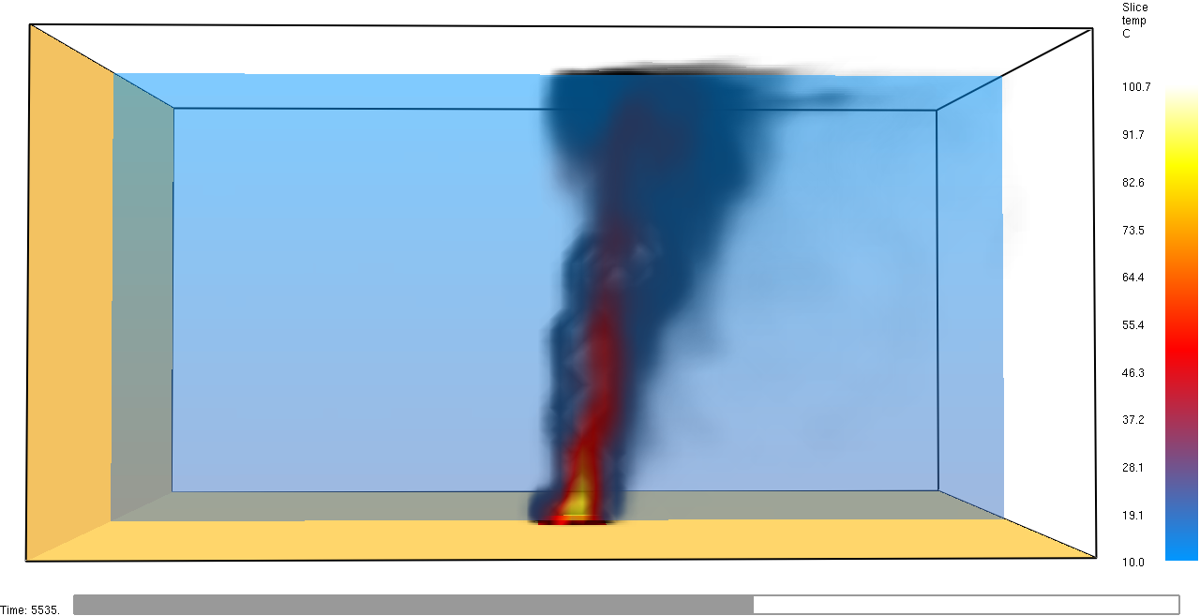
Neutral: Smoke & Temperature (image)

Slide 23
Neutral: Smoke and Temperature (video link)

Slide 24
Neutral: Smoke & Winds (image)

Slide 25
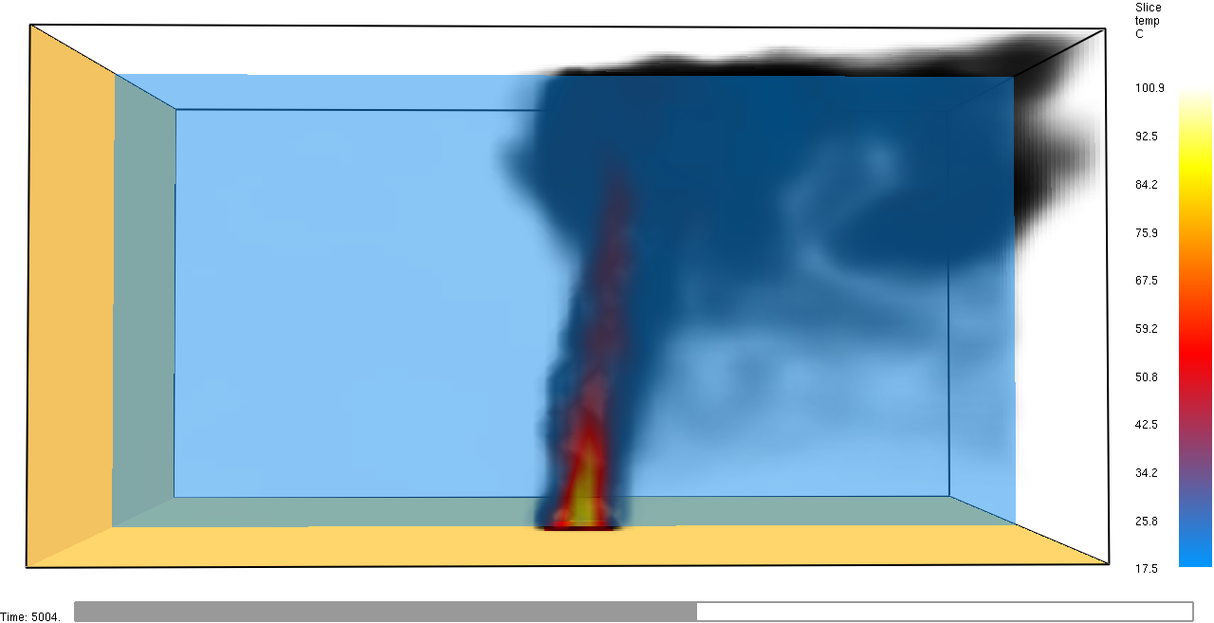
Stable: Smoke & Temperature (image)

Slide 26
Stable: Smoke and Temperature (video link)

Slide 27
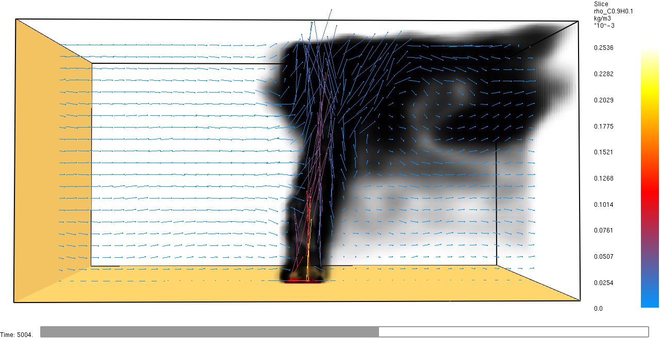
Stable: Smoke & Winds (image)

Slide 28
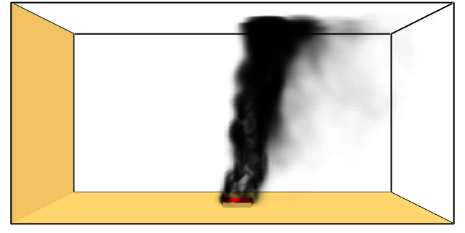
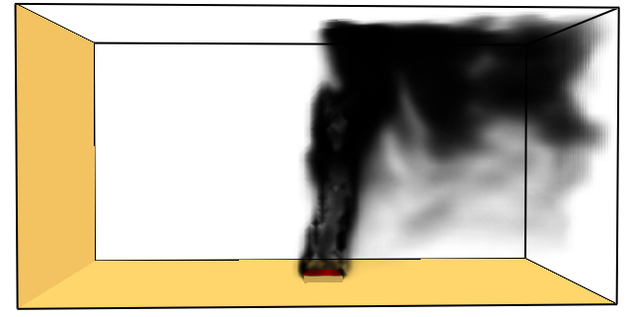
Smoke visuals @ t = 2 hours after fire start
z = 1000 m
Neutral
Stable

Slide 29
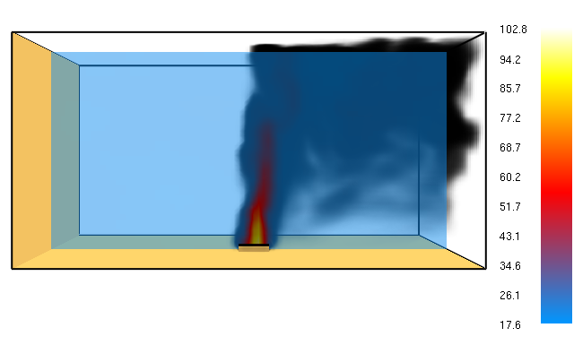
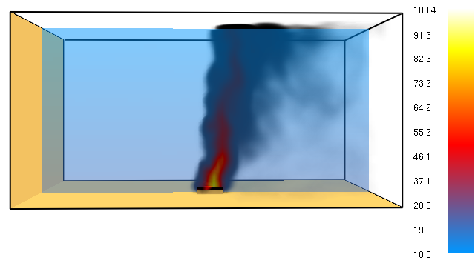
Smoke visuals overlaid w temperature (deg C)
@ t = 2 hours after fire start
Neutral
Stable

Slide 30
Flow vectors @ t = 2 hours after fire start
Stable
Neutral
Stable

Slide 31
PM2.5 (ug/m3) vs. Height (meters)
@ different downwind distances from fire
z(m)
PM2.5 (ug/m3)
PM2.5 (ug/m3)

Slide 32
PM2.5
(ug/m3)
Downwind Distance (m)

Slide 33
Part 3: Gaussian Plume Modeling using BUOYANT

Slide 34
Reminder: Near vs. Far-Field Modeling
Near Field, CFD
Far Field, Gaussian Fire
Notes:
Enhanced buoyancy
Induced circulations

Slide 35
BUOYANT: Basics
Finnish Meteorological Institute
https://gmd.copernicus.org/articles/15/4027/2022/
Steady-State Gaussian plume model
Embedded fire plume rise model
Far-field dispersion (> 1 km)

Slide 36
BUOYANT: Installation & Execution
FORTRAN code (compilation necessary)
Need to install FORTRAN compiler
MSYS2 virtual LINUX required on WINDOWS, has ‘gfortran’ as a package
Command line interface (no GUI)
Enter inputs into text file
Text file outputs

Slide 37
Large Industrial Fires
Question … how much of the plume stays within the ABL?
Run cases to check how model predicts this quantity.
Notes:
Penetration through the top of the ABL
Trapped in inversion layer

Slide 38
BUOYANT: Test Runs
Meteorological Inputs
Wind Speed = 3.22 m/s
Neutral ABL w depth = 1000 m
Pool Fire: Case 1 (“low’ heat release)
Heat Release Rate = 20 kW/m2
Pool Fire: Case 2 (“medium” heat release)
Heat Release Rate = 700 kW/m2
Pool Fire: Case 3 (“high” heat release)
Heat Release Rate = 1800 kW/m2

Slide 39
Reminder: FDS Test Runs
Grid
25 x 25 x 25 m resolution over 2000 x 1000 x 1000 m domain (80 x 40 x 40)
Surface “pool” fire of 150 x 150 m centered at (x, y, z) = (1000,500,25)
Fire Inputs
Single-step mixing controlled combustion
Fuel is propane
Heat Release Rate = 250 kW/m2
Corresponds to a fuel consumption rate of about 0.005 kg/m2/s
Set 10% of reactants to be smoke (by mass)

Slide 40
BUOYANT Test Runs: Results (Fraction of plume that stays in the ABL)
Modeling Run | Heat Release Rate (kW/m2) | Fraction of Plume in ABL
Case 1 (Low Heat Release) | 20 | 0.5597
Case 2 (Medium Heat Release) | 700 | 0.1874
Case 3 (High Heat Release) | 1800 | 0.05533
Fraction in ABL highly sensitive to fire strength (via heat release)
More plume in ABL → High surface concentration
Appears to capture an observable feature of strong fires … that most plume mass can stay aloft above ABL

Slide 41
Conclusions

Slide 42
Dispersion Modeling for Fires
Two approaches demonstrated as alternatives to typical Gaussian models
Initial test results of both appear promising
Computational Fluid Dynamics, CFD)
Fire Dynamics Simulator (FDS)
Steady-Steady Gaussian Modeling with Fire Plume Rise
BUOYANT

